Slide 1
Document No: | GSC-19_016
Source: | Telecommunications Industry Association (TIA)
Contact: | Scott Belcher
Agenda Item: | 2.7
TIA Overview
Scott Belcher, CEO, TIA

Slide 2
Who is TIA
VISION:
Embrace the power of communications to ensure every person has access to knowledge and a better life.
MISSION:
As the voice of the industry, TIA operates at the intersection of vision and reality, accelerating innovation and policy.

Slide 3
Technology and Standards
11 Committees; 72 Subcommittees
60 Standards in past 12 months
Most notably:
TSB-5019: High-performance structured cabling for data centers and other premises
TIA-4994: Sustainable information communications technology
TIA-222-G-4: Standard for mounting small wind turbines on mid-sized steel antenna towers
CDMA and multimode numbering
NFV / SDN Lab
CTO Council

Slide 4
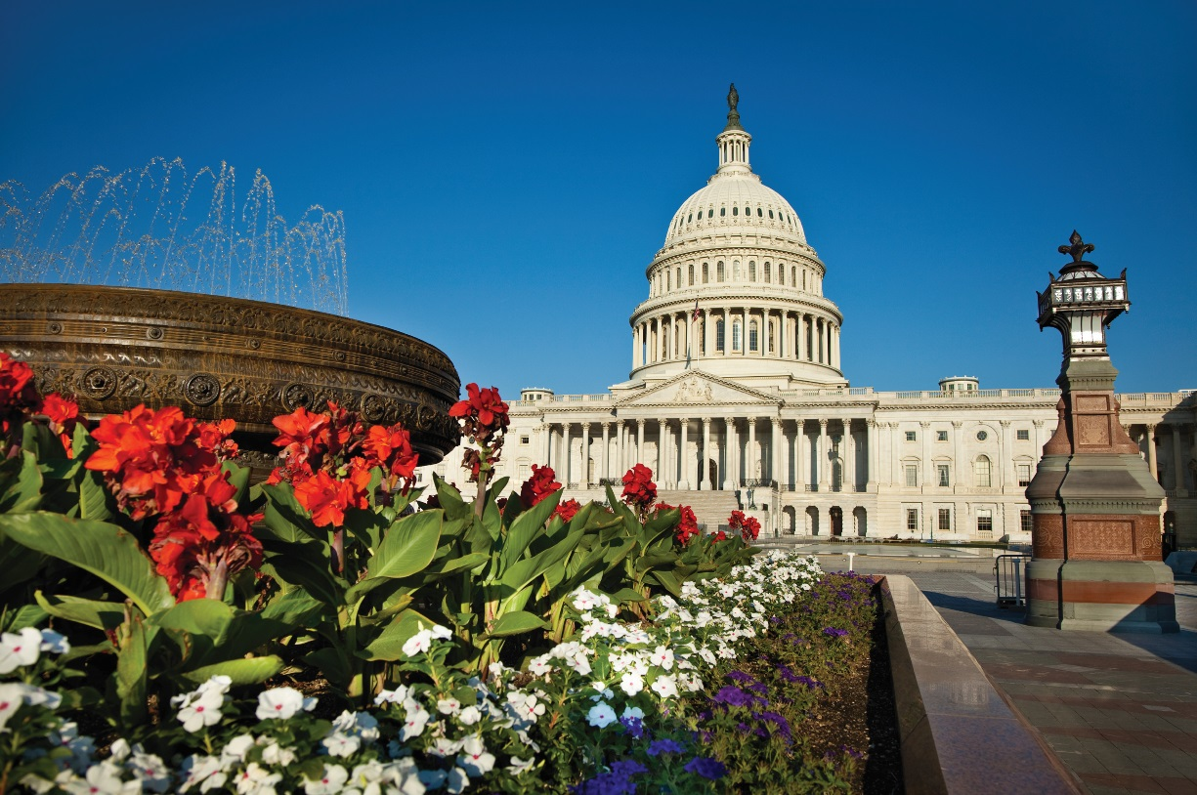
Policy
Net Neutrality
Spectrum
Telecom Update
IoT Workshop and briefings
5G briefings

Slide 5
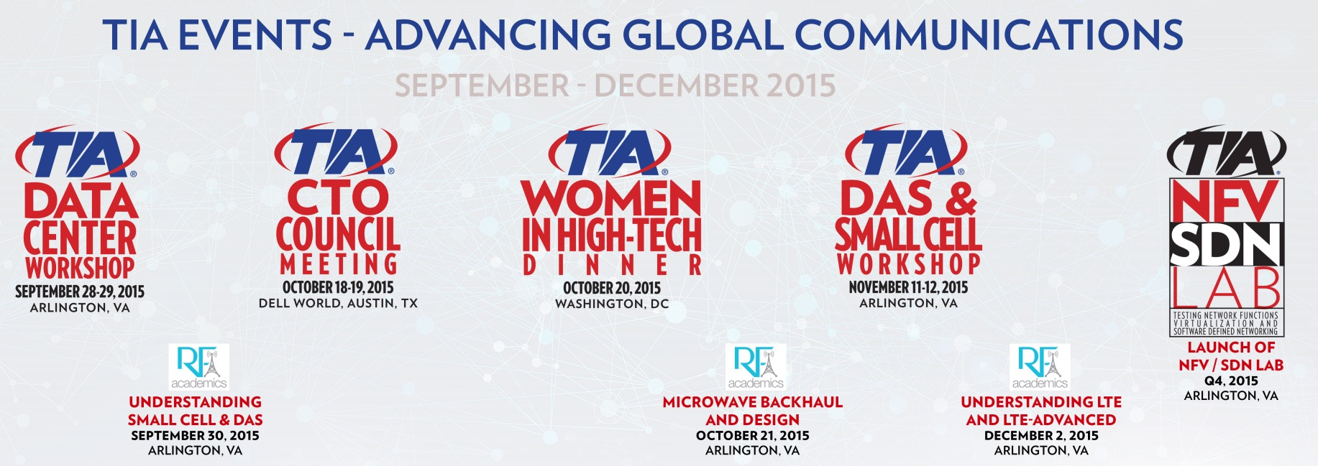
Networking
Connected and Autonomous Vehicle Workshop
IoT Roundtable
Spring Policy Summit
TIA 2015 – Network of the Future
Data Center Workshops
DAS and Small Cell Workshop
Wireless and Cellular Workshops

Slide 6
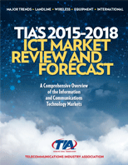
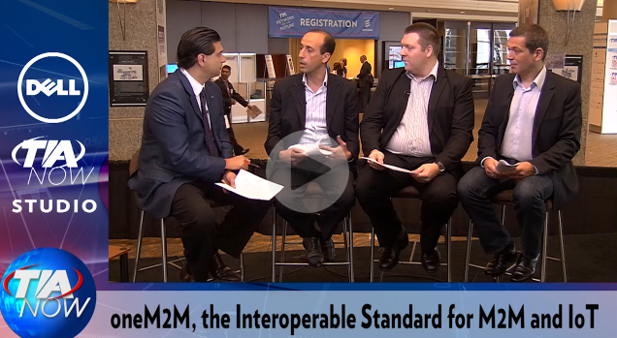
Market Intelligence

