Slide 1
Document No: | GSC-19_015
Source: | ITU
Contact: | Chaesub Lee, François Rancy
Agenda Item: | 2.6
Priorities of ITU
Chaesub Lee, Director ITU Telecommunication Standardization Bureau,
François Rancy, Director ITU Radiocommunication Bureau

Slide 2
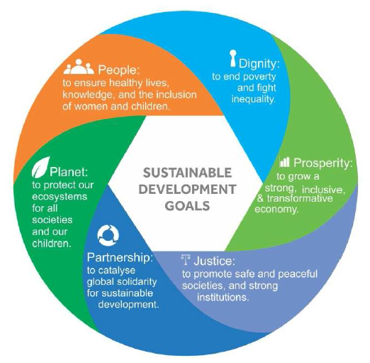
ITU strategic priorities & Connect 2020
ITU Strategic Plan 2016-2019
Connect 2020
Goals and Targets
International collaboration
ITU objectives & outcomes
National & regional plans & commitments
Private sector commitments
Other stakeholders
Collaboration at regional and national level
ITU outputs
Government agencies
Private sector orgs
Intergov. organizations
R&D and Academia
Notes:
During the 2014 Plenipotentiary Conference (PP-14), which was held in Busan, Korea, ITU Member States adopted Resolution 200 (Busan, 2014) ‘Connect 2020 Agenda for global telecommunication/information and communication technology development’, setting out an ambitious vision for the information and communication technology sector for the year 2020.
ITU contributes to the Connect 2020 Agenda through the implementation of its 2016-2019 Strategic Plan, which was also adopted at PP-14.
Connect 2020 is a framework for collaboration and the means for ITU to support the implementation of the Sustainable Development Goals.
It is a commitment by all ITU Member States and an invitation to all stakeholders, including international organizations, the private sector, civil society and academia, to work together towards achieving quantifiable and specific targets.
During the ITU Plenipotentiary Conference, Member States stated their commitment towards implementing Connect 2020 in some 107 policy statements, through national, regional and international initiatives, and promised to provide the necessary data and statistics to properly assess progress, and to engage all stakeholders through the promotion of partnerships.
2015 is a pivotal year to advance Connect 2020, particularly by setting a solid base to define the methodologies to assess progress, identifying and addressing challenges and opportunities, and promoting the role of various stakeholders to accelerate the implementation of the agenda.

Slide 3
Connect 2020 Goals & Targets
Goal 1 Growth – Enable and foster access to and increased use of telecommunications/ICTs
55%
of households should have access to the Internet
60%
of individuals should be using the Internet
40%
Telecommunications/ICTs should be 40% more affordable
by 2020...
Goal 2 Inclusiveness – Bridge the digital divide and provide broadband for all
50%
of households to have access to the Internet in the developing world; 15% in the LDCs
50%
of individuals to be using the Internet in the developing world; 20% in the LDCs
40%
affordability gap between developed and developing countries to be reduced by 40%
5%
Broadband services to cost no more than 5% of average monthly income in the developing countries
90%
of the rural population to be covered by broadband services
Enabling environments ensuring accessible ICTs for persons with disabilities should be established in all countries
Gender equality among Internet users to be reached
Goal 3 Sustainability – Manage challenges resulting from the telecommunication/ICT development
40%
improvement in cybersecurity readiness
50%
reduction in volume of redundant e-waste
30%
decrease in Green House Gas emissions per device generated by the telecommunication/ICT sector
Goal 4 Innovation & Partnership – Lead, improve & adapt to the changing telecommunication/ICT environment
Telecommunication/ICT environment conducive to innovation
Effective partnerships of stakeholders in telecommunication/ICT environment
Notes:
The Goals and the Targets set in the Connect 2020 agenda and ITU Strategic Plan, as endorsed during the ITU PP-14, define the strategic impact and change in the ICT sector that ITU Member States want to see in the world by 2020.
Each goal reinforces the other; in Goal 1: aims to foster growth in the use of ICTs and create a positive impact on short and long-term socioeconomic development, a significantly increase in access to, and use of, the Internet by bringing 1.5 billion addition users online by 2020, and making telecommunications/ICTs significantly more affordable.
In Goal 2 by including everyone, the benefits of ICTs would be extended to all, bridging the digital divide between the developed and developing worlds and reaching marginal and vulnerable populations. Specific targets are defined for providing broadband for all, with emphasis on developing countries, and in particular LDCs, and rural populations, as well as to ensure gender equality online and enable persons with disabilities to effectively use telecommunications/ICTs.
Goal 3 – the ability to sustain the tremendous benefits delivered by ICTs is key, since growth also brings challenges and risks that need to be managed. The aim is to minimize the potential negative impact of ICTs, such as cybersecurity threats, and environmental impacts, including reducing e-waste and GHG emissions resulting from telecommunications and ICT development.
In Goal 4, by encouraging innovation and partnerships, the evolving ICT ecosystem can adapt to the rapidly changing technological and social environment. The goal recognises that due to the particularly dynamic nature of the sector, it is important to ensure that the telecommunication/ICT environment is conducive to innovation. As the ICT ecosystem becomes increasingly complex with a multitude of stakeholders playing a role in its development, effective partnerships are crucial for the successful development of telecommunications/ICT.

Slide 4
Key Focus 2020
Smart Sustainable City
5G
5G
5G
IoT enabled

Slide 5
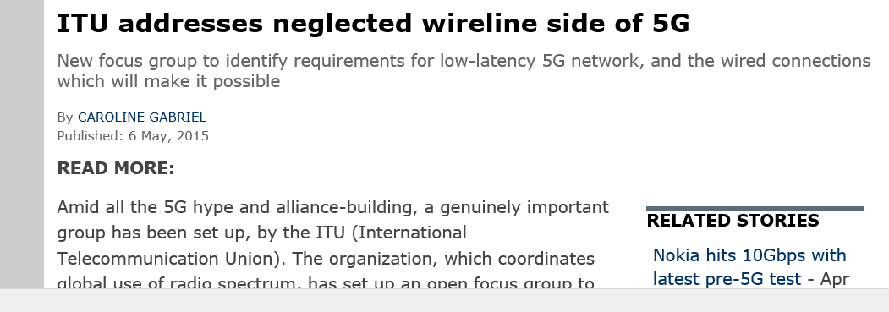
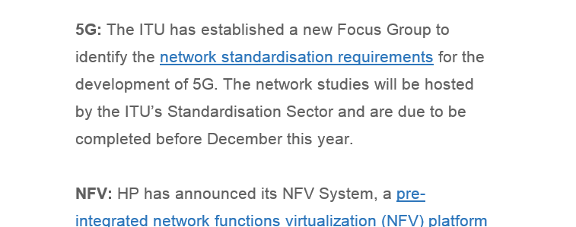
Launch of new groups in ITU-T
ITU-T Focus Group on IMT 2020/5G (1 May 2015)
Studies “non-radio” parts of 5G
ITU-T will continue “Network oriented study beyond 2020”
New ITU-T Study Group 20 (5 June 2015)
“IoT and its applications including smart city and community”

Slide 6
Towards a trusted ICT infrastructure
Trust
Users
Ubiquity
Mobility
Mobility
Applications
Security
Security
Computing
Quality
Quality
Quality
Connectivity
Networks
Connectivity
Connectivity
Connectivity
1990s
~ 2008
~ 2015
2020 ~
Things
Confidence
Dependence
Goodness
Honesty
Expectation
Faith
Future
Integrity
Ability
Surety
Belief
Strength

Slide 7
International spectrum management
World Radiocommunication Conference 2015 (2 to 27 November 2015)
revise the Radio Regulations, the international treaty governing the use of the radio-frequency spectrum and satellite orbits
Challenges:
Facilitate equitable access and rational use of the limited radio frequency resource
Protect essential services – distress and safety
Prevent harmful interference
Facilitate effective operation of radio services
Accommodate the ever-increasing demand
More users, new technologies, new applications, higher data rates

Slide 8
Radiocommunication standardization
Radiocommunication Assembly 2015 - 26 to 30 October 2015
Establish the structure, programme and approval of radiocommunication studies for the 2015-2019 Study Period
Develop Recommendations, Reports, Handbooks on:
Spectrum management - e.g. frequency bands for short range devices
Radiowave propagation​ - e.g. propagation in bands > 6 GHz
Satellite services - e.g. IMT-2020
Terrestrial services – e.g. standards for satellite IMT
Broadcasting service - e.g. worldwide format for UHDTV
Science services – e.g. Earth exploration satellites for climate monitoring

