Slide 1
FGAI4H-S-050-A11
Geneva, 3-5 July 2023
Source: | TG-Outbreaks
Title: | Att.11 - Presentation – Topic Group "Outbreaks"
Contact: | Auss Abbood | E-mail: abbooda@rki.de
Abstract: | This PPT contains a presentation on Topic Group "Outbreaks" given during AI for Health Workshop on 5 July 2023.

Slide 2
Focus Group AI for Health by WHO/ITU – Topic Group Outbreaks
Auss Abbood
2023-07-05

Slide 3
Motivation
Population health can be improved if health threats are detected and contained as fast as possible
It is laborious to
search for outbreaks,
spot the onset of a wave of infections,
detect an increase in severity of a disease,
or detect novel health threats

Slide 4
Motivation
Can we automate part of this process?
Yes! Signals like an increases of case counts can be automatically detected
Most algorithms are freely available and open source

Slide 5
Approach
Literature review:
Algorithms, data, metrics
Ethical and regulatory consideration
Survey:
Which algorithms are used?
What disease are surveilled?
What data is available (aggregation and covariates)?
How are algorithms evaluated (expert labels vs. generated labels)

Slide 6
Results
Vast differences in usage:
Used <-> not used
Statistical <-> AI
Personalized data <-> aggregated
Uni- <-> multivariate
Evaluation?
Country-specific differences
Highly local <-> Country-wide

Slide 7
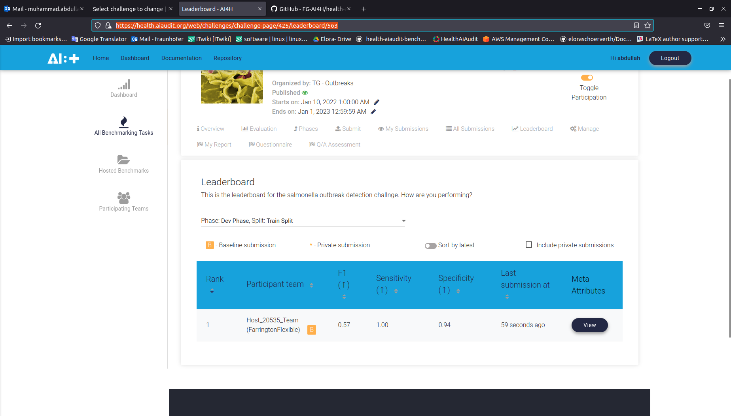
Contribution

Slide 8
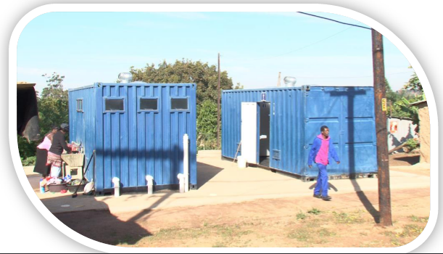
Contribution
https://www.connective-cities.net/secure_doc/user_upload/Provision_of_Communal_Ablution_Blocks_for_Informal_Settlements_eThekwini_South_Africa.pdf
Notes:
Communal Ablution Blocks

Slide 9
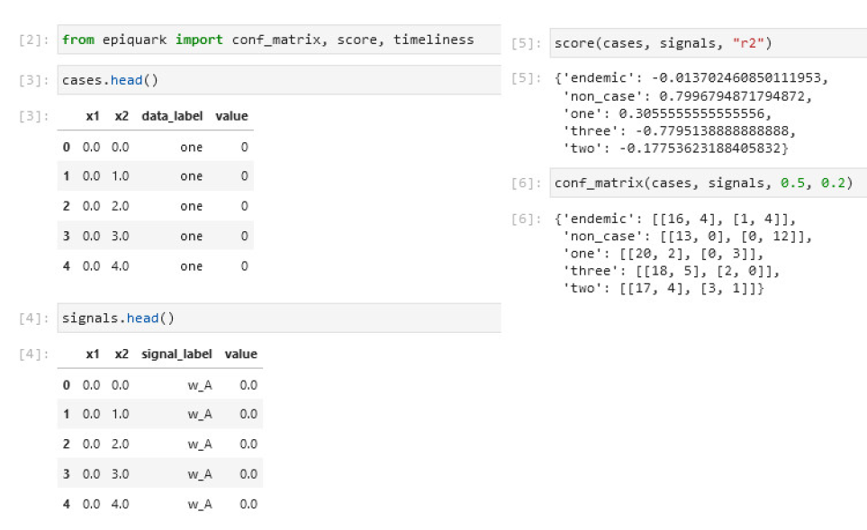
Contribution
Weighted by:
Timeliness
Spatial accuracy
Outbreak size

Slide 10
Contribution

Slide 11
Next steps
Transform Focus Group to Global Initiative to apply lessons learned

