Slide 1
FGAI4H-S-050-A08
Geneva, 3-5 July 2023
Source: | TG-MCH
Title: | Att.8 - Presentation – AI for Maternal and Child Health in developing regions
Contact: | Alexandre Chiavegatto Filho | E-mail: alexdiasporto@usp.br
Abstract: | This PPT contains a presentation on AI for Maternal and Child Health in developing regions given during AI for Health Workshop on 5 July 2023.

Slide 2
AI for Maternal and Child Health in developing regions
Assoc. Prof .Alexandre Chiavegatto Filho
University of São Paulo, Brazil

Slide 3
AI for Maternal and Child Health
Improving the health and well-being of mothers, infants, and children is one of the most important public health goals worldwide.
Every day, an estimated 810 women die from causes related to pregnancy or childbirth and over 15,000 children die from preventable diseases.
Despite notable recent improvements for most countries, the Millenium Development Goal (MDG) target for 2015 of reducing child mortality globally by two thirds was not achieved.
Artificial intelligence methods have the potential of improving maternal and child health decisions, especially in low-resource settings.

Slide 4
Goal: to predict the risk of neonatal mortality using only data routinely available from birth records in Sao Paulo.
Using only a smaller number of variables (WHO’s five minimum perinatal indicators) maintained high predictive performance (AUC of 0.91): maternal age, place of delivery, mode of delivery, birth weight and gestational age.
The 5% births with the highest predicted risk of neonatal death included more than 90% of the actual neonatal deaths. On the other hand, there were no deaths among the 5% births with the lowest predicted risk.

Slide 5
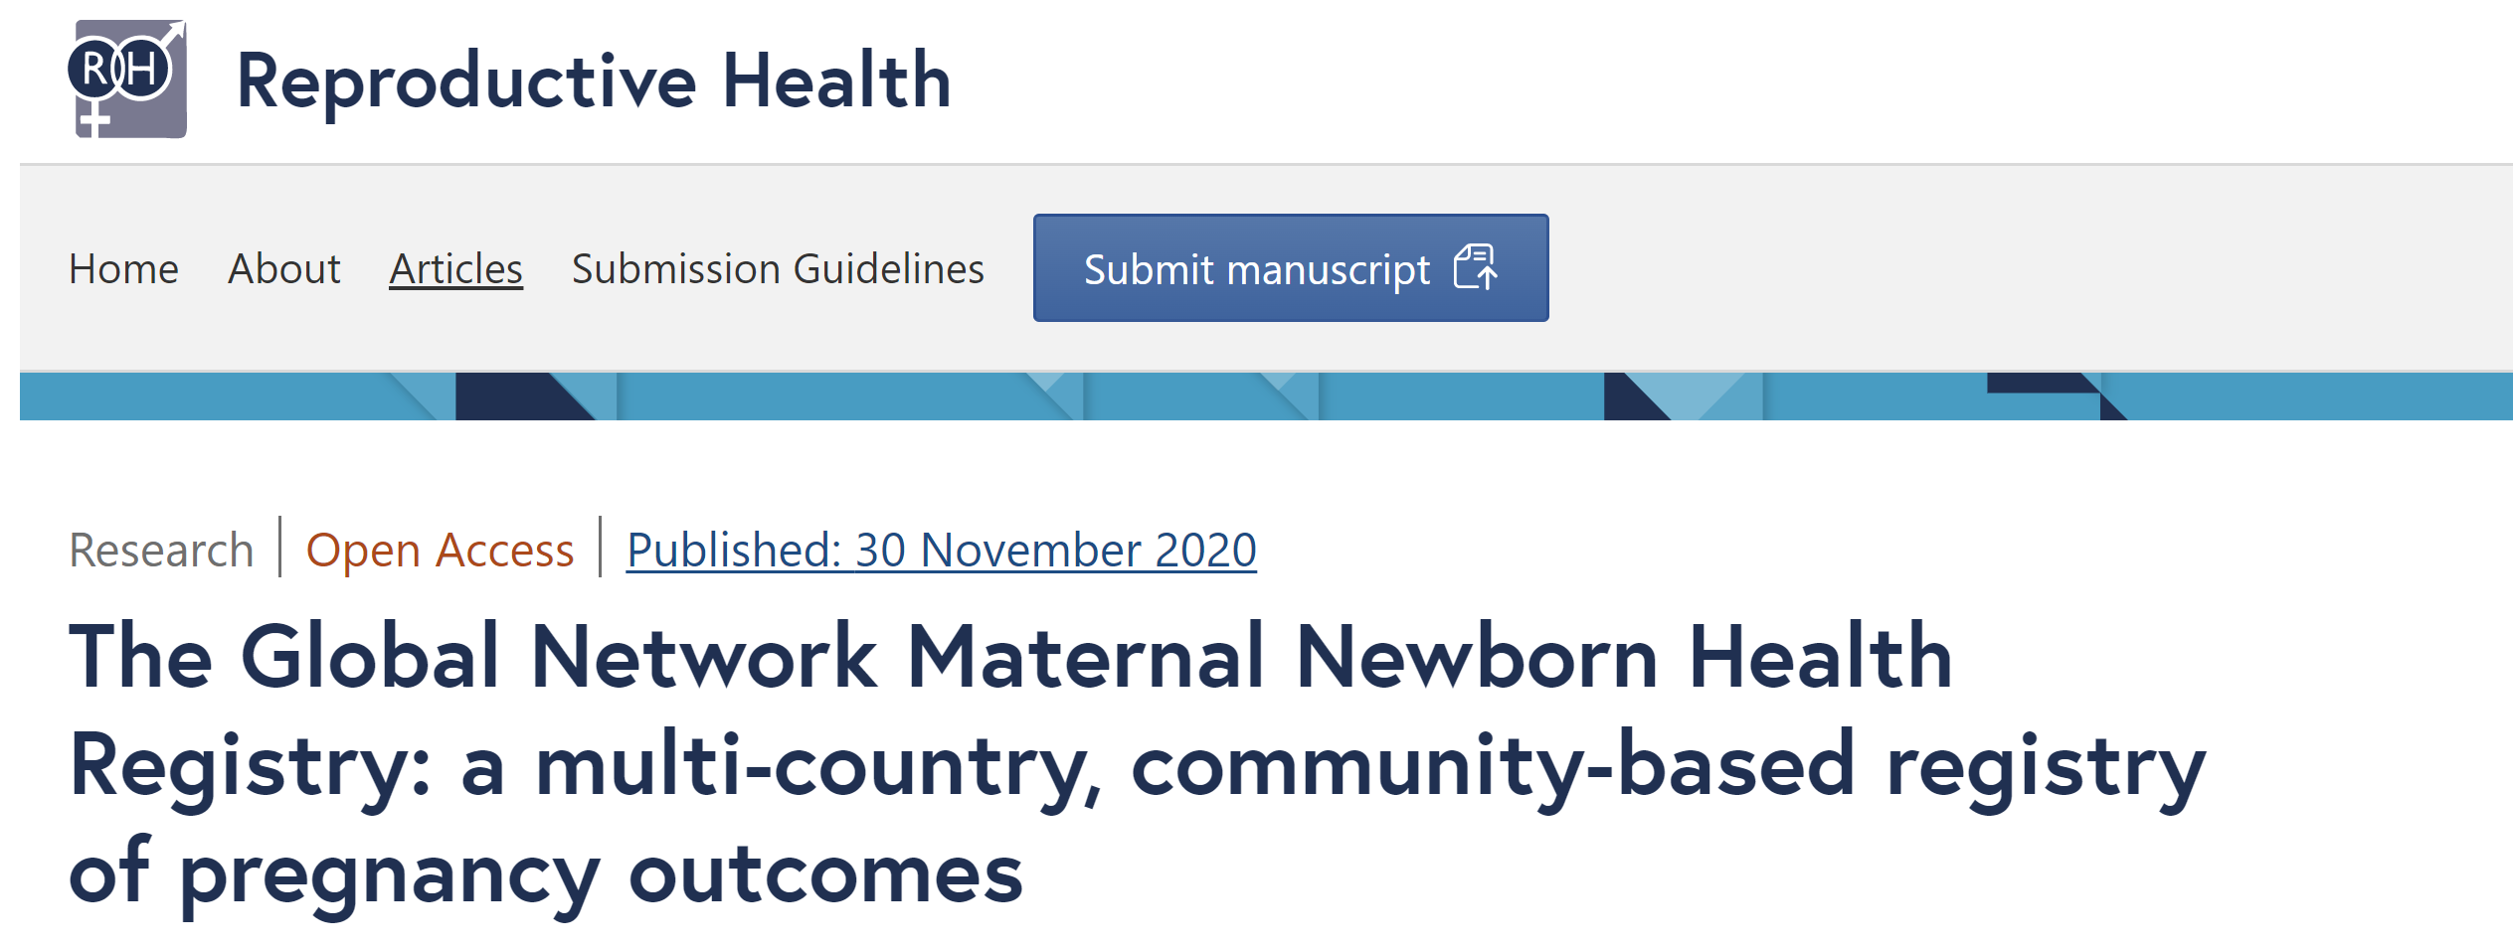
AI for Maternal and Child Health
Global Network's Maternal Newborn Health Registry (MNHR):
Argentina, Democratic Republic of Congo, Zambia, Guatemala, Pakistan, India, Kenya, and Bangladesh.
Three distinct collections (2010-2013, 2014-2016 and 2017-2019).
Around 500,000 pregnancies.

Slide 6
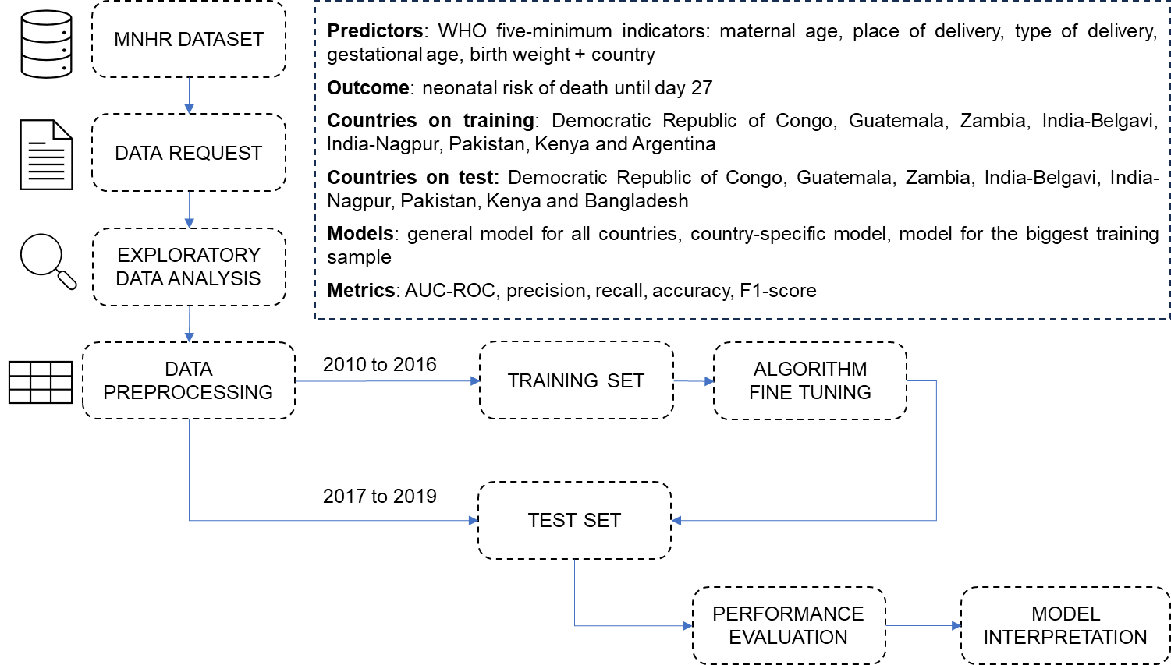

Slide 7
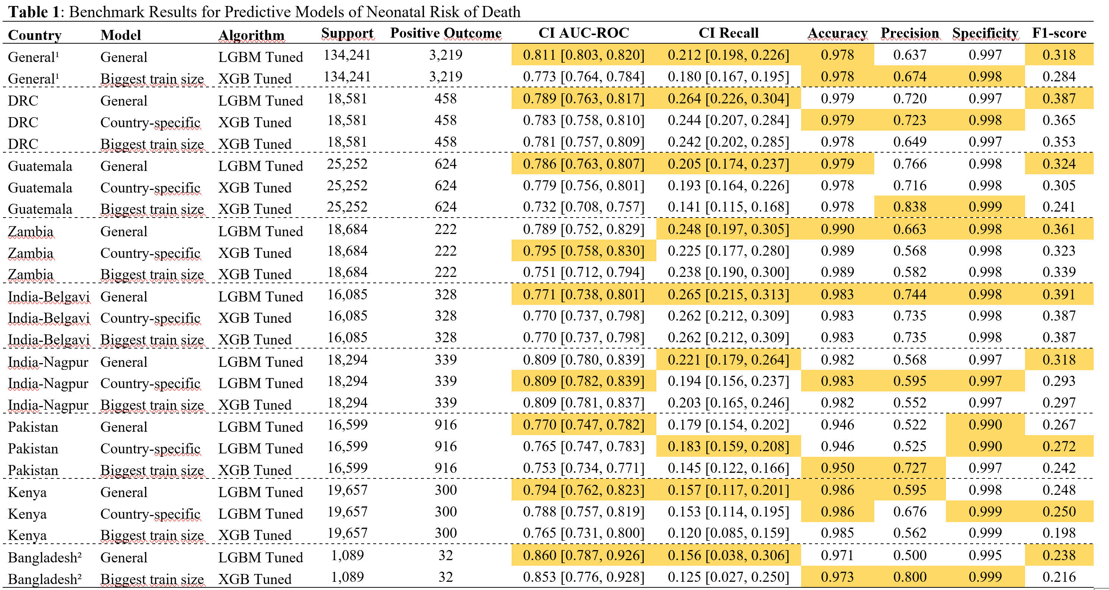

Slide 8
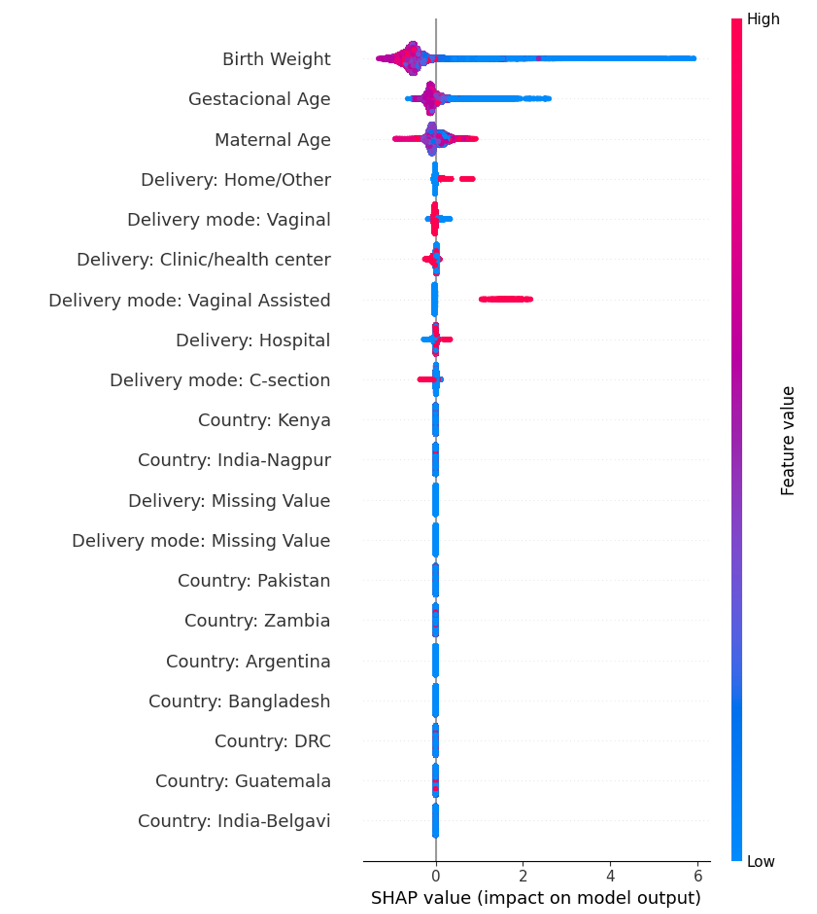

Slide 9
AI for Maternal and Child Health
Conclusion:
- AI is a very promising tool for MCH:
- Low cost of effective interventions in MCH if warnings come early.
- Important challenges:
- Use routinely-available variables, trained and validated in where they will be applied, do not increase existing inequalities.

Slide 10
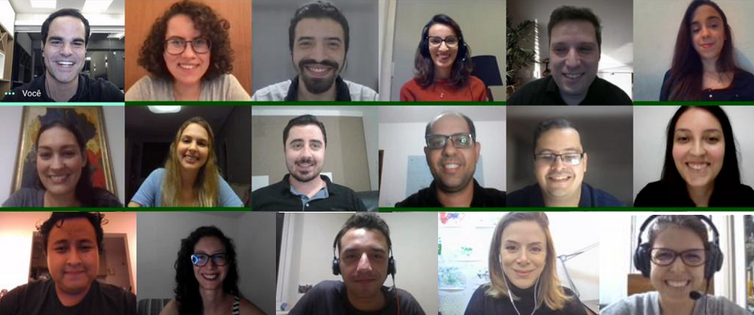
Thank you!
Alexandre Chiavegatto Filho
http://labdaps.fsp.usp.br
@SaudenoBR
@labdaps
alexdiasporto@usp.br

