Slide 1
FGAI4H-S-050-A01
Geneva, 3-5 July 2023
Source: | WG-CE
Title: | Att.1 - Presentation - WG-Clinical Evaluation of AI for Health
Contact: | Eva Weicken | E-mail: eva.weicken@hhi.fraunhofer.de
Abstract: | This PPT contains a presentation on Working Group "Clinical Evaluation of AI for Health“ given during AI for Health Workshop on 5 July 2023.

Slide 2
ITU-WHO Focus Group AI for Health
—
WG-Clinical Evaluation of AI for Health
Workshop - Geneva, 5 July 2023
Naomi Lee, Shubhanan Upadhyay, Eva Weicken & Alastair Denniston, Xiao Liu, Kassandra Karpathakis, Jane Carolan, Tommy Wilkinson

Slide 3
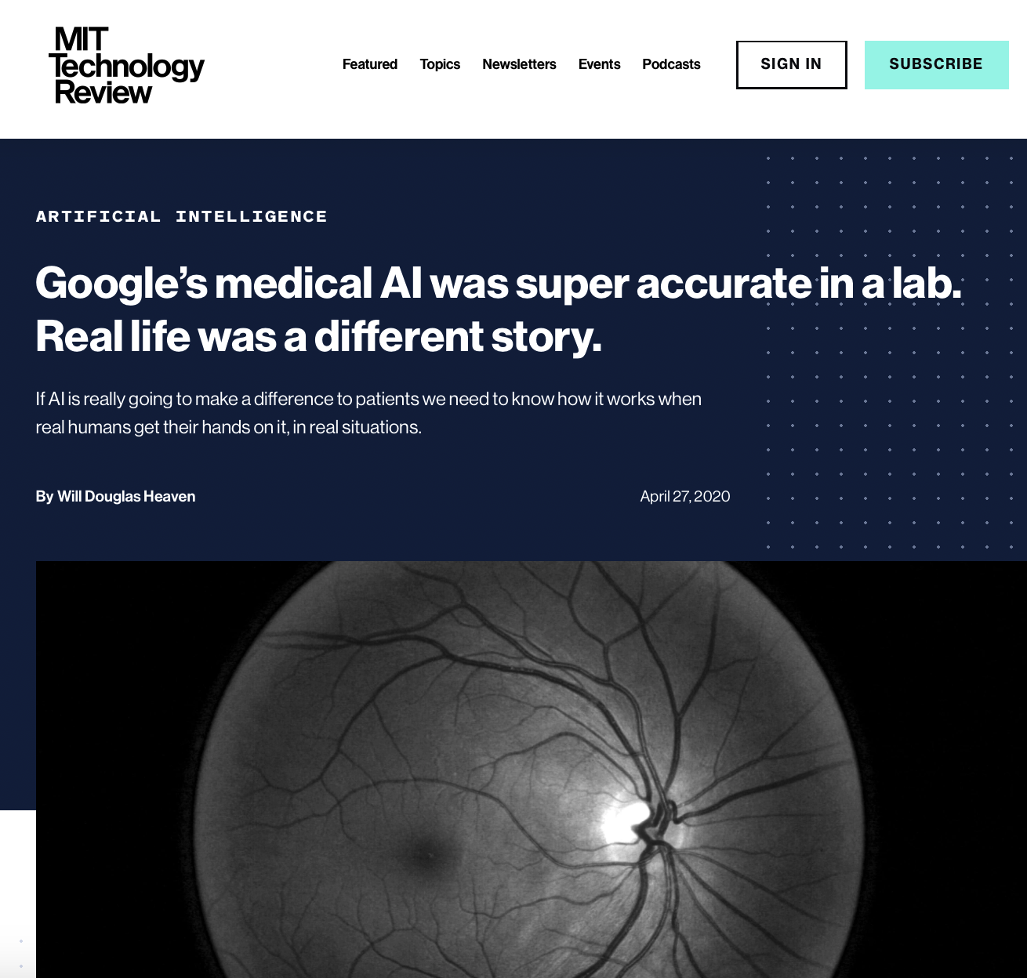
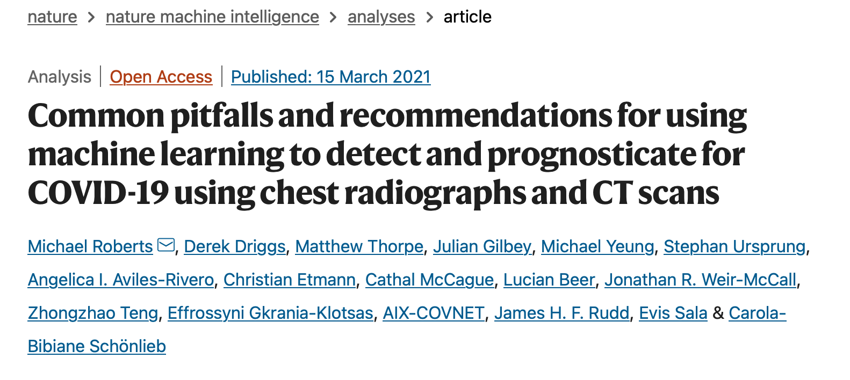
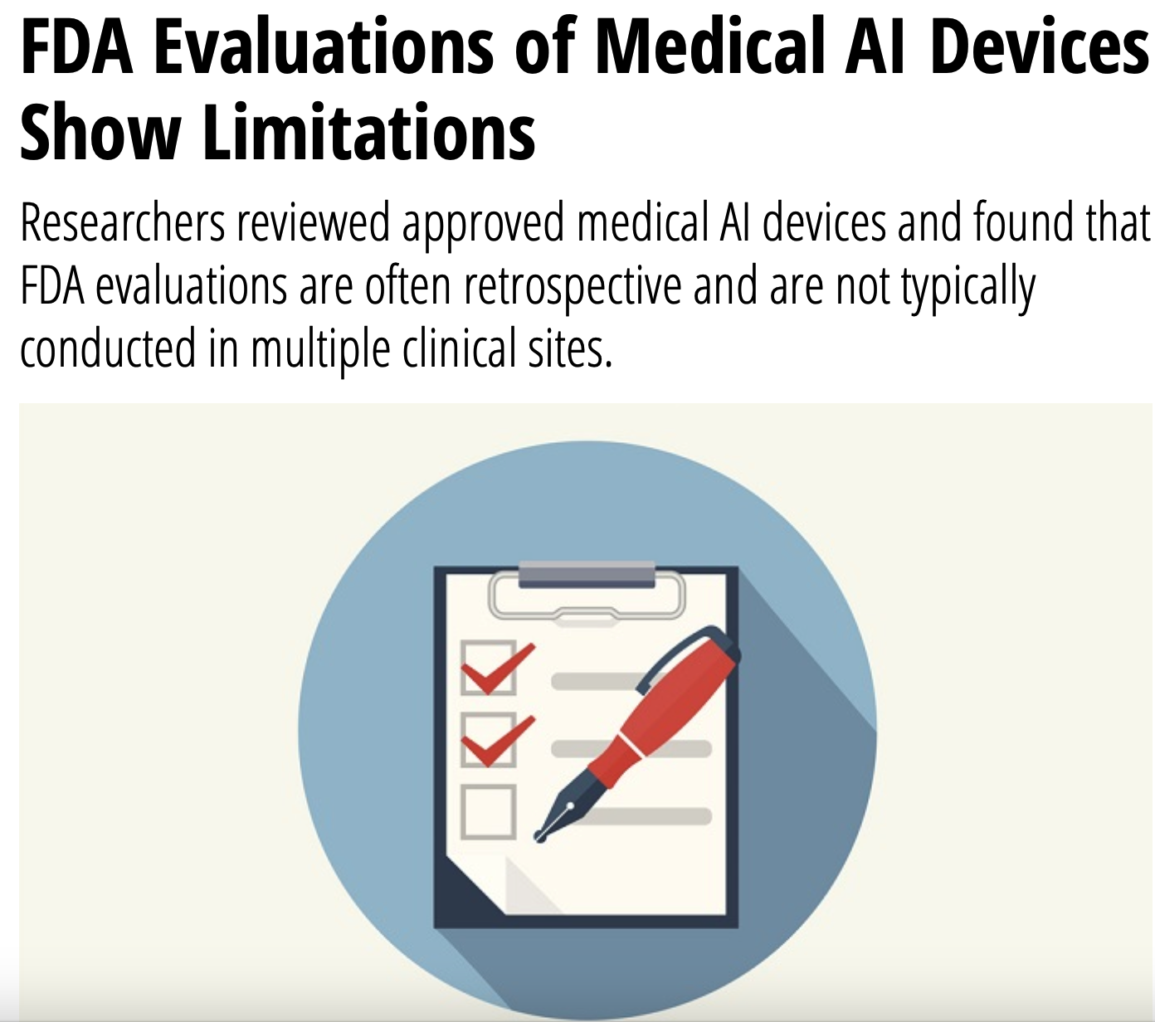
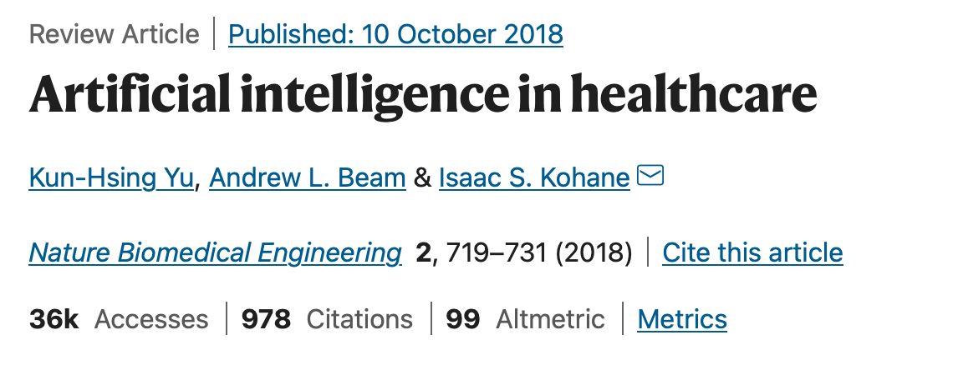
Why clinical evaluation of AI for health?
Initial problem
https://doi.org/10.1038/s42256-021-00307-0
https://healthitanalytics.com/news/fda-evaluations-of-medical-ai-devices-show-limitations
https://www.technologyreview.com/2020/04/27/1000658/google-medical-ai-accurate-lab-real-life-clinic-covid-diabetes-retina-disease/
https://doi.org/10.1038/s41551-018-0305-z

Slide 4
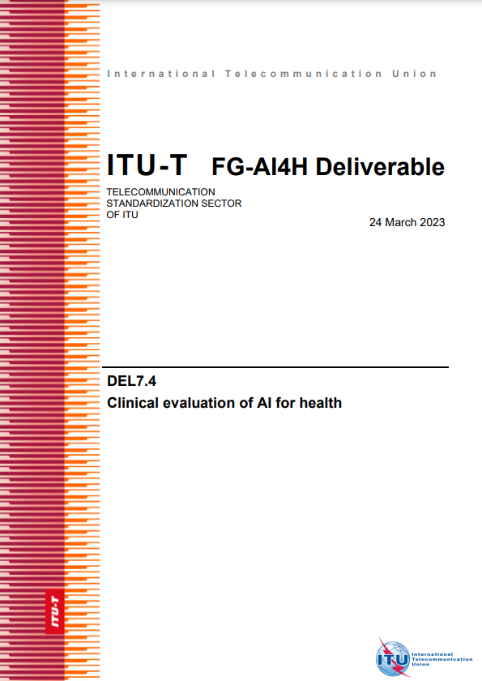
Introduction
ITU-WHO Working Group on Clinical Evaluation
Purpose
Collaboration
Develop a framework (best practices & principles) for clinicians, researchers, policy makers, patients, public, developers
Special consideration: low resourced settings
Members (70+)
External expert group & writing group
Framework on clinical evaluation
—
Design & Purpose Algorithmic validation Clinical validation Ongoing monitoring Ethics & economic eval.

Slide 5
Achievements
2020
2021
2022
2023
Oct: Inaugural workshop
Dec: Meeting
Sep: WHO clearance
Jan & Feb: FG approval
Mar: LMIC meeting
Apr: Review & meeting
Sep: Review
Nov: Meeting
Oct: Meeting
Publications ITU, WHO (ongoing clearance)
Oct/Nov: Follow up meetings
Key deliverable & outputs
Importance & Impact: Development of key deliverable
To be used with other FG outputs
Published through ITU and WHO (under review)

Slide 6
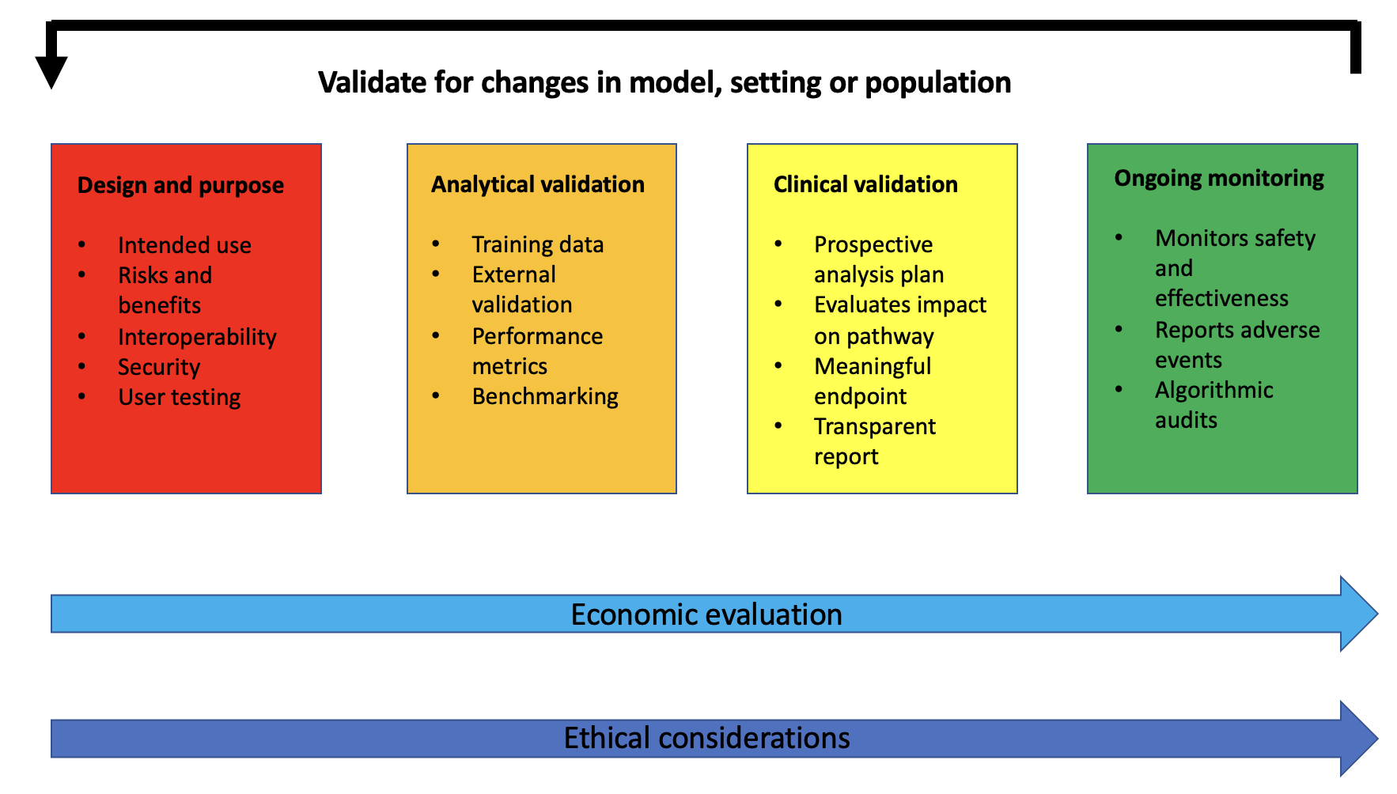
Achievements
Framework for Clinical Evaluation of AI for Health

Slide 7
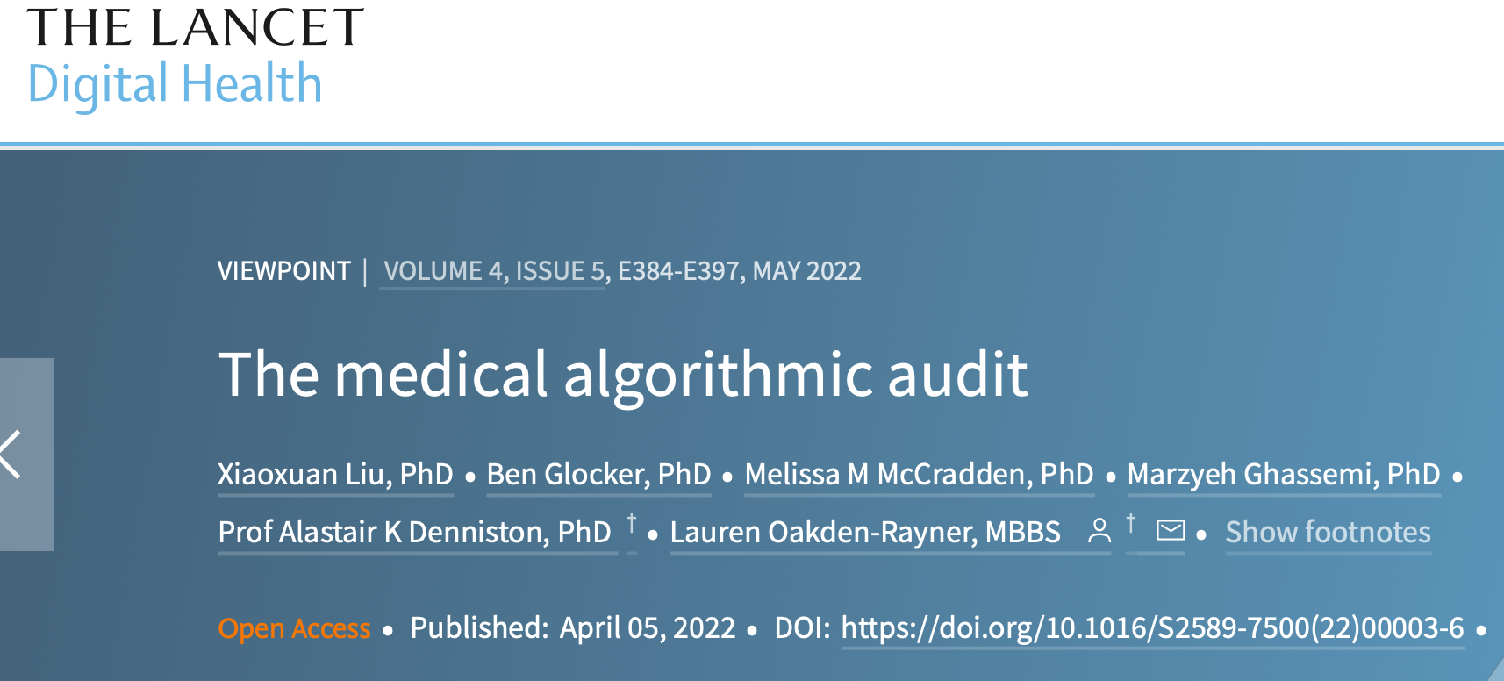
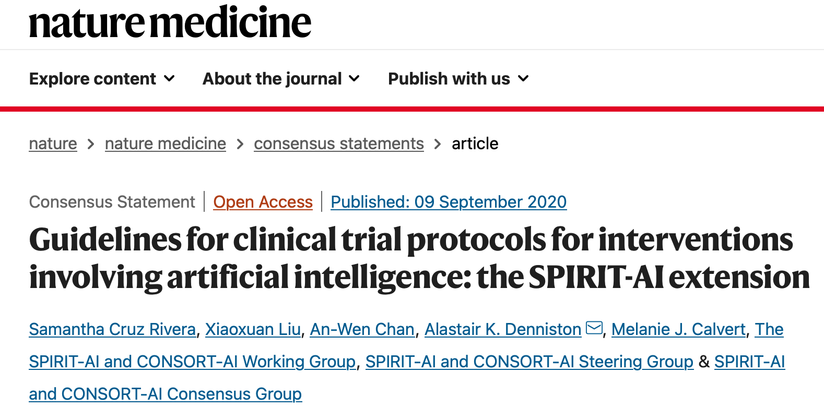
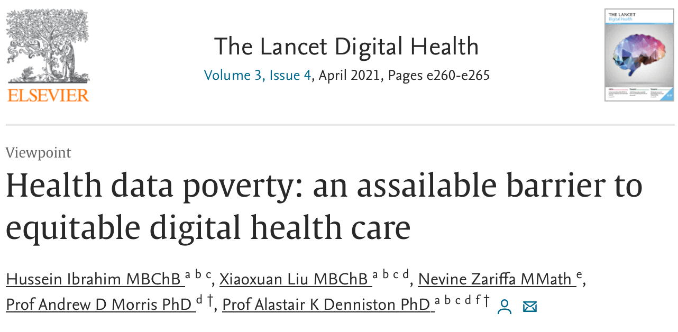
Achievements
Role of ITU-WHO Working Group on Clinical Evaluation
https://doi.org/10.1038/s41591-020-0941-1
https://doi.org/10.1016/S2589-7500(22)00003-6
https://doi.org/10.1038/s41591-020-1037-7
https://doi.org/10.2196/31623
https://doi.org/10.1016/S2589-7500(20)30317-4
https://openknowledge.worldbank.org/server/api/core/bitstreams/f8d4714e-44f5-43b1-bcc3-798cd0d85c9f/content
Beyond the written deliverable, WG-CE has also:
Created a global community of experts with a shared mission of creating a framework that leaves no one behind
Been a catalyst for work globally on clinical evaluation with members authoring major papers and policies in the field
Chairs and members have provided thought leadership through speaking and influencing at global events

Slide 8
Application
Collaboration between WG-CE and Topic Groups (TG)
TG 1
TG 2
WG-CE
TG 3
Utilize WG-CE’s framework for the TG’s benchmarking of AI systems
Reflected in the TG-deliverables (TDD)
Development of a checklist based on WG-CE framework

Slide 9
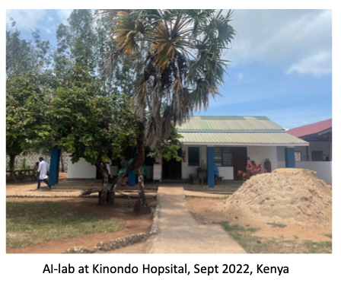
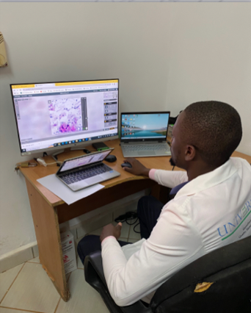
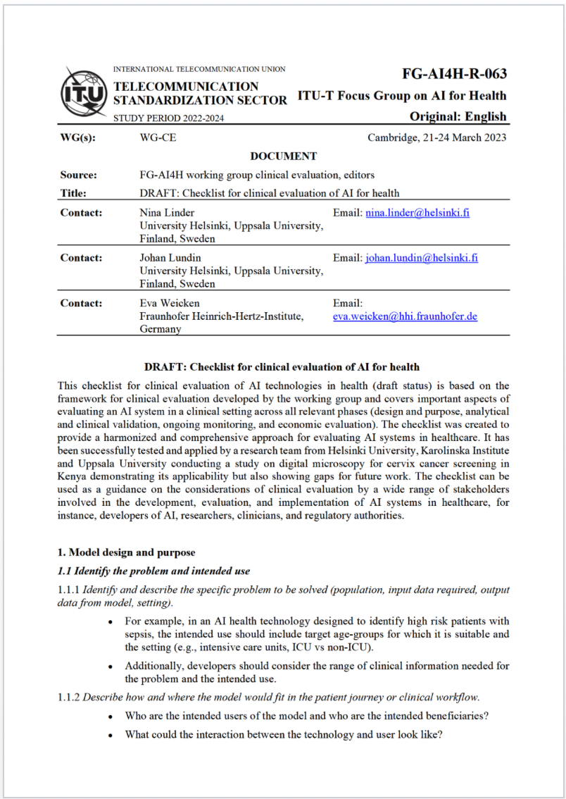
Application
Example: Topic Group “Point-of-Care” (Univ. Helsinki & Karolinska Institute & Uppsala Univ.)
Source: Nina Linder
Clinical projects within TG “Point-of-care” cervical cancer screening in Kenya & Tanzania
Evaluation of the framework by using it from the start of a new validation study in Tanzania
Development of a checklist for clinical evaluation based on the framework

Slide 10
Integration in the ITU-WHO-WIPO Global Initiative (GI)
Working Group on Clinical Evaluation
In considering the move to a GI, the group suggests the following for consideration:
The future structure of the GI needs to serve the purpose and address the most pressing problems for the WHO/ITU stakeholders. Clinical evaluation may not require a standalone stream of work moving forward.
There remain some topics for defined areas of future research: economic evaluation, implementation (relevance for health ministries), applicability for LLMs?
Implementation of the best practice recommendations for evaluation remains a key outstanding challenge. Ideas to address this include:
Development of an (online) course
Further development of the checklist
Additional journal publication
Collaboration to other initiatives (e.g., FIND)

Slide 11
Big thank you to all collaborators!
External expert group (in alphabetical order): AbouElkhir Osama (Tachy Health, Dubai), Akogo Darlington (minoHealth AI Labs, Ghana), Allen Megan (Inspired Ideas, Tanzania), Alsalamah Shada (WHO, Switzerland), Arentz, Matthew (FIND, Switzerland), Baird Pat (Philips, USA), Balachandran Pradeep (Freelancer E-Health, India), Bastawrous Andrew (Peek Vision, Global Eye Health, UK), Bathke Arne (University of Salzburg, Austria), Chiavegatto Filho Alexandre (São Paulo University, Brazil), Cresswell Kathrin (University of Edinburgh, UK), Darkoh Ernest (BroadReach Healthcare, South Africa), Ehrenfeld Jesse (American Medical Association (AMA), USA), Fehr Jana (Hasso-Plattner-Institute, Germany), Fenech Matthew (Una Health, Germany), Fürstenau Daniel (Copenhagen Business School, Denmark), Gaudin Robert (Charitè, Germany), Gilbert Stephen (Technische Universität Dresden, Germany), Glod Mateusz (Infermedica, USA), Greaves Felix (National Institute for Health and Care Excellence (NICE), UK), Gupta Saurabh (Department of Cardiology, All India Institute of Medical Science, India), Gütter Zdenek (University Hospital Olomouc, Czechia), Hatton Grace (Sensyne Health, UK), Ho Dean (National University of Singapore, Singapore), Ibrahim Hussein (Doctors.net.uk, UK), Islam Shariful (Deakin University, AUS), Jarral Reza (Pro Care, NZ), Jeon Jonghong (Electronics and Telecommuncations Research Institute, South Korea), John Oommen (George Institute for Global Health, India), Kadam Rigveda (Head of digital access, FIND, Switzerland), Kherif Ferath (LREN, Switzerland), Kuku Stephanie (WHO, UCL, Switzerland, UK), Kurtys Michal (Infermedica, Poland), Lapão Luís (Velez) (University of Lisbon, Portugal), Linder Nina (University of Helsinki, Finland), Loh Irving (Infermedica, USA), Loveys Kate (University of Auckland, NZ), Magrabi Farah (Macquarie University, Sydney, Australia), Mahajan Arnav (Department of Medicine, University College Cork, Ireland), Malpani Rohit (WHO, Switzerland), Mamun Khondaker (CMED Health, Bangladesh), Masud Jakir Hossain Bhuiyan (CTS, Bangladesh), Matin Rubeta (Oxford University Hospitals NHS Foundation Trust, UK), McCradden Melissa (Sick Kids Hopspital, Canada), Menezes Audrey (Healthily, UK), Murchison Andrew (Oxford University Hospitals NHS Trust, UK), Murphy Lisa (Centre for Improving Data Collaboration at NHSX, UK), Essa Mohamedali (Tanzania AI Lab, Tanzania), Nakasi Rose (Makerere University, Uganda), Oala Luis (Fraunhofer Heinrich Hertz Institute (HHI), Germany), Pankova Natalie (Metadvice, UK), Piekut Agata (Health Action Tank, Poland), Porras Lina (1Doc3, Colombia), Reddy Sandeep (Deakin University, Australia), Salim Ally (Inspired Ideas, Tanzania), Schwendicke Falk (Charitè, Germany), Sethi Tavpritesh (Indraprastha Institute of Information Technology Delhi, India), Sood Harpreet (National Health Service (NHS), UK), Sousa Inês (Fraunhofer Portugal, Portugal), Srivastava Manish (Virginia Polytechnic Institute & State Univ., USA), Starlinger Johannes (Howto Health Digital Business Solutions, Germany), Wasswa William (Global Auto Systems LTD, Uganda), Werneck Leite Alixandro (Tribal, Mexico)
Writing group (in alphabetical order): Carolan Jane (UCL Institute of Health Informatics, UK), Denniston Alastair (University of Birmingham, UK), Karpathakis Kassandra (Harvard University, USA), Lee Naomi (National Institute for Health and Care Excellence (NICE), UK), Liu Xiaoxuan (University of Birmingham, UK), Upadhyay Shubhanan (Ada Health, Germany), Weicken Eva (Fraunhofer Heinrich Hertz Institute (HHI), Germany), Wilkinson Thomas (Ministry of Health, NZ)

