Slide 1
FGAI4H-S-049
Geneva, 3-5 July 2023
Source: | Editor
Title: | DEL10 Update: AI4H use cases: Topic Description Documents
Contact: | Eva Weicken | E-mail: eva.weicken@hhi.fraunhofer.de
Abstract: | This PPT contains a presentation of: an introduction to the topic groups

Slide 2
ITU/WHO FG-AI4H Deliverable 10.0
—
Update AI4H use cases: Topic Description Documents
Eva Weicken, 4 July 2023, ITU HQ, Geneva, Switzerland

Slide 3
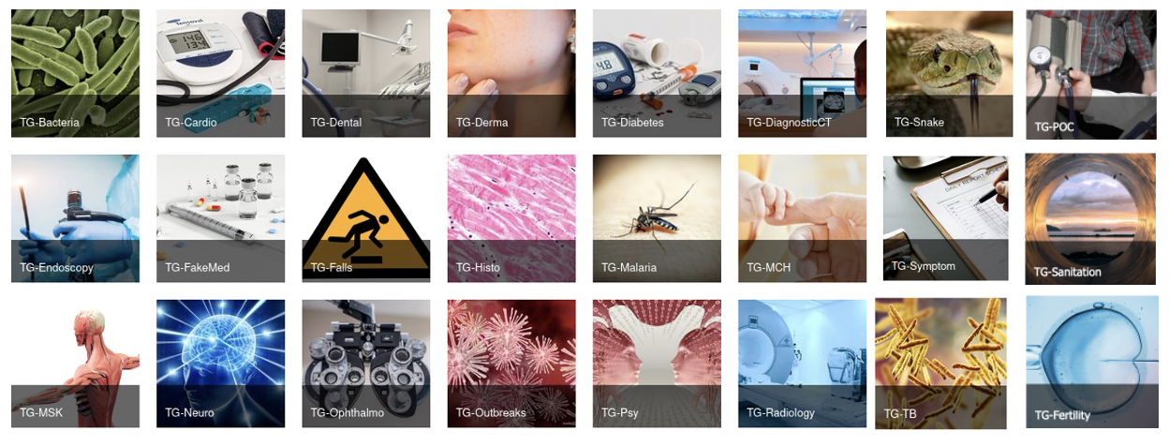
24 topic groups
July 2023
Variety of health use cases in the context of AI
Producing evidence and case studies
Propose harmonized procedures to benchmark AI models
Combine experts & data from various partners

Slide 4
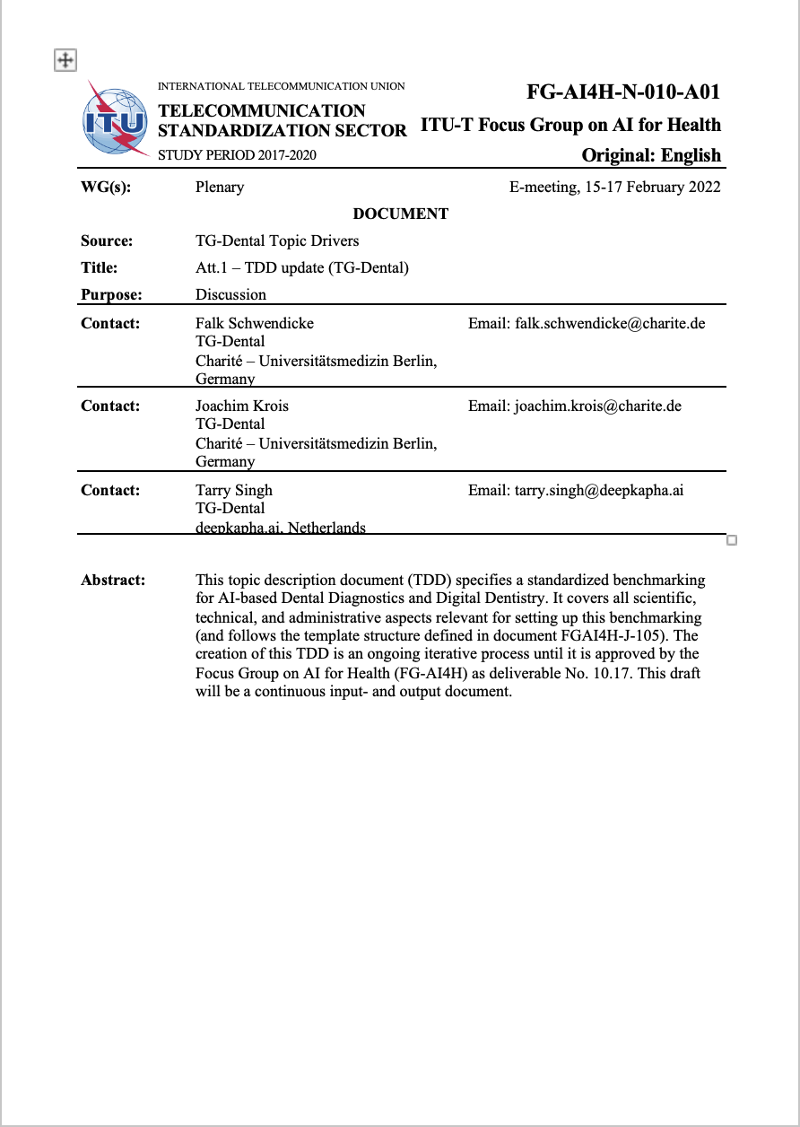
Topic groups organization & output
Topic description documents
Topic groups (TGs) create output documentation, topic driver coordinate work
Sections on the ethical, technical, clinical, regulatory requirements for the benchmarking
Categories: Background, features, operations, considerations
Topic description document
template (Q-105)

Slide 5
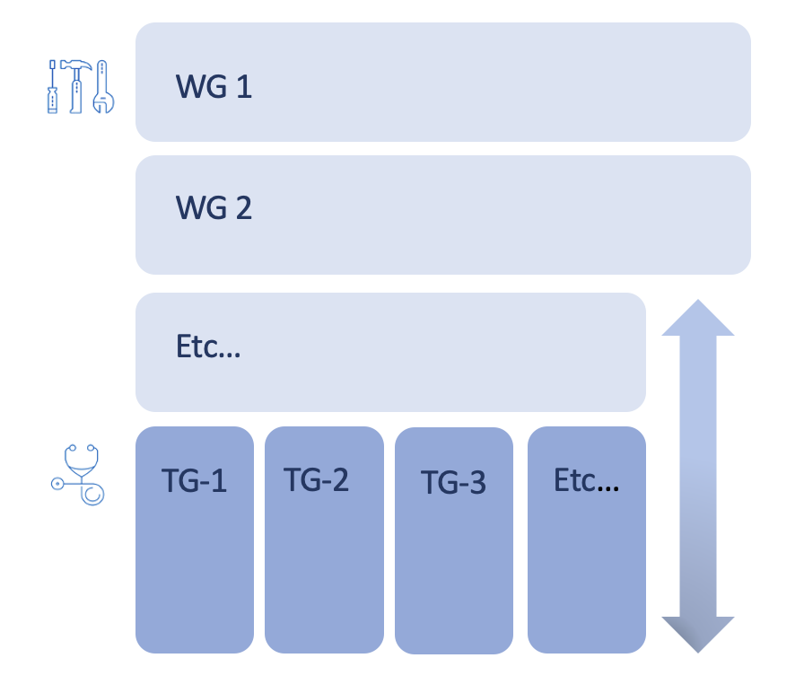
Topic groups x working groups
Matrix structure
Working Groups (WG)
create best practices & guidance documentation for cross cutting topics (ethics, regulation, clinical evaluation, data)
Topic Groups (TG)
apply WG-output in AI benchmarking & test its use, applicability, e.g., WG-CE & TG-Point-of-care
WG = Working Groups
TG = Topic Groups

Slide 6
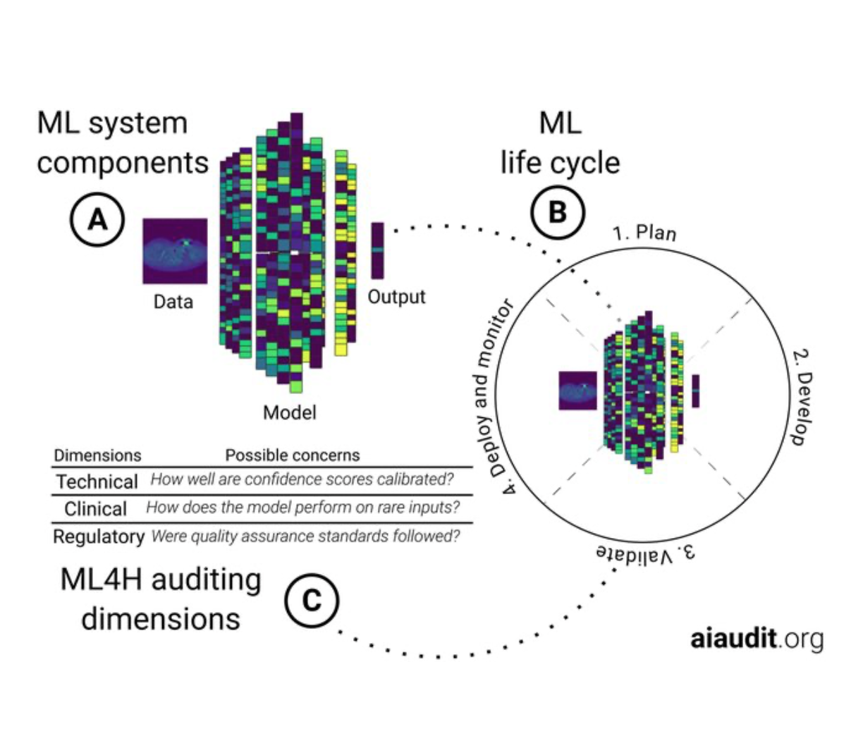
More topic group activities
Open Code initiative & AI audits
& Open Code Initiative
Topic groups
Ophthalmology – Malaria – Symptoms – Psychiatry – Radiology – Neurology – Outbreaks – Dental – Falls …

Slide 7
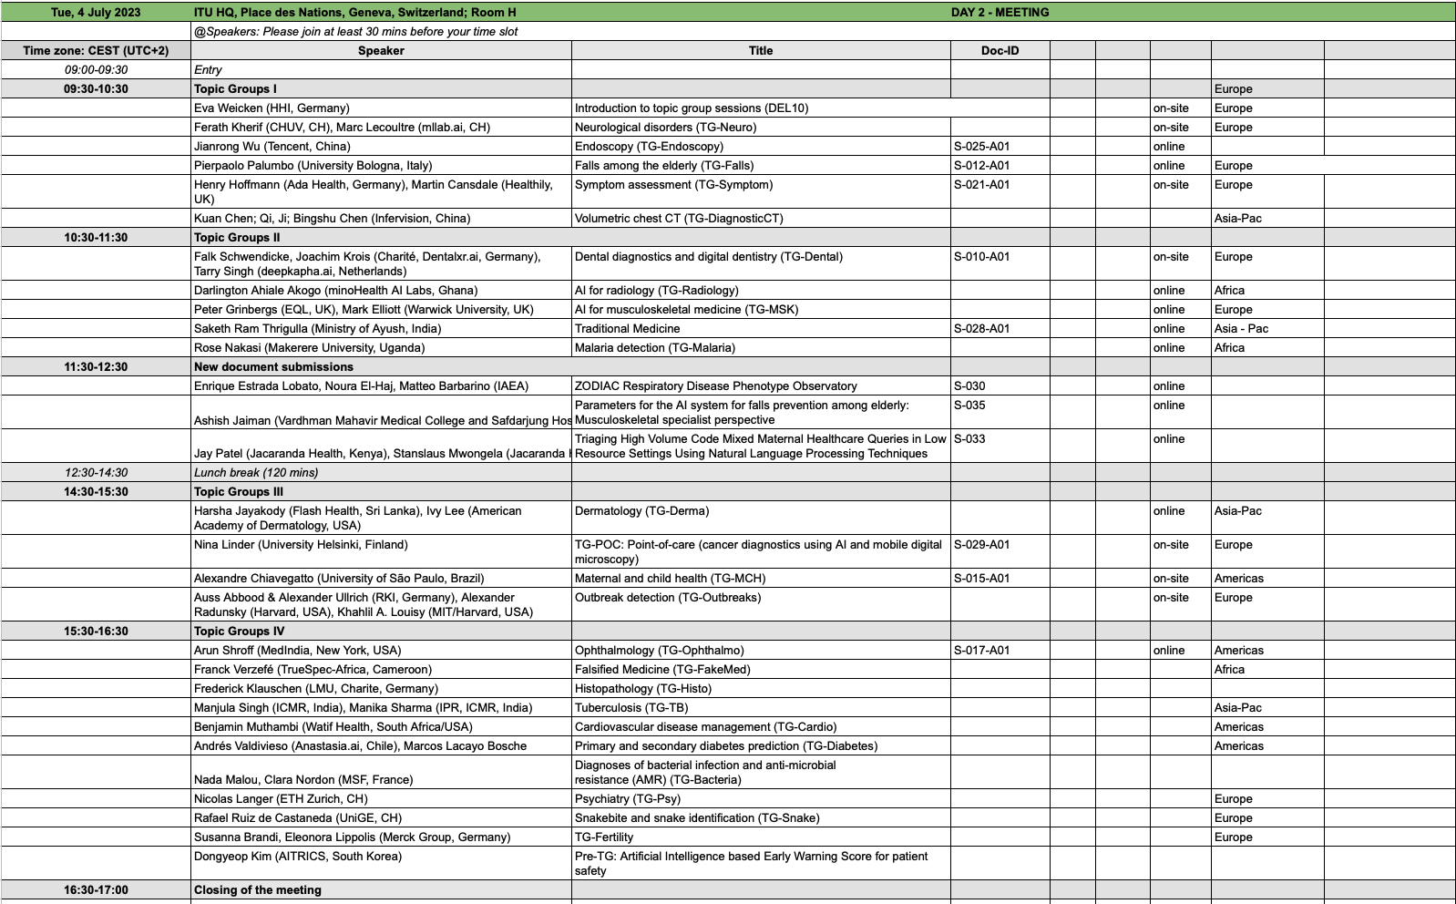
Topic Group presentations today
Schedule

Slide 8
Thank you for your attention!
—
Contact: eva.weicken@hhi.fraunhofer.de

