Slide 1
FGAI4H-S-048
Geneva, 3-5 July 2023
Source: | Editor
Title: | DEL5.4 Update: Training and test data specification
Contact: | Luis Oala Pradeep Balachandran | E-mail: luis.oala@dotphoton.com E-mail: pbn.tvm@gmail.com
Abstract: | This PPT contains a presentation on DEL5.4 update.

Slide 2
5.4
pradeep, pbn.tvm@gmail.com
luis, luis.oala@dotphoton.com

Slide 3
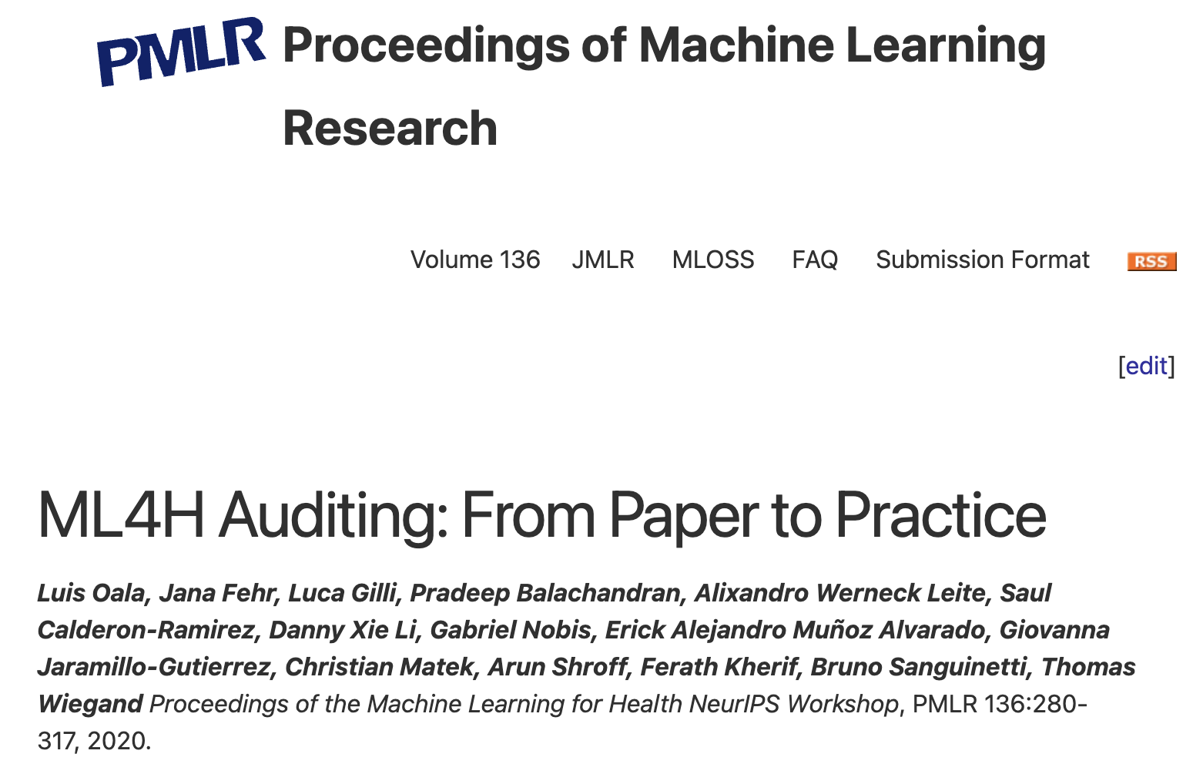
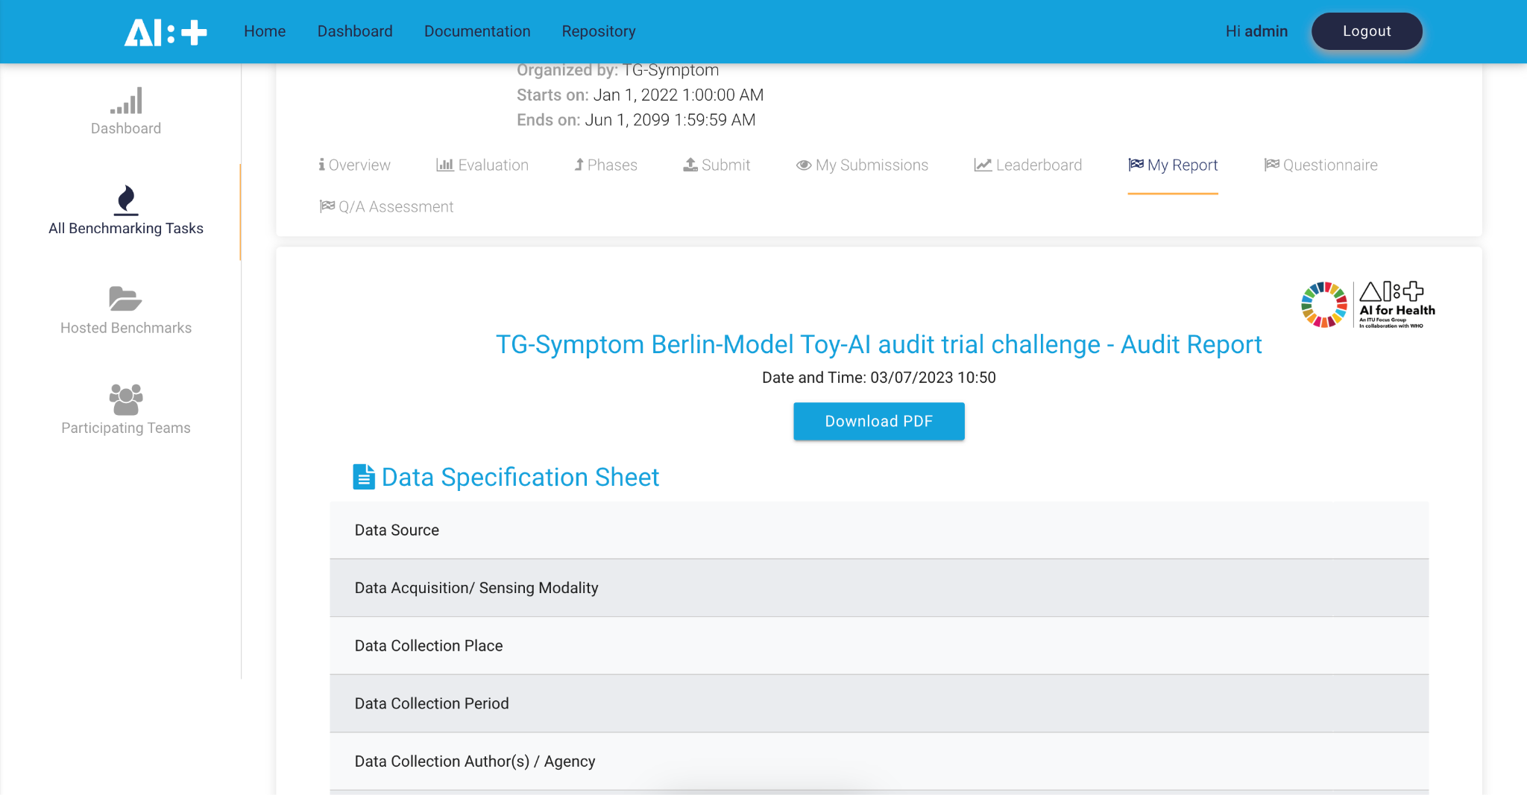
history (2020-2022): collect and consolidate
collect
requirements
standardize
operationalize
research
reg and intl
bodies
neurips ml4h, 2020
FGAI4H-J-048
health.aiaudit.org
industry
berlin, 2020

Slide 4
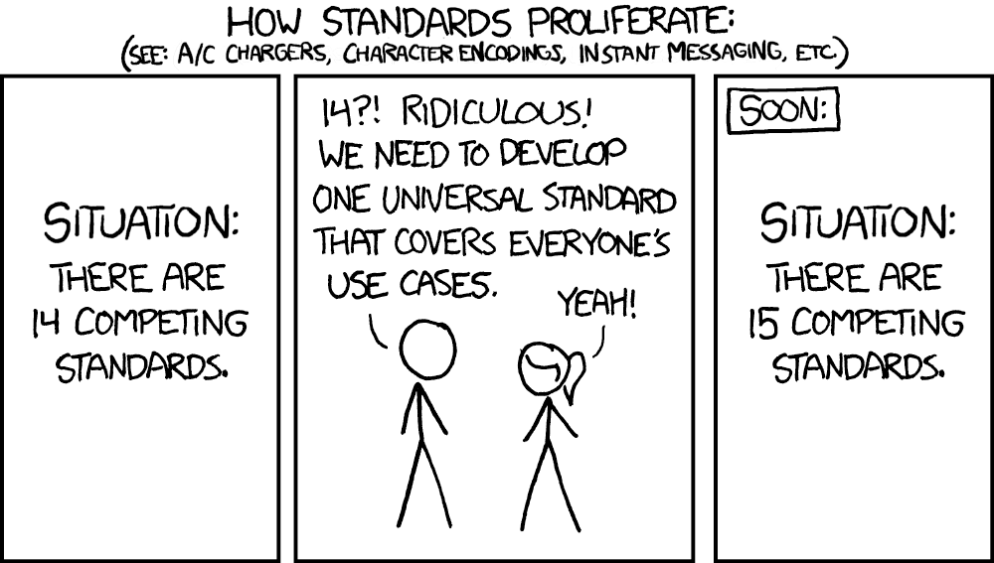
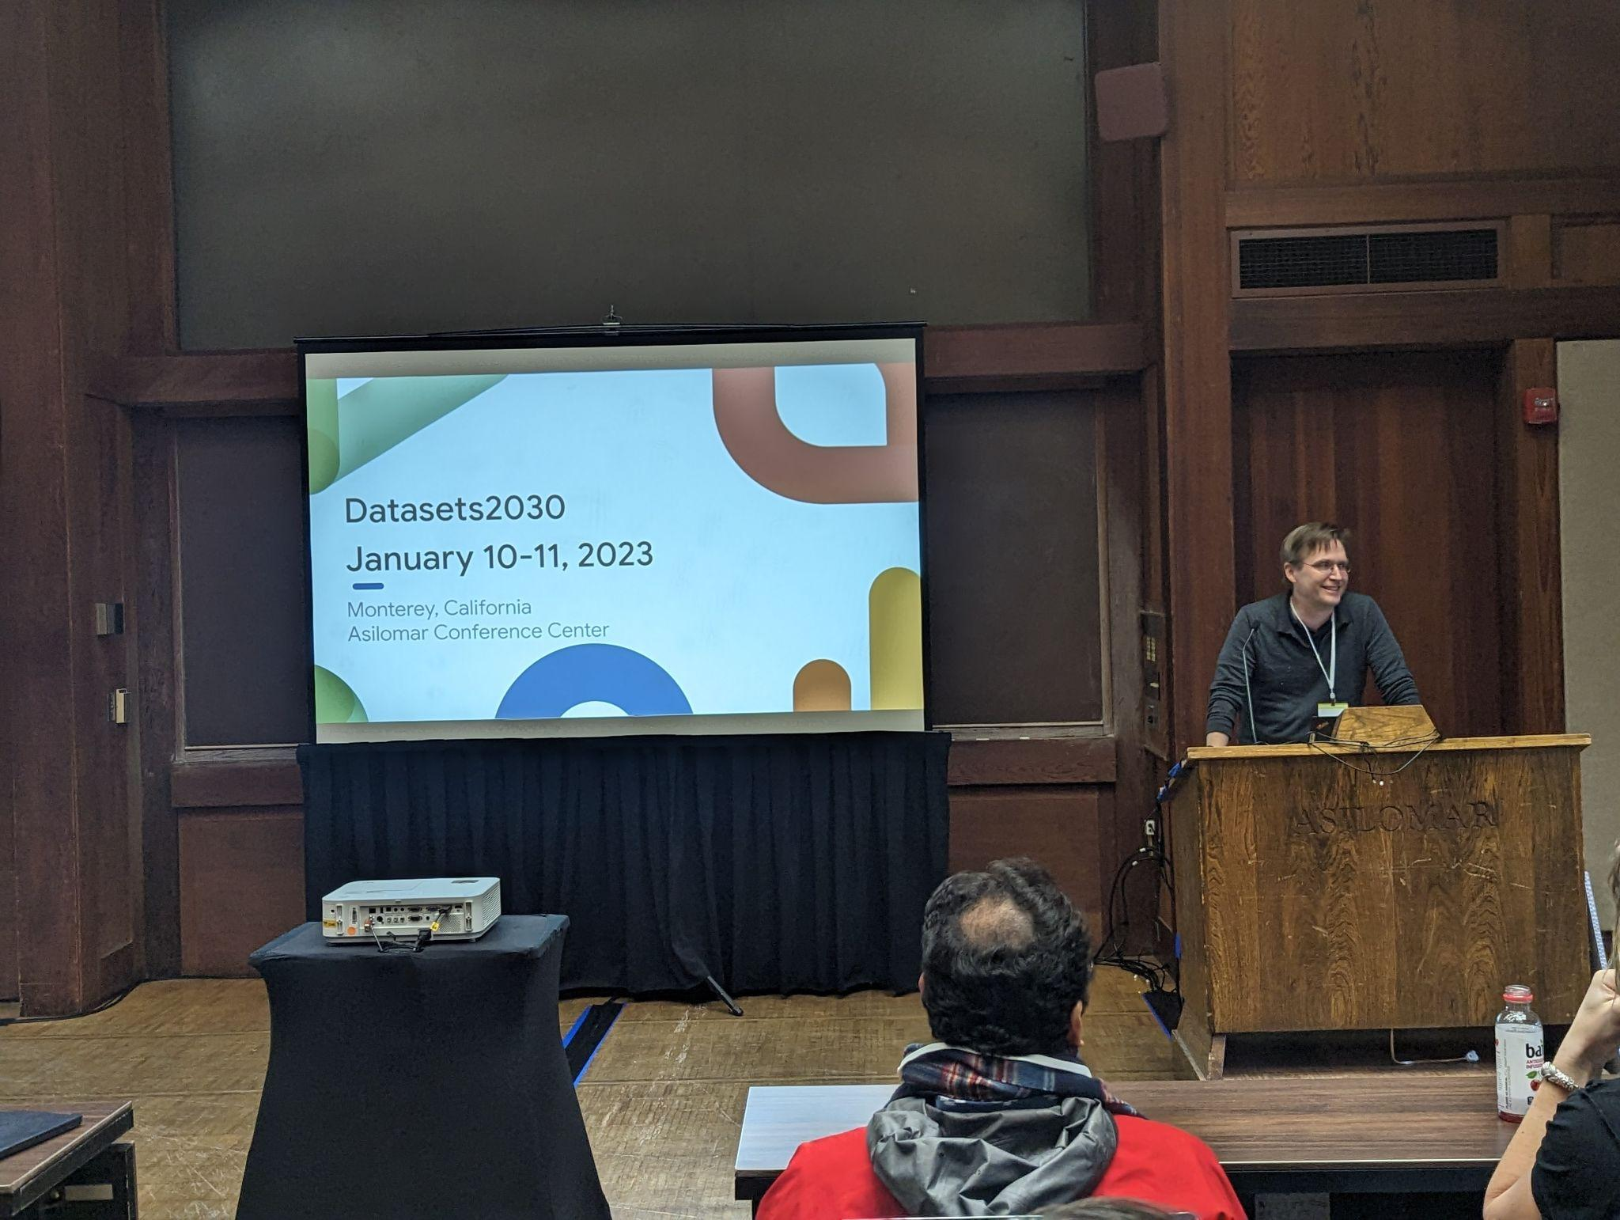
next steps (2023-...): connecting dots, operationalize
jan, 2023 - datasets 2030 group
conference
https://dmlr.ai/
https://data.mlr.press/
journal
https://www.dataperf.org
dataperf: benchmarking data
new dataset standard for ai and ml: croissant
july 29, 2023 @icml honolulu, hawaii
https://github.com/mlcommons/croissant

Slide 5
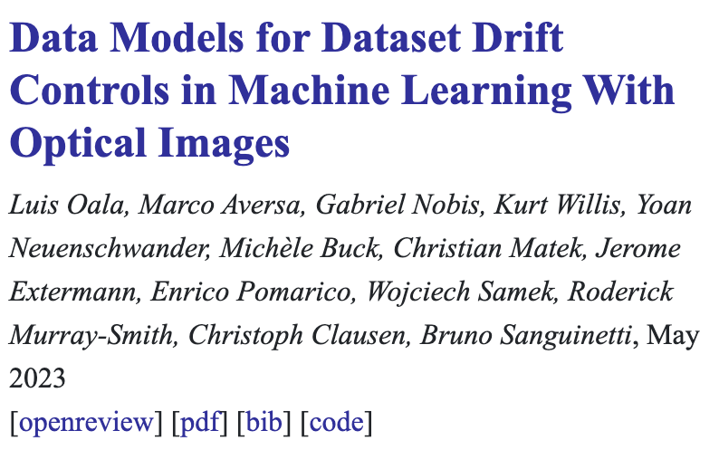
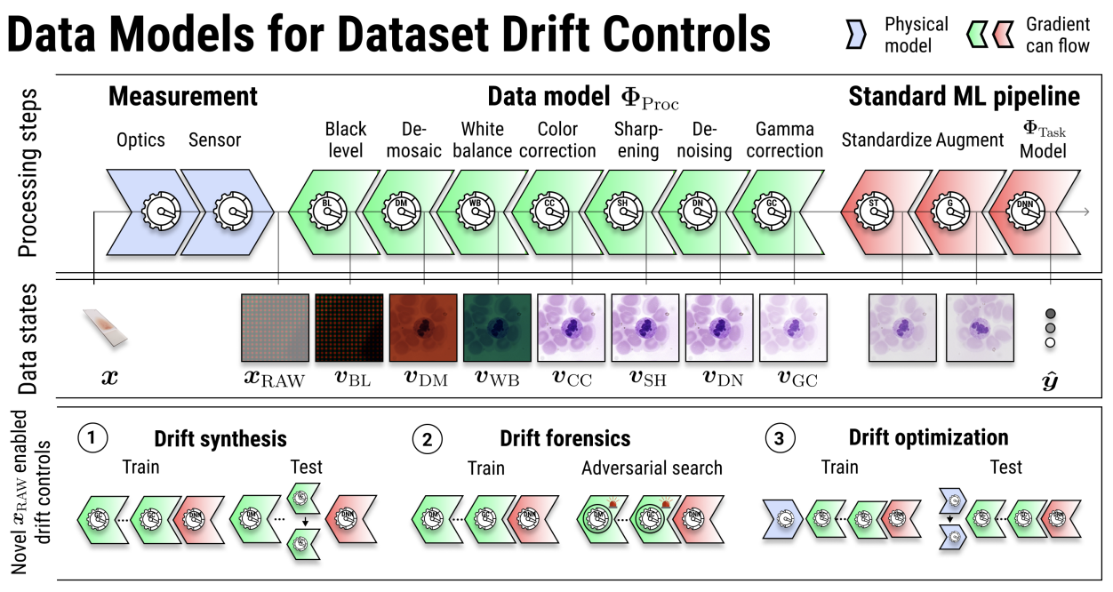
research highlight: a data quality fgai4h success story
health domain experts
+ data acquisition experts
+ ml experts
=
a new, operational method to specify and test data quality

