Slide 1
FGAI4H-S-041
Geneva, 3-5 July 2023
Source: | WG-O
Title: | WG-O: DEL0.1 and DEL7 updates
Contact: | Markus Wenzel | E-mail: markus.wenzel@hhi.fraunhofer.de
Abstract: | This PPT contains the update from WG-O with DEL0.1 and DEL7.

Slide 2

    Update WG-O with DEL0.1 and DEL7
Markus Wenzel (Fraunhofer HHI, Berlin, Germany)
July 2023, Geneva

Slide 3

Working Group Operations [WG-O]
of ITU-WHO Focus Group AI for Health
5/2018
AI for Good
Geneva
11/2018
Columbia Univ.
NYC
4/2019
World Expo
Shanghai
9/2019
UCSAF
Zanzibar
01/2020
PAHO/WHO
Brasilia
05/2020
Online
01/2021Online
09/2021Online
05/2022
Berlin
12/2022
Douala
07/2023
AI for Good
Geneva
10/2018
WHO HQ
Geneva
1/2019
EPFL
Lausanne
5/2019
AI for Good
Geneva
11/2019
ICMR & NICF
New Delhi
09/2020
Online
05/2021
Online
02/2022
Online
09/2022
Helsinki
03/2023
Harvard/MIT
Support meeting/workshop organization, topic groups, funding acquisition
Deliverable editing: DEL0.1, DEL7 (DEL10)

Slide 4
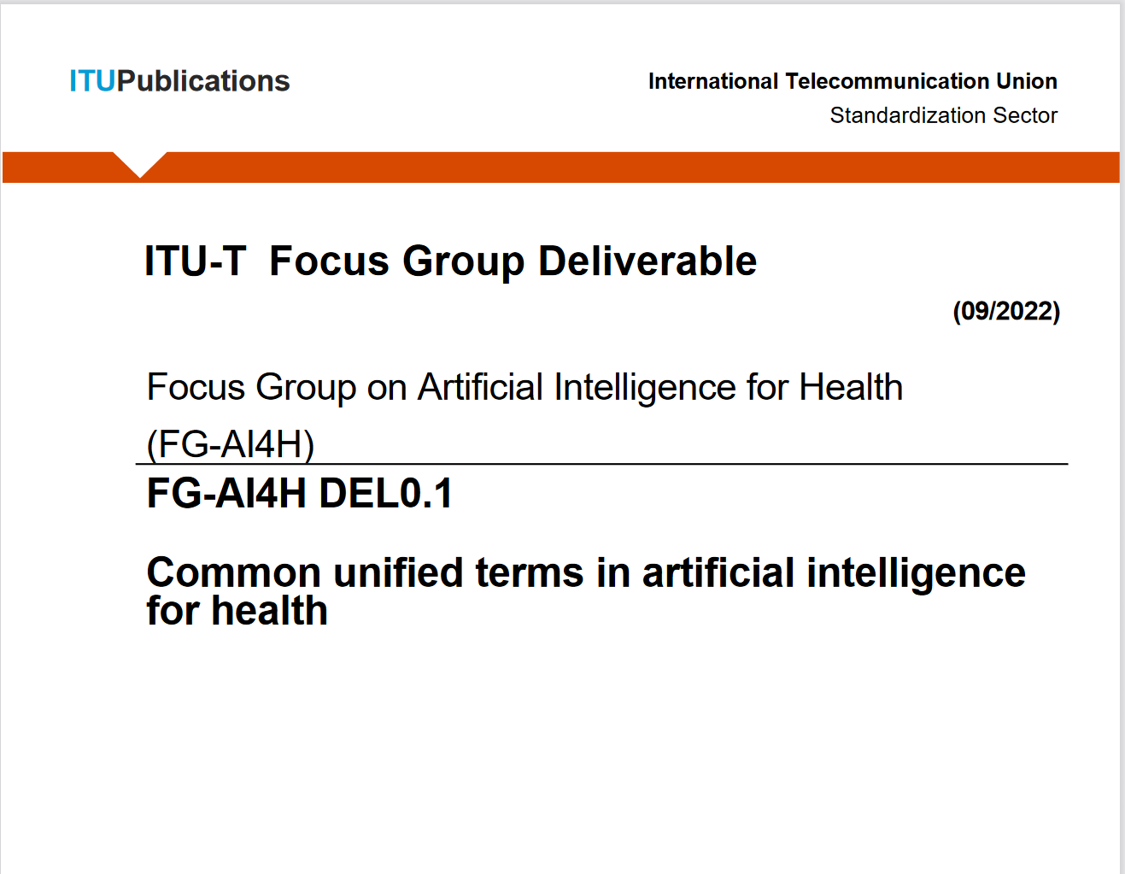
DEL0.1) Common unified terms in AI for health
ITU-WHO Focus Group AI for Health
Glossary: Terms and definitions from renowned sources (journals, standards)
Joint work WHO, ITU, FGAI4H colleagues
https://www.itu.int/dms_pub/itu-t/opb/fg/T-FG-AI4H-2022-1-PDF-E.pdf
ITU-T Joint Coordination Activity on Machine Learning (JCA-ML)
Working on Machine Learning Standardization Roadmap
Glossary of Terms and Definitions for Machine Learning
“request that, if you have any ML-related standards, that are currently in progress or have been approved, you provide the relevant information to JCA-ML as an input document.”
Send liaison statement to JCA-ML

Slide 5


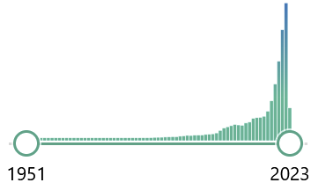
DEL7) AI for health evaluation considerations
ITU-WHO Focus Group AI for Health
DEL7 outline
Background
Evaluation process
Novelty
Standardized model benchmarking
Benchmarking platform requirements
Best practices from literature​
DEL7 status
Published as output document of FG-AI4H
(under publication preparation)
https://www.itu.int/en/ITU-T/focusgroups/ai4h/Pages/deliverables.aspx
Context:
Health AI models offer great potential
Recognize, classify, predict, warn, recommend, …
Effective, safe, accurate, robust, plausible, fair?
Standards for trustworthy healthcare AI needed
Careful evaluation plays crucial role
5

