Slide 1
FGAI4H-S-039-A01
Geneva, 3-5 July 2023
Source: | Inpher
Title: | Att.1 – Presentation - Neuroimaging Based Diagnosis of Alzheimer’s Disease Using Privacy-Preserving Machine Learning
Contact: | Manuel Capel Dimitar Jetchev | E-mail: manuel@inpher.io E-mail: dimitar@inpher.io
Abstract: | This PPT contains a presentation on Neuroimaging Based Diagnosis of Alzheimer’s Disease Using Privacy-Preserving Machine Learning.

Slide 2
Privacy-Preserving Data Science
Summary.7

Slide 3
Company Overview
Inpher pioneered cryptographic Secret Computing© with the leading privacy-preserving compute platform
8 years of experience developing and deploying Privacy-Enhancing Technologies (PETs) for commercial use
Post-quantum encryption-in-use data security
Team of 28 with experienced leadership and deep expertise; 10 PhDs in cryptography, mathematics & ML
Large experience in healthcare applications
Real-world use cases
Inpher has several private clients in including government, financial services and consumer advertising industries
Secure, Privacy-Preserving Data Collaboration Ecosystems
Secure, Collaborative Analytics Network for Asset Managers
Fraud Detection data ecosystems
Inpher is a recipient of several EU research grants in healthcare
Investors
Inpher wins iDash Genomic Data Competition two years in a row
Partners
Neuroimaging Based Diagnosis of Alzheimer’s Using Privacy-Preserving Machine Learning
Notes:
Experience
We’ve been doing this for a while, at least in terms of the recent PETs evolutionary timeline
Kind of old school- well not as old school as Nigel,
We’re focused on scalable PPML and data analytics- what we call secret computing

Slide 4
Thanks to the authors
Part I: https://inpher.io/blog/diagnosis-of-alzheimers-disease-using-privacy-preserving-machine-learning-part-1/
Part II: https://inpher.io/blog/neuroimaging-based-diagnosis-of-alzheimers-disease-using-privacy-preserving-machine-learning-part-2/
The Privacy Risk Right Under Our Nose in Federated Learning : https://inpher.io/blog/the-privacy-risk-right-under-our-nose-in-federated-learning-part-1/

Slide 5
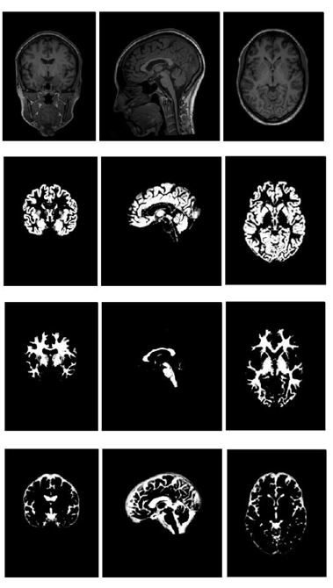
Machine Learning and Digital Technologies show potential for obtaining a robust and reliable diagnosis of dementia
A Jacobian determinant of individual AD patient – dark shades signify contraction, light – expansion. Exemplary case with volume loss in the hippocampus (black) and dilation of the ventricles (white).
Brain tissue classification in a Bayesian probabilistic framework
Clinicians’ perspective: individual diagnostics estimating accurate risk score and propensity of neuromodulatory treatment for a given patient to support better diagnosis
Researchers’ perspective: Identifying relevant biological variables including regional changes in brain volume associated with the pathologies of AD and other dementias to understand the mechanisms underlying Alzheimer’s disease

Slide 6
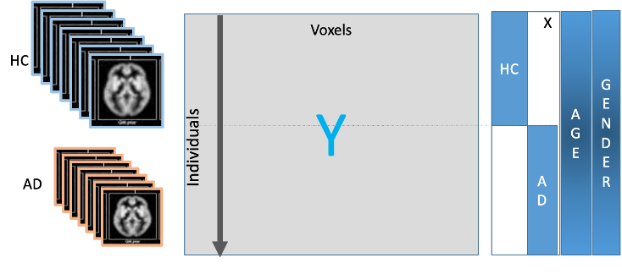
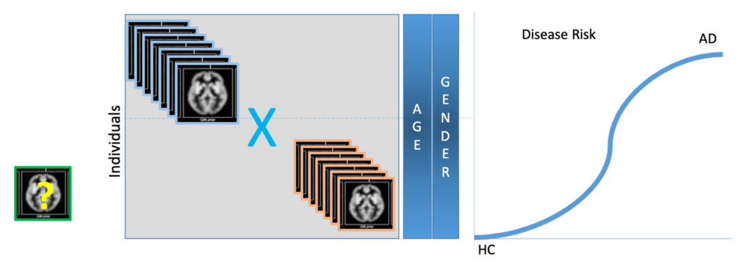
Linear regression and logistic regression models are sensitive to bias
Fitting a Linear Regression Model
Estimating a Patient’s AD Risk score using Logistic Regression Model
How can researchers reduce bias in the input data ?

Slide 7
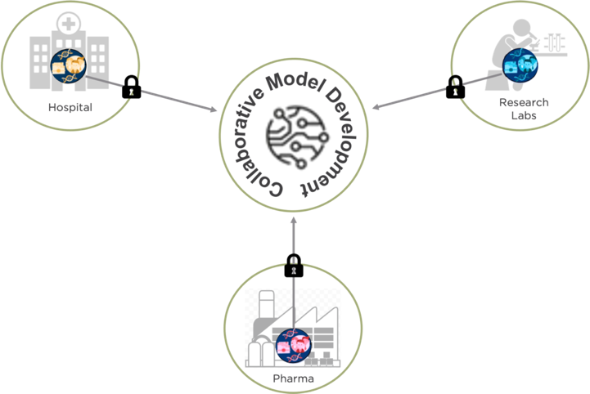
To compute unbiased AI and ML models large amounts of data are required
In order to identify Alzheimer’s disease effectively, it is necessary to have an unbiased prediction model.
Unfortunately, if the training uses data available only at the hospital, the model can skew, since most of the samples are AD patients.
Hence, having access to diverse data sources such as private clinics, radiology labs, and even pharmaceutical companies while safeguarding patient privacy is critical to building great predictive models.
Collaborative Model Development
Notes:
In order to identify Alzheimer’s disease effectively, it is necessary to have an unbiased prediction model. Unfortunately, if the training uses data available only at the hospital, the model can skew, since most of the samples are AD patients. Hence, having access to diverse data sources such as private clinics, radiology labs, and even pharmaceutical companies while safeguarding patient privacy is critical to building great predictive models.

Slide 8
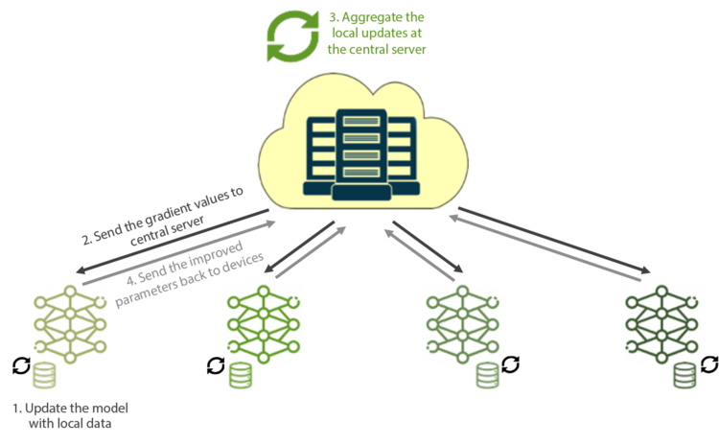
Federated Learning enables multiple parties to jointly train a shared model without collecting raw personal identifiers while keeping the device data local.
Notes:
Train the models on the devices by using local data
In the first step, the current model is downloaded from the central server to the devices. Once downloaded, the model is updated using the device’s local data for a specific number of iterations. FL relies on local devices’ computation power to process the data.
Send local updates (gradient data) to the central server
Next, the gradient values from the locally trained model on the devices are sent to the central server. Since the training is performed on the devices, the technique is built to accommodate millions of devices with minimum latencies or overheads, as the compute nodes need not communicate with each other—only with the central server
Aggregate all the local updates at the central server
Once the devices send local updates to the central server, the server’s task is to aggregate the model parameters into a global model. Algorithms such as FedAvg or FedSVD make it easier to use functions such as Stochastic Gradient Descent in an FL environment.
Broadcast the improved parameters back to the devices
With the updated parameters, devices can access a more accurate model than they could have built using their local data. A new party can join or leave at any time without halting the training of the model, as it’s not reliant on any specific data.

Slide 9
Federated Learning may not always provide sufficient privacy guarantees
Communicating model updates throughout the training process can reveal sensitive information; even incur deep leakage, either to a third-party or to the central server.
Membership Inference Attacks
Exploitation of privacy leakages about individual data records
Model Poisoning Attacks
The manipulation of the model by a malicious party by injecting bad data
Model Inversion Attacks
Attacker can learn about participant’s private data by quering the model and the individual updates multiple times
How to protect the models and the input data while computing the required models?
Notes:
Membership Inference Attacks: With Membership inference attacks, adversaries can exploit privacy leakage about individual data records in FL training. The membership inference attack can determine if the record was in the model’s training dataset. An adversary builds a shadow model to create a dataset that is familiar to the original dataset. If the (shadow) model’s prediction has high confidence values, it is similar to the original dataset.
Inference attacks exploit privacy leakage that occurs during gradient sharing in FL training. Model updates can leak extra information about the unintended features of participants’ training data to the adversarial participants, as deep learning models appear to internally recognize many features of the data that are not apparently related to the main tasks.
Model Poisoning Attacks: Model poisoning attacks affect model performance without being noticed. One could deploy a flipping attack by manipulating the model update or a more complex target attack that can leverage global ML models to do what they want. This blog post details more on model poisoning attacks
Model Inversion Attacks: If an adversary can query the model enough times, they can reconstruct the clear-text model using an Equation solving attack. The adversary can learn about the distribution of the training data from other participating devices. The adversary can also save the snapshot of the FL model parameters, and conduct property inference by exploiting the difference between the consecutive snapshots, which is equal to the aggregated updates from all participants less the adversary. The main reason is that the gradients are derived from the participants’ private data.

Slide 10
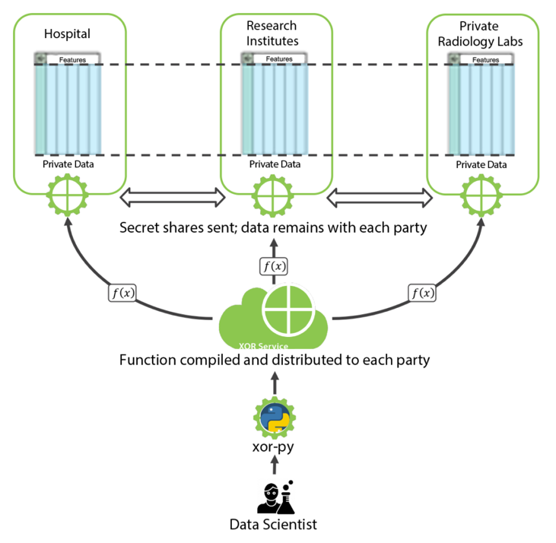
Secure Multiparty Computation can be used to securely aggregate horizontally split data
Workflow Illustration for PPML with SMPC

Slide 11
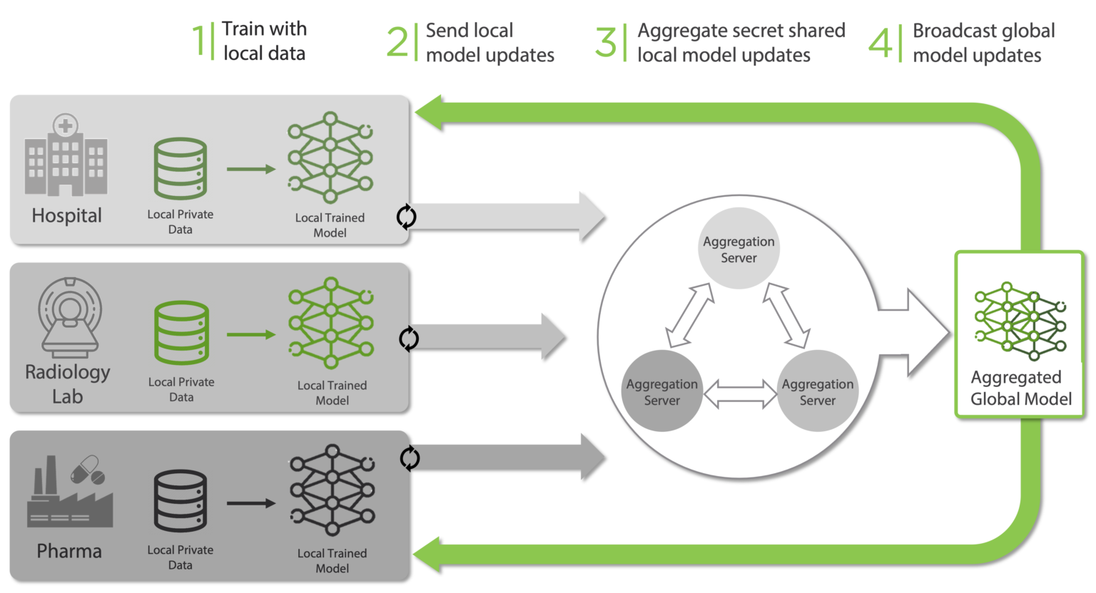
Concept for enabling secure aggregation to Alzheimer Disease Models
Workflow Illustration for PPFL with SMPC secure aggregation

Slide 12
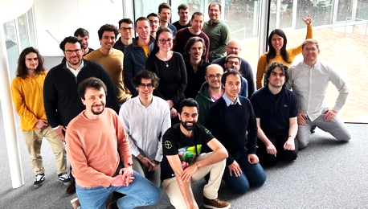
Key Take Aways
Machine Learning and AI can help researchers develop models to screen, diagnose and predict patient outcomes
Federated Learning can be used to aggregate the large amounts of data required but presents privacy risks
Federated Learning with Secure Aggregation is required to protect against privacy leakage and model inversion attacks
Contact:
Manuel Capel
Director Business Development
manuel@inpher.io
Thank you !

Slide 13
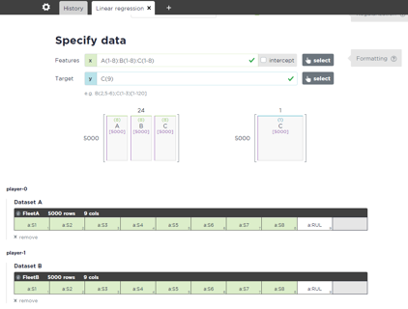
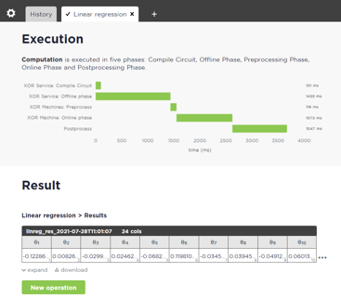
Try the XOR Secret Computing Platform Today!
https://inpher.io/trial/
Product
1. Choose use case
2. Select (provided) data sources
3. Secret compute the results!
Notes:
- Better than explaining it, you can sign up and use it today!

Slide 14
Appendix

Slide 15
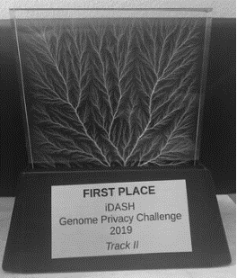
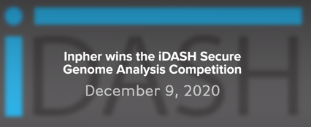
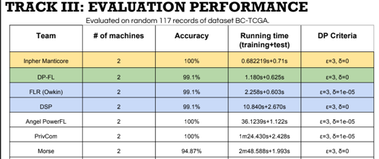
iDash – Secure genome analysis competition
Published in the International Journal of Medical Informatics
iDash 2018 (3rd place) – Pure Homomorphic Encryption
Objective: to identify genotype to phenotype relevance
Genomic Service provider train algos in Encrypted form using GWAS (Genome-Wide Association algorithm)
Patients upload Genome in encrypted form
iDash 2019 (1st place) – Pure Homomorphic Encryption
Objective: Predict pieces of missing DNA data
Model is proprietary – Patients do not send data in the clear
Inference only - no training required
iDash 2020 (1st place x 2) – MPC and Homomorphic Encryption
Objective: Cancer prediction model and tumor classification
MPC Track
GenoPPML
Inpher wins 1st place at the 2019 iDash Competition Genome Privacy & Security Competition
Notes:
2018 slides with bewnchmarks
2019 slides with Benchmarks
2020

Slide 16
Inpher wins iDash 2020
Track III: Differentially private federated learning for cancer prediction model
Healthcare
Genomics
Diagnostics
Training of a machine learning model on gene expression data for breast tumors.
Healthcare
To implement a federated learning algorithm trained by two parties holding respective training data. Noise should be added to the intermediate results to ensure differential privacy under a given budget.
1st place
100% Accuracy
Fastest running time
Privacy budget respected
input a dataset of gene expression profiles; output a model file
Notes:
with data secretly shared across multiple hospitals

Slide 17
Horizon Projects
Inpher is actively participating
Horizon EU is a European-wide research & innovation funding program in Health and other missions of interest for the EU
Inpher is part of Moore4Medical, a consortium of 66 participants who received funding to accelerate innovation in electronic medical devices. Inpher investigates data privacy aspect.
Inpher is a member of the PHASE IV AI consortium led by Fujitsu and Turku University to further advance Secure Multiparty Computation specifically for Healthcare applications as well Fit4Health.
If successful, Inpher will collaborate with CHUV to continue the development of its Neuroimaging-based Privacy-Preserving Machine Learning solution

Slide 18
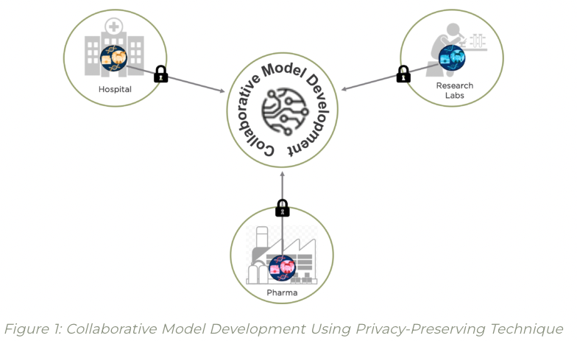
Types of data problems Secret Computing can solve
Computing private data (single source or multi-distributed source)
Joining data that is both distributed and private respectively (incl Fuzzy matching) / Identification (Double Blind trade matching, No-Fly List, KYC-related)
Computing marginal statistics of the joined data and only revealing results -> Use those statistics to generate Synthetic data for analysis
Privacy Preserving Machine Learning, Federated Learning, Multiparty Computation, Secret Sharing, Differential Privacy, Fully Homomorphic Encryption (FHE)
Enabler for Synthetic Data Generation
Notes:
1 min

Slide 19
Further Reading
3rd party content introducing encryption in use technology & applications
WORLD ECONOMIC FORUM: The Next Generation of Data-Sharing in Financial Services: Using Privacy Enhancing Techniques to Unlock New Value
This report explores PETs and their ability to unlock new value in the financial services industry by facilitating new forms of data-sharing. Inpher is mentioned on pages 14 and 19.
Link to full report text
GARTNER: Cool Vendors in Privacy Preservation in Analytics
Inpher was named a 2019 Gartner Cool Vendor in Privacy Preservation in Analytics.
Link to report overview
ACCENTURE: Maximize collaboration through secure data sharing
This report reviews how Privacy Preserving Computation techniques allow data to be jointly analyzed between parties without exposing all aspects of it. Inpher is mentioned on page 11.
Link to full report text
UNITED NATIONS: UN Handbook for Privacy-Preserving Techniques
This handbook describes motivations for privacy-preserving approaches; presents examples of use cases; and describes relevant technical capabilities.
Link to handbook
THE ROYAL SOCIETY (UK): Protecting privacy in practice: The current use, development and limits of Privacy Enhancing Technologies in data analysis
This report provides a high-level overview of current PETs, and the roles that they can play, in order to inform applied data science research and government departments’ digital strategies as well as those of business.
Link to full report text
Appendix

Slide 20
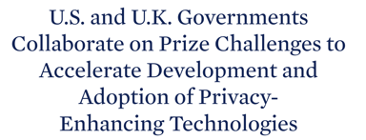
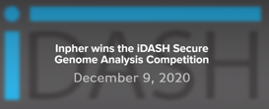
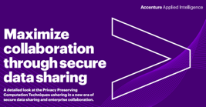
Inpher in the Press and awards
2020 Gartner Emerging Technologies: Homomorphic Encryption for Data Sharing
2019 Cool Vendor Award
US Winners
(out of 76 submissions)
Nov. 10, 2022
Inpher wins 1st place at the 2019 iDash Competition Genome Privacy & Security Competition
March 16, 2021
Aug. 2019
Aug. 2019
2022 Techsprint on Confidentiality
Inpher Advises Senate Commerce Committee on Privacy-Enhancing Technologies

