Slide 1
FGAI4H-S-038-A01
Geneva, 3-5 July 2023
Source: | World Health Organization Department of Sexual and Reproductive Health and Research
Title: | Att.1 – Presentation - AI and Sexual and Reproductive Health and Rights: Opportunities and risks
Contact: | Tigest Tamrat Lale Say | Email: tamratt@who.int Email: sayl@who.int
Abstract: | This PPT contains a high-level overview of emerging uses and implications of AI for sexual and reproductive health and rights

Slide 2
Artificial intelligence and sexual and reproductive health and rights (SRHR)
Tigest Tamrat
Scientist, Department of Sexual and Reproductive Health and Research

Slide 3
Opportunities and emerging use cases
Sexual
Reproductive
Maternal
Contraception counselling and provision
Safe abortion
Fertility care
Prevention and control of HIV & other STIs, including cervical cancer
Sexual function & psychosocial counselling
Gender-based violence prevention, support & care
Antenatal care
Intrapartum and perinatal care
Postnatal care
Comprehensive sexuality education
Chatbots
Diagnostics
Image analysis
Software as-a- medical device
Predictive modelling

Slide 4
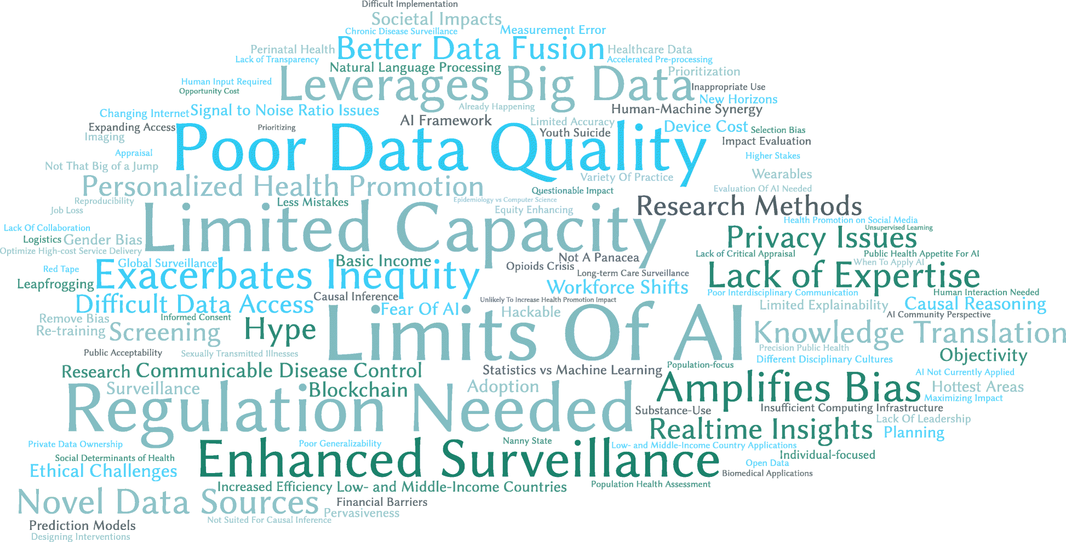
Risks and implications
Heightened risks in SRHR
General implications (Morgenstern, J.D et al. 2021)
Commodification of sensitive personal health data
Infringement on bodily autonomy
Gender biases in development of models
Perpetuating misinformation

Slide 5
Upcoming plans
Scoping review on use of AI in SRHR
Technical brief describing implications of AI and SRHR
Potential research to explore and assess emerging practices of relevance to SRHR

Slide 6
For more info: Tigest Tamrat tamratt@who.int @HRPresearch

