Slide 1
FGAI4H-S-018-A03
Geneva, 3-5 July 2023
Source: | TG-Outbreaks Topic Driver
Title: | Att.3 – Presentation (TG-Outbreaks)
Contact: | Alex Radunsky (ITGH) Khahlil Louisy (ITGH) Alexander Ullrich (RKI) Auss Abbood (RKI) | Alex.Radunsky@mail.harvard.edu klouisy@hks.harvard.edu ullricha@rki.de abbooda@rki.de
Abstract: | This PPT contains updates on the Topic Group merging.

Slide 2
Topic Group: Outbreaks

Slide 3
Summary on updates
Merging of TDDs of former TG Outbreaks and TG Sanitation completed
New labeled data was generated for benchmarking
Updates in regulatory and ethical sections
TG Outbreaks- FG-AI4R

Slide 4
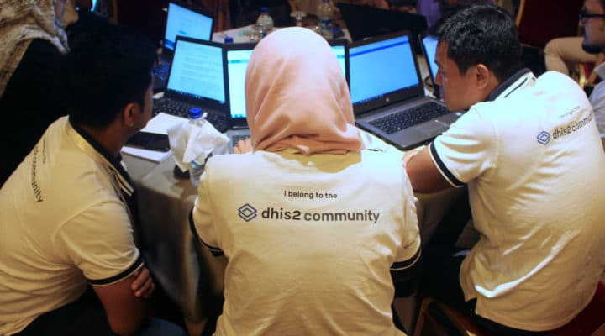
Motivation
Public health experts perform surveillance to detect events
If surveillance reveals unexpected patterns (signals), investigations are prompted
Surveillance intensity is constrained by budget -> AI
https://dhis2.org/
TG Outbreaks- FG-AI4R

Slide 5
Motivation
Surveillance uses large amounts of data:
Primary data such as lab data, sentinel networks, genomic, etc.
Secondary data such as CAB, EO, news articles, etc.
More data helps detect relevant signals earlier / more often
TG Outbreaks- FG-AI4R
Notes:
Communal ablution block (CAB)
Earth observation (EO)

Slide 6
Motivation
Signal detection is almost completely data-driven
AI can help humans to detect signals faster and more accurately
Leaves more time for responding to events
TG Outbreaks- FG-AI4R

Slide 7
Using AI: Objective
AI needs to produce signals that are:
Specific
Timely
Spatially accurate
Communicate uncertainty faithfully
Reflect the expected impact on public health
TDD: Detailed description of use-cases, data, ethics, and metrics, and regulations
TG Outbreaks- FG-AI4R

Slide 8
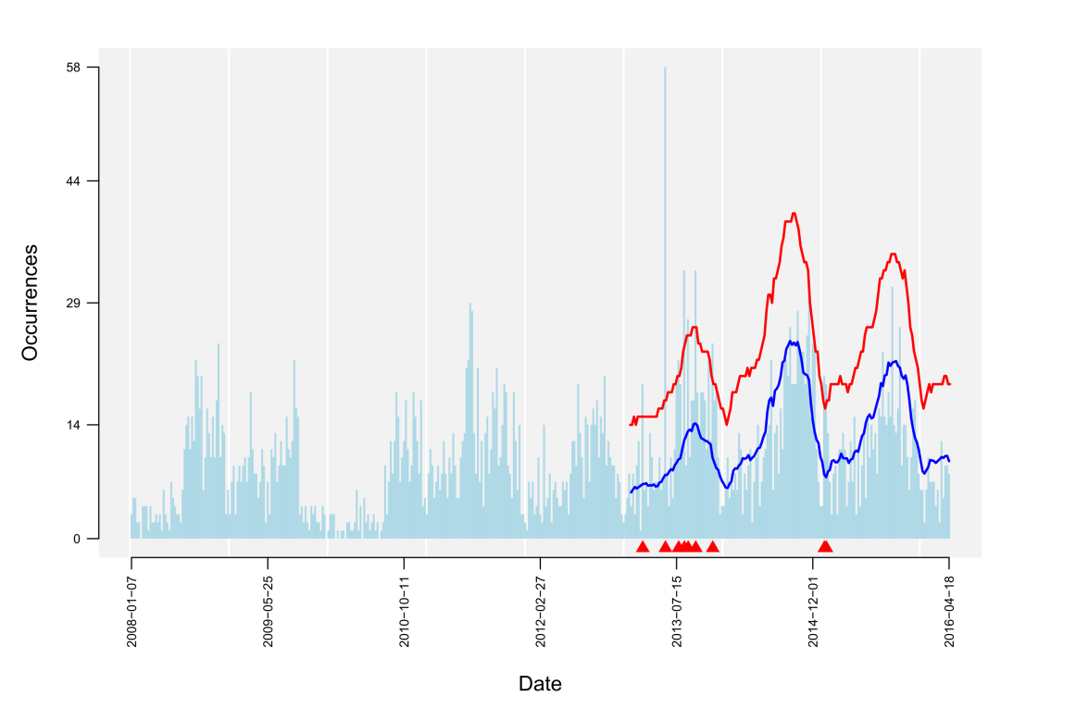
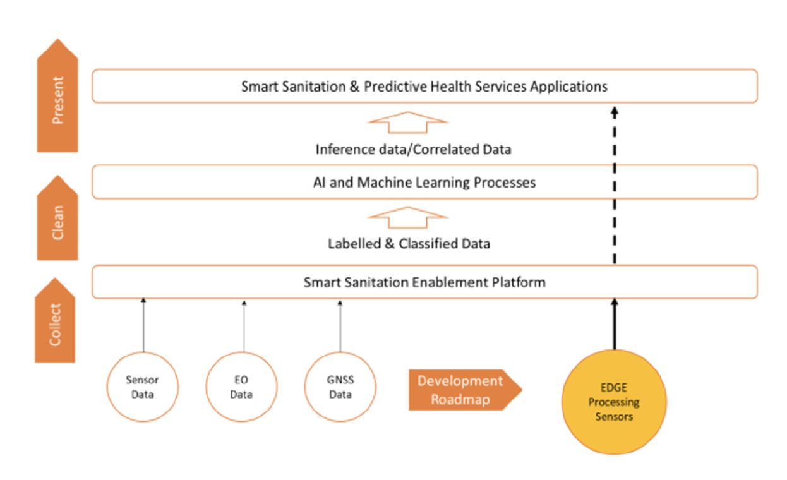
Before merging
AI task
Detection of aberrant case numbers ( )
TG Outbreaks- FG-AI4R
Notes:
Communal ablution block (CAB) occupation sensors, water meters, and acoustic diarrheal sensors; and in the pyrolysis plant: faecal sludge moisture content, calorific values, heavy metal content, presence and severity of pathogenic contamination.
Global navigation satellite system + Earth observation data

Slide 9
Document merging
Theoretical framework applied to certain scenarios
Wastewater surveillance
Mandatory reporting systems
Discussions on hospital surveillance systems
Search for partners for Global Initiative
International public health researchers
Hospital chains
TG Outbreaks- FG-AI4R

Slide 10
Using AI: Ethics
General updates and more references on
Difficulty of population level data in regards of quality of data
Bias when transferring algorithm between use-cases (hospitals, diseases, countries)
Individual-level risk due to population-level signal detection (e.g., stigma)
Equal outcome across different groups
TG Outbreaks- FG-AI4R

Slide 11
Regulation of Outbreak Detection Systems
Not Clinical Decision Support Software according to FDA
Because no critical medical data is used
Only intended as a support system
Used by health care professionals
TG Outbreaks- FG-AI4R

Slide 12
Labeled data generation
TG Outbreaks- FG-AI4R

Slide 13
Labeled data generation
TG Outbreaks- FG-AI4R

Slide 14
Open points
Run benchmarks with new data sets & write about it
Discuss with potential partners for Global Initiative
TG Outbreaks- FG-AI4R

