Slide 1
FGAI4H-S-015-A03
Geneva, 3-5 July 2023
Source: | TG-MCH Topic Driver
Title: | Att.3 – Presentation (TG-MCH)
Contact: | Alexandre Chiavegatto Filho | E-mail: alexdiasporto@usp.br
Abstract: | This PPT contains a presentation on the updates of the Topic Group on Maternal and Child Health in developing regions.

Slide 2





AI for Maternal and Child Health in developing regions
Assoc. Prof .Alexandre Chiavegatto Filho
University of São Paulo, Brazil

Slide 3
AI for Maternal and Child Health
Improving the health and well-being of mothers, infants, and children is one of the most important public health goals worldwide.
Every day, an estimated 810 women die from causes related to pregnancy or childbirth and over 15,000 children die from preventable diseases.
Despite notable recent improvements for most countries, the Millenium Development Goal (MDG) target for 2015 of reducing child mortality globally by two thirds was not achieved.
Artificial intelligence methods have the potential of improving maternal and child health decisions, especially in low-resource settings.

Slide 4
AI for Maternal and Child Health
Potential AI-based applications in MCH:
i. Prenatal predictions:
a. Fetal growth, final gestational age and incidence of comorbidities during pregnancy.
b. Risk of maternal and fetal mortality.
Hospital warning systems for the necessity of labour rooms and neonatal intensive care units.
iii. Post-natal predictions:
b. Risk of neonatal and postneonatal mortality.
c. Risk of rehospitalization after childbirth discharge.

Slide 5
AI for Maternal and Child Health
Avoiding the occurrence of negative child outcomes often involves low-cost interventions.
- But requires to be applicable in low-income settings.
In order to be effective in low-income settings:
  Algorithms need to use routinely-available variables for making predictions.
  Must be trained and validated in these low-income settings.

Slide 6
AI for Maternal and Child Health
Previous studies:
A 2019 study used machine learning to predict postpartum hospital admission in the first 12 weeks after delivery found a high predictive performance for hospitalization from hypertensive disorders (AUC = 0.879) (Betts et al., 2019).
An analysis from 2020 found that machine learning was able to predict height-for-age z-scores in children from a rural area of Pakistan (Harrison et al., 2020).
A study from 2021 found that machine learning algorithms were able to predict with reasonable accuracy the risk of readmission for complications of hypertensive disorders of pregnancy (Hoffman et al., 2021).

Slide 7


Goal: to predict the risk of neonatal mortality using only data routinely available from birth records in Sao Paulo.
The 5% births with the highest predicted risk of neonatal death included more than 90% of the actual neonatal deaths. On the other hand, there were no deaths among the 5% births with the lowest predicted risk.
Using only a smaller number of variables (WHO’s five minimum perinatal indicators) maintained high predictive performance (AUC of 0.91): maternal age, place of delivery, mode of delivery, birth weight and gestational age.

Slide 8
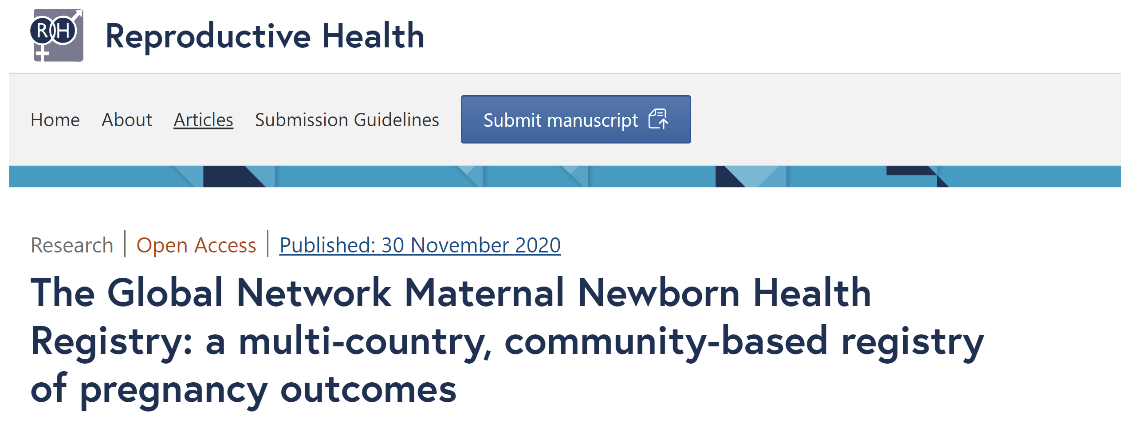
AI for Maternal and Child Health
Global Network's Maternal Newborn Health Registry (MNHR):
  Argentina, Democratic Republic of Congo, Zambia, Guatemala, Pakistan, India, Kenya, and Bangladesh.
  Three distinct collections (2010-2013, 2014-2016 and 2017-2019).
  Around 500,000 pregnancies.

Slide 9
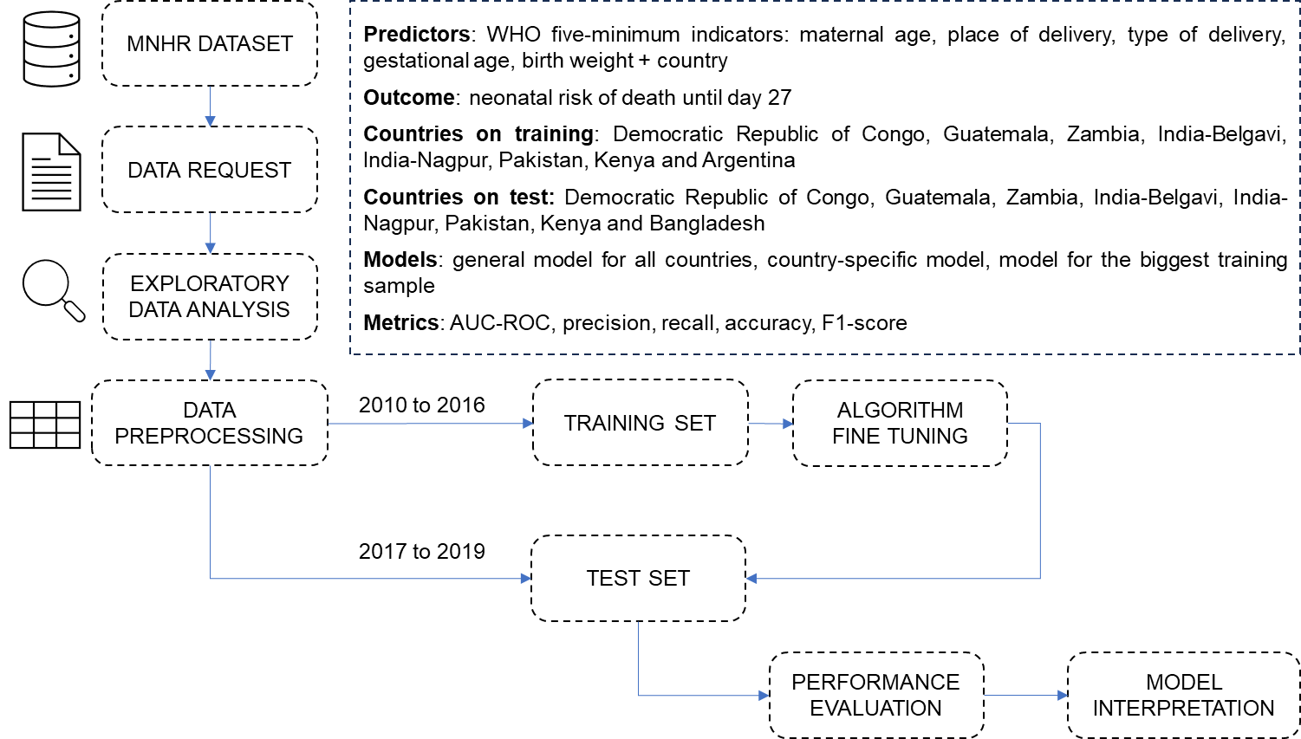

Slide 10
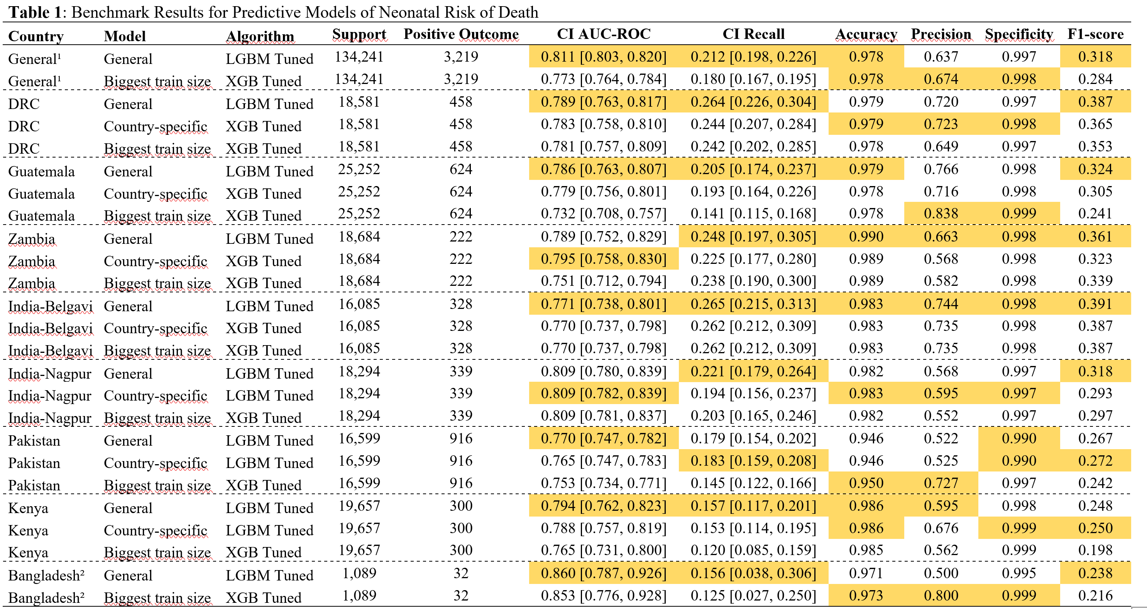

Slide 11
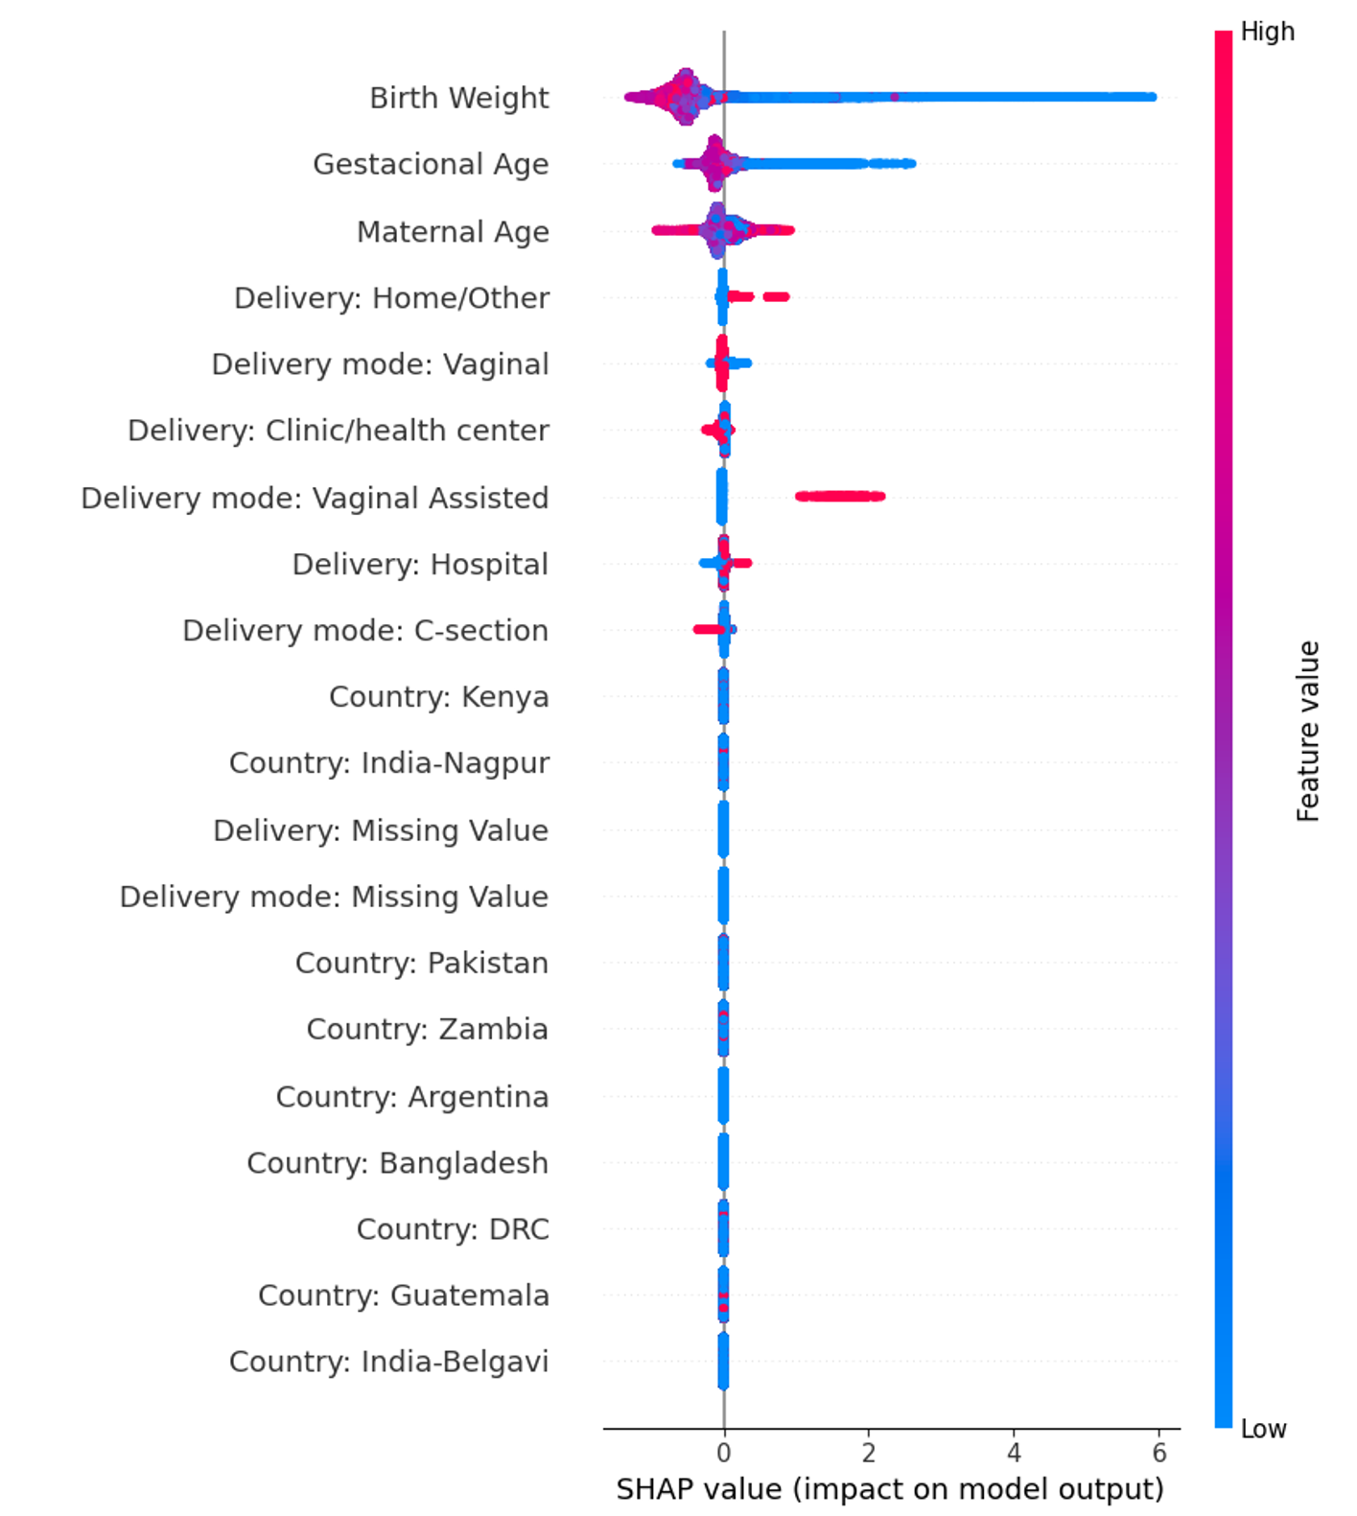

Slide 12
AI for Maternal and Child Health
Conclusion:
- AI is a very promising tool for MCH:
- Low cost of effective interventions in MCH if warnings come early.
- Important challenges:
- Use routinely-available variables, trained and validated in where they will be applied, do not increase existing inequalities.

Slide 13







Thank you!
Alexandre Chiavegatto Filho
http://labdaps.fsp.usp.br
@SaudenoBR
@labdaps
alexdiasporto@usp.br

