Slide 1
FGAI4H-S-014-A03
Geneva, 3-5 July 2023
Source: | TG-Malaria
Title: | Att.3 – Presentation (TG-Malaria)
Contact: | Rose Nakasi | E-mail: g.nakasirose@gmail.com
Abstract: | This PPT contains a presentation to give updates on TG-Malaria.

Slide 2
Topic Group-Malaria: AI based detection of Malaria-an update Meeting S
Rose Nakasi, PhD
g.nakasirose@gmail.com
Makerere University, Uganda
E-meeting, 3rd – 5th July 2023

Slide 3
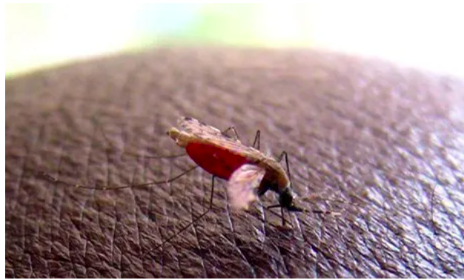
Background
Malaria burden in endemic Countries
Accounts for over 3.4 billion cases globally
Lack of enough trained lab technicians
1.72 microscopes per 100,000
population, but only 0.85 Microscopists per 100,000
Gold standard diagnosis(microscopy) challenge
SOP requires not to view more than 30 slides a day
Less diagnosis throughput
Variations in individual expert judgment
AI solution
Supports image analysis and has potential to improve the timeliness and accuracy
There is need to;
Standardise benchmarking AI solutions for the detection of Malaria
Notes:
Why this Topic Group? Context, WHO/ITU necessity
The Global Problem
The opportunity (and the challenge) | What is Symptom Assessment? How might it help?
The case for benchmarking? Why needed?
How the Topic Group can help, what outcomes might feed into

Slide 4
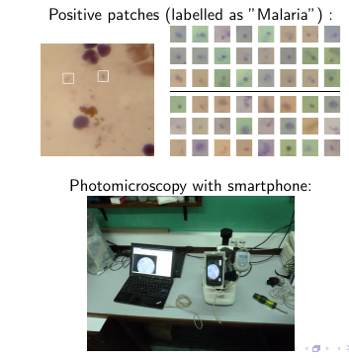
Digital imaging
Setup

Slide 5
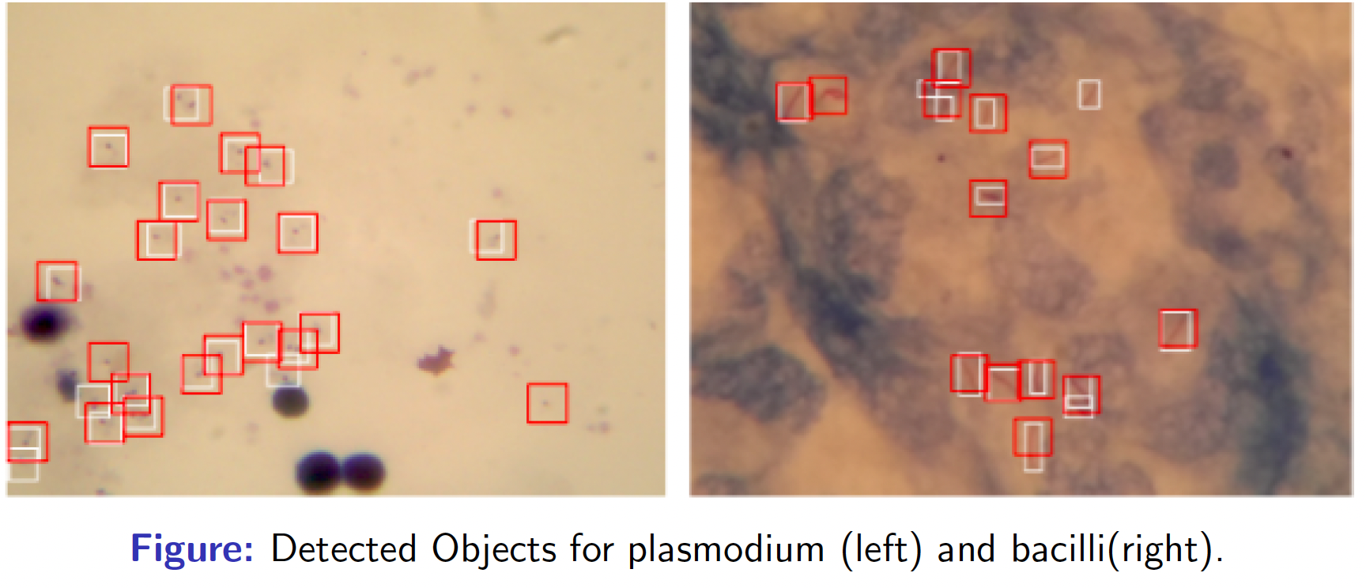
Digital Microscopy imaging analysis
Inference using CNN model

Slide 6
TG-Malaria activities
Quality datasets needed
Have more datasets for training and testing
Well labelled datasets
Solution
AI models and approaches related to malaria detection.
Suggestions on scoring metrics.
Improvements on the benchmarking framework.
Support to the group on different aspects (data, methods, benchmarking, etc.) of this topic
Extension of the solution to improve disease surveillance and prediction.
Heterogeneous Data needed

Slide 7
Updates from the topic group
Holding bi-weekly online meetings to discuss benchmarking improvements
Publications related to Topic group
Developed Minimal Benchmarking platforms for evaluating malaria detection models
Launching challenge
Joined WG-CE meeting on LMIC-considerations
Updates available in TDD

Slide 8
TG-Malaria Online meetings
Online Skype meetings
Discuss updates on benchmarking platform improvements (data, AI models, Interface)
Discuss technical implementation details that come with improvements
Develop simple models for testing the updated benchmarking platform
Platform beta testing
*Launching the challenge

Slide 9
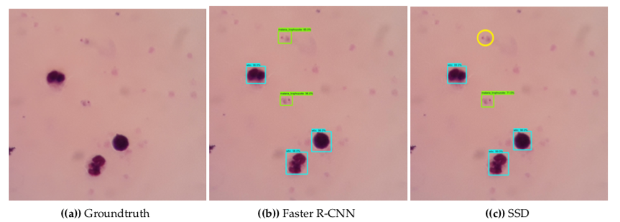
Some publications
Mobile-Aware Deep Learning Algorithms for Malaria Parasites and White Blood Cells Localization in Thick Blood Smears.
(MDPI Algorithms 2021, 14, 17. (2021))

Slide 10
First Benchmarking Platform v1
Our first benchmarking attempt required the following;
Inputs
A well annotated dataset of thick blood smear images
AI models to be submitted to the benchmarking platform
Outputs
Performance of AI
Scores & Metrics
ROC AUC
Precision
recall
Average precision
Report
Performance of AI models

Slide 11
Update on Benchmarking platform-V2
Add new public dataset of thin blood smear dataset
A well annotated dataset of thin blood smear images
A total of 27,558 images
Infected and uninfected cells
Adding support for deep learning library (pytorch and tensorflow)
Cclassification tasks
Setting up time budget for up-to 1 hour/submissionn.
To allow for heavy submissions
Adding support for uploading dataset
Towards crowdsourcing

Slide 12
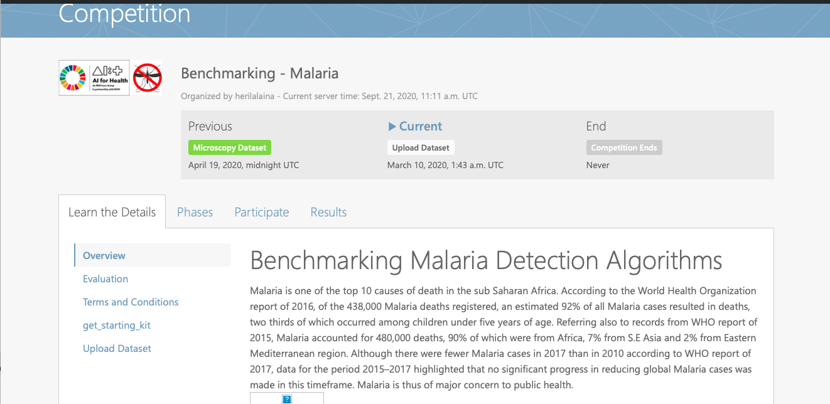
User interface for the challenge
Benchmarking-Malaria platform with codalab
https://codalab.lri.fr/competitions/775

Slide 13
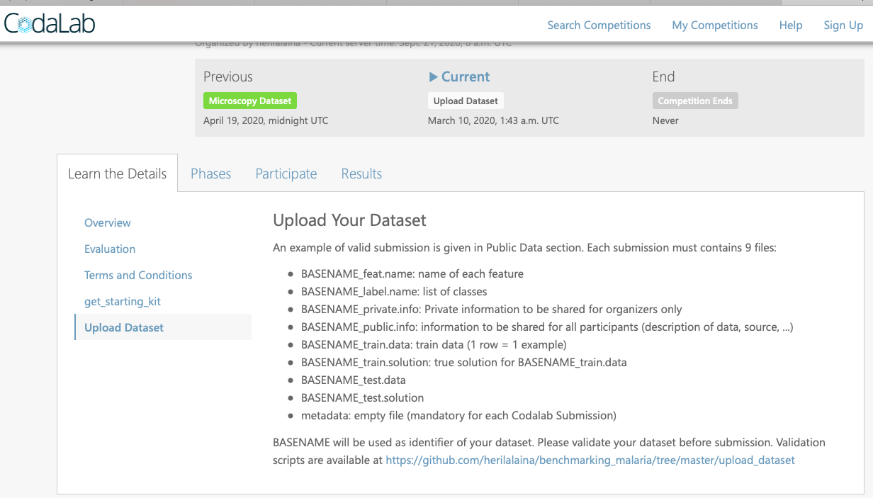
Support for uploading dataset

Slide 14
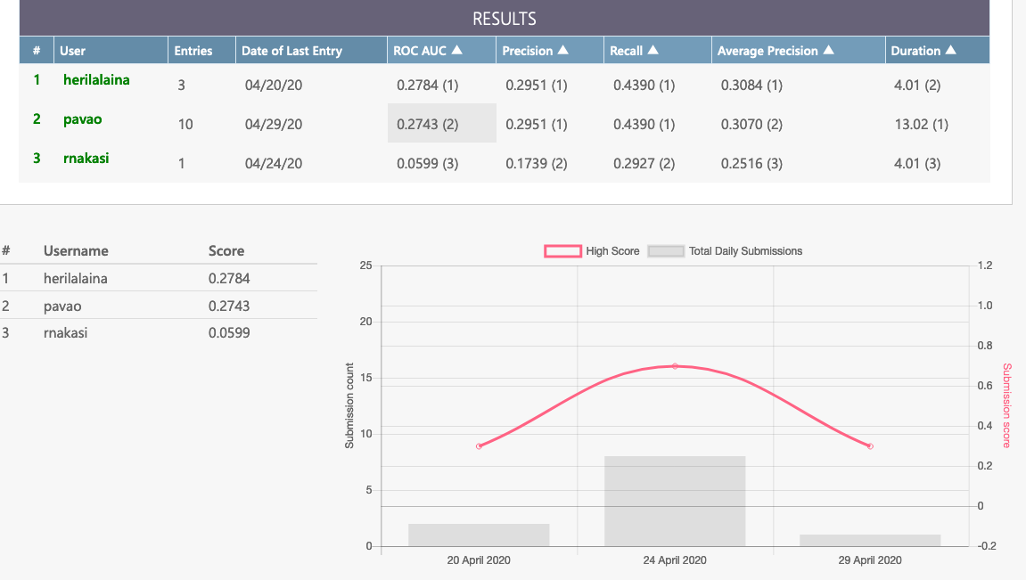
Scoring metrices
Preliminary results

Slide 15
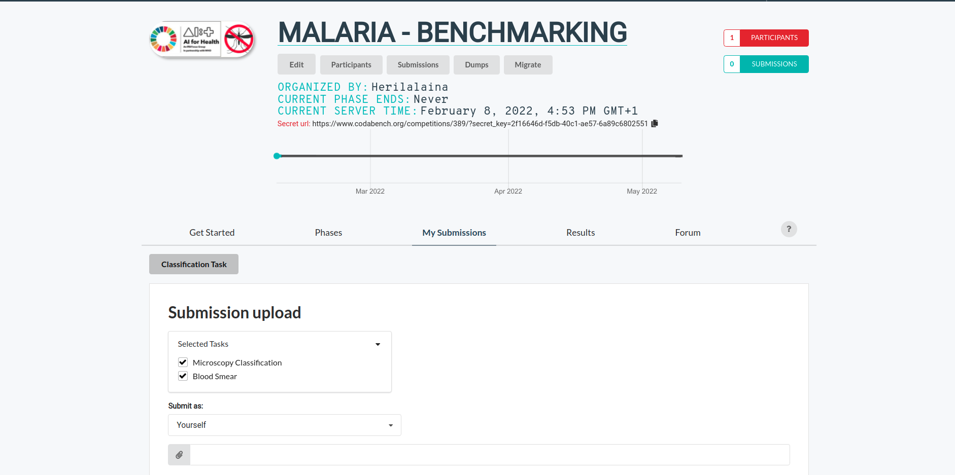
User interface for the Codabench
New Benchmarking-Malaria platform with codabench

Slide 16
Current Tasks undertaken
Dataset curation based on standardised data collection protocol
Developing a standardised data collection protocol
Public dataset under collection
Thick Blood smear images
Thin blood smear image

Slide 17
Next steps
Iterating with different algorithms to assess performance on new datasets collected
For tasks like
parasite detection
parasitemia determination
species identification
growth stage identification,
and artifact detection.
Creating a new challenge to be tested on our developed codalab benchmarking platform
using the new benchmarking dataset to a wider community
Publishing outcomes of analytics

Slide 18
Call for participation
Participation can be in form of:
Provision of quality labelled data
AI models and algorithms for benchmarking task on malaria
General support on different aspects of this topic (data, methods, benchmarking, etc.)

Slide 19
Contact us
TG-Malaria
fgai4htgmalaria@lists.itu.int
TG-Driver
g.nakasirose@gmail.com

Slide 20
Topic Group members:
Name | Affiliation
Philippe Verstraete | Co-founder of Milan and Associates, Italy
Laura Moro, | Researcher, science & medical writer. Co-founder of AI Scope, Spain
Dr. Helmi Zakariah. | Cofounder of AIME company, Malaysia
Martha Shaka | Researcher at University of Dodoma, Tanzania
Ana Rivière Cinnamond | Advisor and Pubic Health Expert under Health Emergency Information & Risk Assessment Department with PAHO/WHO.
Rigveda Kadam | Senior Access Officer, FIND, Switetzerland
Seda Yerlikaya | Scientific Officer, FIND, Switetzerland
Herilalaina RAKOTOARISON | PhD student in Machine learning from the Université Paris-Saclay)

