Slide 1
FGAI4H-S-010-A03
Geneva, 3-5 July 2023
Source: | TG-Dental Topic Driver
Title: | Att.3 – Presentation (TG-Dental)
Contact: | Dr Joachim Krois | E-mail: joachim.krois@gmail.com
Abstract: | This PPT summarizes the status of work within TG-Dental, for presentation and discussion during the meeting.

Slide 2
Meeting S TG-Dental Update
July 3–5, 2023
Falk Schwendicke, Joachim Krois, Tarry Singh, Jae-Hong Lee, Akhilanand Chaurasia, Robert André Gaudin, Sergio Uribe, Hossein Mohammad-Rahimi, Janet Brinz, Anahita Haiat, Gürkan Ünsal, Nielsen Santos Pereira, Ulrike Kuchler, Shankeeth Vinayahalingam, Balazs Feher, Francesc Perez Pastor, Lisa Schneider, Chen Nadler, Sahel Hassanzadeh-Samani, Parisa Motie, Ragda Abdalla-Aslan, Teodora Karteva, Jelena Roganovic, Kunaal Dhingra, Prabhat Kumar Chaudhari, Olga Tryfonos, Marja Laine, Rata Rokhshad, Fatemeh Sohrabniya, Zeynab Pirayesh, Shada Alsalamah, Sakher AlQahtani, Revan Birke Koca-Ünsal, Lubaina T. Arsiwala, Parul Khare, Amit Punj, Manal Hamdan, Zaid Badr, Tamara Peric, Mihiri Silva, Bree Jones, Miroslav Radenković, Martha Duchrau, Mohammed Omar, Gowri Sivaramakrishnan, Jaisri Thoppay, Saujanya Karki, Tarja Tanner, Marja-Liisa Laitala, Johannes Tanne, Sanaa Chala, Raphaël Richert, Pierre Lahoud, Julien Issa, Nisha Manila, Fahad Umer, Gauthier Dot, Sharon Tan, Sara Haghighat, Nora Saif, Marwa Baraka, Sarina Azimian, Ali Rahbar, Aleksander Krasowski, Nermin Morgan

Slide 3
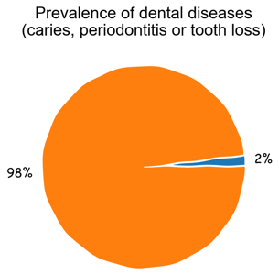
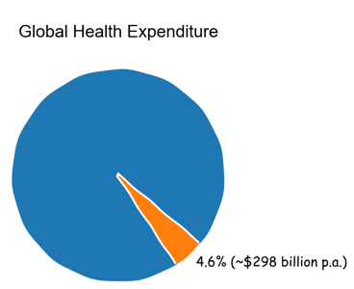
Relevance and impact of oral diseases

Slide 4
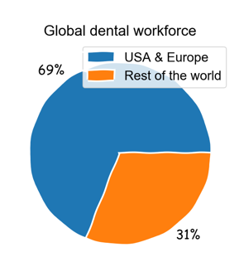
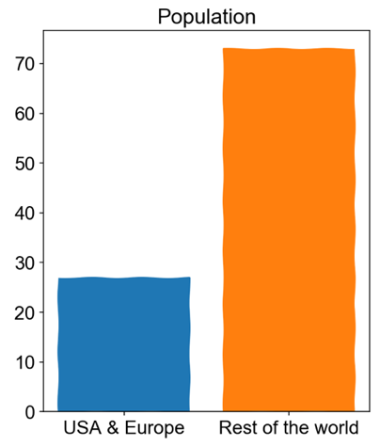
Unequal access to dental services

Slide 5
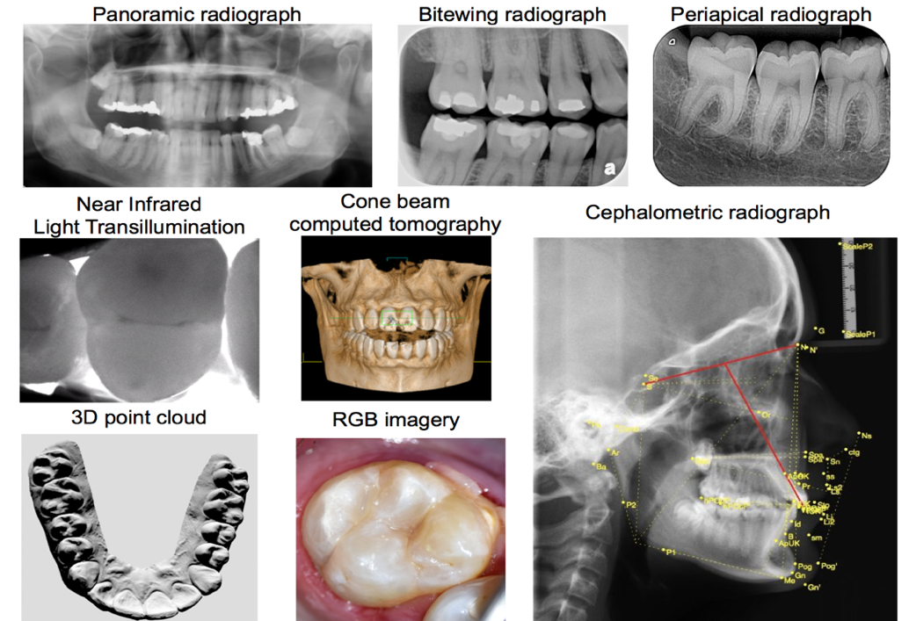
TG-Dental – An overview
Dental Diagnostics and Digital Dentistry
Established at Meeting G (New Delhi, India)
Data modalities
Imaging
Dental history
Clinical investigation
further physical or (bio)chemical or microbiological assessments

Slide 6
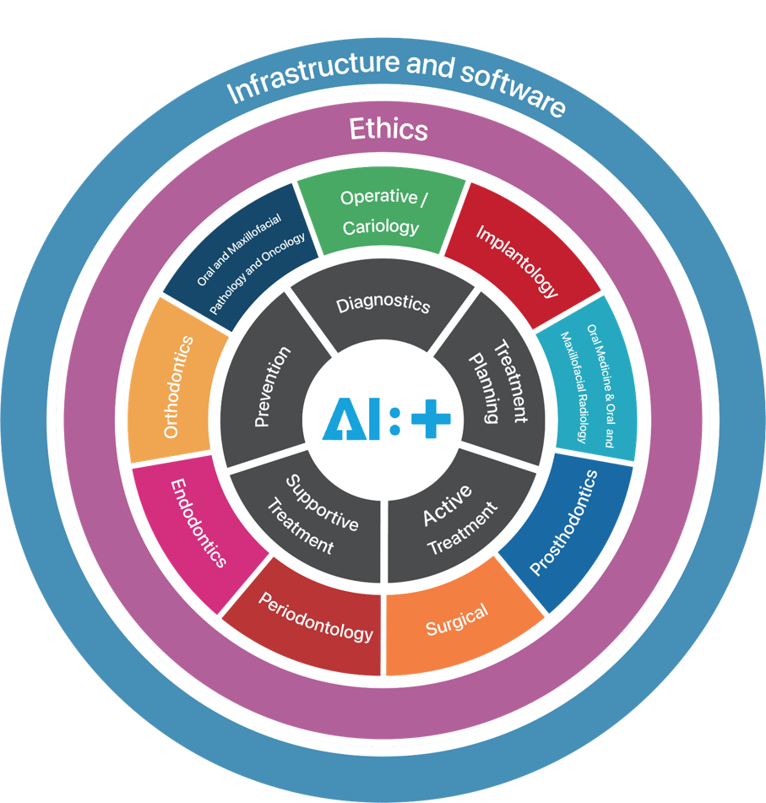
TG-Dental – Subtopic groups
TG Dental Subtopic groups
Operative and Cariology
Implantology
Oral Medicine & Oral and Maxiofacial Radiology
Prosthodonics
Surgical
Periodondology
Endodontocs
Orthodontcs
Oral and Maxiofacial Pathology and Oncology
Notes:
Shank, Ulrike and Balazs is missing

Slide 7
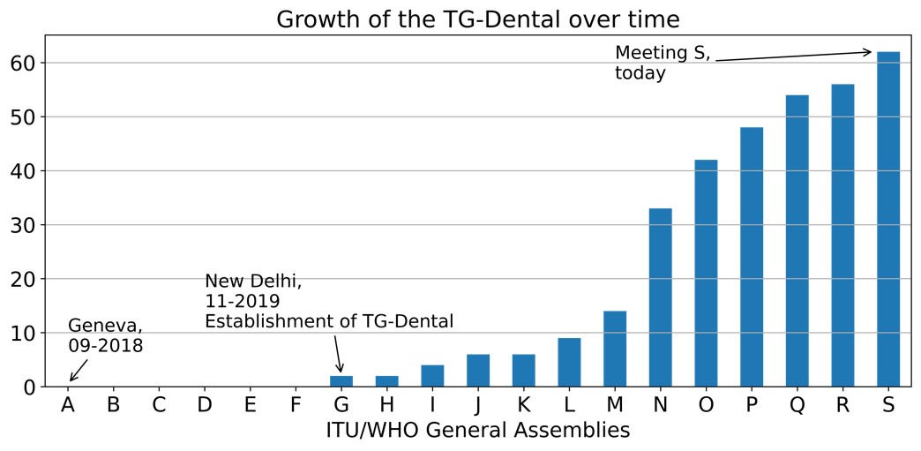
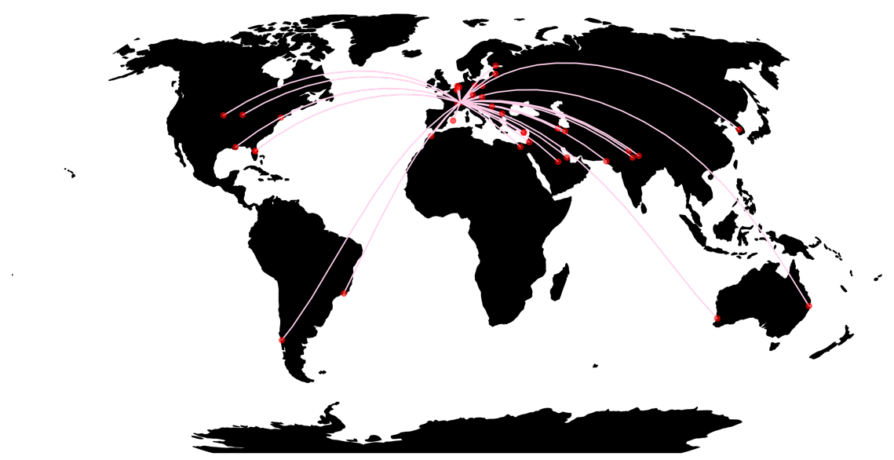
TG-Dental – Contributors
62 members / 93 in TGD slack
27 countries
6 continents
Notes:
Shank, Ulrike and Balazs is missing

Slide 8
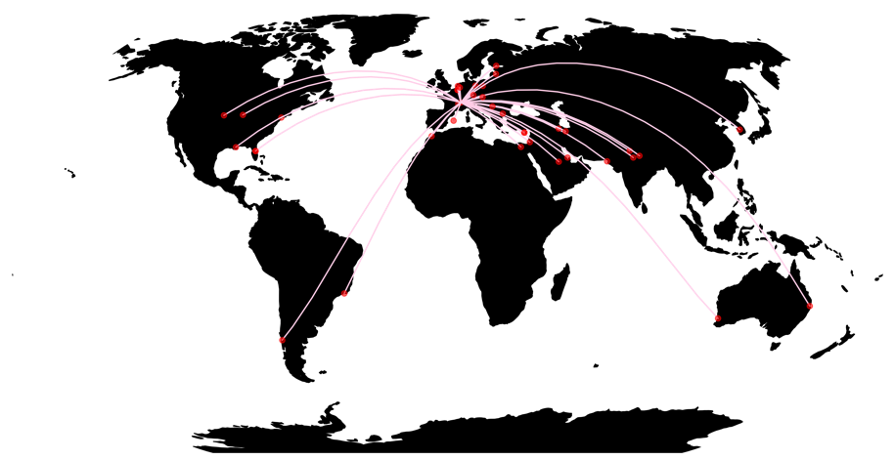
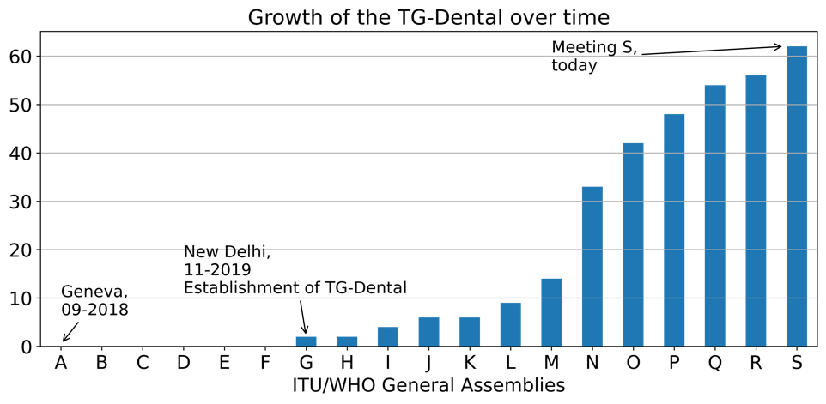
TG-Dental – Contributors
62 members
27 countries
6 continents
Notes:
Shank, Ulrike and Balazs is missing

Slide 9
Welcoming six new members to the topic group
Nora Saif Assoc. Prof. Oral & Maxillofacial Radiology Cairo University Egypt
Ali Rahbar Research Committee, Shahid Beheshti University of Medical Sciences Tehran, Iran
Marwa Baraka Lecturer in Pediatric Dentistry and Dental Public Health Department, Faculty of Dentistry, Alexandria University, Egypt
Aleksander Krasowski Charite - Universitätsmedizin Berlin Germany
Sarina Azimian Dentist, Graduate School of Dentistry, Shahid Beheshti University of Medical Sciences, Tehran, Iran
Nermin Morgan Ass. Professor. Oral and maxillofacial radiology, Mansoura University, Egypt Collaborative researcher. OMFS-IMPATH group, KU Leuven, Belgium

Slide 10
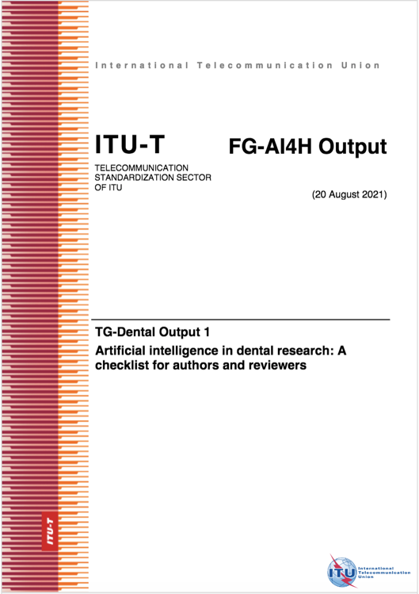
Artificial intelligence in dental research: A checklist for authors and reviewers
Artificial intelligence in dental research: A checklist for authors and reviewers (FGAI4H-M-004-A01)
The checklist for dental AI studies was produced as a collaboration of experts from the International Association for Dental Research (IADR), the E-oral Health Network and the ITU/WHO Focus Group on AI for Health.
Objectives: The number of studies employing artificial intelligence (AI), specifically machine and deep learning, is growing fast. The majority of studies suffer from limitations in planning, conduct and reporting, resulting in low robustness, reproducibility and applicability. This document provides a consented checklist on planning, conducting and reporting of AI studies for authors, reviewers and readers in dental research.

Slide 11
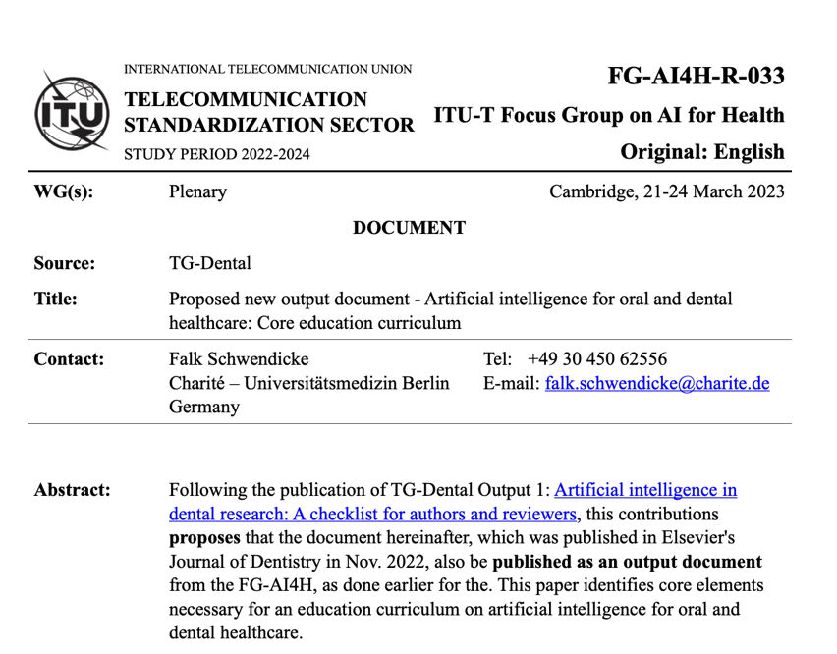
Artificial intelligence for oral and dental healthcare: Core education curriculum
Artificial intelligence for oral and dental healthcare: Core education curriculum (FGAI4H-R-033)
Falk Schwendicke^{1,2}, Akhilanand Chaurasia^{2,3}, Thomas Wiegand^{2,4}, Sergio E. Uribe^{2,5, 6}, Margherita Fontana⁷, Ilze Akota⁸, Olga Tryfonos^{2,9}, Joachim Krois^{1,2} on behalf of the IADR e-oral health network and the ITU/WHO focus group AI for Health.
(1) Basic definitions and terms, the principle of machine learning, the idea of training, validating and testing models, the definition of reference tests, dynamic and static AI, black box and explainability
(2) Use cases, types of AI, typical setup of AI software
(3) Evaluation metrics, their interpretation, the relevant impact of AI on patient or societal health outcomes
(4) Issues around generalizability and representativeness, explainability, autonomy and accountability

Slide 12
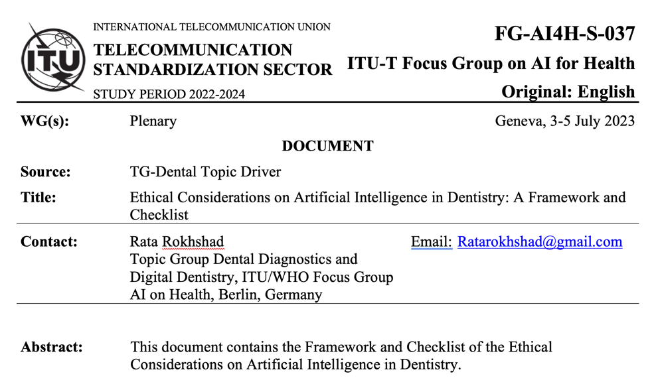
Ethical Considerations on Artificial Intelligence in Dentistry: A Framework and Checklist
Ethical Considerations on Artificial Intelligence in Dentistry: A Framework and Checklist (FG-AI4H-S-037) Rata Rokhshad, Maxime Ducret, Akhilanand Chaurasia, Teodora Karteva, Miroslav Radenkovic, Jelena Roganovic, Manal Hamdan, Hossein Mohammad-Rahimi¹ Joachim Krois,Pierre Lahoud, Falk Schwendicke
Objective: Artificial Intelligence (AI) refers to the ability of machines to perform cognitive and intellectual human tasks. In dentistry, AI offers the potential to enhance diagnostic accuracy, improve patient outcomes and streamline workflows. The present study provides a framework and a checklist to evaluate AI applications in dentistry from this perspective.
Methods: Lending from existing guidance documents, an initial draft of the checklist and an explanatory paper were derived and discussed among the groups members.
Results: The checklist was consented to in an anonymous voting process by 29 group members. Overall, 11 principles were identified (diversity, transparency, wellness, privacy protection, solidarity, equity, prudence, law and governance, sustainable development, accountability, and responsibility, respect of autonomy, decision-making).
Conclusions: Providers, patients, researchers, industry, and other stakeholders should consider these principles when developing, implementing, or receiving AI applications in dentistry.

Slide 13
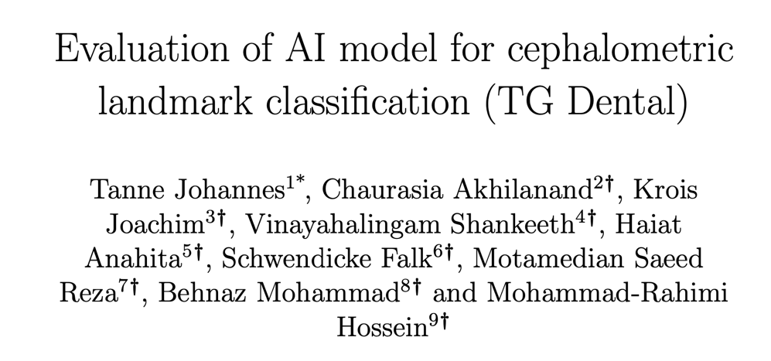
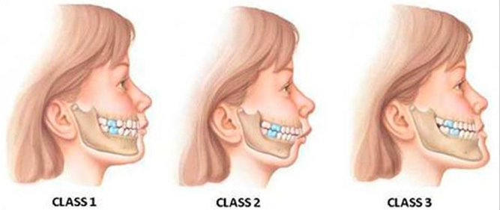
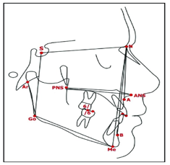
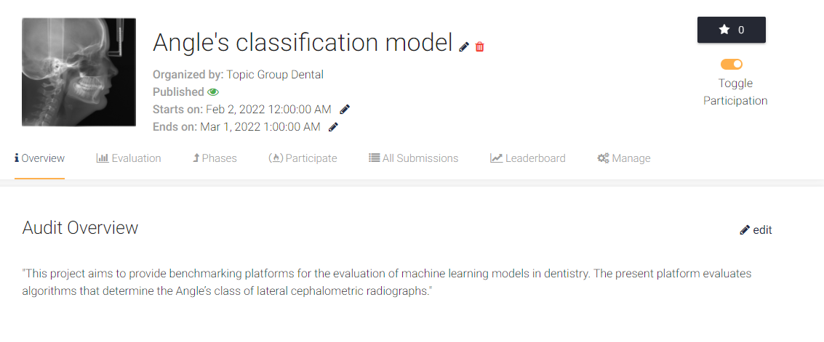
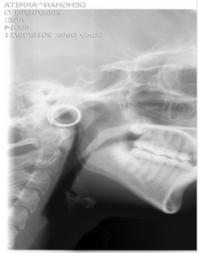
Participation in FG-AI4H Trial Audits 2.0 project

Slide 14
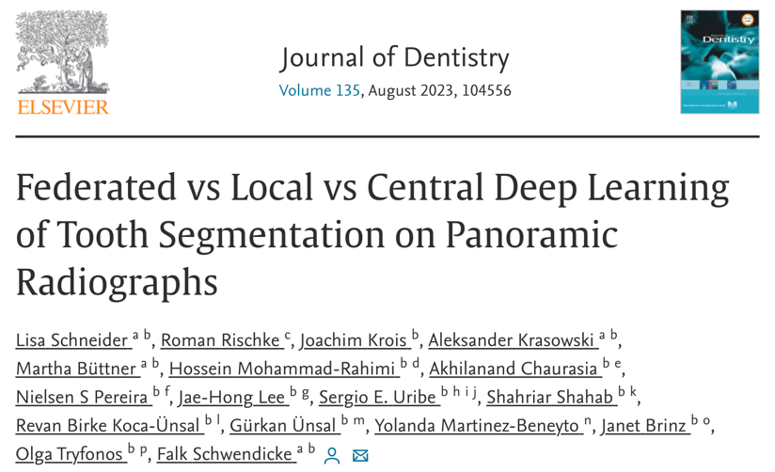
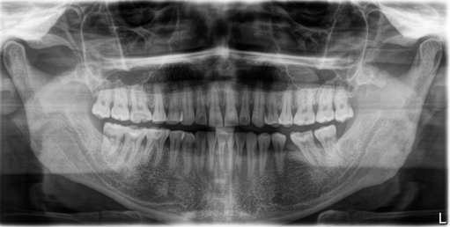
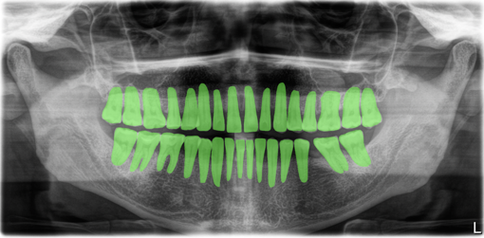
Establishment of a benchmark dataset for tooth classification, detection and segmentation
Multi-center benchmark study (MCBS)
Establish a dataset of high heterogeneity and bias
Establish a process to generate ground truth labels
Multi-center modelling with the goal to establish most influential biases (population characteristics, dental status, X-ray machinery, etc)
Dataset
Dental panoramic radiographs
Collected according to defined data specification requirements
1996 images
7 centers from 5 countries
24 annotators
Approx. 63,800 tooth masks!

Slide 15
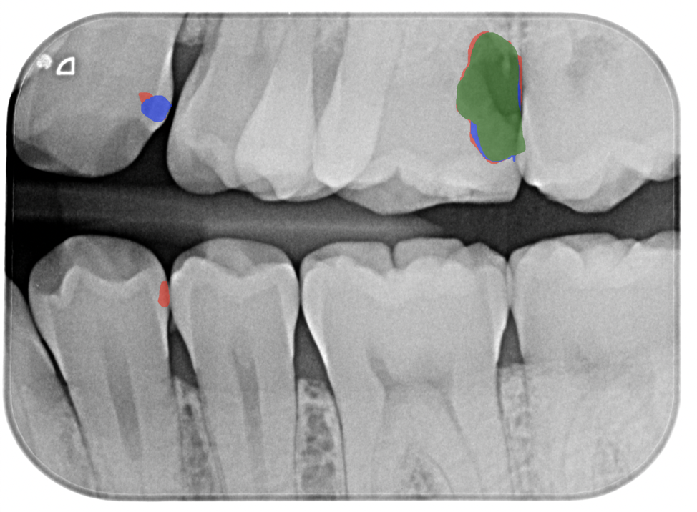
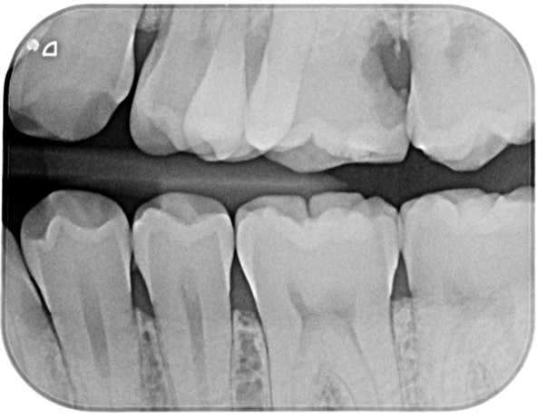
Evaluation of annotation accuracy of dental expert for caries detection on bitewing radiographs
Dataset
Dental bitewing radiographs
Collected according to defined data specification requirements
880 images
3 annotators
Annotated
Original

Slide 16
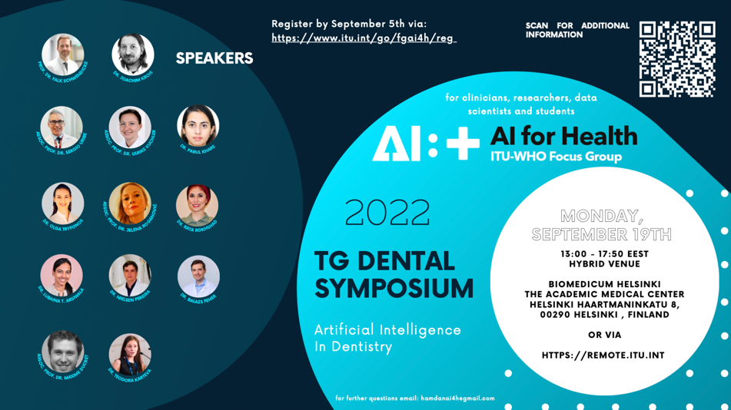
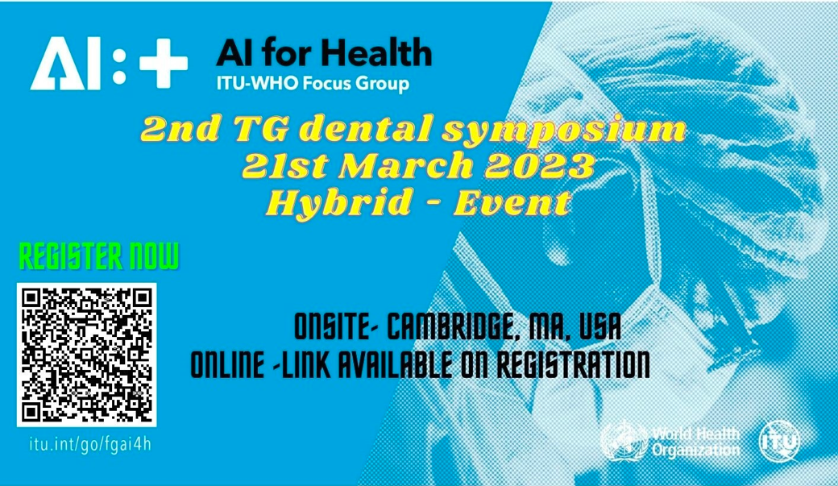
Series of TG-Dental Symposia

Slide 17
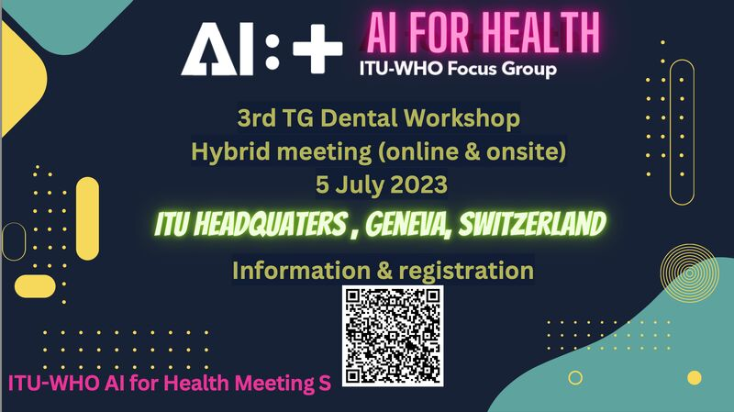
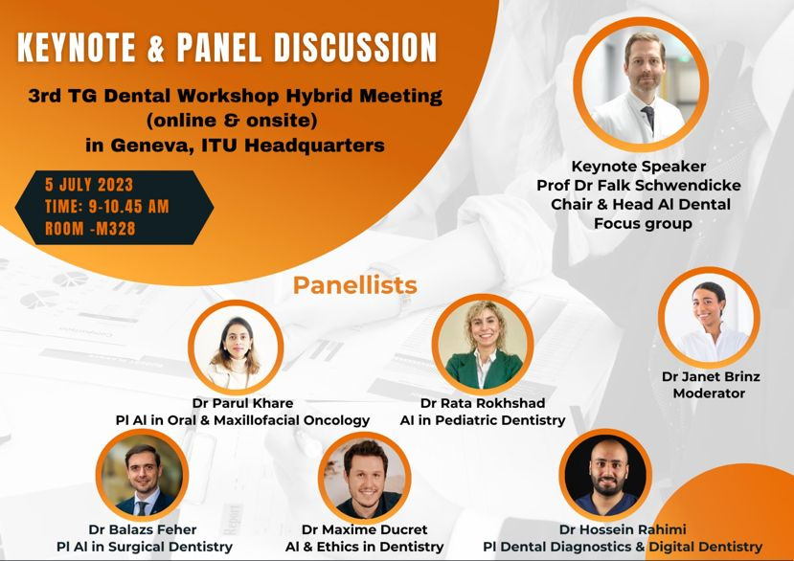
Series of TG-Dental Symposia
Wednesday July 5th at 9:00 am CEST (M328)

Slide 18
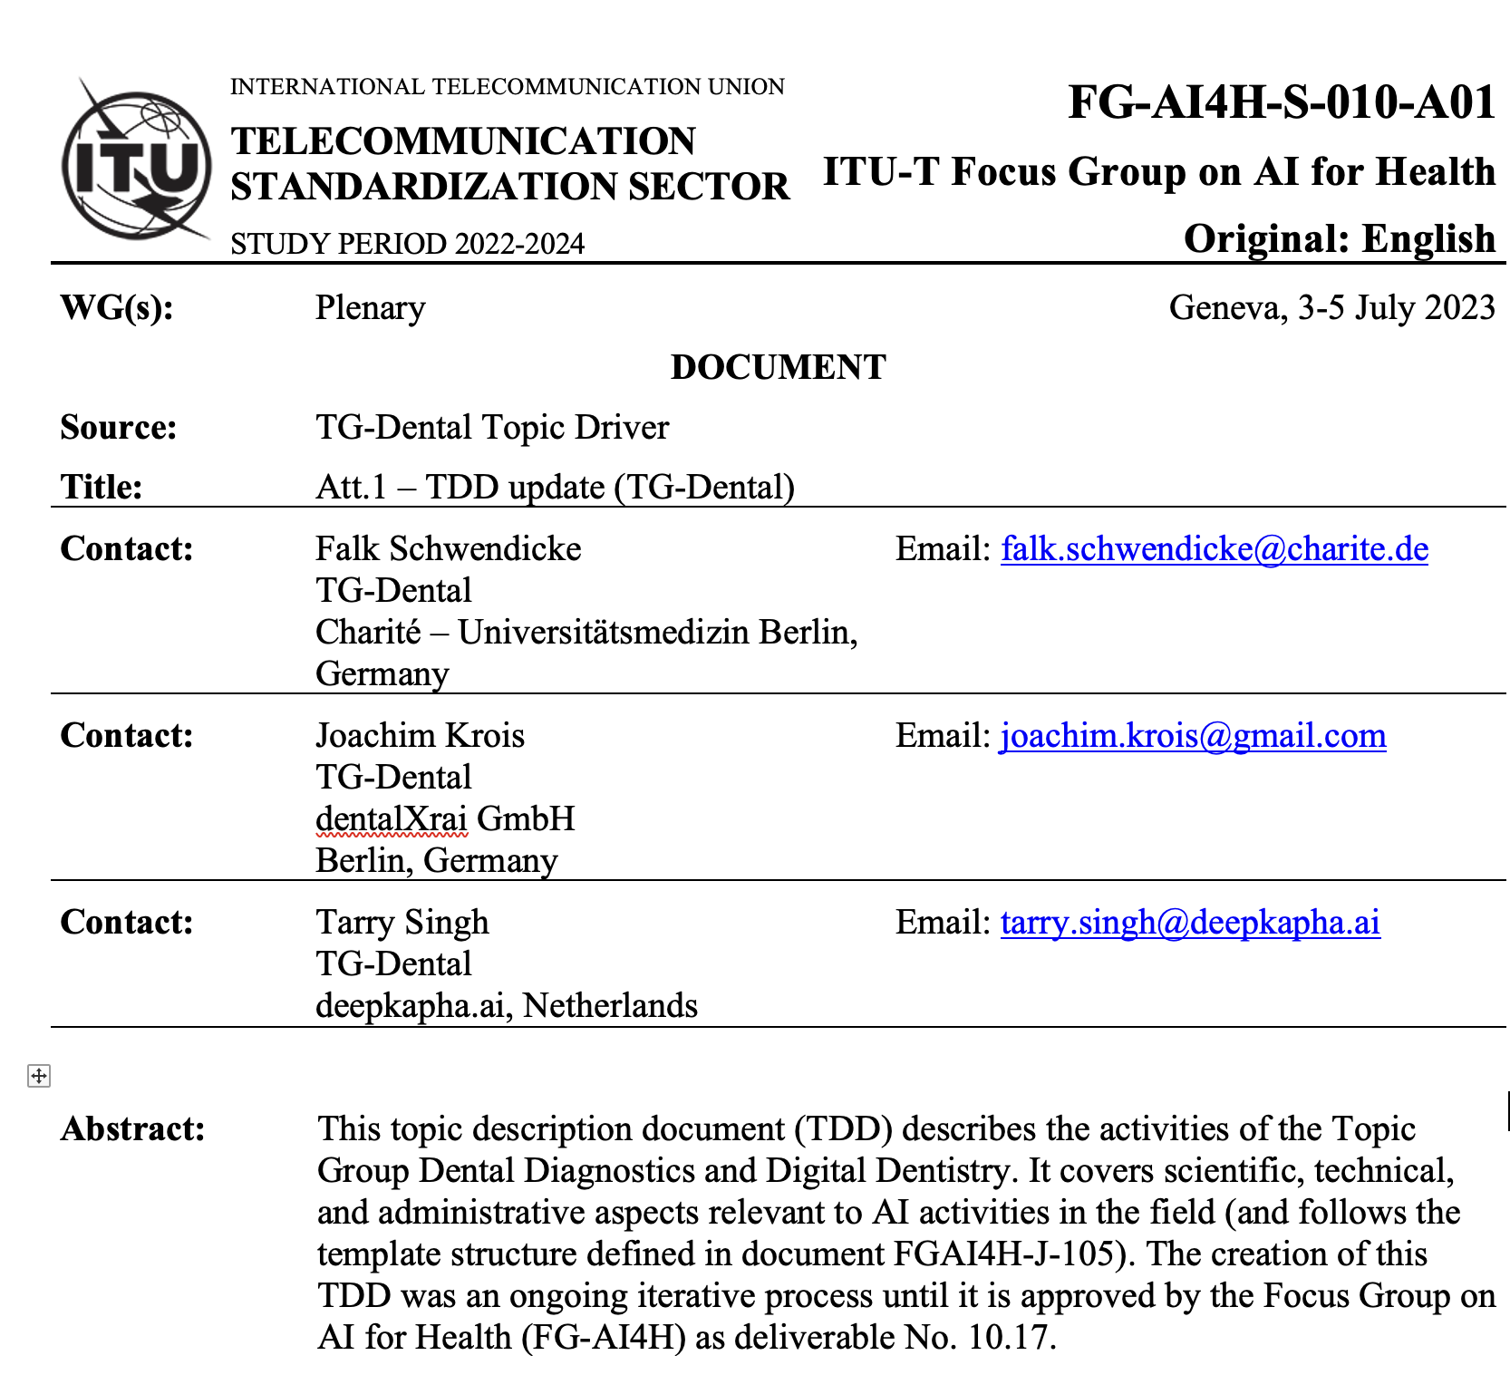
TDD (FG-AI4H-S-010-A01)

Slide 19
Thank you!
July 3–5, 2023
Falk Schwendicke, Joachim Krois, Tarry Singh, Jae-Hong Lee, Akhilanand Chaurasia, Robert André Gaudin, Sergio Uribe, Hossein Mohammad-Rahimi, Janet Brinz, Anahita Haiat, Gürkan Ünsal, Nielsen Santos Pereira, Ulrike Kuchler, Shankeeth Vinayahalingam, Balazs Feher, Francesc Perez Pastor, Lisa Schneider, Chen Nadler, Sahel Hassanzadeh-Samani, Parisa Motie, Ragda Abdalla-Aslan, Teodora Karteva, Jelena Roganovic, Kunaal Dhingra, Prabhat Kumar Chaudhari, Olga Tryfonos, Marja Laine, Rata Rokhshad, Fatemeh Sohrabniya, Zeynab Pirayesh, Shada Alsalamah, Sakher AlQahtani, Revan Birke Koca-Ünsal, Lubaina T. Arsiwala, Parul Khare, Amit Punj, Manal Hamdan, Zaid Badr, Tamara Peric, Mihiri Silva, Bree Jones, Miroslav Radenković, Martha Duchrau, Mohammed Omar, Gowri Sivaramakrishnan, Jaisri Thoppay, Saujanya Karki, Tarja Tanner, Marja-Liisa Laitala, Johannes Tanne, Sanaa Chala, Raphaël Richert, Pierre Lahoud, Julien Issa, Nisha Manila, Fahad Umer, Gauthier Dot, Sharon Tan, Sara Haghighat, Nora Saif, Marwa Baraka, Sarina Azimian, Ali Rahbar, Aleksander Krasowski, Nermin Morgan

