Slide 1
FGAI4H-R-065
Cambridge, 21-24 March 2023
Source: | Editors DEL5.6
Title: | DEL5.6: Data sharing practices –Progress review presentation
Purpose: | Discussion
Contact: | Ferath Kherif CHUV - LREN Switzerland | E-mail: Ferath.kherif@chuv.ch
Abstract: | This PPT discusses the latest updates made on the deliverable Updated DEL5.6: Data sharing practices + Data sourcing.

Slide 2
Data Sharing and Data sourcing

Slide 3
Data Sharing and Data sourcing
Initial draft describes the objectives and proposes an initial outline of the planned deliverable “Data Sharing Practices”
This deliverable aims to provide an overview of the existing best practices for data sharing of health-related data, including the requirement to enable secure data sharing and issues related to data governance.
The documents described established solutions and novel approaches based on distributed and federated environments.
Health is not a local problem and requires a connected structure, universal solutions, and joined principles

Slide 4
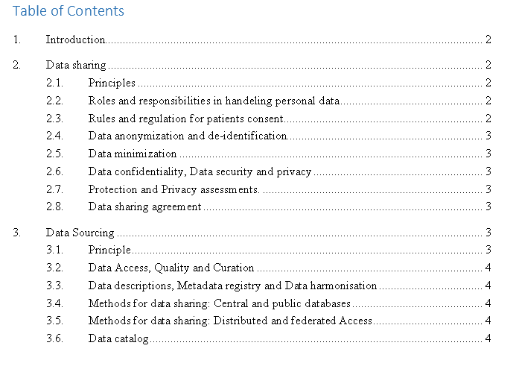
Data Sharing and Data sourcing
Health is not a local problem and requires a connected structure, universal solutions, and joined principles

Slide 5
Data Sharing Principles
Sharing medical data at scale is necessary to improve the development and adoption of artificial intelligence solutions for healthcare and to make these solutions more robust.
Negotiate the balance between potential harm from sharing critical data and the potential benefit of improving care.

Slide 6
Data Sharing Principles
Sharing data for appropriate and authorised purposes. Why the data is being used
Sharing data only with authorised users. Who is using the data
Using data in a safe and secure environment.
Applying appropriate protections to the data. Where the data is being used
Ensuring public outputs from data sharing projects do not identify the people or organisations in the data.

Slide 7
Data Sharing and Data sourcing
Necessary steps and requirements to enable secure data sharing
Methods for Data sourcing
Centralized data sources
Distributed data sources
Health is not a local problem and requires a connected structure, universal solutions, and joined principles

Slide 8
Data Sharing and Data sourcing
Necessary steps and requirements to enable secure data sharing
Roles and responsibilities of the data providers, data processors & data receivers
Data anonymization and de-identification
Data minimization
Data confidentiality, Data security and privacy
Protection and Privacy assessments.
Responsibilities of data providers and data receivers
Necessary steps and requirements to enable secure data sourcing
Description of data
Data ingestion and update
Results and dissemination of results including IA models
Health is not a local problem and requires a connected structure, universal solutions, and joined principles

Slide 9
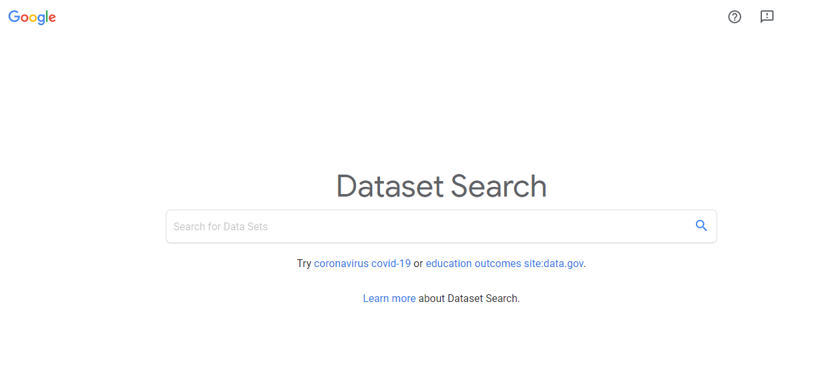
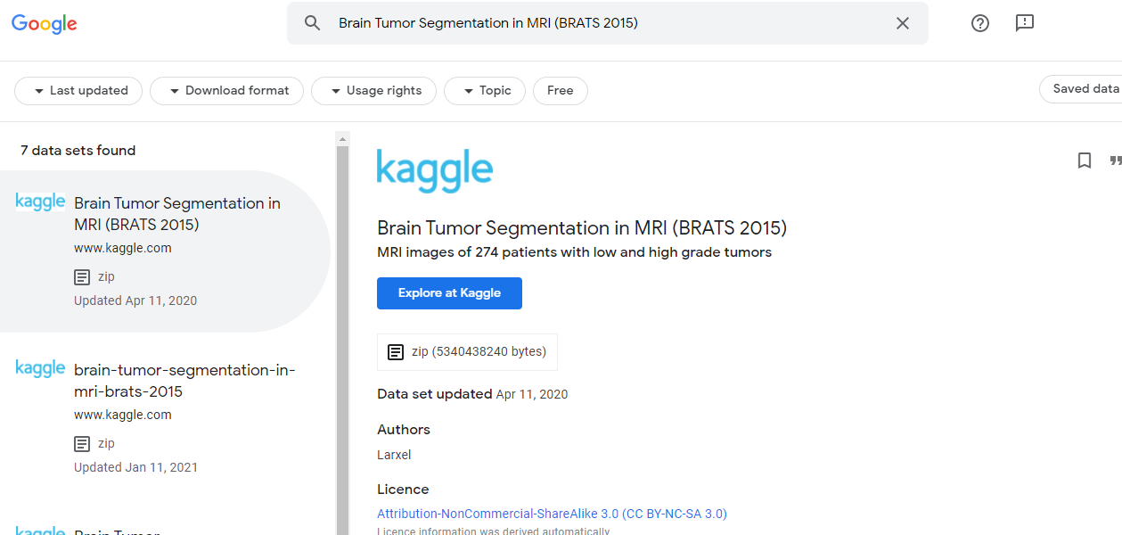
Best practices for data sharing/Sourcing Platform
Data Catalogue & Search

Slide 10
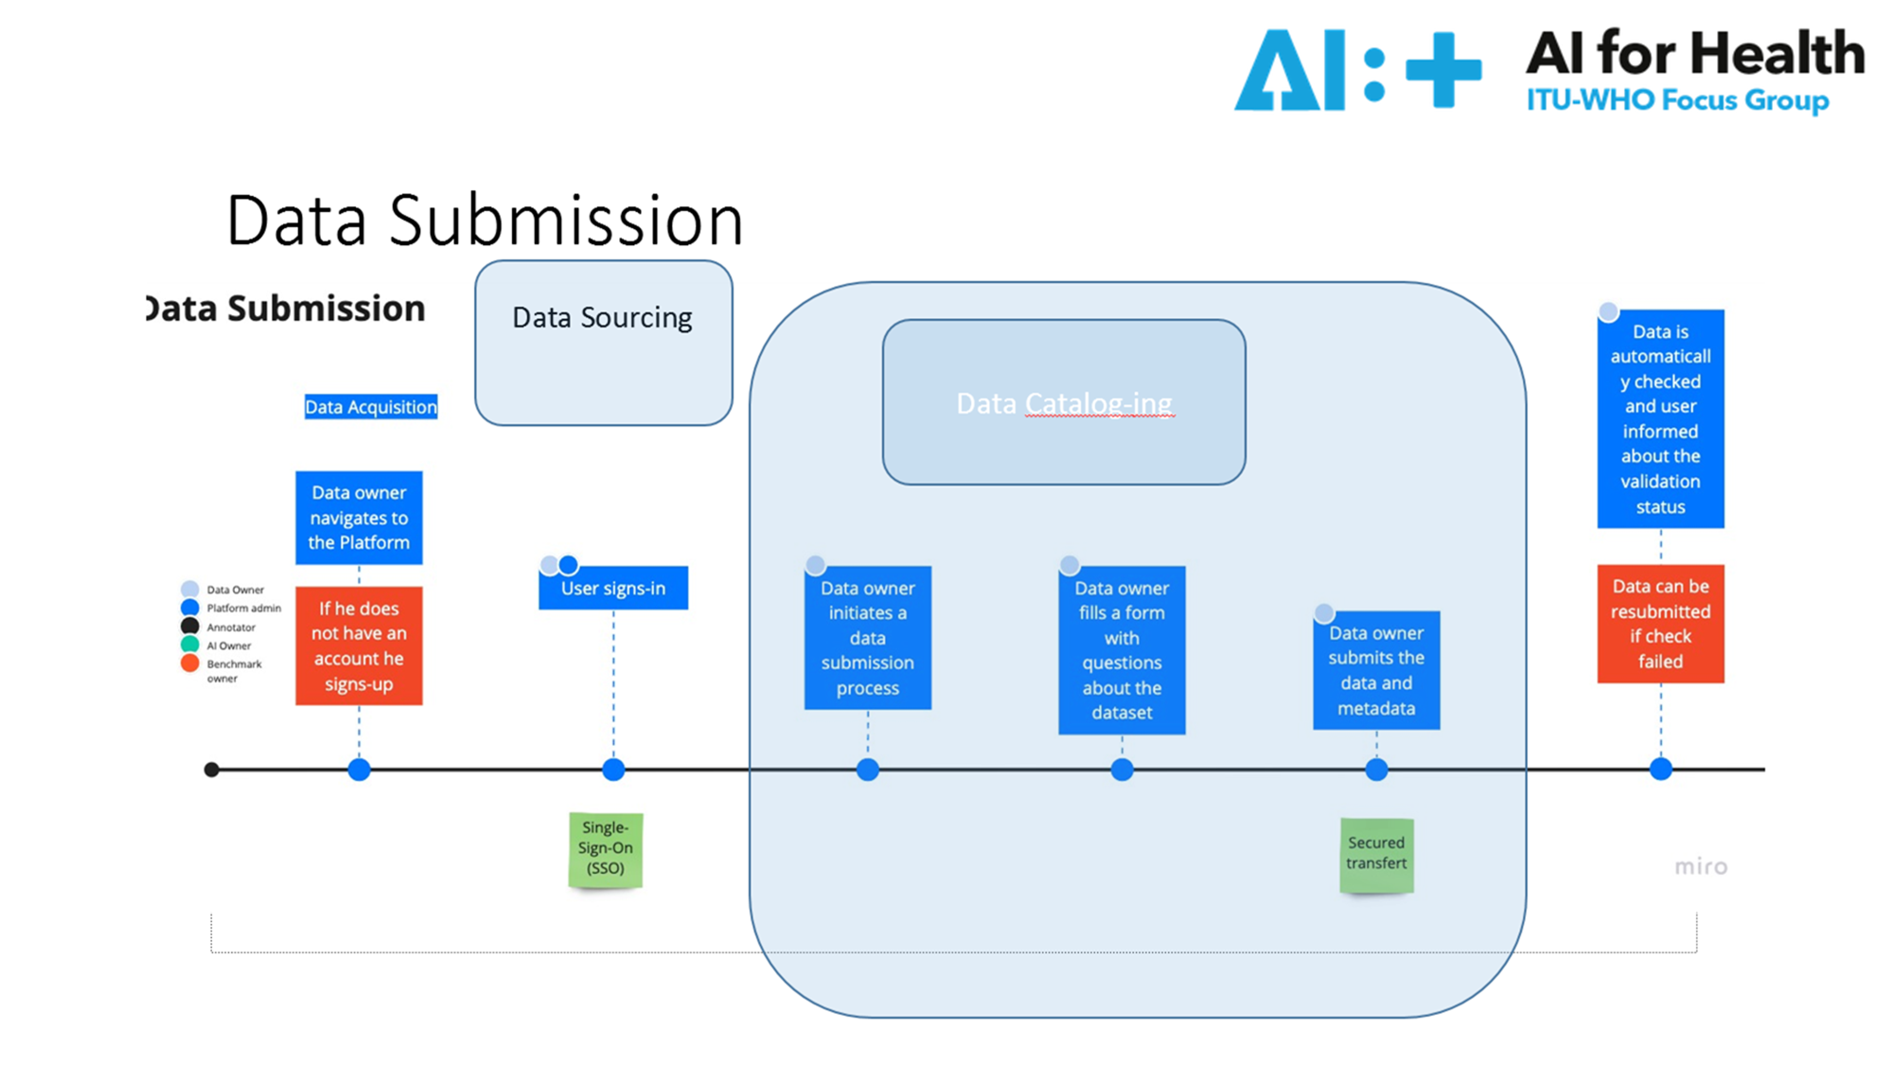
Notes:
The goal of the open code initiative is to provide software tools to help AI professionals build solution ready to be cleared by regulatory bodies
To achieve this goal we involve developers to code the platform but also regulators and medical professionals who deliver us specific requirements
We are building a tool that is universal and can be used across borders
Usable by multiple stakehoders to build, assess and use algorithms

Slide 11
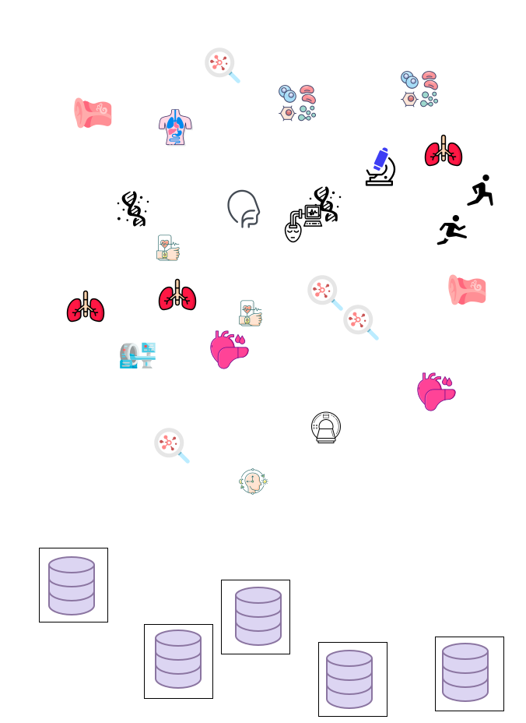
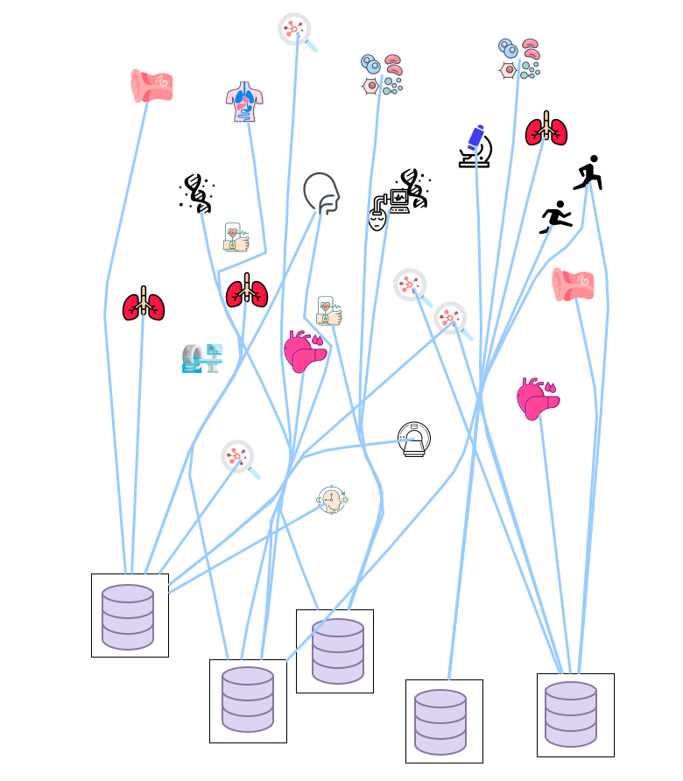
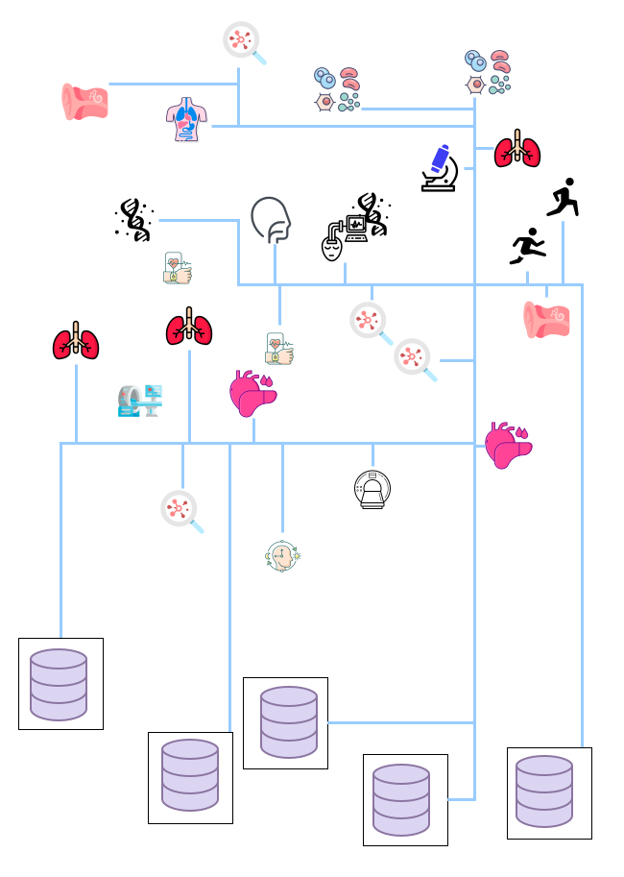
Implement tools and define the processes
data descriptions and intelligent use in the context of the FG - AI4H objectives, including ethical, annotation, and validation challenges.
Discover / Capture
Connect Data
Link Data

Slide 12
High Level Architecture
API ACCESS LAYER
DATA Catalogue Cloud
LOCAL DATA
Devices

Slide 13
High Level Architecture
DATA SPACES
Semantic Layer- UMLS driven
API ACCESS LAYER
DATA Catalogue Cloud
LOCAL DATA
Devices

Slide 14
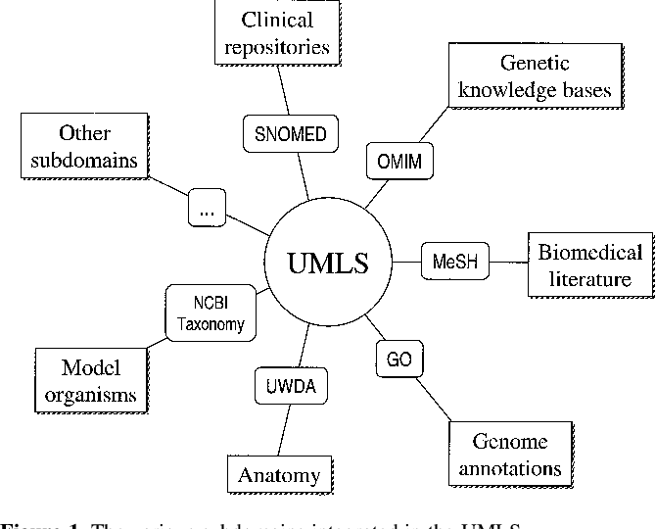
High Level Architecture
DATA SPACES
Semantic Layer- UMLS driven
UMLS is developed by the National Library of Medicine (NLM) and integrates various biomedical vocabularies (SNOMED CT, ICD-10, ICD-11, LOINC) and terminologies into a unified framework.
FHIR resources (Patient, Condition, and Observation): create a structured and standardized representation of healthcare data

Slide 15
Metadata Components
Technologies/Platforms tested
Data search, data management
- Data lineage support
- Amundsen
- DataHub
- Atlas
- CKAN
- Magda - Federation
-Cloud based
- Google DC
- AWS
-Azure
Technologies/Platforms Selected/built
Data search, data management
+ data lineage support +federation
+ Annotation metadata +link to ML model
+ Governance
Combined multiple approaches based on own development and Obiba.org suites :
- MetaData capture
- Data curation according to standards
-Storage: ontologies/semantic based query
- Publish data
- Manage data transfer according to privacy sharing principles (D5.6)
- Advanced query capabilities according to context information.
- data transfer to ML models
Cloud computing optimization platform
Intelligent Data management

Slide 16
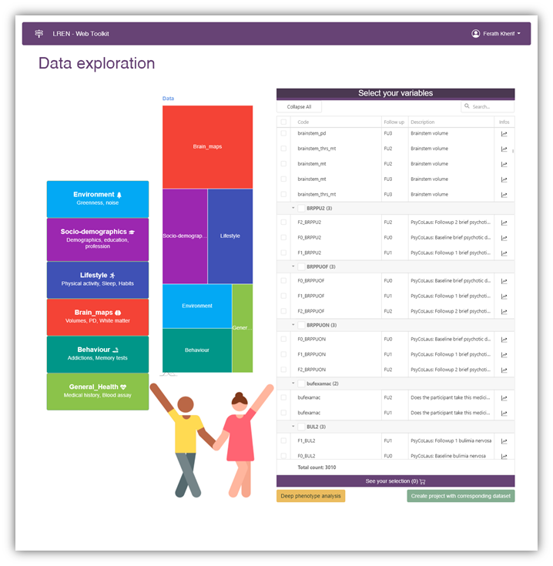
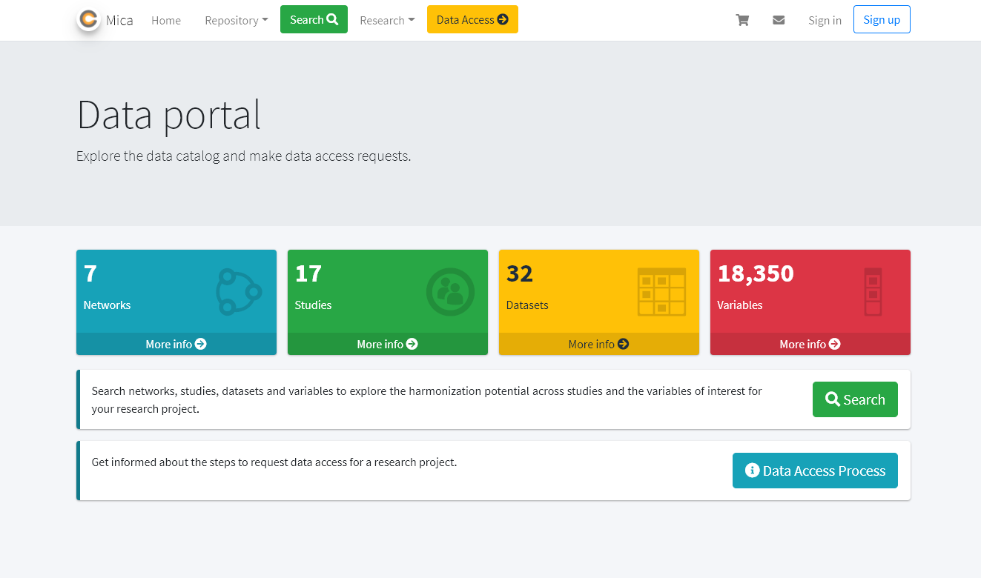
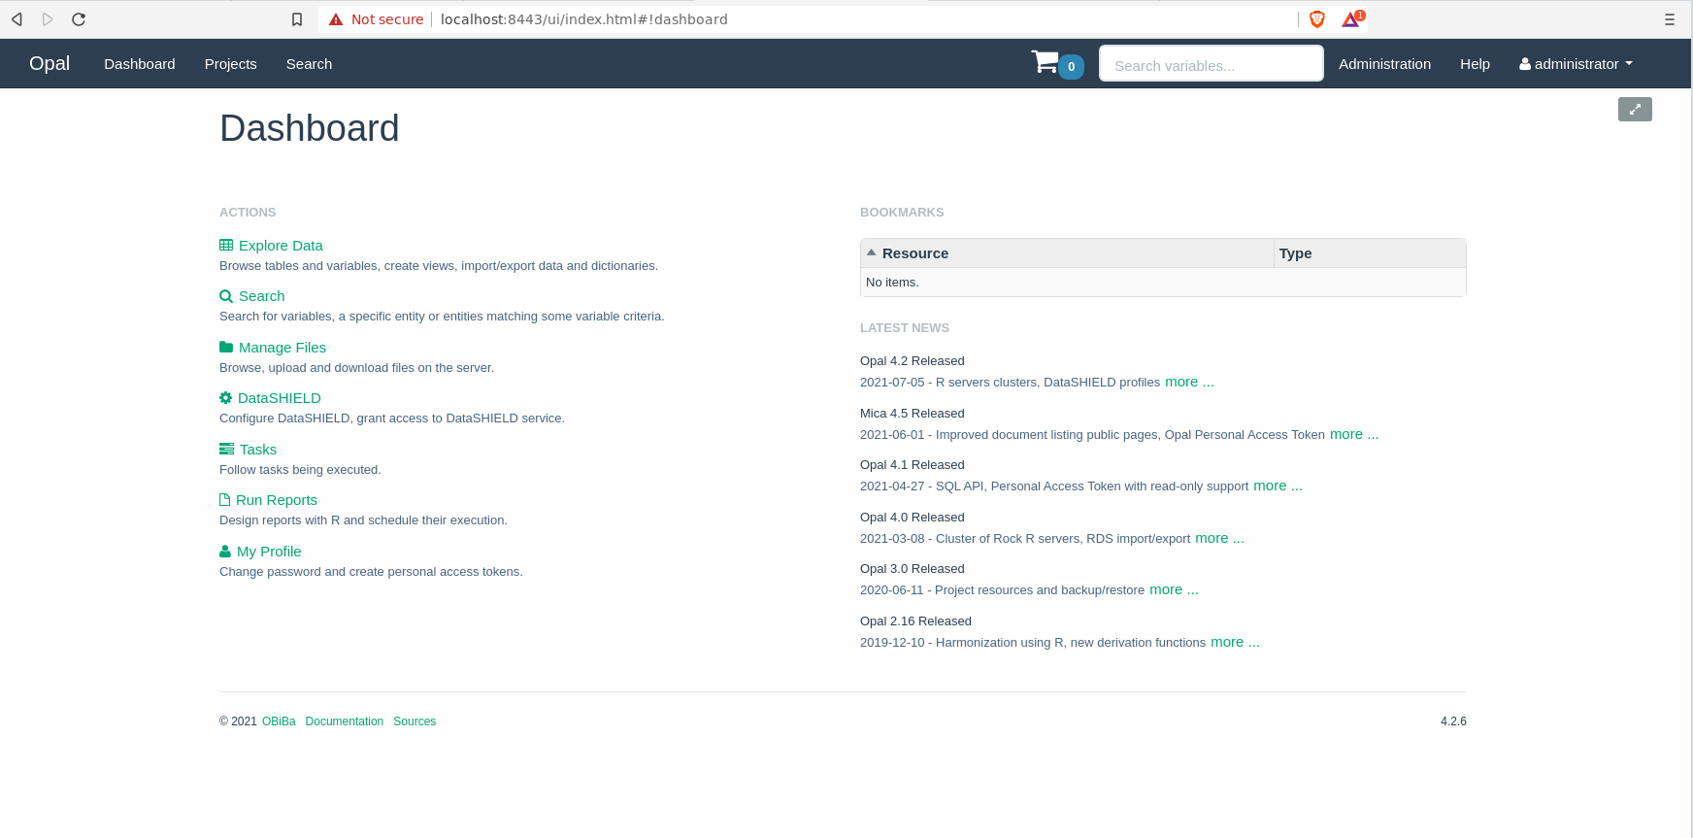
Data sourcing
Own development and Obiba.org suites

Slide 17
Data sourcing
Own development and Obiba.org suites

Slide 18
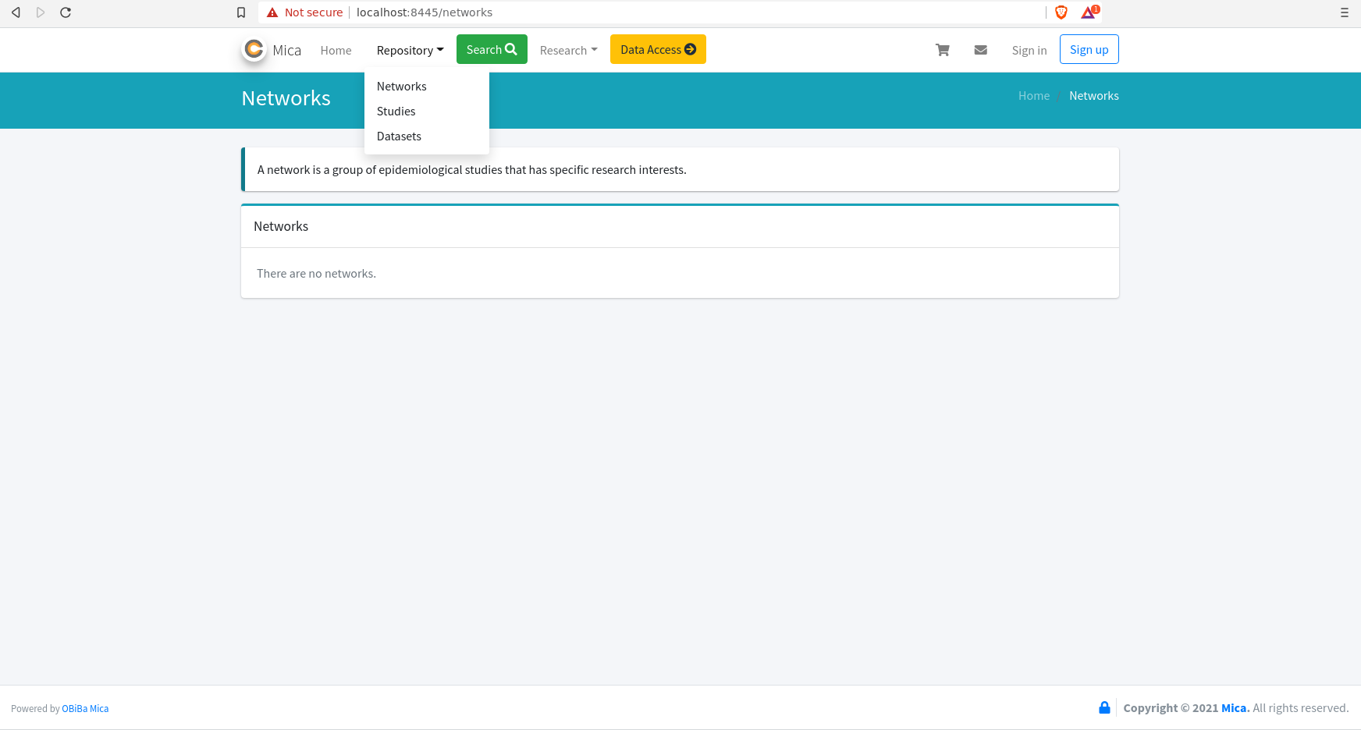
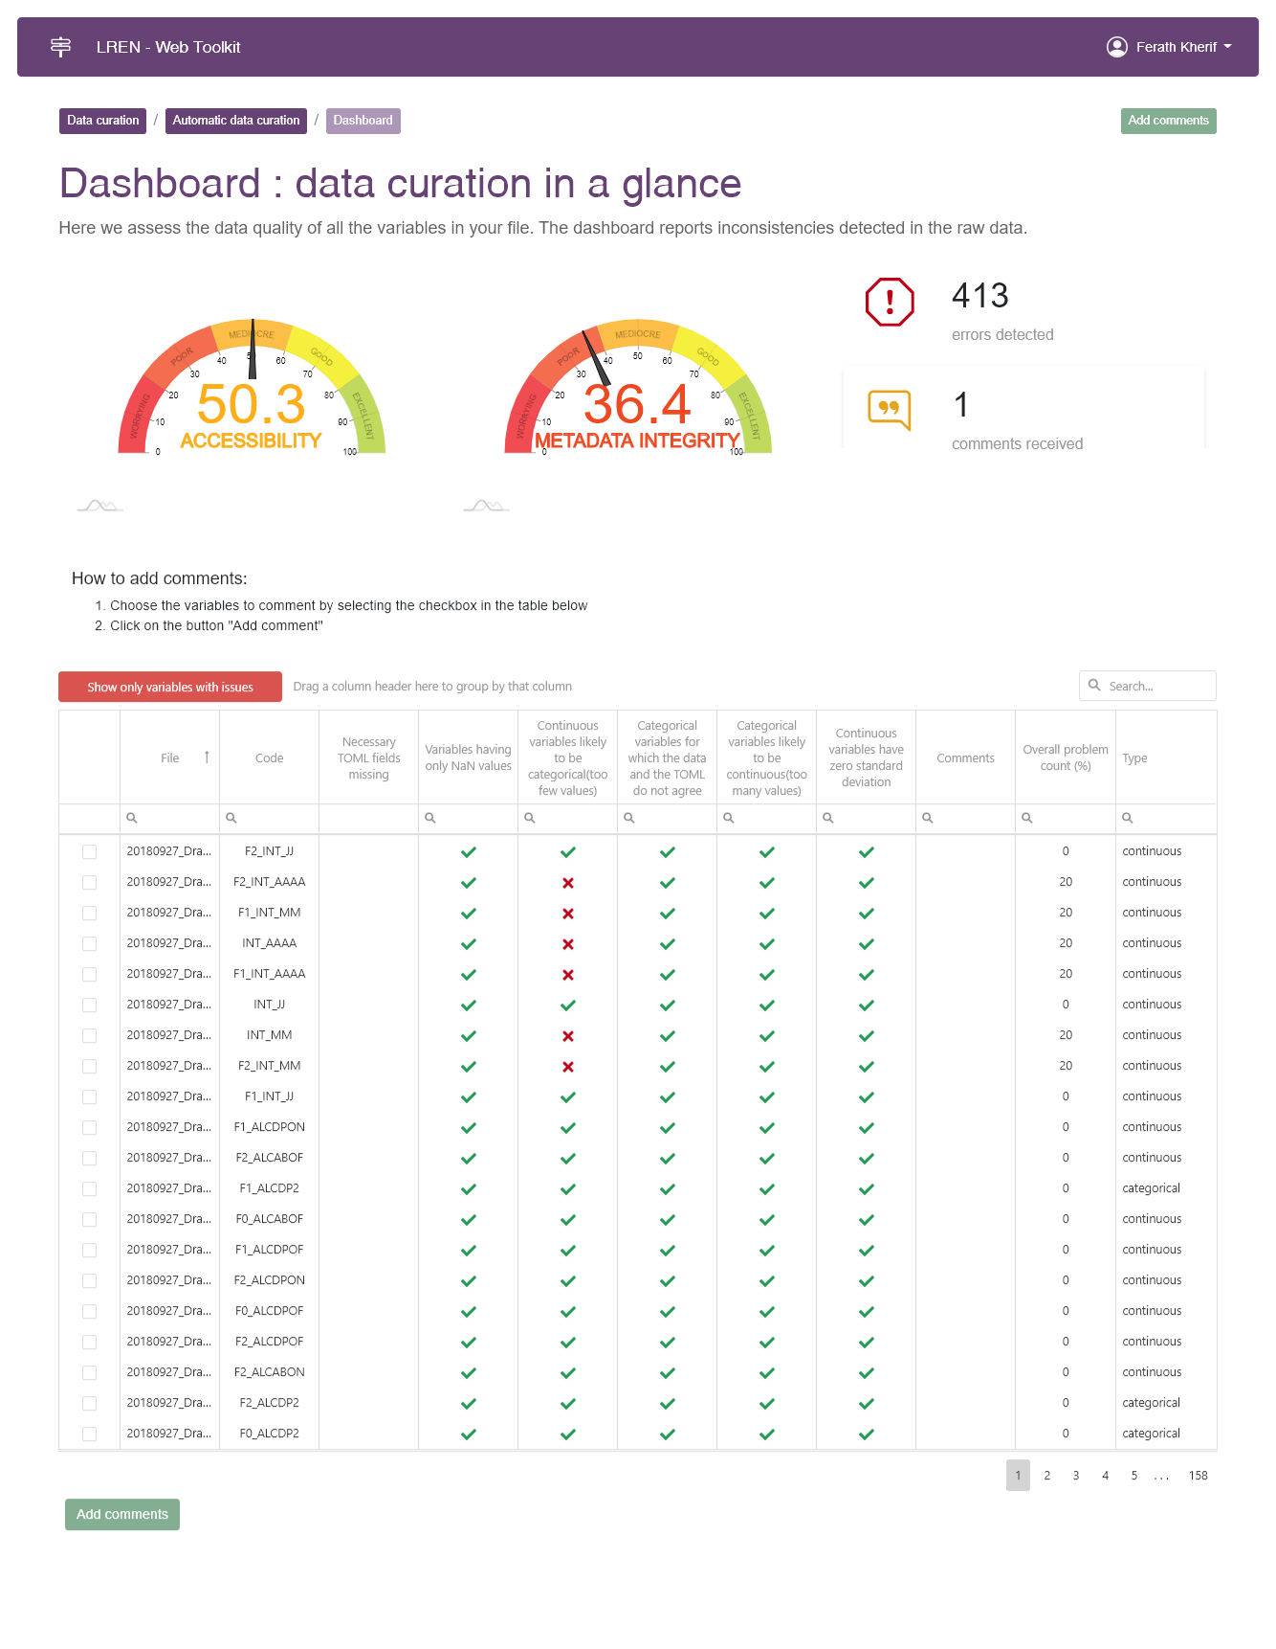
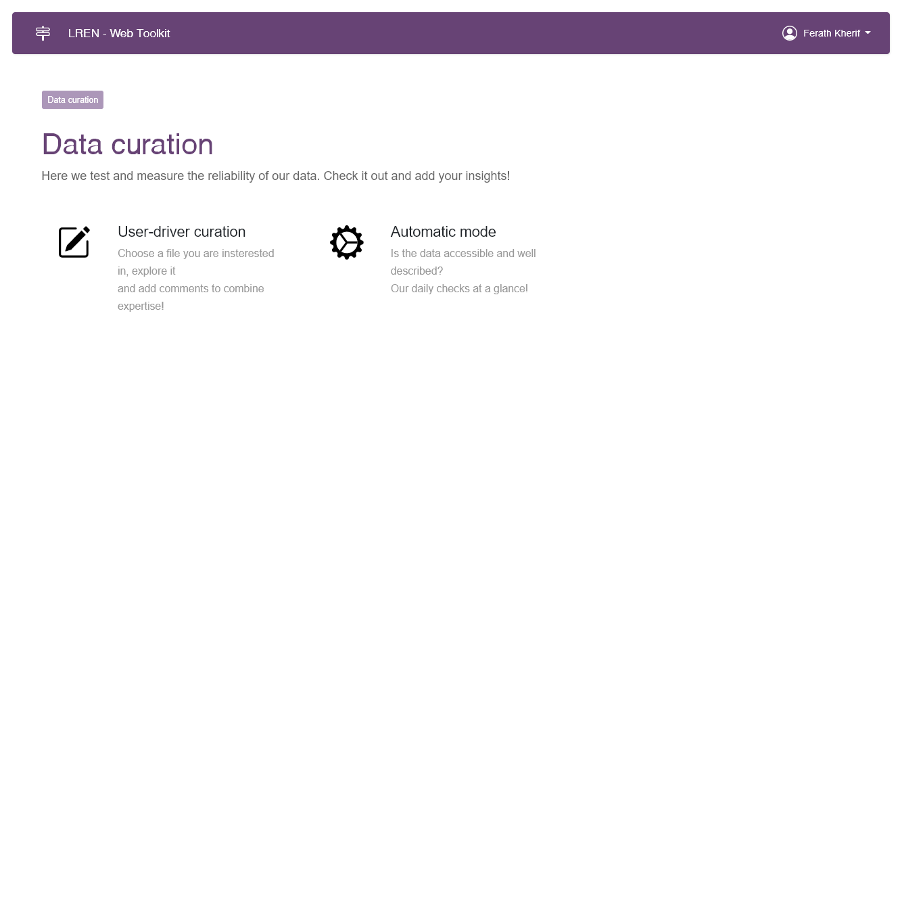
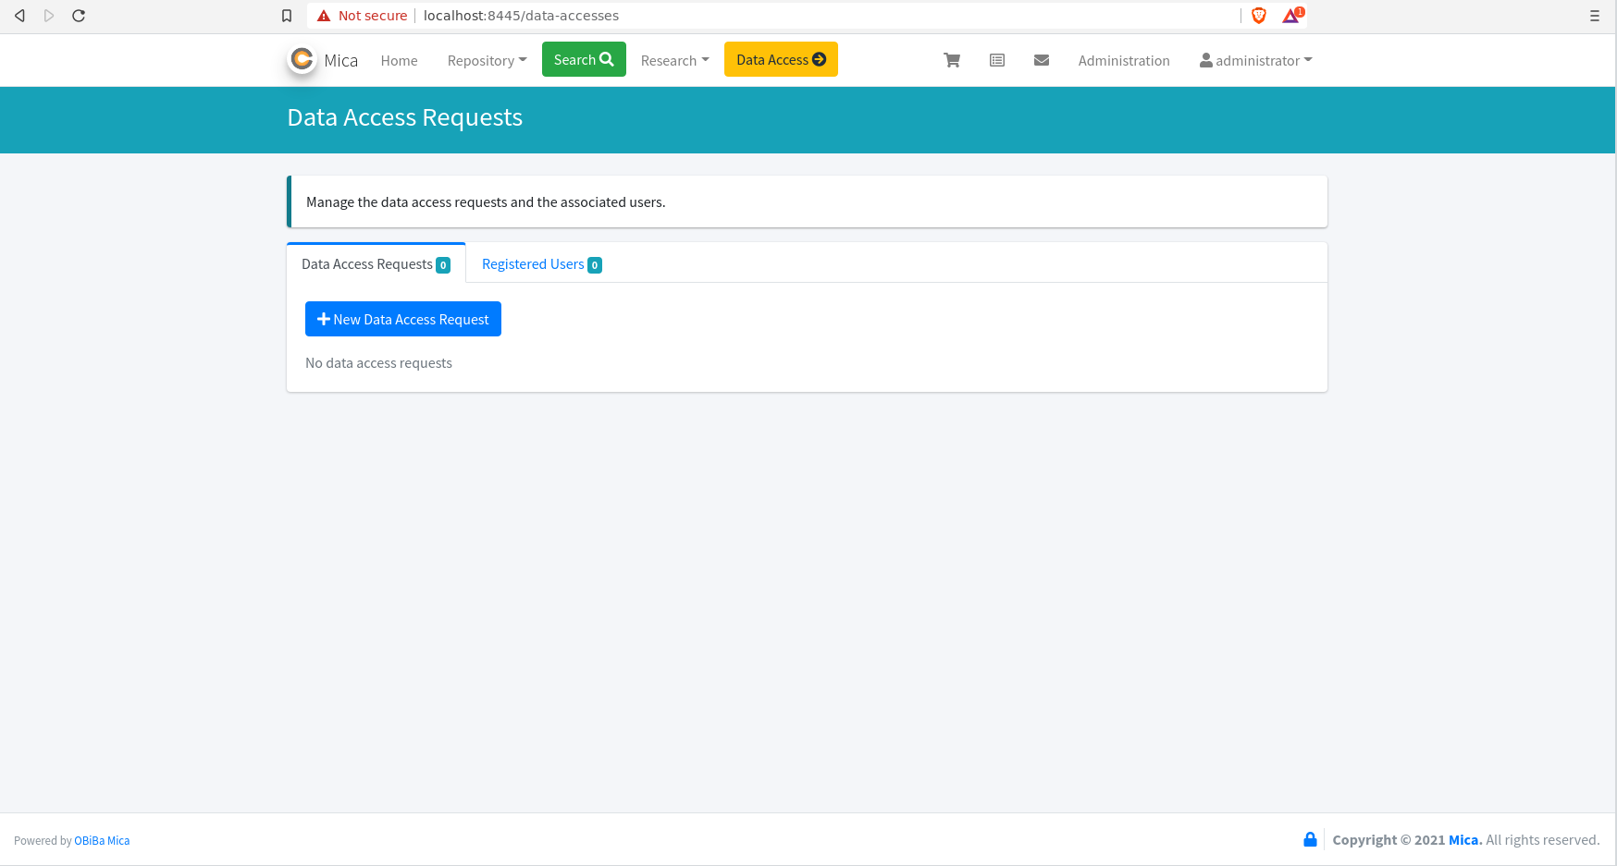
Data Access Request
Data Quality
DACQORD Principle

Slide 19
Data Curation
Data Quality
DACQORD Principle

Slide 20
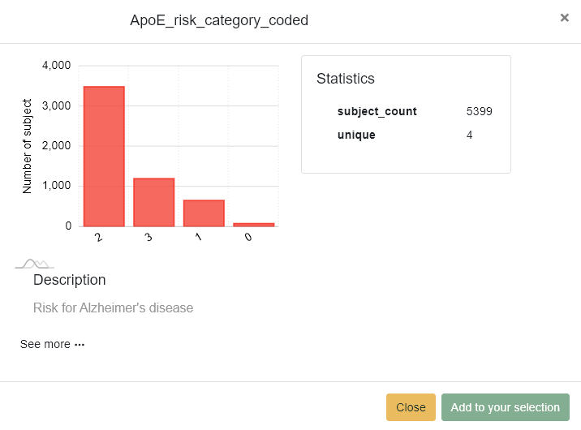
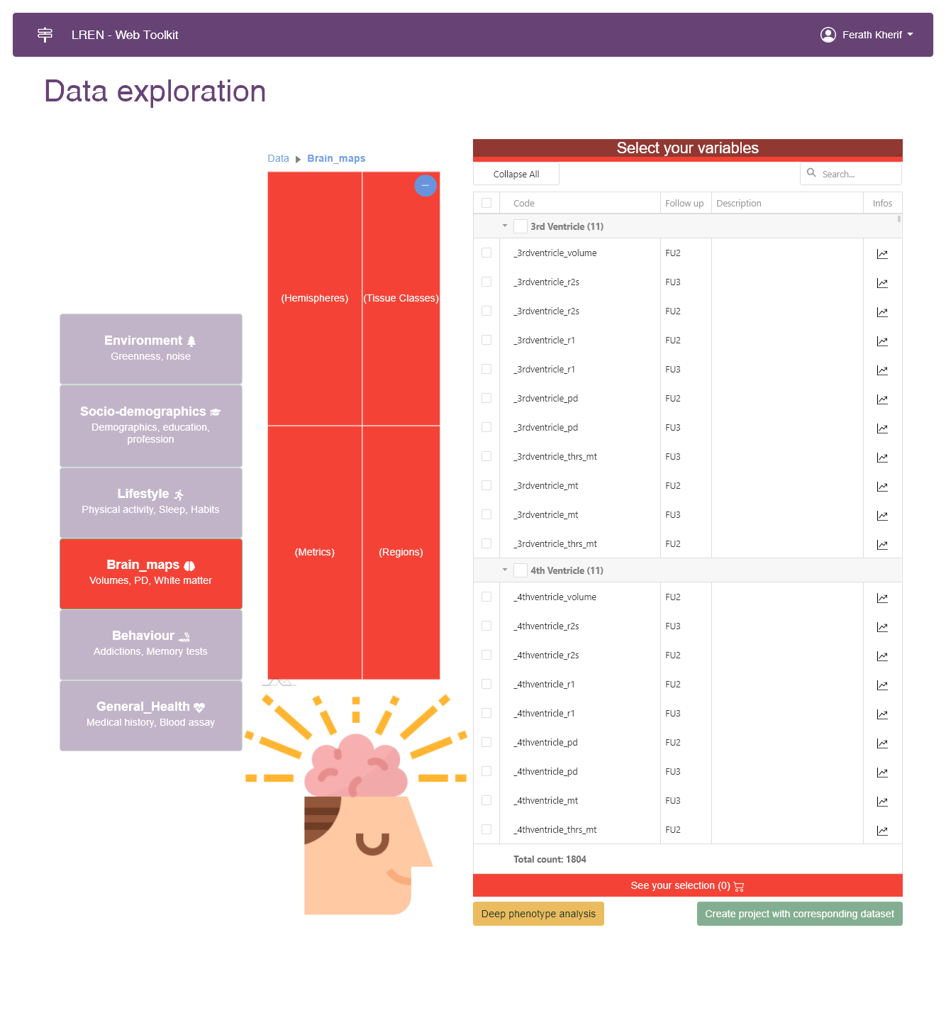
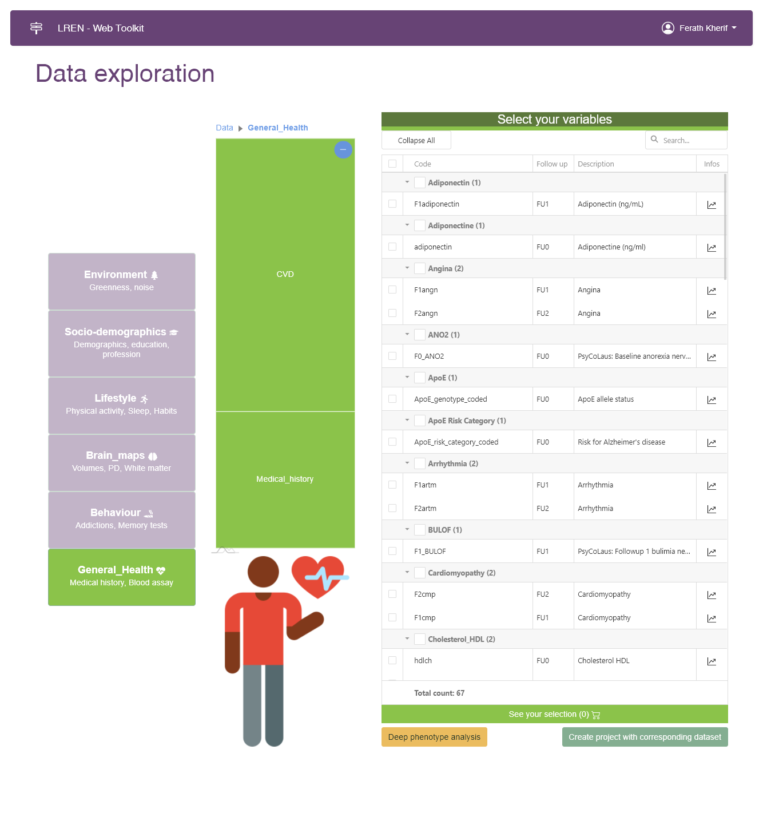
MVP: Data sourcing

Slide 21
PLAN
Data Schema and Metadata
Machine and human-readable data schema that includes metadata and contextual information
Compatibility with existing healthcare data standards and regulations
Federated Sourcing and Integration
Federated sourcing from multiple countries
Integration with open code AI platforms
Data Quality and Validation
Ability to execute queries and validate data quality
Scalability and Security
Scalability to handle large and diverse datasets
Robust security and privacy measures to protect sensitive data
User Interface and Accessibility
Easy-to-use interface for data discovery and sharing
Demonstration validation: showcasing its effectiveness of the federated approach

Slide 22
Thanks for your attention
Contact
Ferath.kherif@chuv.ch

