Slide 1
FGAI4H-R-064
Cambridge, 21-24 March 2023
Source: | Robert Koch Institute (RKI)
Title: | AI & Benchmarking for outbreak detection
Contact: | Brenden Meagher | E-mail: bmeagher@bu.edu
Abstract: | The Robert Koch Institute (RKI) in Germany has developed a way to evaluate outbreak detection algorithms using benchmarks to measure their effectiveness. The process involves training the algorithm on available data and then testing it on data that is not publicly available to avoid bias. The use cases for AI in healthcare are unparalleled, but barriers remain for its use. Benchmarking can help verify the reliability of AI outbreak detection systems, even with differing infection sources and demographics. The same mechanisms can be applied to outbreak prediction once disease detection is secured. A draft whitepaper has been created to explain how AI benchmarking works for outbreak detection in a way that non-AI educated people can understand.

Slide 2
AI & Benchmarking for outbreak detection
Brenden Meagher, Yagna Sreeramaneni, Zuber Khan

Slide 3
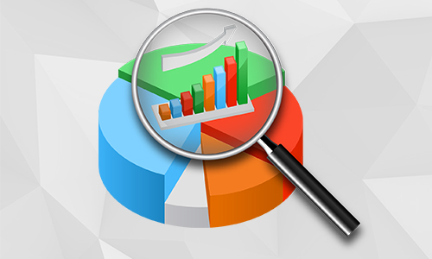
What did we do?
RKI (Robert Koch Institute, Germany)
The concept of Benchmarking
Notes:
Make the concept of AI benchmarking easy to understand
The writers don’t have an extensive background in AI
We communicated with Auss from to learn how their systems work
This lead to the creation of a draft, explaining how AI benchmarking works for outbreak detection, written in a way that non-AI educated people can understand

Slide 4
Benchmarking
What is benchmarking?
What info is needed?
Notes:
RKI came up with a way to evaluate an outbreak detection algorithm. Namely, what kind of information needs to be available about the AI, what kind of tasks is it required to solve, and which metrics are needed to measure the AI's performance. The process is all about training your algorithm on available data. The algorithm is then tested on data that is not publicly available.
Benchmarks test AI algorithms for their effectiveness. It's a strategy for engineers and users to know how effective the model code is at doing what it's designed to do.
AI algorithms need to be trained on available data, but that opens the opportunity for bias. The solution: test your algorithm on data that is not publicly available.

Slide 5
The purpose:
Notes:
The use cases for AI are unparalleled but barriers remain for it’s use in healthcare. In disease outbreak tracing and modeling, the results of algorithms have very direct impacts on people’s lives; the body of science is in the the process of regulating this and setting standards to ensure accurate algorithms that can improve public health;
AI is all about being a few steps ahead of the situation, acting with data that we haven't seen yet and seeing the outbreaks before epidemiologists realize there is one. Benchmarking can help verify that even with differing infection sources, differing demographics, and the very real potential for multiple outbreaks, AI outbreak detection systems are robust and reliable. Once disease detection is secured, we can apply the same mechanisms to outbreak prediction.

