Slide 1
FGAI4H-R-061
Cambridge, 21-24 March 2023
Source: | TG-Outbreaks
Title: | Update on the TG-Outbreak work
Contact: | Alex Radunsky (ITGH) Khahlil Louisy (ITGH) Alexander Ullrich (RKI) Auss Abbood (RKI) | Alex.Radunsky@mail.harvard.edu klouisy@hks.harvard.edu ullricha@rki.de abbooda@rki.de
Abstract: | This PPT contains updates on the Topic Group merging.

Slide 2
Topic Group: Outbreaks

Slide 3
Summary
Still in the process of merging TDDs of TG Outbreaks and TG Sanitation
Scope of TG expanded application and expertise wise
Students project benefitted from new group constellation
TG Outbreaks- FG-AI4R

Slide 4
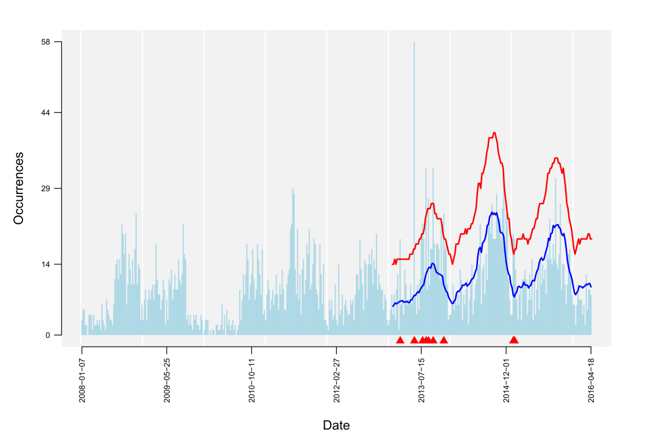
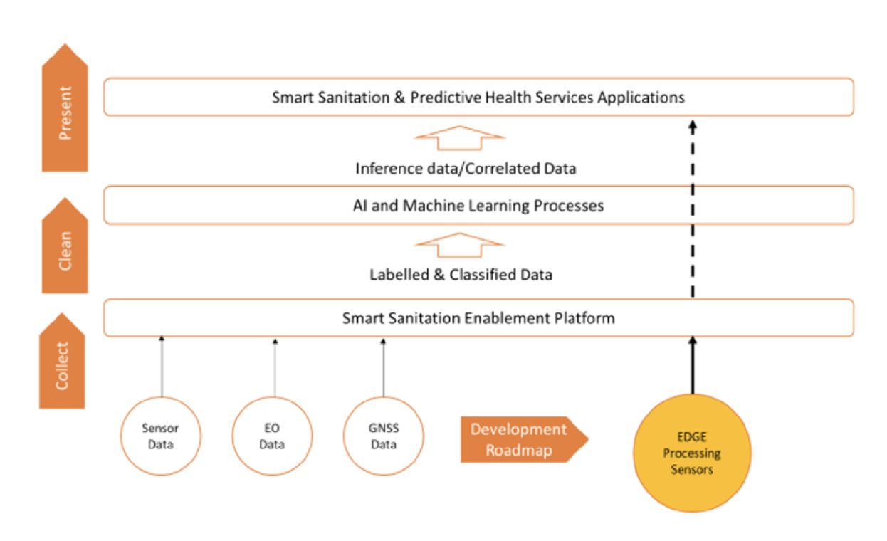
Before merging
AI task
Detection of aberrant case numbers ( )
TG Outbreaks- FG-AI4R
Notes:
Communal ablution block (CAB) occupation sensors, water meters, and acoustic diarrheal sensors; and in the pyrolysis plant: faecal sludge moisture content, calorific values, heavy metal content, presence and severity of pathogenic contamination.
Global navigation satellite system + Earth observation data

Slide 5
Commonalities: Definitions
Health hazard incidents are called events
Detecting and mitigating these events leads to an improved health outcome
Infectious diseases are among the most impactful hazards
TG Outbreaks- FG-AI4R

Slide 6
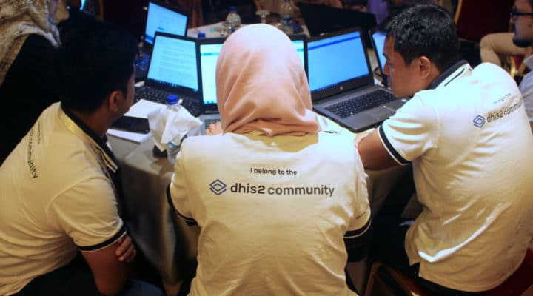
Commonalities: Opportunities for AI
Public health experts perform surveillance to detect events
If surveillance reveals unexpected patterns (signals), investigations are prompted
Surveillance intensity is constrained by budget -> AI
https://dhis2.org/
TG Outbreaks- FG-AI4R

Slide 7
Definitions
Event: Defined by start, end time, hazard, location, and affected population
Signal: Warns about an event and is uncertain
Sporadic hazards are not an event, because they do not satisfy all properties
TG Outbreaks- FG-AI4R

Slide 8
Motivation
Why do we need AI to improve signal detection?
How can we improve the detection and prediction of signals?
TG Outbreaks- FG-AI4R

Slide 9
Why do we need AI?
Surveillance uses large amounts of data:
Primary data such as lab data, sentinel networks, genomic, etc.
Secondary data such as CAB, EO, news articles, etc.
More data helps detect relevant signals earlier / more often
TG Outbreaks- FG-AI4R

Slide 10
Where comes AI into play?
Signal detection is almost completely data-driven
AI can help humans to detect signals faster and more accurately
Leaves more time for responding to events
TG Outbreaks- FG-AI4R

Slide 11
Using AI: Objective
AI needs to produce signals that are:
Specific
Timely
Spatially accurate
Communicate uncertainty faithfully
Reflect the expected impact on public health
Updates on use-cases, data, ethics, and metrics
TG Outbreaks- FG-AI4R

Slide 12
Using AI: Use cases
Although metrics, data, and algorithm may be similar, we need to distinguish by use case:
Scenario I: Outbreaks
Small, clustered, blend with sporadic events, need to be investigated and can be contained
Scenario II: Waves
Large, preparation and mitigation more important, timeliness > detection
Scenario III: Emergence
Similar to scenario I except for unknown symptoms and lack of lab tests
TG Outbreaks- FG-AI4R

Slide 13
Using AI: Ethics
Risk-assessment of benchmarking AI in TG Outbreaks using social ecological model
Mapping core AI ethics principles (e.g., justice as fairness, autonomy as informational privacy; transparency as explainability) to mitigate ethical risk of predictive ML in outbreak detection
Develop sub-criteria (guidelines) for ethical framework developed for AI in outbreak detection
MPOX student work in progress
TG Outbreaks- FG-AI4R

Slide 14
Using AI: Data
Privacy preserving
Reasonably high spatial and temporal resolution
Demographic data
Secondary data (weather, internet texts, genomic…)
TG Outbreaks- FG-AI4R

Slide 15
Using AI: Approaches
Algorithms
(Unsupervised) aberration detection
Classification
Forecasting
Clustering
TG Outbreaks- FG-AI4R

Slide 16
Using AI: Metrics
Outbreak-based metrics
Specificity, sensitivity
Timeliness
Weighting by outbreak size
Spatial accuracy
Forecast-based metrics
Hit-rate
Weighted interval score
Relative error
MSRE
Shape-based
TG Outbreaks- FG-AI4R
Notes:
Add examples

Slide 17
Setting
2
ø
ø
3
3
X
X
2
ø
ø
2
ø
3
2
1
1
ø
ø
ø
1
X
ø
ø
X
X
X
ø
X
ø
X
X
X
TG Outbreaks- FG-AI4R

Slide 18
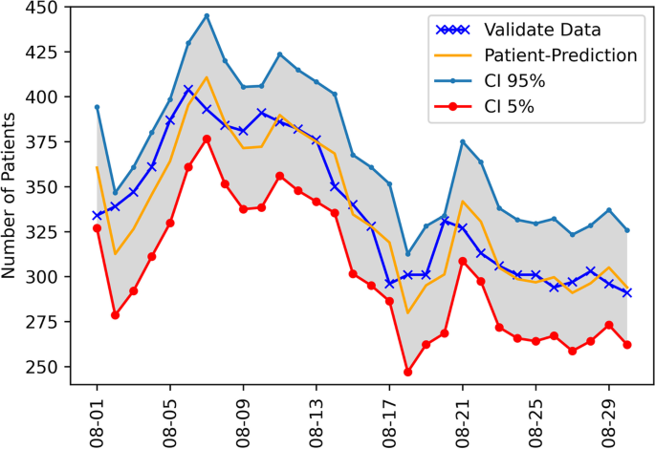
Using AI: Metrics
https://bmcmedresmethodol.biomedcentral.com/articles/10.1186/s12874-022-01755-x
TG Outbreaks- FG-AI4R
Notes:
Add examples

Slide 19
Outlook
Finish merging TDDs
Get more data from RKI to upload to healthaudit platform (working with lawyers)
Specify ethical framework with current pipeline
TG Outbreaks- FG-AI4R

