Slide 1
FGAI4H-R-060
Cambridge, 21-24 March 2023
Source: | WG-Ethics
Title: | WG-Ethics update
Contact: | Andreas Reis (WHO) Ursula (Yu) Zhao (WHO) | E-mail: reisa@who.int E-mail: zhaoy@who.int
Abstract: | This PPT contains an update from Ethics Sub-Group on activities on WG-Ethics.

Slide 2
ITU/WHO Focus Group “AI for Health”
Meeting R
21-24 March 2023
Boston, USA
Update from Ethics Sub-Group
22 March 2023

Slide 3
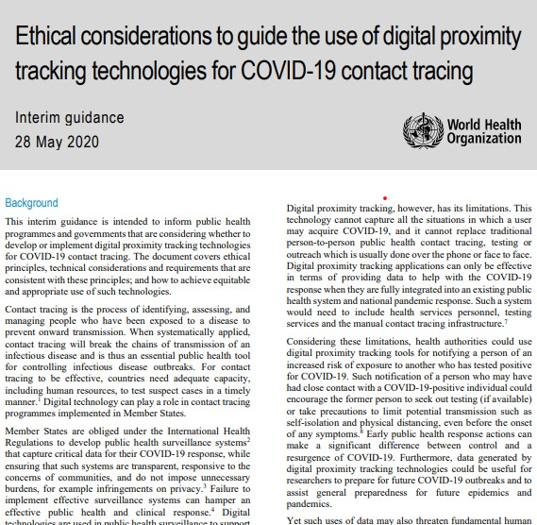
WHO publications on Ethics and governance of AI for health
https://www.who.int/publications/i/item/WHO-2019-nCoV-Ethics_Contact_tracing_apps-2020.1
https://www.who.int/publications/i/item/9789240029200
https://www.who.int/publications/i/item/9789240040793

Slide 4
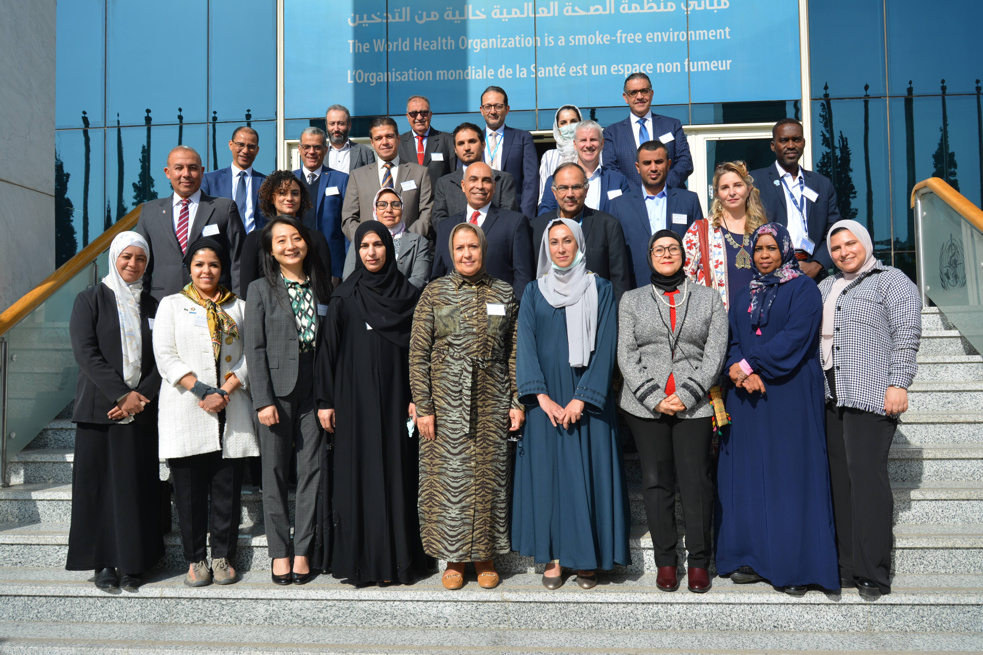
Ethics WG activities to date and ongoing
Dissemination
Regional workshops:
PAHO: Panama,14-16 Nov. 2022
EURO: Denmark, 1-2 Dec. 2022
EMRO: Egypt, 14-16 Dec. 2022
Engagement with other global health agencies (e.g. UNFPA on the use of AI-based cervical cancer technologies) and international organizations (e.g. Council of Europe on Ethics of patient-doctor relationship)
On-line curriculum on AI ethics guidance (over 10,000 users have completed the course)

Slide 5
Ethics WG activities (ongoing and future)
Dissemination
Regional workshops for other WHO regions (AFRO, SEARO, WPRO).
Knowledge Development
Development of a policy brief/checklist (and potentially full guidance) on health legislation, to assist countries with integration of ethical considerations related to the use of AI
Development of new ethics document examining the use of generative AI in science, healthcare, and medicine.
Research and/or policy documents under development include ethical considerations of use of AI for (a) health financing; (b) evidence-informed policy development; (c) reproductive health; (d) pharmaceutical R&D; (e) epidemic surveillance.

Slide 6
Ethics WG activities (ongoing and future)
Ethics of AI-based epidemic surveillance
Surveillance is one of the key functions of public health
September 2021: WHO establishes Hub for Pandemic and Epidemic Intelligence
aims to transform the global surveillance of emerging public health threats
Public health surveillance raises some critical ethics issues
2017 WHO guidelines on ethical issues in public health & 2021 Guidance on Ethics & Governance of AI4H
Work underway to scope and address the specific ethical issues related to AI-based epidemic surveillance

Slide 7
FG-AI4H Ethics WG activities (ongoing and future)
Online curriculum for programmers
30 May 2022 Berlin meeting / workshop:
Demand by AI designers on specific training course
Background: Generic WHO online training course on Ethics & Governance of AI
Decision to develop an on-line curriculum for programmers on integrating ethical considerations into the design of AI health technologies
Several meetings of FG-AI4H Ethics Sub-group to discuss and conceptualize the online training course

Slide 8
FG-AI4H Ethics WG activities (ongoing and future)
Online curriculum for programmers
Target audience
The course targets those individuals involved in data creation, data acquisition, model development, model evaluation, and model deployment of AI technologies for health applications, whether they work in public, private or not-for-profit sectors. It is expected to be of interest to:
full stack developers,
software engineers,
data scientists,
front and back-end specialists, and
principal investigators and/or site investigators.

Slide 9
FG-AI4H Ethics WG activities (ongoing and future)
Online curriculum for programmers
Objectives
Identify and describe the ethical challenges and risks that can materialize during the AI technology lifecycle.
Assess the ethical challenges and risks by raising relevant issues or questions throughout the decision-making process in all phases of the AI lifecycle.
Mitigate ethical challenges and risks by making informed decisions while integrating ethical, medical, epistemic, societal, and political considerations and values.

Slide 10
FG-AI4H Ethics WG activities (ongoing and future)
Online curriculum for programmers
Methodology
Modules organized around the AI-product development lifecycle and how different ethical principles apply at each stage
Case-study (challenge) based approach
Provide examples of tools and technologies that are associated with implementing ethical design in practice.

Slide 11
FG-AI4H Ethics WG activities (ongoing and future)
Online curriculum for programmers
Timeline
Open call: December 2022
Provider selected and course skeleton draft by mid-April 2023
Online meeting of FG-AI4H Ethics Sub-group end of April 2023
Full course development May-June 2023
Review by FG-AI4H Ethics Sub-group in June 2023
Goal: Course live by September 2023

Slide 12
We must ensure the Digital Health revolution is safe, sustainable and leaves no one behind.
Thank you!

