Slide 1
FGAI4H-R-052-A02
Cambridge, 21-24 March 2023
Source: | Editors DEL7.4
Title: | Att.2 – Presentation - DEL7.4 update: Clinical evaluation of AI for health
Contact: | Eva Weicken | E-mail: eva.weicken@hhi.fraunhofer.de
Abstract: | This PPT contains a presentation of: an update on DEL 7.4 “Clinical evaluation of AI for health”

Slide 2
ITU/WHO FG-AI4H Working Group Clinical Evaluation
—
Update & future direction
Eva Weicken & Shubs Upadhyay, Nina Linder, Johan Lundin
22 March 2023, Harvard Innovation Labs, Harvard Business School, Cambridge, US

Slide 3
ITU/WHO FG-AI4H Working Group Clinical Evaluation
—
Evolution & Milestones

Slide 4
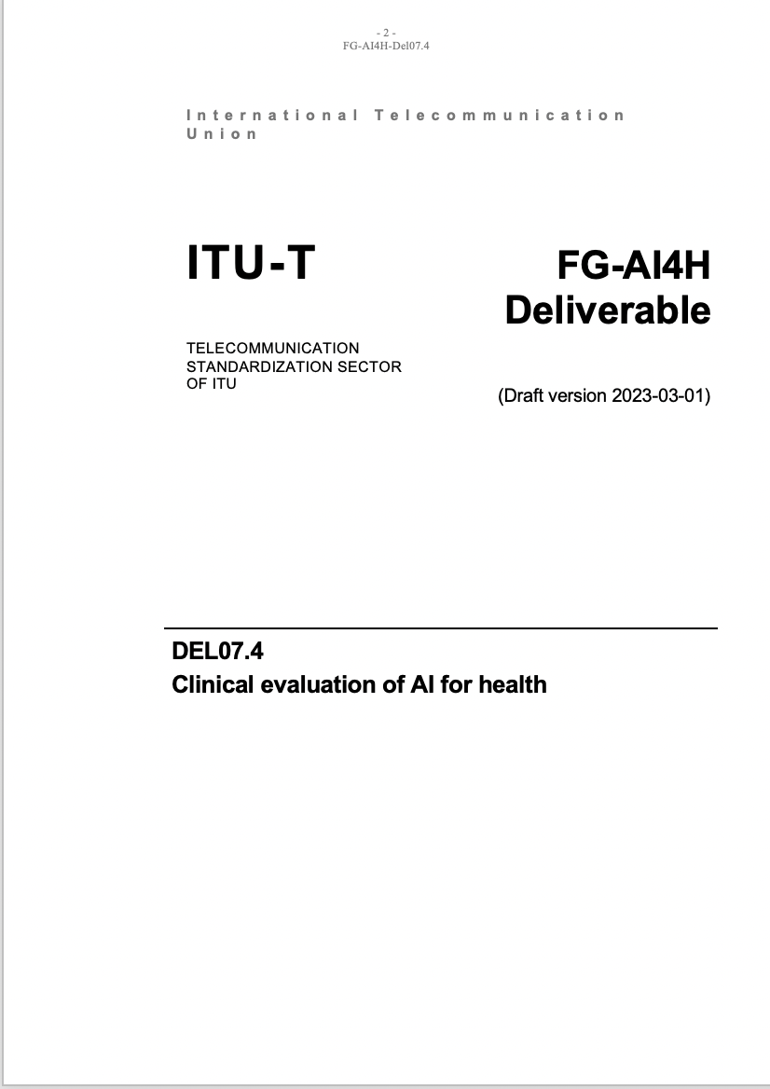
Purpose
What‘s it all about?
Framework on clinical evaluation
—
Design & Purpose – Algorithmic validation - Clinical validation – Ongoing monitoring – Ethics – Economic evaluation
Main goals
Collaboration with other expert groups & global stakeholders
Best practice evaluation and principles
Special consideration LMIC settings
Framework for: clinicians, researchers, developers, regulators, policy makers & patients, public
Define gaps for future research
To be used with other FG-AI4H guidance

Slide 5
Collaboration
Group members
External expert group (in alphabetical order): AbouElkhir Osama (Tachy Health, Dubai), Akogo Darlington (minoHealth AI Labs, Ghana), Allen Megan (Inspired Ideas, Tanzania), Alsalamah Shada (WHO, Switzerland), Arentz, Matthew (FIND, Switzerland), Baird Pat (Philips, USA), Balachandran Pradeep (Freelancer E-Health, India), Bastawrous Andrew (Peek Vision, Global Eye Health, UK), Bathke Arne (University of Salzburg, Austria), Chiavegatto Filho Alexandre (São Paulo University, Brazil), Cresswell Kathrin (University of Edinburgh, UK), Darkoh Ernest (BroadReach Healthcare, South Africa), Ehrenfeld Jesse (American Medical Association (AMA), USA), Fehr Jana (Hasso-Plattner-Institute, Germany), Fenech Matthew (Una Health, Germany), Fürstenau Daniel (Copenhagen Business School, Denmark), Gaudin Robert (Charitè, Germany), Gilbert Stephen (Technische Universität Dresden, Germany), Glod Mateusz (Infermedica, USA), Greaves Felix (National Institute for Health and Care Excellence (NICE), UK), Gupta Saurabh (Department of Cardiology, All India Institute of Medical Science, India), Gütter Zdenek (University Hospital Olomouc, Czechia), Hatton Grace (Sensyne Health, UK), Ho Dean (National University of Singapore, Singapore), Ibrahim Hussein (Doctors.net.uk, UK), Islam Shariful (Deakin University, AUS), Jarral Reza (Pro Care, NZ), Jeon Jonghong (Electronics and Telecommuncations Research Institute, South Korea), John Oommen (George Institute for Global Health, India), Kadam Rigveda (Head of digital access, FIND, Switzerland), Kherif Ferath (LREN, Switzerland), Kuku Stephanie (WHO, UCL, Switzerland, UK), Kurtys Michal (Infermedica, Poland), Lapão Luís (Velez) (University of Lisbon, Portugal), Linder Nina (University of Helsinki, Finland), Loh Irving (Infermedica, USA), Loveys Kate (University of Auckland, NZ), Magrabi Farah (Macquarie University, Sydney, Australia), Mahajan Arnav (Department of Medicine, University College Cork, Ireland), Malpani Rohit (WHO, Switzerland), Mamun Khondaker (CMED Health, Bangladesh), Masud Jakir Hossain Bhuiyan (CTS, Bangladesh), Matin Rubeta (Oxford University Hospitals NHS Foundation Trust, UK), McCradden Melissa (Sick Kids Hopspital, Canada), Menezes Audrey (Healthily, UK), Murchison Andrew (Oxford University Hospitals NHS Trust, UK), Murphy Lisa (Centre for Improving Data Collaboration at NHSX, UK), Essa Mohamedali (Tanzania AI Lab, Tanzania), Nakasi Rose (Makerere University, Uganda), Oala Luis (Fraunhofer Heinrich Hertz Institute (HHI), Germany), Pankova Natalie (Metadvice, UK), Piekut Agata (Health Action Tank, Poland), Porras Lina (1Doc3, Colombia), Reddy Sandeep (Deakin University, Australia), Salim Ally (Inspired Ideas, Tanzania), Schwendicke Falk (Charitè, Germany), Sethi Tavpritesh (Indraprastha Institute of Information Technology Delhi, India), Sood Harpreet (National Health Service (NHS), UK), Sousa Inês (Fraunhofer Portugal, Portugal), Srivastava Manish (Virginia Polytechnic Institute & State Univ., USA), Starlinger Johannes (Howto Health Digital Business Solutions, Germany), Wasswa William (Global Auto Systems LTD, Uganda), Werneck Leite Alixandro (Tribal, Mexico)
Writing group (in alphabetical order): Carolan Jane (UCL Institute of Health Informatics, UK), Denniston Alastair (University of Birmingham, UK), Karpathakis Kassandra (Harvard University, USA), Lee Naomi (National Institute for Health and Care Excellence (NICE), UK), Liu Xiaoxuan (University of Birmingham, UK), Upadhyay Shubhanan (Ada Health, Germany), Weicken Eva (Fraunhofer Heinrich Hertz Institute (HHI), Germany), Wilkinson Thomas (Ministry of Health, NZ)

Slide 6
Timeline
Development of the framework & deliverable
2020
2021
2022
2023
10: Inaugural workshop
12: Meeting
09: WHO clearance
02/03: ITU approval
03: LMIC meeting
04: Review 1 & meeting
09: Review 2
11: Meeting
10: Meeting “future priorities”
10/11: Follow up meetings
Publications (ITU/WHO)

Slide 7
ITU/WHO FG-AI4H Working Group Clinical Evaluation
—
Framework for Clinical evaluation of AI4 Health

Slide 8
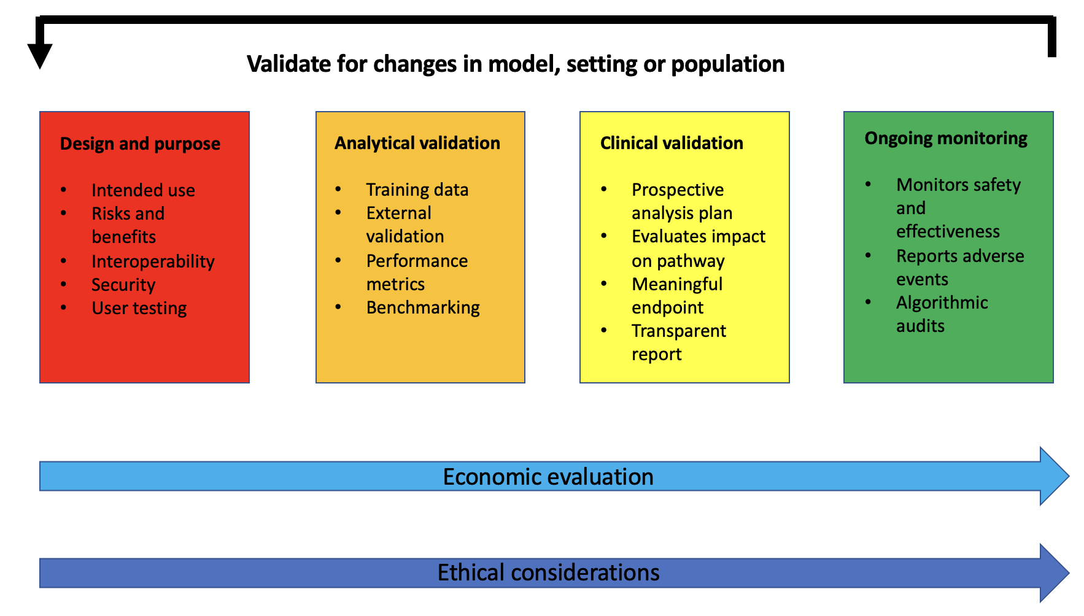
Framework for clinical evaluation of AI4H
Across four phases
Source: Del 7.4

Slide 9
ITU/WHO FG-AI4H Working Group Clinical Evaluation
—
Update & Future direction

Slide 10
Latest activities & future direction
Overview
Latest activities
Publication through ITU & WHO
Outreach & communication, e.g., CAICT
Collaboration, e.g., FIND
Improvement & applicability, e.g., Helsinki University/Karolinska Institute/ Uppsala University
Future direction
Economic evaluation
Applicability & gaps for future research

Slide 11
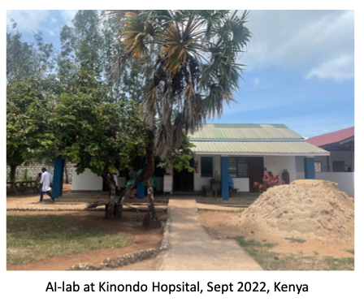
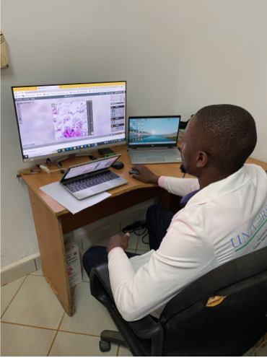
Implementation
Topic group “point-of-care” University Helsinki & Karolinska Institute & Uppsala University
Aim & purpose
Testing applicability & use framework in a clinical study
Study on cervix-cancer screening by digital microscopy in Kenya
Development of a checklist for clinical evaluation based on the guidance
Source: Nina Linder, TG-POC

Slide 12
Adaptation of the Checklist for clinical evaluation of AI for health
Example: POC for cervical cancer screening using AI
Our clinical projects within the TG-Point-of-care/cervical cancer screening in Kenya and Tanzania
We are evaluating the document by using it from the start of a new validation study in Tanzania
We here show a couple of examples from the clinical evaluation document
Model Design & Purpose
Economic evaluation
Link to checklist draft here

Slide 13
Model design & purpose
Example: POC for cervical cancer screening using AI
1.1.1 Identify and describe the specific problem to be solved (population, input data required, output data from model, setting).
Develop and evaluate an AI based method for cell-based screening of cervical cancer at the POC in a recourse limited setting.
1.1.2 Describe how and where the model would fit in the patient journey or clinical workflow.
To be used by health care professionals at small and middle-sized hospitals and beneficiaries are women 18-65 years from the general population.
Easy to use instrument for digitizing the cytological samples and results clearly reported back to the end user (technician, nurse, doctor).
Prompt diagnostics at the POC also allowing task shifting. Not fully autonomous, remote (e.g., a pathologist) expert verifies AI findings.
1.1.3 Consider and describe any special circumstances related to the intended users or context.
Needs to be tailored to access of treatment (e.g., cryo, biopsy, surgery, chemo). Internet outage possible in rural regions, electricity, internet outage. Differences in prevalence in different regions.
Staining variation between labs and technicians and
Generalizability of the AI system still to be confirmed (e.g., differences in cervical cancer prevalence, differences between the training set and the prospective study population)

Slide 14
Future direction of the WG-CE
Global Initiative of AI for Health
Who do we need to work on this?
&
How can the ideas be realized?

Slide 15
Get involved & Contact
—
eva.weicken@hhi.fraunhofer.de

Slide 16
Thank you for your attention!
—

