Slide 1
FGAI4H-R-050-A01
Cambridge, 21-24 March 2023
Source: | Editors DEL10
Title: | Att.1 – Presentation - DEL10 Update: AI4H use cases
Contact: | Eva Weicken | E-mail: eva.weicken@hhi.fraunhofer.de
Abstract: | This PPT contains a presentation of: an introduction to the topic groups an update on DEL 10_0 “Del. 10_0: AI4H use cases: Topic Description Documents”.

Slide 2
ITU/WHO FG-AI4H Deliverable 10.0
—
Update AI4H use cases: Topic Description Documents
Eva Weicken, 23. March 2023, Harvard Innovation Labs, Harvard Business School, Cambridge, US

Slide 3
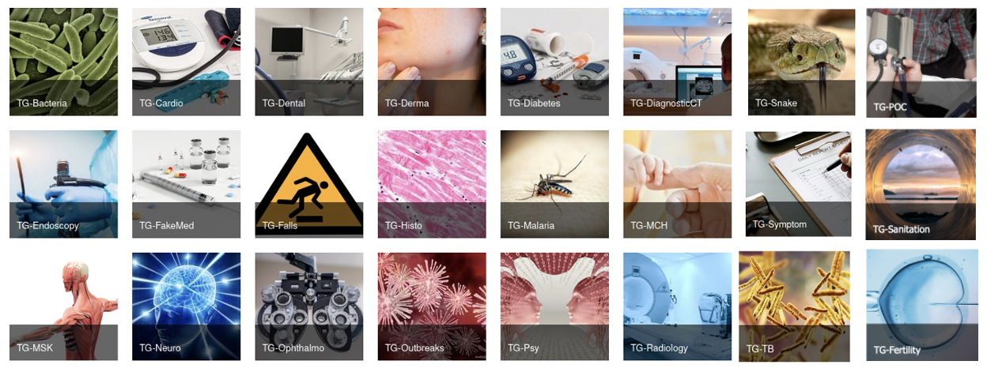
24 topic groups
By March 2023
Variety of health use cases in the context of AI
Producing evidence and case studies
Propose harmonized procedures to benchmark AI models
Combine experts & data from various partners

Slide 4
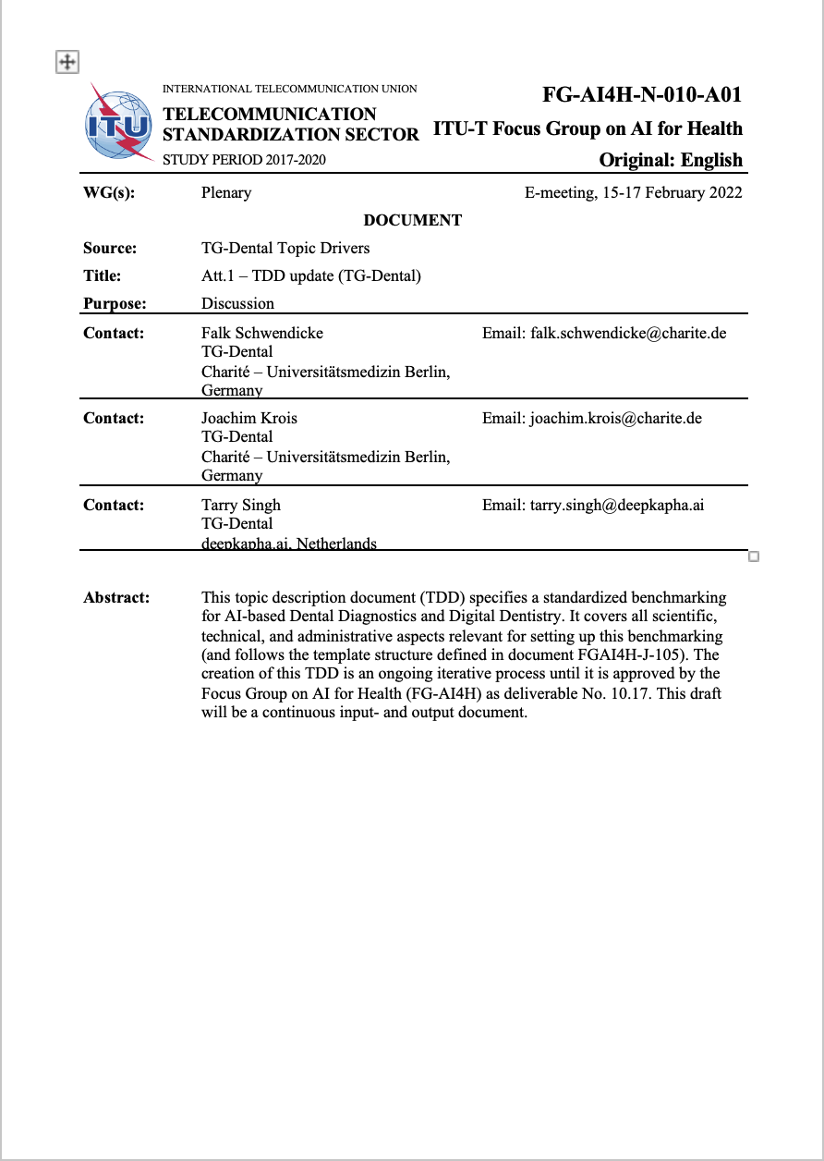
Topic groups organization & output
Topic description documents
Topic groups (TGs) create output documentation, topic driver coordinate work
Sections on the ethical, technical, clinical, regulatory requirements for the benchmarking
Categories: Background, features, operations, considerations
Topic description document
template (J-105)

Slide 5
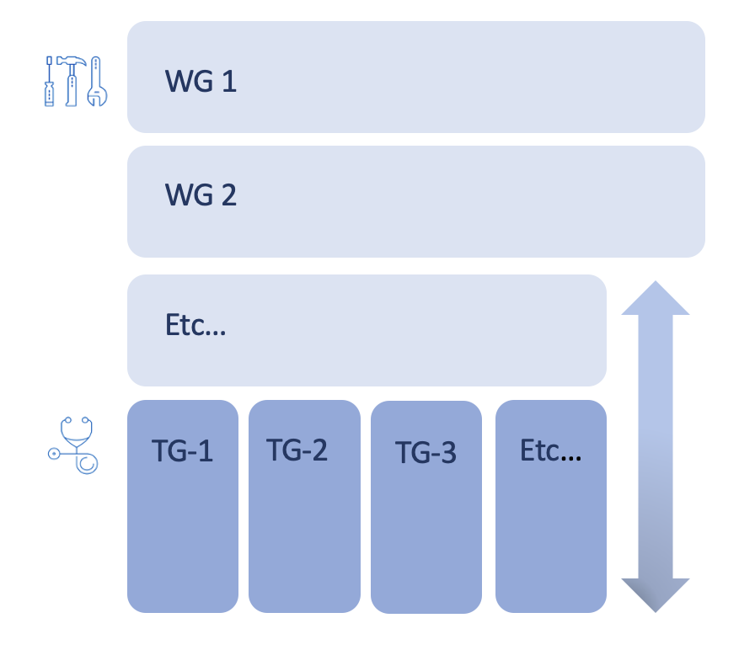
Topic groups x working groups
Matrix structure
Working Groups
(horizontal) create best practices and guidance documentation for cross cutting topics (ethics, regulation,..)
Topic Groups
(vertical) apply these within their benchmarking procedure
WG = Working Groups
TG = Topic Groups

Slide 6
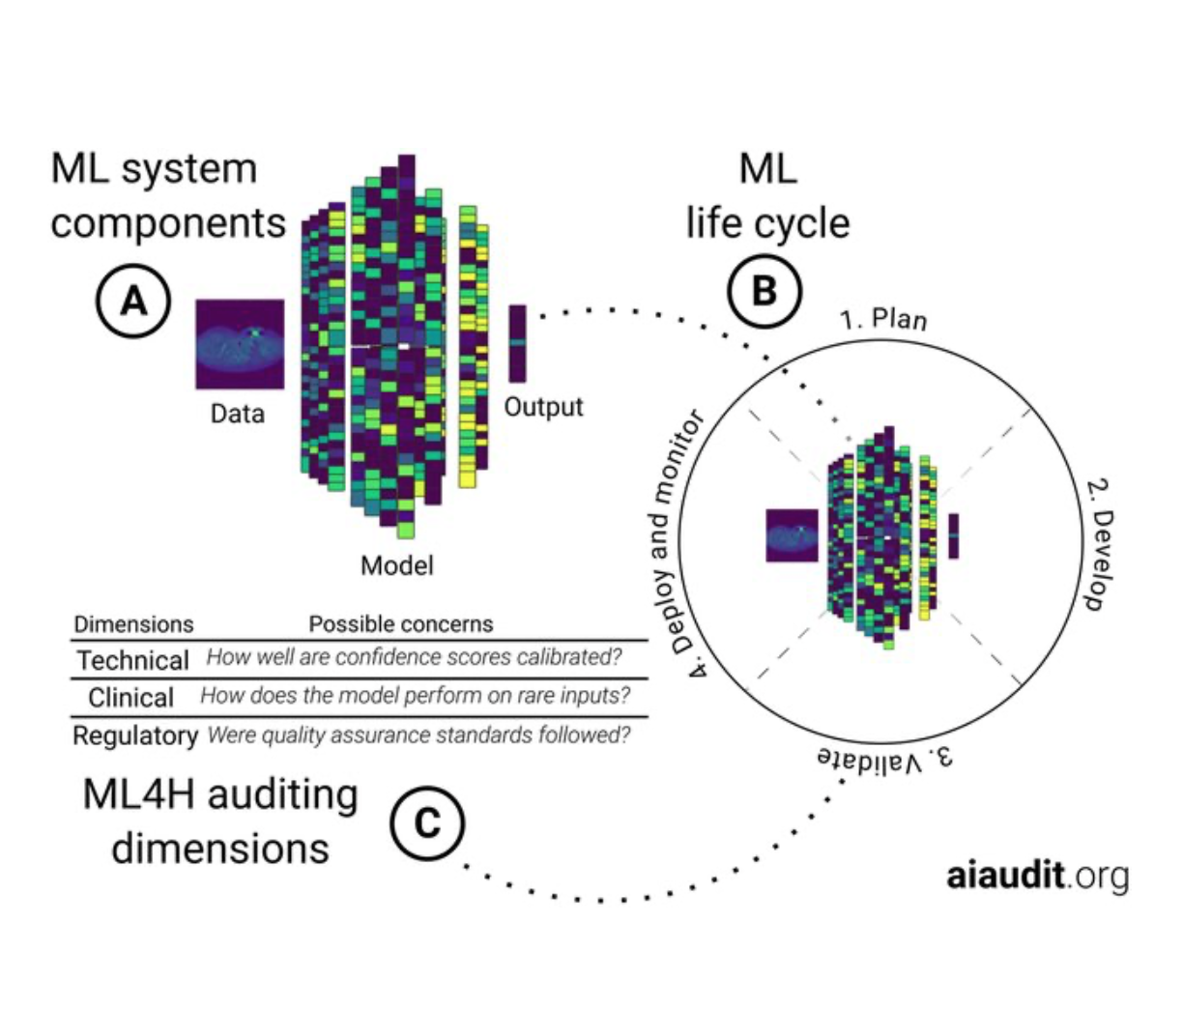
More topic group activities
OCI & AI audits
& Open Code Initiative
Topic groups
Ophthalmology – Malaria – Symptoms – Psychiatry – Radiology – Neurology – Outbreaks – Dental – Falls …

Slide 7
Thank you for your attention!
—

