Slide 1
FGAI4H-R-042-A01
Cambridge, 21-24 March 2023
Source: | Markus Wenzel¹, David Neumann¹, Sandeep Reddy², Annika Reinke³, Alberto Merola⁴, Steffen Vogler⁵ ¹Fraunhofer HHI, ²Deakin University, ³DKFZ, ⁴AICURA medical, ⁵Bayer
Title: | Att.1 – Presentation - DEL07 Update: AI for Health Evaluation Considerations
Contact: | Markus Wenzel | E-mail: markus.wenzel@hhi.fraunhofer.de
Abstract: | This PPT contains a summary of updates in DEL07: AI for Health Evaluation Considerations, for presentation and discussion during the meeting.

Slide 2
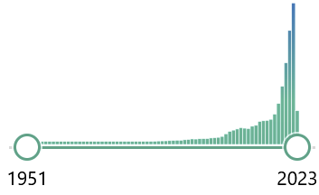
DEL7: AI for health evaluation considerations
Healthcare AI models:
Offer great potential for many applications in healthcare
Recognize, classify, predict, warn early, recommend, help to decide, …
Effective, safe, accurate on new data, robust, plausible, fair?
Standards for trustworthy healthcare AI needed
Careful evaluation plays crucial role

Slide 3
DEL7: AI for health evaluation considerations
Background
Evaluation process
Novelty
Standardized model benchmarking
Benchmarking platform requirements
Best practices from literature

Slide 4
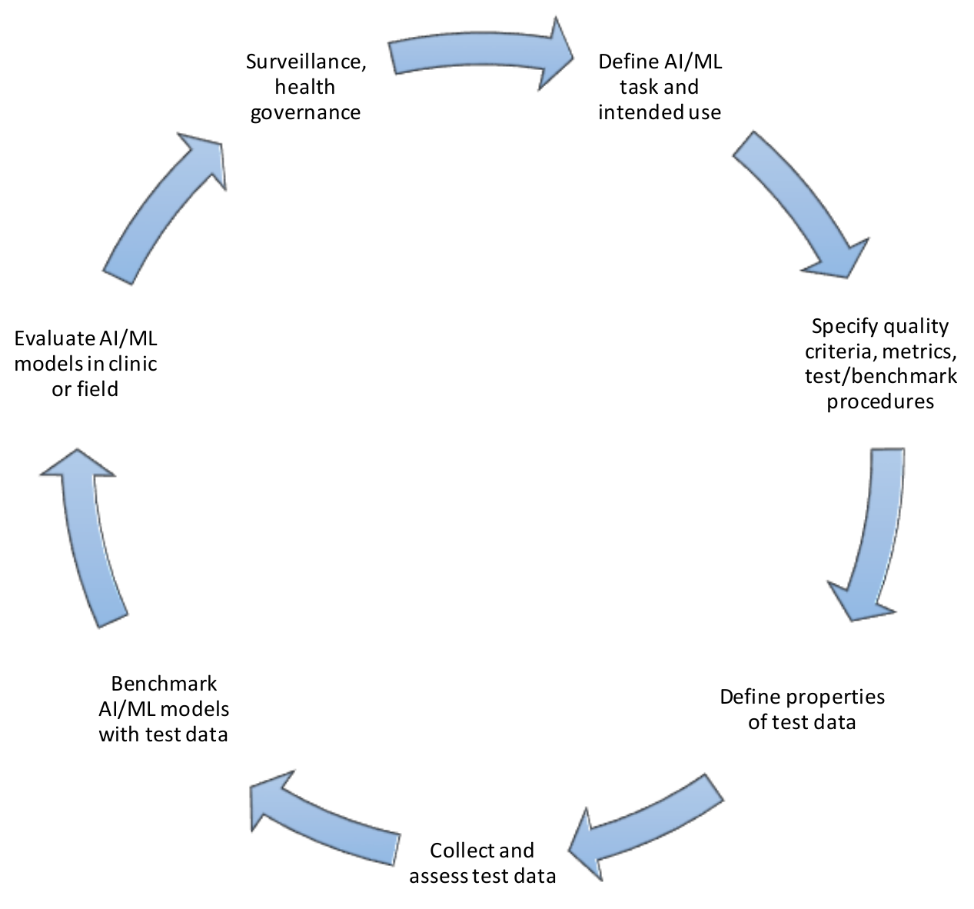
Cyclical evaluation process

Slide 5
Cyclical evaluation process
DEL7.4) Clinical Evaluation
DEL 1) Ethics/ governance & DEL2) regulation
DEL 7.2) Technical test specification
DEL10.*) Topic Description Documents (TDDs)
DEL 7) Evaluation Considerations
DEL 5.*) Data specification etc.

Slide 6
Novel aspects of health AI model evaluation
Appropriate test data sets
Internal vs. external validation
Technical vs. clinical criteria
Proper benchmarking
Complex models and settings
Self-learning algorithms
Human factors
Misuse accurate tools
Design of clinical trials with AI
Agreement on/interoperable encoding of benchmarking cases
Testing existing AI products vs. ML-challenges

Slide 7
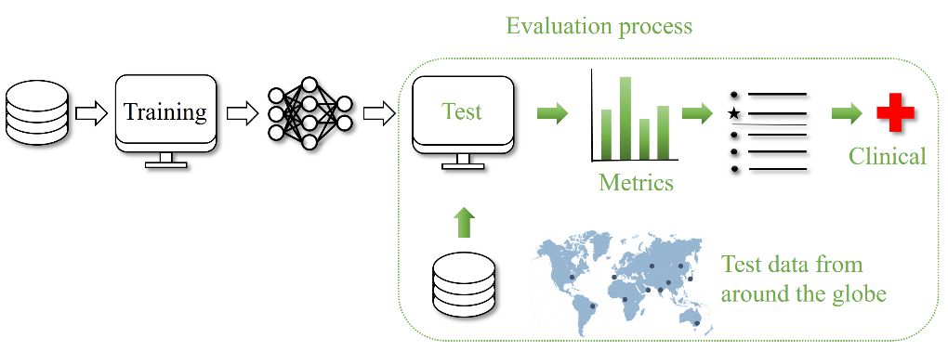
Standardized benchmarking
Independent model validation with standard procedures on separate test data and subsequent clinical evaluation
(1) Closed environment, (2) Via interface, (3) Federated

Slide 8
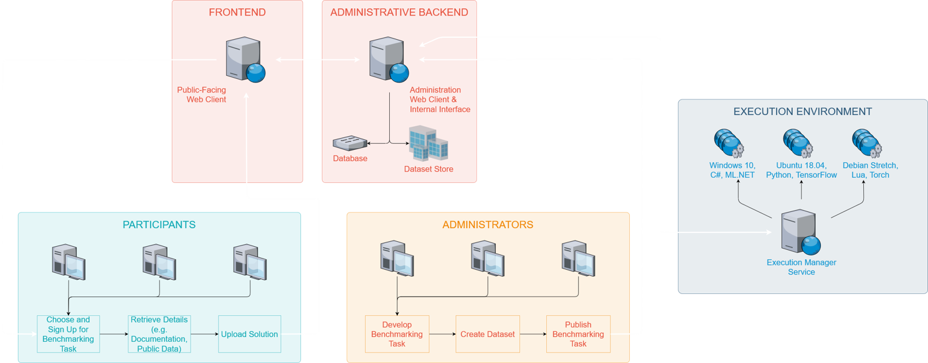
Benchmarking platform – requirements
System overview (administrative backend · frontend · execution environment)​
General considerations (security · hosting · computing resources · availability)​

Slide 9
Turning vision for AI4H benchmarking platform into practice
See talk: evaluation package of Open Code Initiative of ITU/WHO FG-AI4H
http:/github.com/fg-ai4h & https://health.aiaudit.org/ as part of https://ai4h.net

Slide 10
Collection of publications with best practices
Scientific literature and other documents
Relevant quotes & brief discussion

Slide 11
DEL7: AI for health evaluation considerations
Status update:
Added text on role of explainable AI (suggested in previous meeting in December in Douala, Cameroon)
Polished text; current version in good shape
Online approval process: shared over ITU/WHO FG-AI4H mailing list in February
Turned into output document of the ITU/WHO FG-AI4H

Slide 12
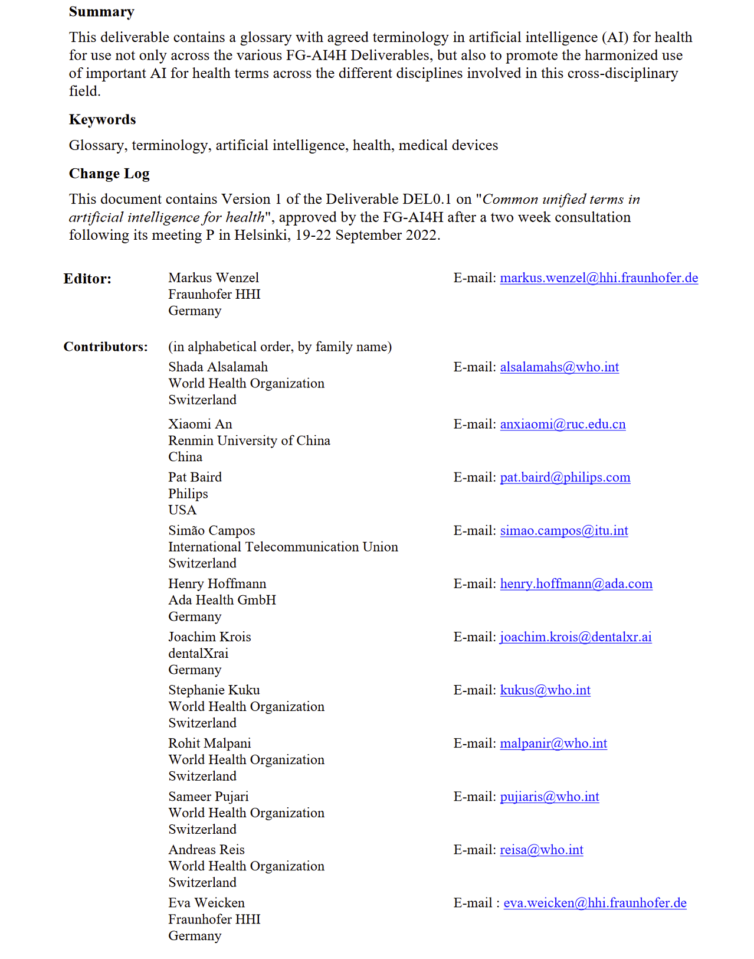
DEL0.1: Common unified terms in AI for health
Glossary
Terms and definitions
From renowned sources (journals, standards)
https://www.itu.int/en/ITU-T/focusgroups/ai4h/Documents/del/DEL0_1-A20220922-(Prepub).pdf

Slide 13
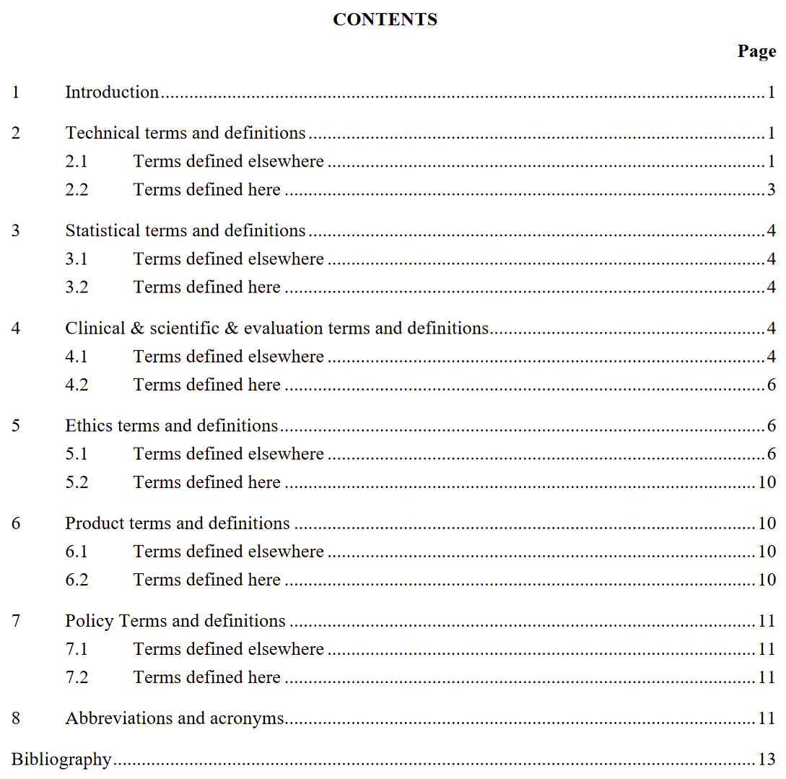
DEL0.1: Common unified terms in AI for health
Glossary
Terms and definitions
From renowned sources (journals, standards)
https://www.itu.int/en/ITU-T/focusgroups/ai4h/Documents/del/DEL0_1-A20220922-(Prepub).pdf

Slide 14
DEL0.1: Common unified terms in AI for health
Glossary
Terms and definitions
From renowned sources (journals, standards)
https://www.itu.int/en/ITU-T/focusgroups/ai4h/Documents/del/DEL0_1-A20220922-(Prepub).pdf

Slide 15
itu.int/go/fgai4h
markus.wenzel@hhi.fraunhofer.de

