Slide 1
FGAI4H-R-040-A06
Cambridge, 21-24 March 2023
Source: | Charité Universitätsmedizin Berlin
Title: | Att.6 – Presentation - Overcoming Current Challenges in Dental Deep Learning
Contact: | Martha Büttner | E-mail: martha.buettner@charite.de
Abstract: | This PPT contains a presentation on overcoming current challenges in dental deep learning given in the AI for Dentistry Symposium on 21 March 2023.

Slide 2
Overcoming Current Challenges in Dental Deep Learning Martha Büttner | 21.03.2023 | Dental Symposium WHO & ITU FG AI4H
Oral Diagnostics, Digital Dentistry and Health Services Research

Slide 3
Agenda - Challenges
Data sharing
Annotation bottle neck
Missing comparability

Slide 4
Data Sharing
1

Slide 5
Challenge
International Data Sharing
AI requires big amount of data
Medical data is high sensitive
Especially dental image data difficult to de-identify
Data protection barriers are high
Generalizabilty of deep learning models of high importance
AI model performance differ when exposed to data from different centers
Leeds to bias and unfair medical diagnostic

Slide 6
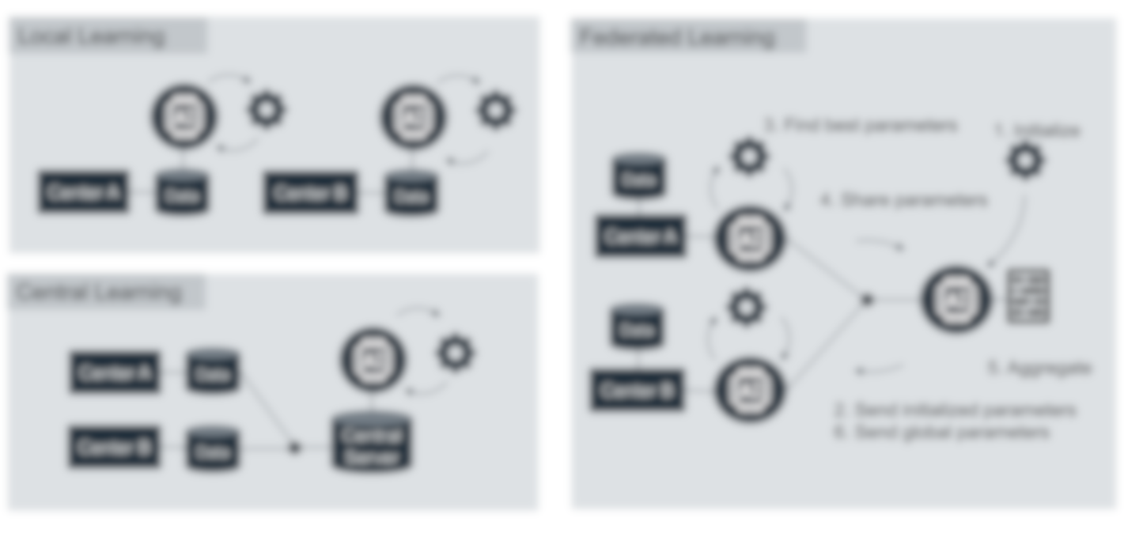
Proposed Solution
Federated Learning
model on cross-center data without sharing

Slide 7
Project
Federated Learning for Tooth Segmentation
Simulation of FL on data from 9 different centers
Tooth segmentation on panoramic images (n=143 to n=1,881 per center)
Compared against local learning
8 out of 9 centers: FL outperformed local learning
FL outperformed local learning across all centers in generalizability

Slide 8
Annotation Bottle Neck
2

Slide 9
Challenge
Medical Annotation
Most medical AI solution trained in a supervised manner
High amount of labeled data required
Expert needed for annotation
Time consuming
Cost intensive

Slide 10
Proposed Solution
Semi Supervised Learning
First Model trained on small amount of labeled data
Teacher model
Prediction on unlabeled data
Prediction used to train a new model
Student model
Fine tuning on labeled data
Student model becomes a teacher model

Slide 11
Project
Semi supervised caries segmentation
Application of semi-supervised learning to two diffrent problems and data types
Angle classification on intraoral photographs
Segmentation of caries lesions on bitewing radiographs
Model benefited from semi supervised approach
Student model outperformed teacher models significantly (evaluated metrics: Dice, IoU, Sensitivity, PPV)

Slide 12
Missing Comparability
3

Slide 13
Challenge
Missing Comparability
Inconsistent reporting
Systematic review identified high amount of different metrics
Difficult to perform meta analysis

Slide 14
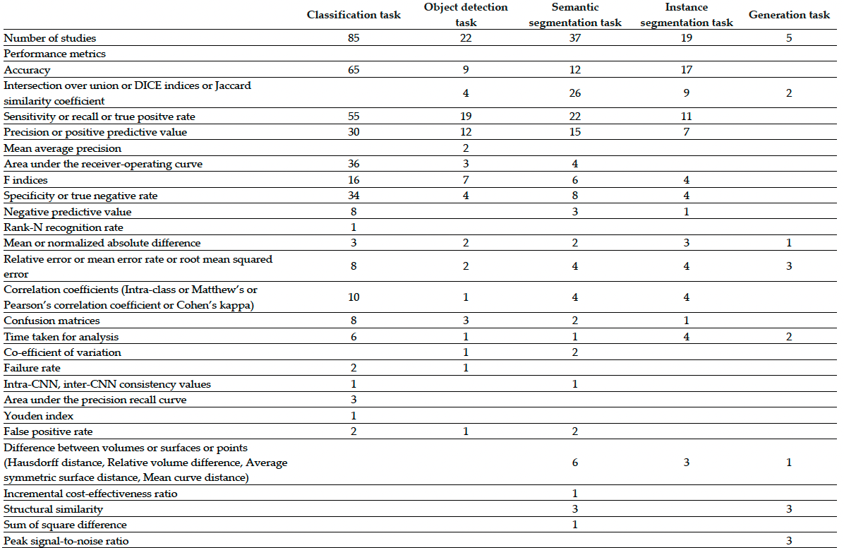
Challenge
Inconsistent reporting
Systematic review identified immensive amount of diffrent metrics
Difficult to perform meta analysis
Current reporting guidelines do not focus on metircs
Metrics need technical knowledge to interpret
Medical devices need evaluation on clinical metrics based on confusion matrix

Slide 15
Challenge
Missing Comparability
Inconsistent reporting
Systematic review identified high amount of different metrics
Difficult to perform meta analysis
Current reporting guidelines do not focus on metrics
Metrics need technical knowledge to interpret
Medical devices need evaluation on clinical metrics based on confusion matrix

Slide 16
Outlook
Core Outcome Development
Development of reporting guidelines for dental computer vision
Combining clinical and technical perspective
Translation to clinical interpretable metrics
Consensus for reporting requirement
Manuals for generating clinical relevant metrics

Slide 17
Thank you for your attention! Martha Büttner | martha.buettner@charite.de
Oral Diagnostics, Digital Dentistry and Health Services Research

