Slide 1
FGAI4H-R-040-A04
Cambridge, 21-24 March 2023
Source: | Charité Universitätsmedizin Berlin
Title: | Att.4 – Presentation - Gaze pattern analysis and Artificial Intelligence in dentistry
Contact: | Lubaina Arsiwala-Scheppach | E-mail: lubaina.arsiwala@charite.de
Abstract: | This PPT contains a presentation on gaze pattern analysis and Artificial Intelligence in dentistry given in the AI for Dentistry Symposium on 21 March 2023.

Slide 2
Gaze pattern analysis and Artificial Intelligence in dentistry Dr. Lubaina Arsiwala-Scheppach | 21 March 2023 | Boston, USA

Slide 3
DISCLOSURE OF CONFLICT OF INTEREST
Falk Schwendicke and Joachim Krois are co-founders of an AI start-up called dentalXr.ai

Slide 4
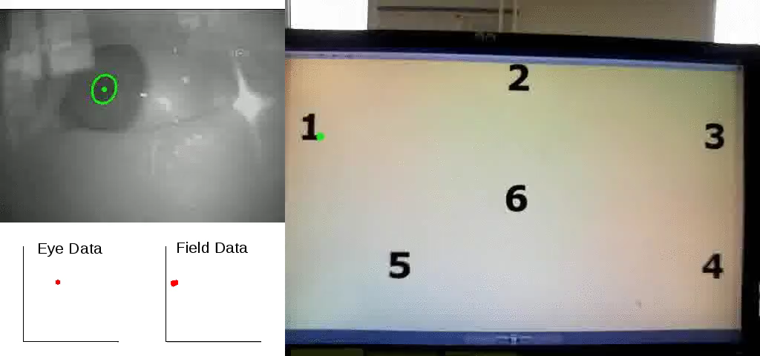
WHAT IS EYE TRACKING ?
Notes:
Eye tracking is the process of measuring either the point of gaze, where one is looking, or the motion of an eye relative to the head.

Slide 5
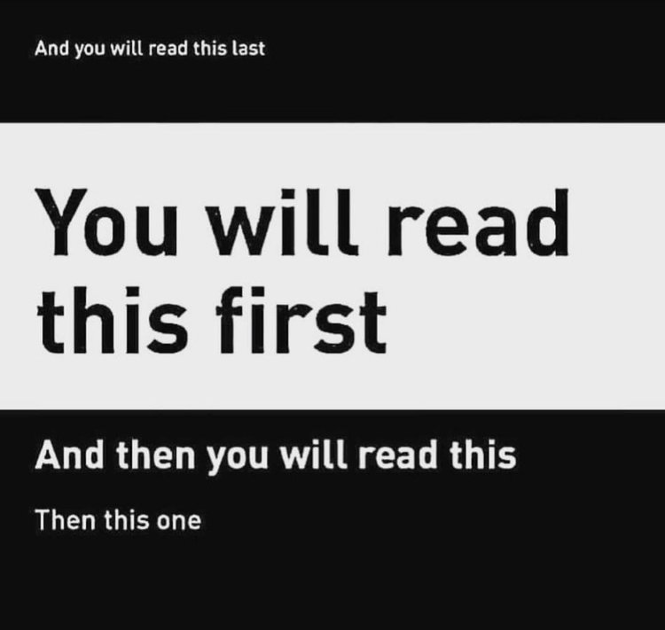
WHY EYE TRACKING?

Slide 6
WHY EYE TRACKING?
Academic: researchers use information about eye movements to assess attention, compare group behavior, measure visual responses, and more.
Industry: Leading consumer brands use eye tracking to better understand customer experience and product performance by measuring visual attention to key messages in advertisements, placement and branding, package design, and more.

Slide 7
EXISTING EVIDENCE?
Efficient and thorough inspection of medical images leads to faster feature recognition and better clinical reasoning.
Professionals employ both a heightened focus to certain features and prior knowledge, leading to a context-dependent gaze behavior.
Much of the previous literature has focused on the comparison between experts and novices, confirming that experts are usually faster, but nevertheless more accurate.
Moreover, image content has been shown to have a significant impact on expert eye movements
Different gaze patterns for different types of images.

Slide 8
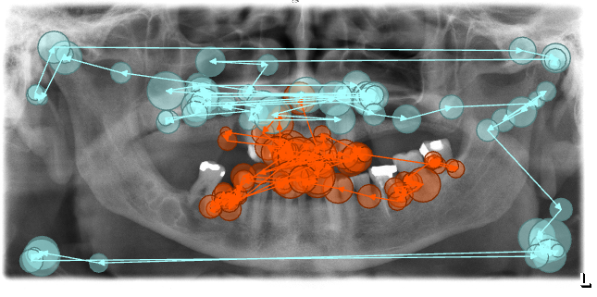
TERMINOLOGY
Scan Path
The path followed by your eyes when viewing a field for a given task.
Gaze Pattern
The characteristic feature of your scan path.
Compare and classify gaze
patterns for behavior recognition.

Slide 9
TERMINOLOGY
Fixations
Area that you focus or linger on.
Saccades
The transitions between areas of focus.

Slide 10
EQUIPMENT
Eye tracker
Screen-based devices require respondents to sit in front of a monitor. These devices track the eyes within certain limits.
Eye tracking software
It turns the stream of data that comes from the eye tracker into interpretable insights and visualizations.

Slide 11
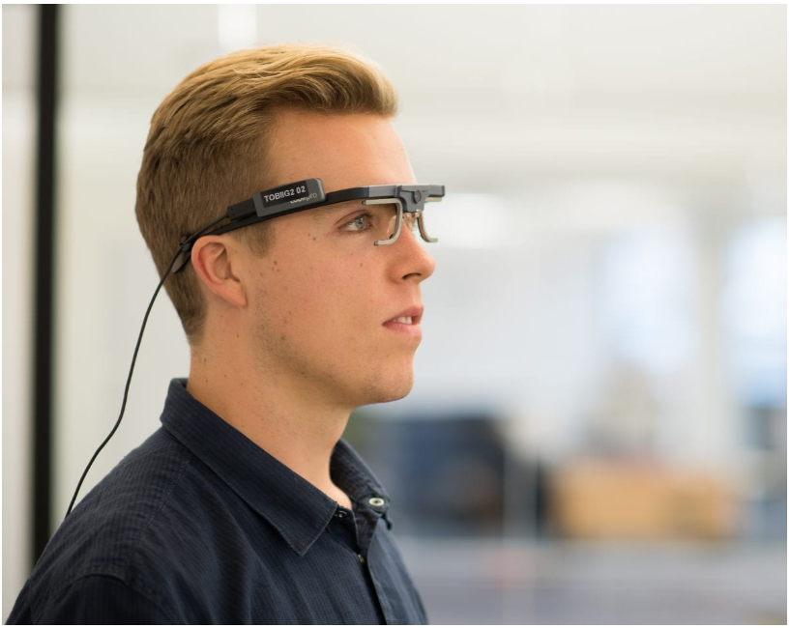
EQUIPMENT
Glasses-based device

Slide 12
HOW DOES EYE TRACKING WORK?
Light from infrared cameras is directed toward the participant’s pupils, causing reflections in the eye. These reflections can provide information about the movement and direction of the eyes.
Then the eye tracking software turns this data into gaze patterns which give researchers the insights they are looking for.
Notes:
as infrared light is not visible to humans it doesn’t cause any distraction while the eyes are being tracked.

Slide 13
USE OF AI IN EYE TRACKING
Pupil detection: In real-world scenarios, automated pupil detection faces various challenges, such as illumination changes, reflections (on glasses), make-up, and physiological eye characteristics.
1
Gaze pattern analysis i.e., use of convolutional neural networks to detect fixations, saccades, and other eye movement types.
2
13

Slide 14
An example of our study
Participants: 22 dentists
Images: 140 bitewing radiographs
Task: Diagnose primary caries in bitewing radiographs of the permanent dentition
Healthy teeth, teeth with caries, teeth with restorations (fillings)
During this task, the dentists’ eye movements were tracked.
Our aim was to characterize their gaze patterns.

Slide 15
RESULTS
1
2
3
Time to 1st fixation
Fixation count
Fixation duration
15

Slide 16
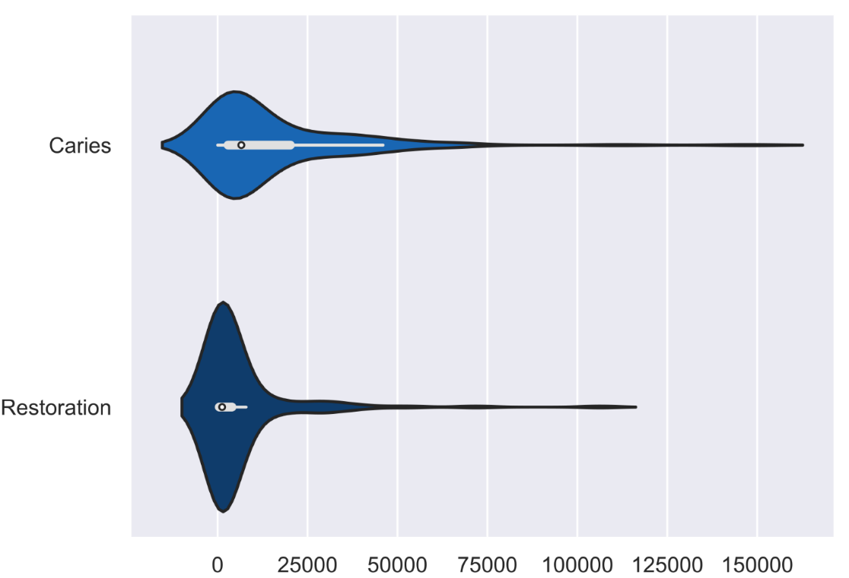
RESULTS
Time to First Fixation, milliseconds
P <0.001
16

Slide 17
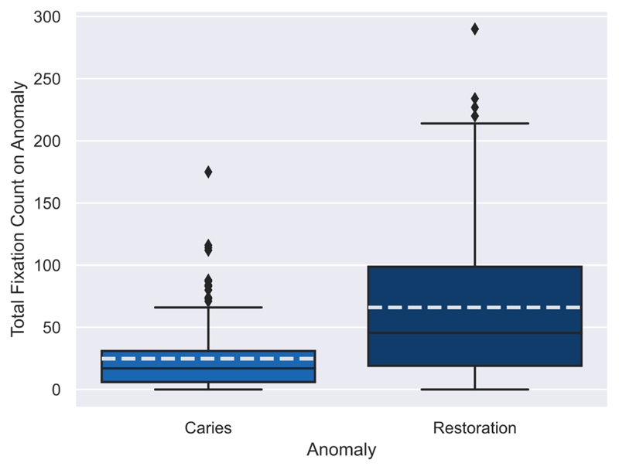
RESULTS
Fixation Count
P <0.001
17

Slide 18
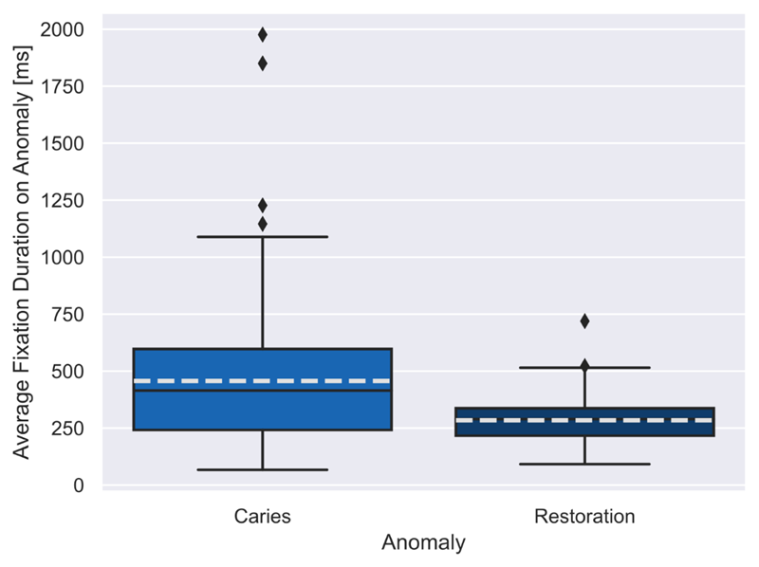
RESULTS
Average Fixation Duration, milliseconds
P = 0.002
18

Slide 19
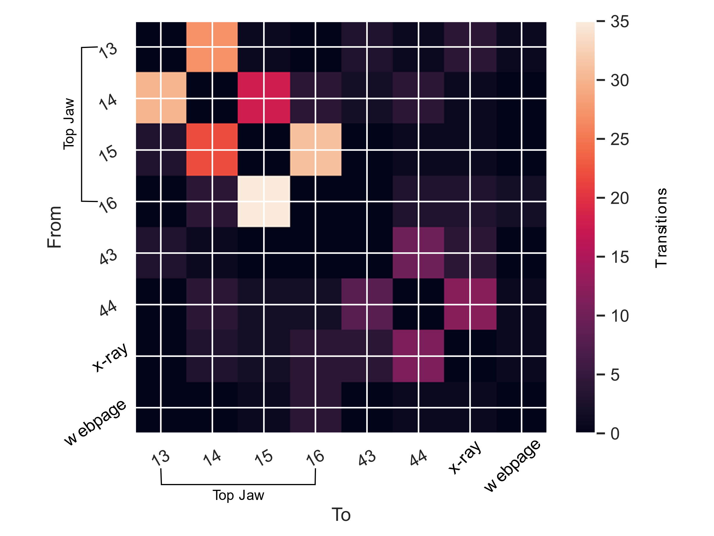
RESULTS
Gaze transitions
19
Notes:
To further investigate the procedural aspect of dental experts’ gaze, we looked at the transition behavior of the scan paths. We looked at how often the gaze transitions to a neighboring tooth (e.g., tooth 24 to tooth 25) v/s a not so neighboring tooth (e.g., tooth 27 to tooth 34). When there are a high number of transitions to the next nearest tooth, this gaze strategy can be indicative of systematic search thoroughly moving in a semi-linear fashion between the teeth. Showed a systematic search pattern.

Slide 20
Applications of eye tracking
Automated expertise recognition
To create more seamless user-AI interactions
Augmented or virtual reality
Psychology
Knowing when and how people look is essential for understanding how attention is
distributed. Eye tracking is widely used within psychological tests.
Healthcare
Studies have used eye tracking in diagnosing autism, as well as other neurological disorders.
Future uses may employ eye tracking in providing optimal patient care in medical settings.
20

Slide 21
Applications of eye tracking
Neuro-marketing
Following gaze patterns while people shop has been a growing topic within neuro-marketing for
many years. Being able to see what people attend to or ignore can be crucial for implementing
optimal packaging design, store layout, and point-of-sale displays.
It is also valuable to study the gaze patterns of website visitors.
How long does it take them to find a specific product on the site?
Which kind of visual information do they ignore (but are supposed to respond to)?
Where do your website visitors look?
What do they look at and how much time do they spend looking at it?
21

Slide 22
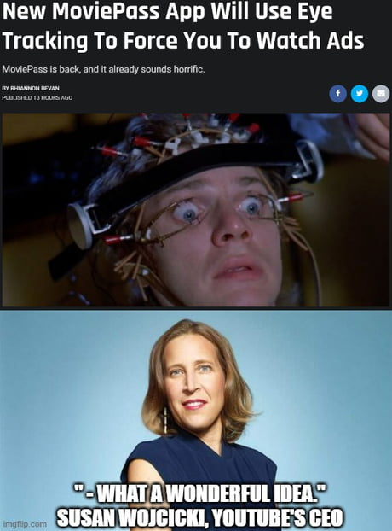
Dr. Lubaina Arsiwala-Scheppach
Email: lubaina.arsiwala@charite.de

Slide 23
SUPPLEMENTARY SLIDES

Slide 24
Quality checks on scan path data
Gaze signal > 0.60
Scrolling behavior: Erroneous data points were excluded
24

Slide 25
EYE TRACKING TOOL
The remote eye tracker used was the SmartEye Aurora running at 60Hz and positioned under a monitor (1920 x 1080px).
Participants were unconstrained and positioned approximately 70cm from the system.
Gaze data was collected the whole duration of the experiment.
Gaze data was then pre-processed using the iMotions software (version 8.2.22899.4).
Event detection was the iMotions implementation of the I-VT algorithm, with a minimum fixation duration of 60ms and a velocity threshold of 30deg/s.
The current analysis used the fixations reported from the software, which are interpolated between the left and the right eye.
We interpret fixations as the areas of attentional focus related to the stimuli presented on the screen.
25

