Slide 1
FGAI4H-R-040-A02
Cambridge, 21-24 March 2023
Source: | Johannes Tanne Consulting
Title: | Att.2 - Presentation - Data sharing for AI in Dentistry
Contact: | Johannes Tanne | E-mail: tannejohannes@gmail.com
Abstract: | This PPT contains a presentation on data sharing for AI in Dentistry given in the AI for Dentistry Symposium on 21 March 2023.

Slide 2
Data sharing for AI in Dentistry
Dr. Johannes Tanne
Contact:
Dr. Johannes Tanne
Quality & Regulatory Affairs Management
tannejohannes@gmail.com
Johannes Tanne Consulting - AI4H 2023

Slide 3
Introduction to Data Sharing
Benchmark Data Sets TG-Dental:
Large dental data sets necessary for augmented software (AI software) to assist dentists in diagnosis and treatment
Background: Benefits and challenges of sharing dental images (for AI), roles & responsibilities (data owner, controller/processor)
Ethical and privacy concerns to be addressed
Conclusion and ToDos
Johannes Tanne Consulting - AI4H 2023

Slide 4
Benefits of data sharing
Improvement of model quality
More accurate and robust models
Improving time saving and patient communication
→ DEL2.2 TG-Regulatory
“Good practices for health applications of machine learning: Considerations for manufacturers and regulators”
Johannes Tanne Consulting - AI4H 2023

Slide 5
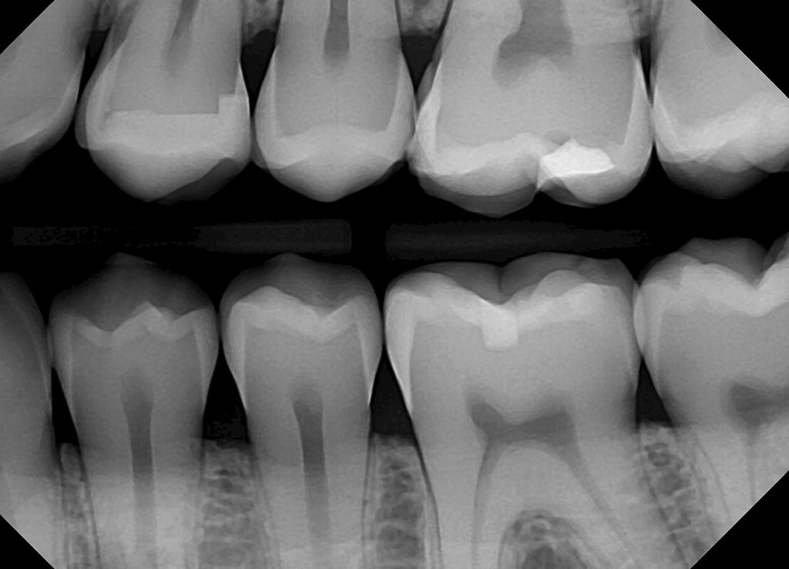
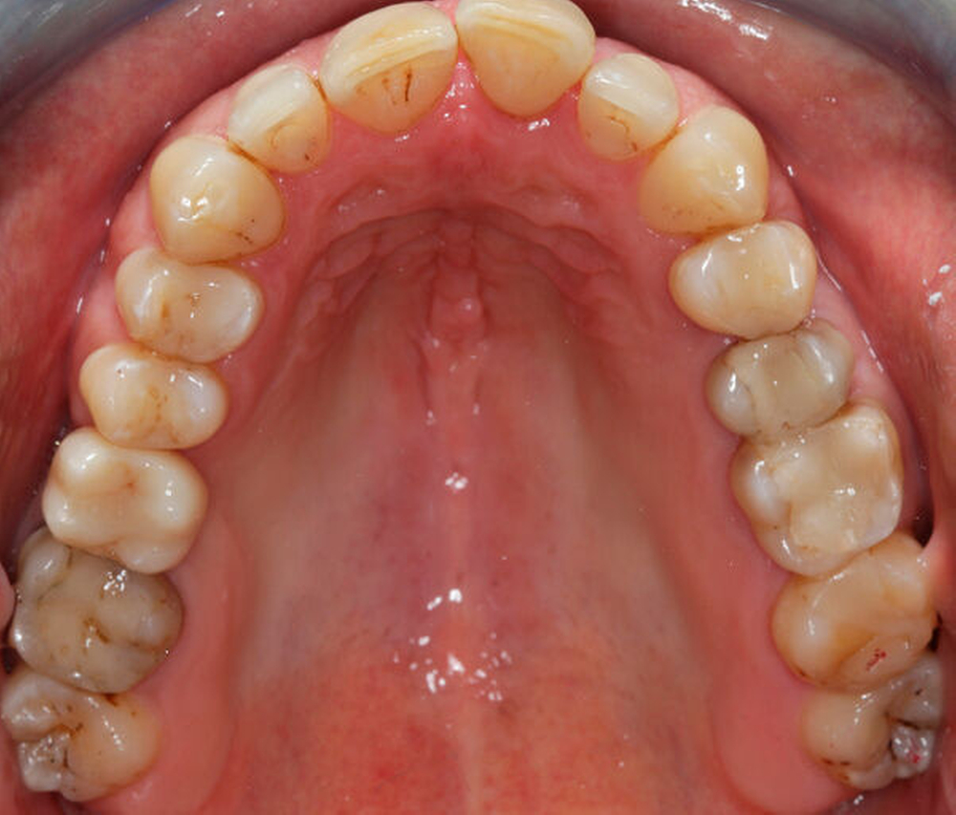
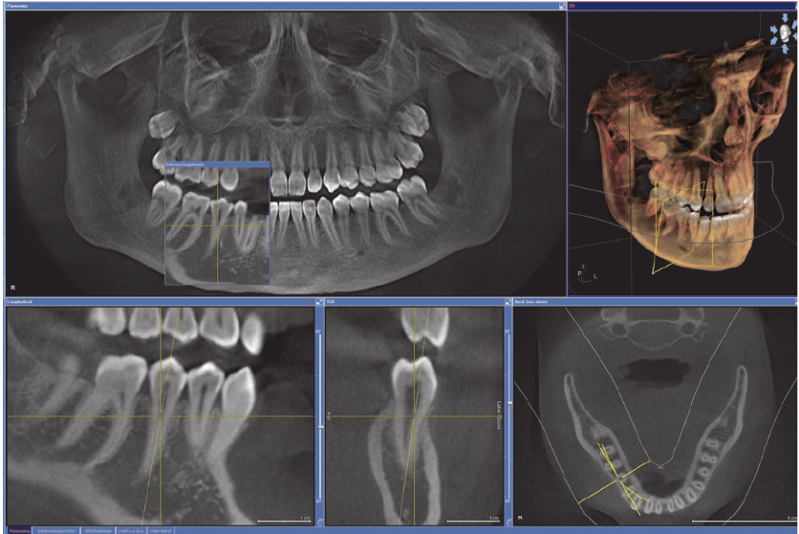
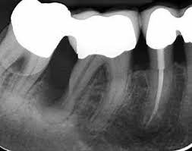
Overview of dental images
Visualization teeth, jaw, surrounding structures
X-rays, intraoral photo, CBCT, MRI
diff. settings & modalities (X-Ray: BW, PERI, PAN etc.)
Detecting pathological and non-pathological structures, anatomic features, evaluating the alignment of teeth etc.
https://dentistry.com/topics/bitewing-x-rays/
https://www.zm-online.de
https://www.zmk-aktuell.de
Grundlagen der DVT Technologie; January 2007; Quintessenz
Johannes Tanne Consulting - AI4H 2023

Slide 6
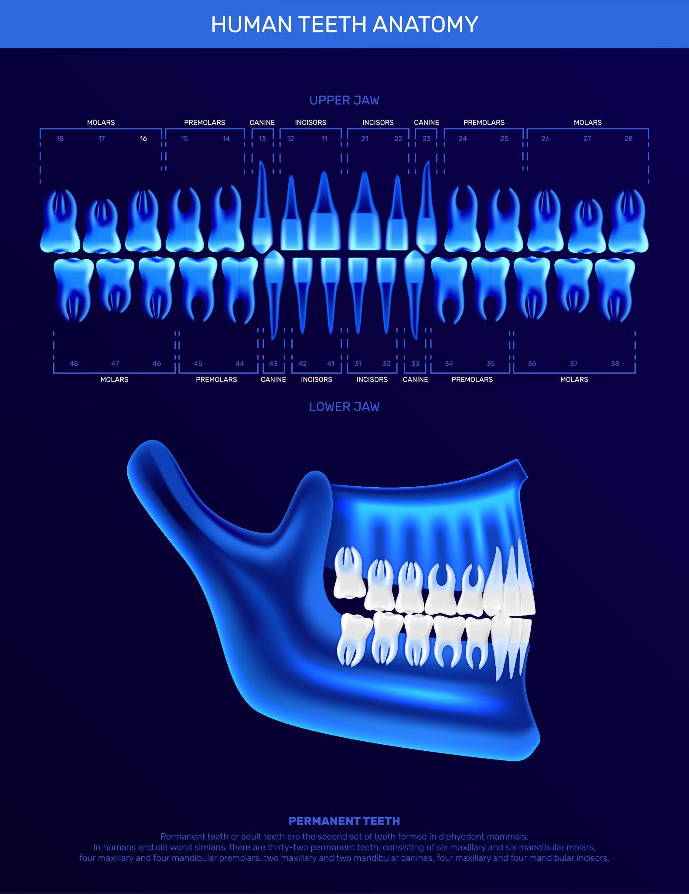
Workflow for data sharing
Collection and preprocessing of dental imaging data
Appropriate consent from patients & de-identification (patient privacy)
Data transferred to a secure data sharing platform/ network, available ML
Collaboration: appropriate processing, use and monitoring ethical and legal requirements
TG-Dental
Storage and processing
Data collection
Johannes Tanne Consulting - AI4H 2023

Slide 7
Data collection
High-quality: essential for accurate and effective AI models
Various imaging techniques (digital X-Ray, CT, intraoral images)
Type of modality used depend on diagnostic condition
Consent from patient
→ Standardized and consistent data collection method: accuracy and comparability across different datasets
Johannes Tanne Consulting - AI4H 2023

Slide 8
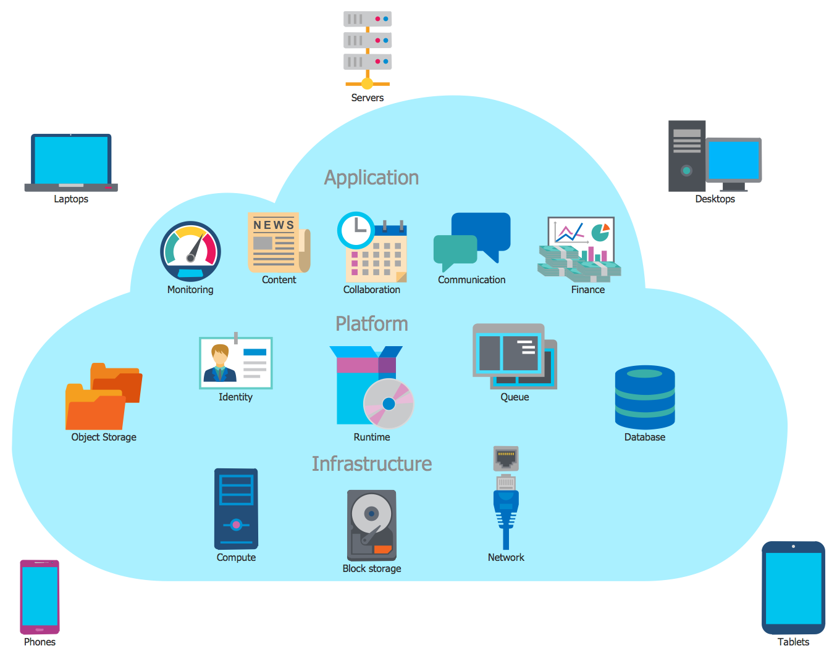
De-identification
Image may include personal information
→ pseudonymization techniques to protect patient privacy
Risk of identification by contextual information or by combining multiple data sources
→ technical and organizational measures
GDPR: informed consent for data sharing and data subjects' rights to access and control their data
Data protection impact assessment: identify risk
Data sharing agreements (data controller & processor): scope, purpose of data sharing, as well as mechanisms for ensuring data security and confidentiality
Balance between the potential benefits of AI technology and the need to protect patient privacy and security
https://www.conceptdraw.com/
https://www.lepide.com/
Johannes Tanne Consulting - AI4H 2023

Slide 9
Storage and Sharing - data owner obligations
Data is stored securely and in compliance with relevant data protection regulations (GDPR, HIPAA)
Encryption and access controls to prevent unauthorized access or theft
Origin of data and storage under consideration of transatlantic agreements
Policies and procedures (authorized parties and specific purposes)
Sharing in a standardized and interoperable format
Balance the needs of patient privacy
Johannes Tanne Consulting - AI4H 2023

Slide 10
Challenges of data sharing
Range of technical, legal, and ethical issues
How to handle retrospectively
Technical challenges: data standardization, data quality, and data security
Legal challenges: data ownership, intellectual property rights and privacy regulations
Ethical challenges: informed consent, transparency
Johannes Tanne Consulting - AI4H 2023

Slide 11
Conclusion
Data sharing important for built up benchmark data set but challenges include data privacy, security, and ethical considerations
Agreements for sharing patient data: define data processor, controller; define data owner (ITU first commitment, requirements to be clarified)
Use secure data sharing platforms: Standard Contractual Clauses for cloud providers
Comply with national/international data protection regulations and standards
ToDos
Data protection impact assessment: Consider the potential risks and benefits of data sharing
Data sharing agreement (WIP)
Contact:
Dr. Johannes Tanne
Quality & Regulatory Affairs Management
tannejohannes@gmail.com

