Slide 1
FGAI4H-R-039-A08
Cambridge, 21-24 March 2023
Source: | Harvard University
Title: | Att.8 - Presentation - (Differential) Privacy in Medical Settings
Contact: | Cynthia Dwork | E-mail: dwork@seas.harvard.edu
Abstract: | This PPT contains a presentation on Differential Privacy in Medical Settings given in the workshop on 21 March 2023.

Slide 2
(Differential) Privacy in Medical Settings
Cynthia Dwork
Harvard University
Notes:
I’m here to say a few words about the elusive nature of privacy and differential privacy, a definition of privacy tailored to the statistical analysis of large data sets.

Slide 3
Statistics
TexPoint fonts used in EMF.
Read the TexPoint manual before you delete this box.: AAAAAAAA
Notes:
Let’s talk about statistics.

Slide 4
Statistics “Feel” Private
A quantity computed from a sample, tells us about the population as a whole
Two datasets, collected independently from same population and with correct methodology, should tell us essentially the same things
Sense of privacy derived from this fact
  “No one knows I am in the sample … I can claim I opted out”
  “It’s not about *me*”
On the right track but needs help.
Differential Privacy provides this help.
Notes:
This is why the field of statistics works!

Slide 5
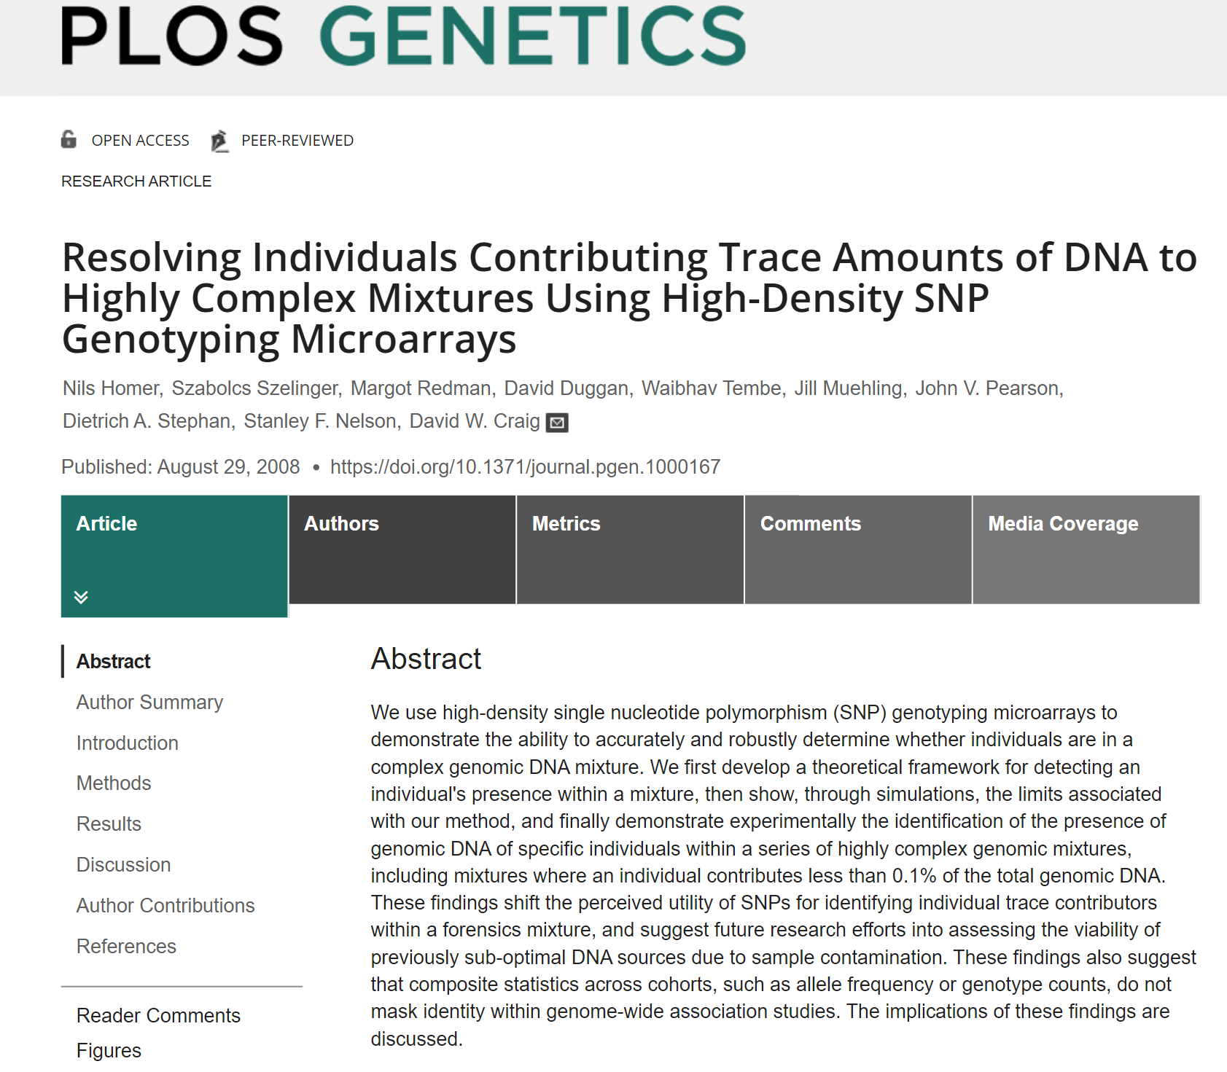
Notes:
We all know that genomic privacy is dead – it’s very easy to capture my dna from a discarded cup of coffee (I saw it on Law and Order)..
Many of you have probably heard about the 2008 work of Homer et al., which showed how to compromise the privacy of individuals in a medical study based only on (1) statistics about the Minor allele frequencies about the case group and comparable statistics for a control; together with (2) the genomic information from an individual.

Slide 6
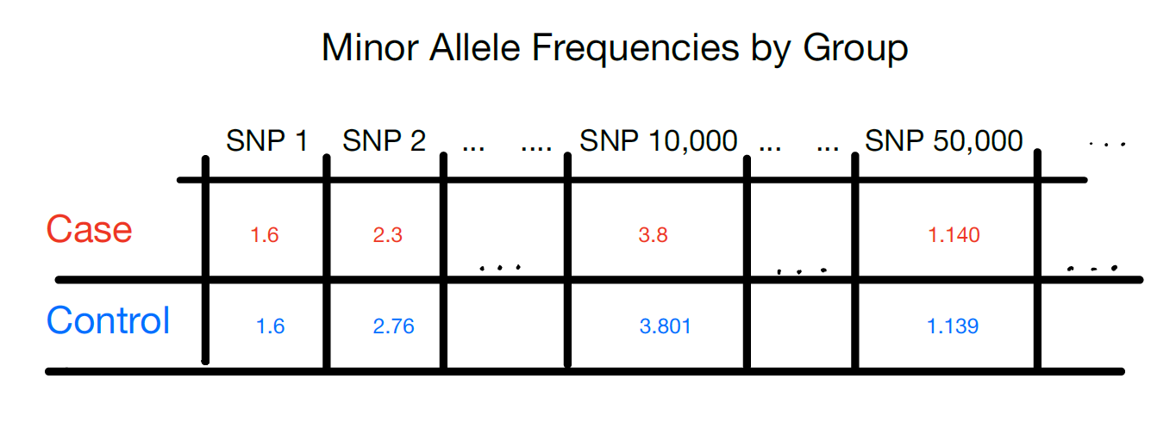
Notes:
For example, we may have data of the following type for individuals diagnosed with an illness in the Case group, and healthy individuals in the control group. In case you thought the attack was theoretical, it’s quite practical, as the next slide will show

Slide 7
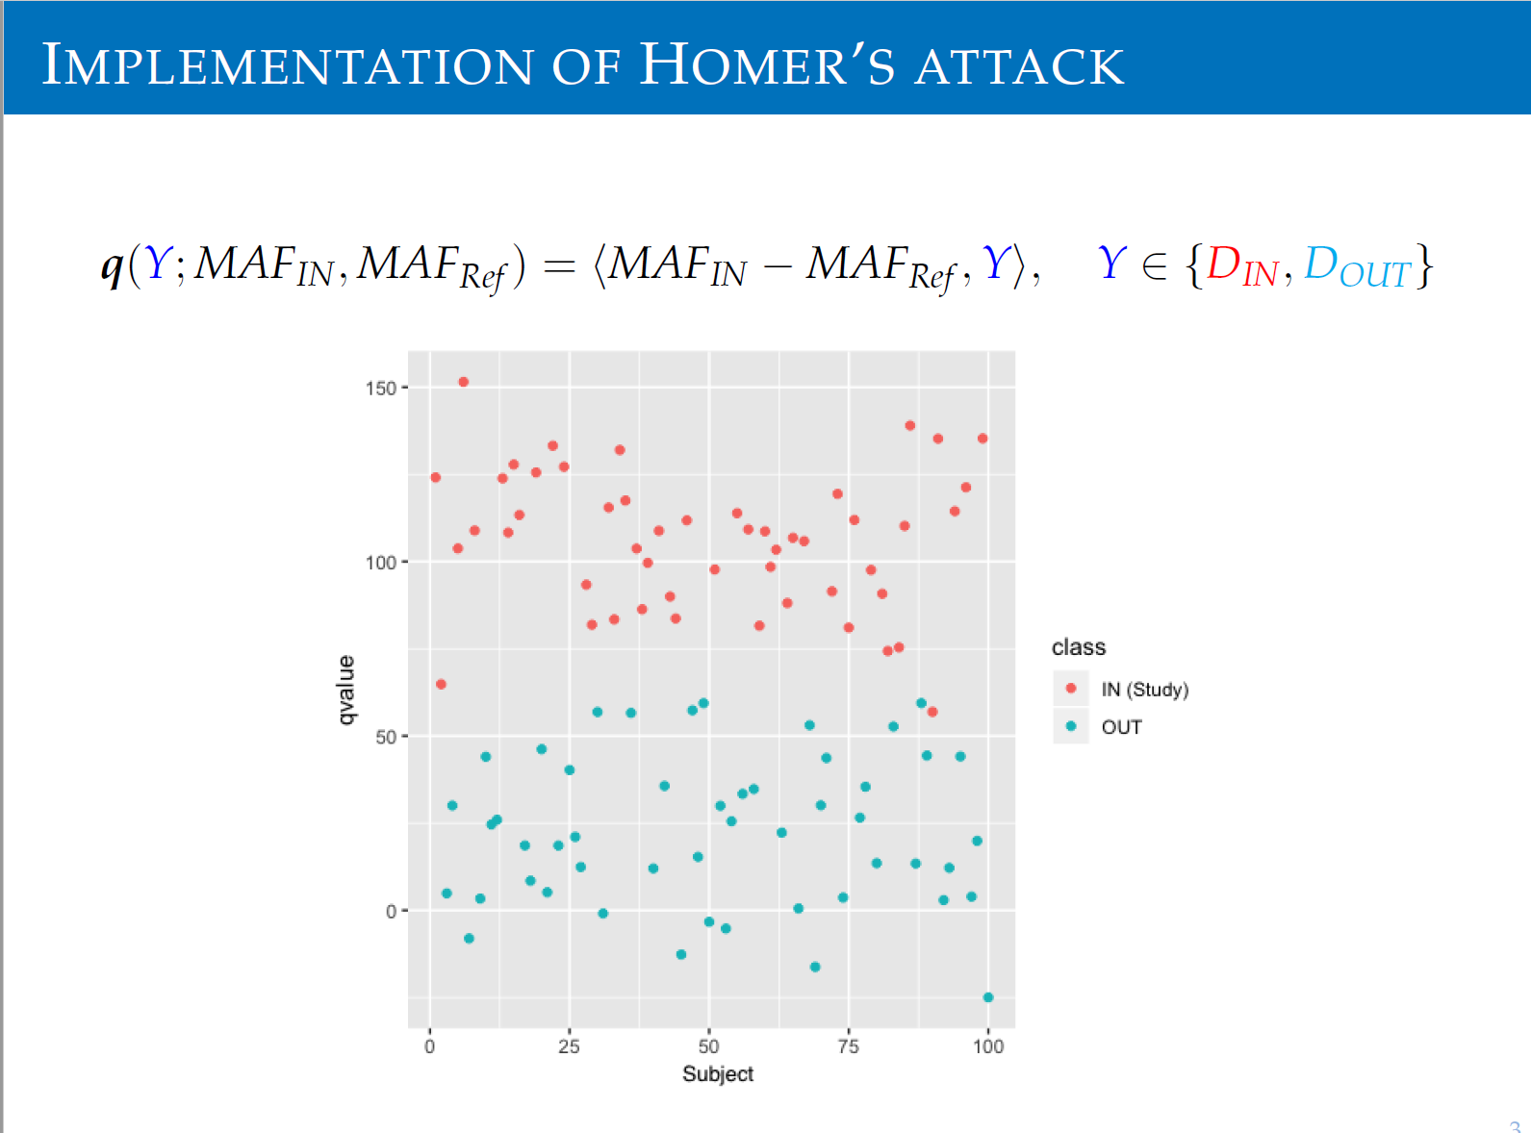
Source: Linjun Zhang

Slide 8
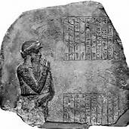
Fundamental Law of Info Recovery
“Overly accurate” estimates of “too many” statistics is blatantly non-private
Analogy: cumulative effects of radiation
Notes:
In fact, the attack is resilient to quite a bit of noise that may be introduced to the statistics in the hope of providing privacy. In general, the FL of IR tells us that…
The phenomenon is analogous to exposure to small doses of radiation. Every statistic reveals a little statistical hint about the dataset, and just as small doses of radiation accumulate to cancer-casing cumulative effects, these hints can accumulate to devastating privacy losses.

Slide 9
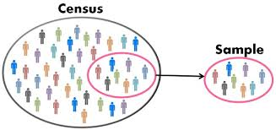
“Statistical” Privacy for All Computations
Differential privacy preserves “I could have opted out” privacy for every computation, including total population counts
Image credit: Keydifferences.com
Notes:
What can we do about this?

Slide 10
The Definition of Differential Privacy
Motivation and Meaning
TexPoint fonts used in EMF.
Read the TexPoint manual before you delete this box.: AAAAAAAA

Slide 11
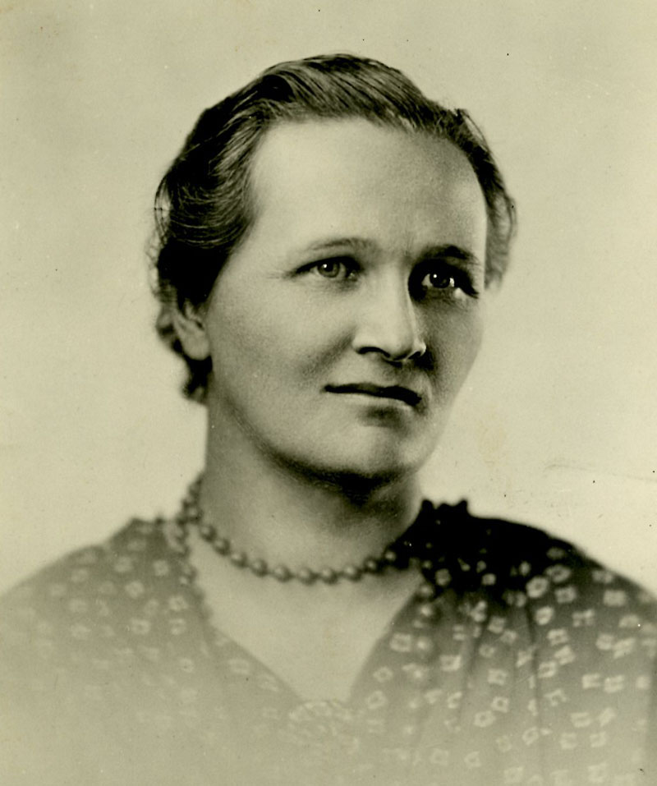
Privacy-Preserving Data Analysis?
q₁
a₁
M
q₂
a₂
q₃
a₃
Database
data analyst
Notes:
Cecilia Helena Payne-Gaposchkin (May 10, 1900 – December 7, 1979) among first women to obtain PhD in astronomy AND first PERSON to obtain one at Harvard; ascertained the temperatures of the different classes of stars and estimated the great abundance of hydrogen in them (much more than earth) while doing the research for her dissertation, contradicting the belief at the time that the sun and the earth had similar composition.
Definitions are essential. Without them we literally do not know what we are talking about. What do we mean by privacy-preserving data analysis? What kind of protection should we offer to Cecilia Payne?

Slide 12
Privacy-Preserving Data Analysis?
“Can’t learn anything new about Payne”?
Dalenius, 1977
q₁
a₁
M
q₂
a₂
q₃
a₃
Database
data analyst
Notes:
A natural candidate, certainly the one that I first tried, was articulated by Tore Dalenius in 1977. It says that the data analyst can’t learn anything “new” about Payne. Payne may be an extrovert and publish all sorts of things about herself on the web, that’s fine, and we don’t punish the statistical database for revealing this, but the analyst shouldn’t be able to glean any new particulars about Payne.

Slide 13
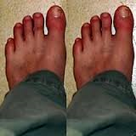
Privacy-Preserving Data Analysis?
“Can’t learn anything new about Payne”?
Then what is the point?
q₁
a₁
M
q₂
a₂
q₃
a₃
Database
data analyst

Slide 14

Privacy-Preserving Data Analysis?
“Can’t learn anything new about Payne”?
Then what is the point?
q₁
a₁
M
q₂
a₂
q₃
a₃
Database
data analyst
Notes:
Has Payne’s privacy been compromised?

Slide 15
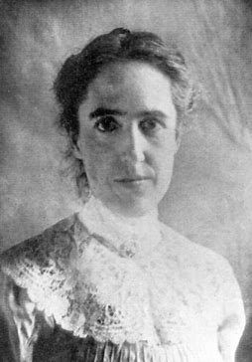
Privacy-Preserving Data Analysis?
Ideally: learn same things if Payne is replaced by another random member of the population
q₁
a₁
M
q₂
a₂
q₃
a₃
Database
data analyst
Notes:
I would have learned the same thing if Payne had been replaced by another random member of the population.
Henrietta Swan Leavitt (1868-1921) first to note a relation between certain variable stars’ peak brightness and the period over which their brightness varied, which proved a valuable means for measuring distances across space

Slide 16
Differential Privacy
The outcome of any analysis is essentially equally likely*, independent of whether any individual joins, or refrains from joining, the dataset.
*likelihood: over random choices made by the algorithm

Slide 17
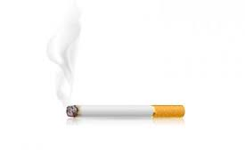

Teachings vs Participation
q₁
a₁
M
q₂
a₂
q₃
a₃
Database
data analyst
Notes:
DP separates what is learned about Payne from the teachings of the database as a whole from what is learned about Payne as a result of participation
Knowledge can cause harm; DP separates the harms from the teachings from the harms due to participation
Suppose the db teaches us that smoking causes cancer….. Smoker S is harmed: her insurance premiums might rise.
[[click]]Smoker S’s p[remiums wold rise even if she were not in the database.
And smoking causes cancer is the kind of things we want to learn.
Smoker S might enroll in a smoking cessation program.

Slide 18
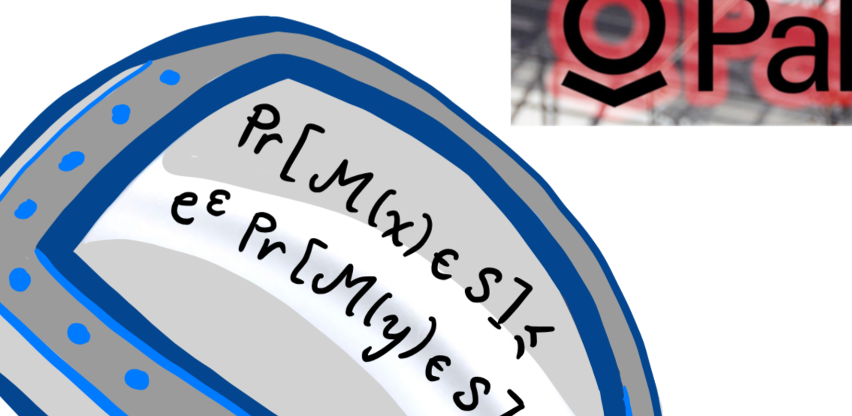
Harvard Kennedy School
March 21, 2023
Thank You!
TexPoint fonts used in EMF.
Read the TexPoint manual before you delete this box.: AAAAAAAA
Notes:
Fundamental objects

Slide 19
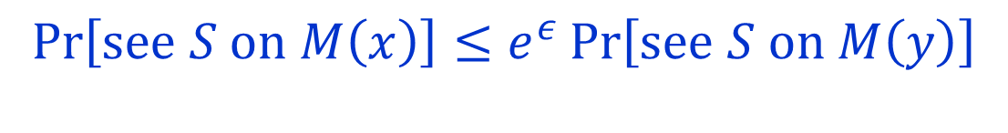
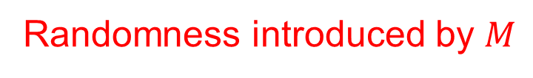

Differential Privacy
$M$ gives $ε$-differential privacy if for all pairs of adjacent data sets $x,y$, and all output events $S$
$$\operatorname{Pr}\left[see S on M\left(x\right)\right]≤e^{ε}\operatorname{Pr}\left[see S on M\left(y\right)\right]$$
“Privacy Loss” bound
Randomness introduced by $M$
DworkMcSherryNissimSmith 2006
Notes:
Differential privacy bounds the ratio of the probabilities of any event on any pair of neighboring databases.

Slide 20
Key Properties
Future-Proof
  Resilient to present/future information from other sources
Composes Gracefully and Automatically
  Understand cumulative privacy loss over multiple comps At worst, the losses add up.
Differential privacy is programmable
q₁
a₁
M
q₂
a₂
q₃
a₃
Database
data analyst

