Slide 1
FGAI4H-R-039-A07
Cambridge, 21-24 March 2023
Source: | HHI.fraunhofer
Title: | Att.7 - Presentation - Challenges of development & deployment of AI in clinical settings
Contact: | Eva Weicken | E-mail: eva.weicken@hhi.fraunhofer.de
Abstract: | This PPT contains a presentation on Challenges of development & deployment of AI in clinical settings given in the workshop on 21 March 2023.

Slide 2
ITU/WHO FG-AI4H Working Group Clinical Evaluation
—
Workshop „Challenges of development & deployment of AI
in clinical settings“
21 March 2023, MIT Kresge Auditorium, Cambridge, US

Slide 3
ITU/WHO FG-AI4H Working Group Clinical Evaluation
—
Evolution & Milestones

Slide 4
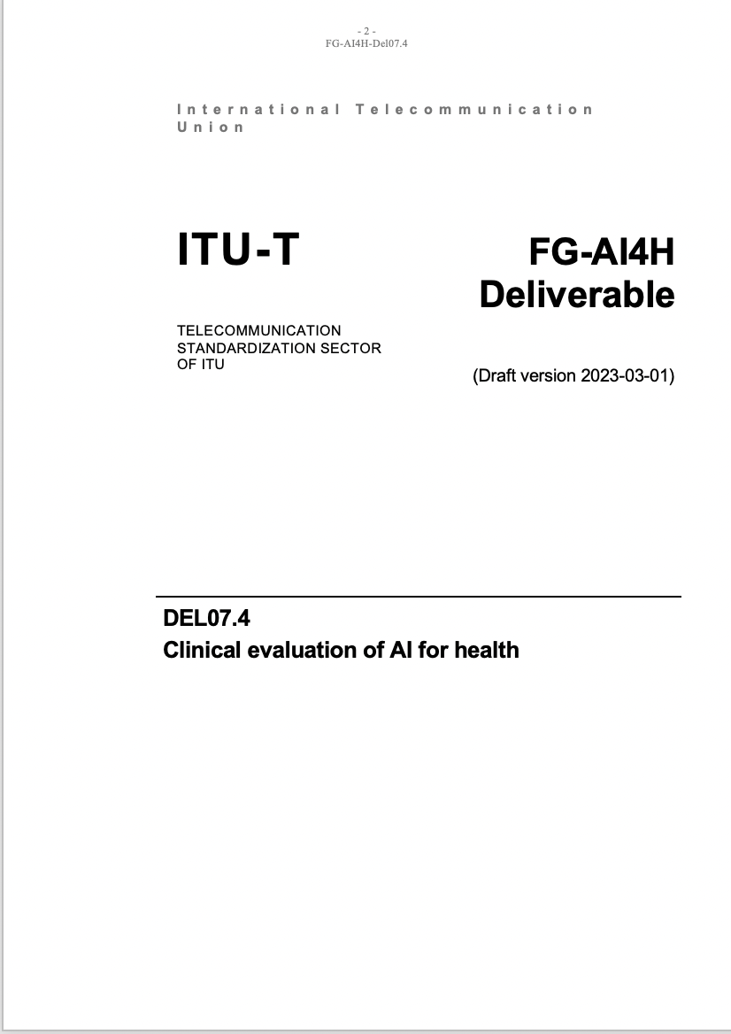
Purpose
What‘s it all about?
Framework on clinical evaluation
—
Design & Purpose – Algorithmic validation - Clinical validation – Ongoing monitoring – Ethics – Economic evaluation
Main goals
Collaboration with other expert groups & global stakeholders
Best practice evaluation and principles
Special consideration LMIC settings
Framework for: clinicians, researchers, developers, regulators, policy makers & patients, public
Define gaps for future research
To be used with other FG-AI4H guidance

Slide 5
Collaboration
Group members
External expert group (in alphabetical order): AbouElkhir Osama (Tachy Health, Dubai), Akogo Darlington (minoHealth AI Labs, Ghana), Allen Megan (Inspired Ideas, Tanzania), Alsalamah Shada (WHO, Switzerland), Arentz, Matthew (FIND, Switzerland), Baird Pat (Philips, USA), Balachandran Pradeep (Freelancer E-Health, India), Bastawrous Andrew (Peek Vision, Global Eye Health, UK), Bathke Arne (University of Salzburg, Austria), Chiavegatto Filho Alexandre (São Paulo University, Brazil), Cresswell Kathrin (University of Edinburgh, UK), Darkoh Ernest (BroadReach Healthcare, South Africa), Ehrenfeld Jesse (American Medical Association (AMA), USA), Fehr Jana (Hasso-Plattner-Institute, Germany), Fenech Matthew (Una Health, Germany), Fürstenau Daniel (Copenhagen Business School, Denmark), Gaudin Robert (Charitè, Germany), Gilbert Stephen (Technische Universität Dresden, Germany), Glod Mateusz (Infermedica, USA), Greaves Felix (National Institute for Health and Care Excellence (NICE), UK), Gupta Saurabh (Department of Cardiology, All India Institute of Medical Science, India), Gütter Zdenek (University Hospital Olomouc, Czechia), Hatton Grace (Sensyne Health, UK), Ho Dean (National University of Singapore, Singapore), Ibrahim Hussein (Doctors.net.uk, UK), Islam Shariful (Deakin University, AUS), Jarral Reza (Pro Care, NZ), Jeon Jonghong (Electronics and Telecommuncations Research Institute, South Korea), John Oommen (George Institute for Global Health, India), Kadam Rigveda (Head of digital access, FIND, Switzerland), Kherif Ferath (LREN, Switzerland), Kuku Stephanie (WHO, UCL, Switzerland, UK), Kurtys Michal (Infermedica, Poland), Lapão Luís (Velez) (University of Lisbon, Portugal), Linder Nina (University of Helsinki, Finland), Loh Irving (Infermedica, USA), Loveys Kate (University of Auckland, NZ), Magrabi Farah (Macquarie University, Sydney, Australia), Mahajan Arnav (Department of Medicine, University College Cork, Ireland), Malpani Rohit (WHO, Switzerland), Mamun Khondaker (CMED Health, Bangladesh), Masud Jakir Hossain Bhuiyan (CTS, Bangladesh), Matin Rubeta (Oxford University Hospitals NHS Foundation Trust, UK), McCradden Melissa (Sick Kids Hopspital, Canada), Menezes Audrey (Healthily, UK), Murchison Andrew (Oxford University Hospitals NHS Trust, UK), Murphy Lisa (Centre for Improving Data Collaboration at NHSX, UK), Essa Mohamedali (Tanzania AI Lab, Tanzania), Nakasi Rose (Makerere University, Uganda), Oala Luis (Fraunhofer Heinrich Hertz Institute (HHI), Germany), Pankova Natalie (Metadvice, UK), Piekut Agata (Health Action Tank, Poland), Porras Lina (1Doc3, Colombia), Reddy Sandeep (Deakin University, Australia), Salim Ally (Inspired Ideas, Tanzania), Schwendicke Falk (Charitè, Germany), Sethi Tavpritesh (Indraprastha Institute of Information Technology Delhi, India), Sood Harpreet (National Health Service (NHS), UK), Sousa Inês (Fraunhofer Portugal, Portugal), Srivastava Manish (Virginia Polytechnic Institute & State Univ., USA), Starlinger Johannes (Howto Health Digital Business Solutions, Germany), Wasswa William (Global Auto Systems LTD, Uganda), Werneck Leite Alixandro (Tribal, Mexico)
Writing group (in alphabetical order): Carolan Jane (UCL Institute of Health Informatics, UK), Denniston Alastair (University of Birmingham, UK), Karpathakis Kassandra (Decimal.Health, USA), Lee Naomi (National Institute for Health and Care Excellence (NICE), UK), Liu Xiaoxuan (University of Birmingham, UK), Upadhyay Shubhanan (Ada Health, Germany), Weicken Eva (Fraunhofer Heinrich Hertz Institute (HHI), Germany), Wilkinson Thomas (Ministry of Health, NZ)

Slide 6
Timeline
Development of the framework & deliverable
2020
2021
2022
2023
10: Inaugural workshop
12: Meeting
09: WHO clearance
02/03: ITU approval
03: LMIC meeting
04: Review 1 & meeting
09: Review 2
11: Meeting
10: Meeting “future priorities”
10/11: Follow up meetings
Publications (ITU/WHO)

Slide 7
Join WG-CE meeting session tomorrow!
22nd March, 11:15 – 12:45 EST
Update & future direction

Slide 8
Workshop Challenges of development & deployment of AI in clinical settings
Participants
Speakers & Panelists
Zahra Hoodbhoy (The Aga Khan University)
Xiao Liu (University of Birmingham)
Mark Sendak (Duke University & Duke Institute for Health Innovation)
Melissa Mc Cradden (Hospital of Sick Children)
Rose Nakasi (Makerere University, Uganda)
Moderators
Kassandra Karpathakis (Harvard University)
Alastair Denniston (University of Birmingham)

Slide 9
Get involved & Contact
—
eva.weicken@hhi.fraunhofer.de

Slide 10
Thank you for your attention!
—

