Slide 1
FGAI4H-R-039-A06
Cambridge, 21-24 March 2023
Source: | Makerere University
Title: | Att.6 – Presentation - Challenges of development & deployment of digitized malaria detection in Uganda
Contact: | Rose Nakasi | E-mail: g.nakasirose@gmail.com
Abstract: | This PPT contains a presentation on Challenges of development & deployment of AI in clinical settings given in the workshop on 21 March 2023.

Slide 2
Challenges of development & deployment of AI in clinical settings:-My experience Meeting R
Rose Nakasi, PhD
g.nakasirose@gmail.com
Makerere University, Uganda
E-meeting, 21st – 24th March 2023

Slide 3
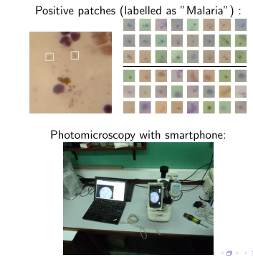
Digital Microscopy of Malaria
Setup

Slide 4
AI Development and deployment challenges
Lack of enough datasets
Data shortages in Africa
Lack of enabling government policies
Lack of a formidable policy on AI implementation strategies in Africa to prioritise the design and deployment of AI
Un developed open discussions on the ethical implications of AI In health
Supports image analysis and has potential to improve the timeliness and accuracy
Attitude of healthcare practioners
Sceptism in adopting and using new technology
Insufficient infrastructure and poor yet expensive network connectivity
Changes in technology
Notes:
Why this Topic Group? Context, WHO/ITU necessity
The Global Problem
The opportunity (and the challenge) | What is Symptom Assessment? How might it help?
The case for benchmarking? Why needed?
How the Topic Group can help, what outcomes might feed into

