Slide 1
FGAI4H-R-038-A01
Cambridge, 21-24 March 2023
Source: | AITRICS (KR)
Title: | Att.1 – Presentation - New TG or subtopic proposal: Artificial Intelligence based Early Warning Score for patient safety
Contact: | Dongyeop Kim AITRICS Republic of Korea | E-mail: dykim@aitrics.com
Abstract: | This PPT contains a presentation of R-038.

Slide 2
AI-based Early Warning Score
for patient safety
ITU-WHO FG-AI4H, TG proposal
Dongyeop Kim
Manager, Regulatory Affairs & Quality Assurance
noah@aitrics.com

Slide 3

Our Vision
Save patient’s life and provide
innovative workflow to medical staff
3

Slide 4


About us
Innovating healthcare workflow with the World Class AI/ML Expertise
Accepted papers
in Global Top-tier conferences
(ICLR, ICML, NeurIPS, etc.)
First-approved
medical device in Korea
Partnerships with the
best institutions
KAIST (Korea Advanced Institute of Science and Technology)
National Health Insurance Ilsan Hospital (KR)
National Cancer Center (KR)
Severance Hospital (KR)
Cleveland Clinic (US)
Year
Number of Papers
2021 | 15
2020 | 24
2019 | 22
(approved by Oct 2022)
Sepsis Prediction
Major adverse event Prediction
(Cardiac Arrest, ICU transfer, Mortality)
Mortality Prediction (* only in ICU)
Advanced Technology
Market-ready
Partnerships
4

Slide 5
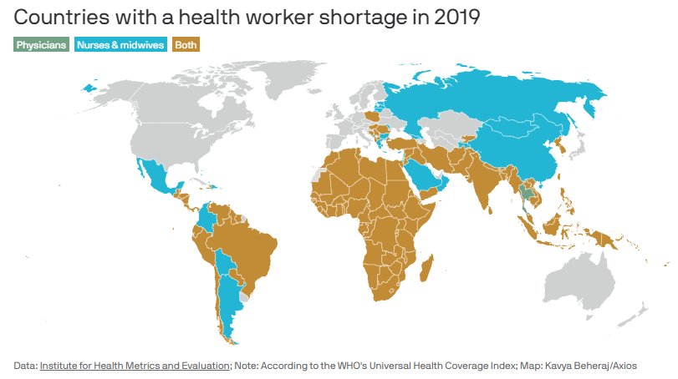
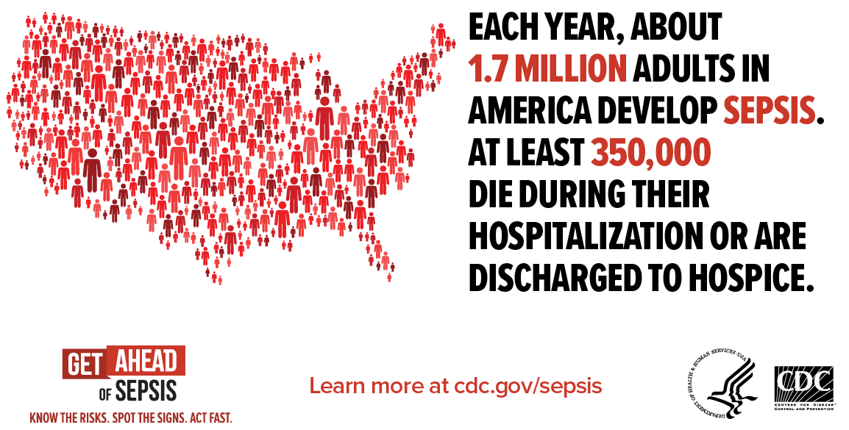
Countries are facing with a lack of medical resources since pandemic.
Acute life-threatening Infections or diseases are still a significant burden on healthcare systems.
The issue of health worker shortage
Life-threatening acute disease
Increased demand for medical services during pandemic, aging population, etc.
The large amount of time and money required to train medical staff
Major factor that increasing costs for disease management
1 in 3 people who dies in a hospital had sepsis during their hospitalization
“Measuring the availability of human resources for health and … a systematic analysis for the Global Burden of Disease Study 2019”, The Lancet (2022)
Centers for Disease Control and Prevention (US), “What is Sepsis?”
5

Slide 6







Problems with conventional Early Warning Scores
Early warning scores (EWS) assist medical staff to identify patient's deterioration.
They trigger an alert to indicate
a patient who requires closer monitoring.
Alarm
fatigue
Low performance
Single-dimensional data
Non-uniform
evaluation
6

Slide 7
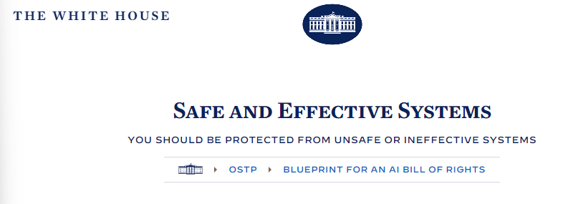
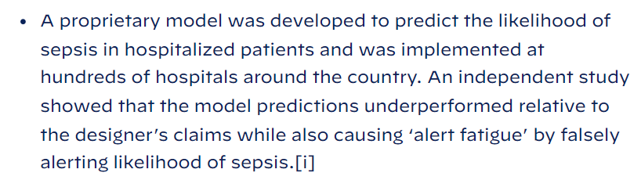

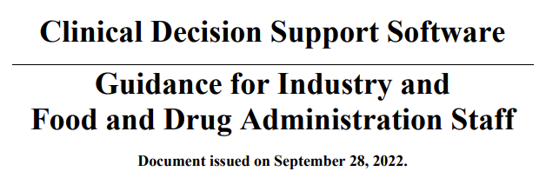

AI/ML-based EWS shows higher performance,
but must prove itself to solve regulatory concerns
“Machine learning may improve performance of screening tools,
in a meta-analysis … performance was higher than the traditional screening tools such as SIRS, MEWS, and SOFA”
International Guidelines for management of Sepsis and Septic shock 2021,
Society of Critical Care Medicine
In Oct 2022
[i] Andrew Wong et al. External validation of a widely implemented proprietary sepsis prediction model in hospitalized patients. JAMA Intern Med. 2021; 181(8):1065-1070. doi:10.1001/jamainternmed.2021.2626
In Sep 2022
“Software to predict risk of sepsis, stroke
should be regulated as a medical device”, says FDA
7

Slide 8
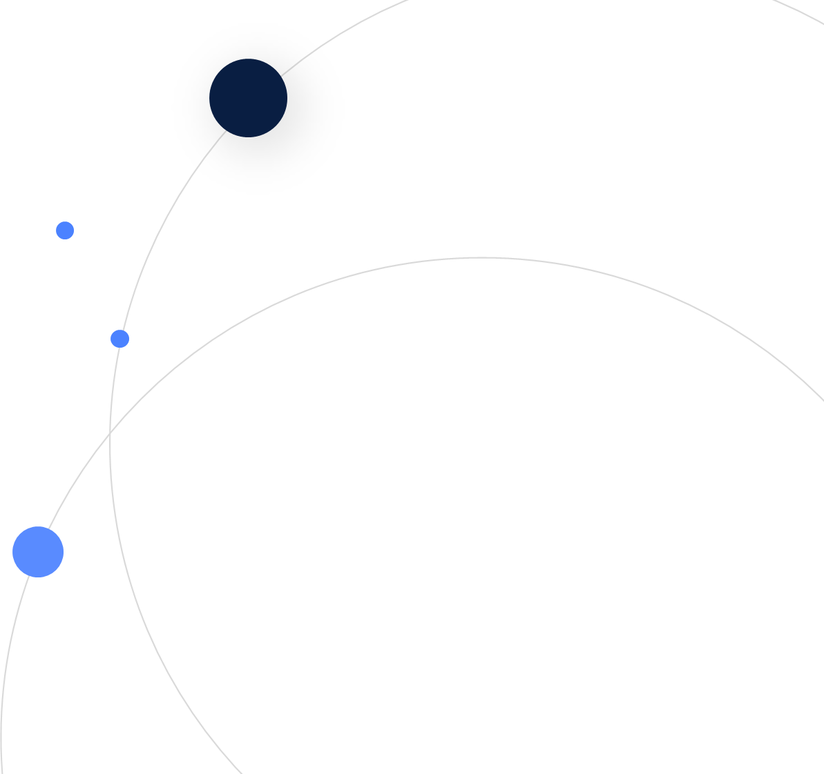
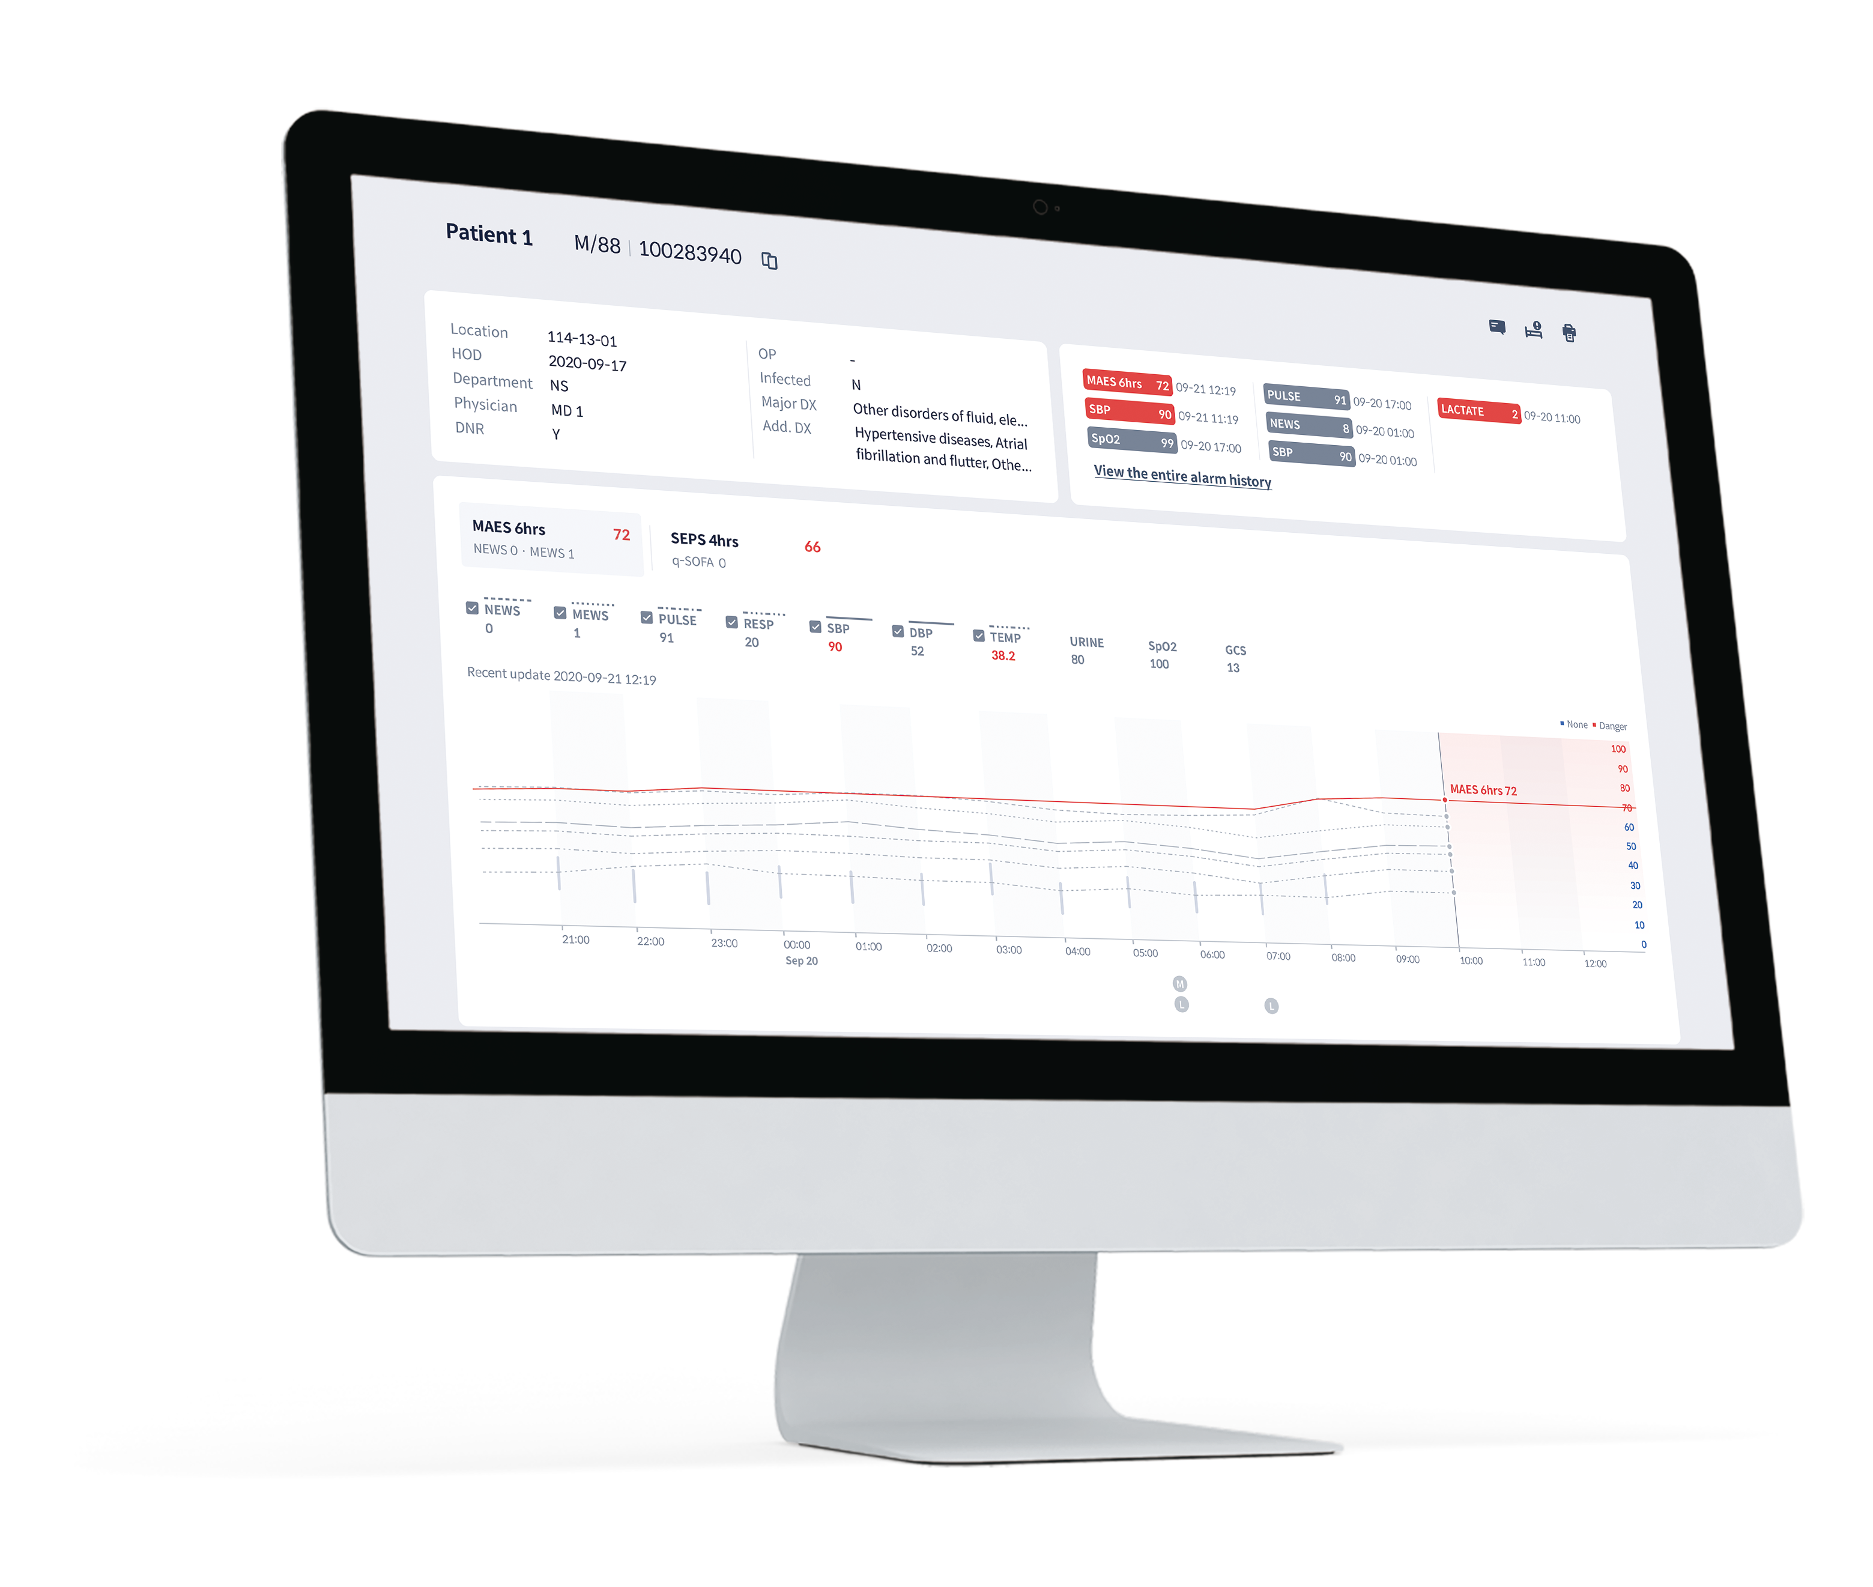

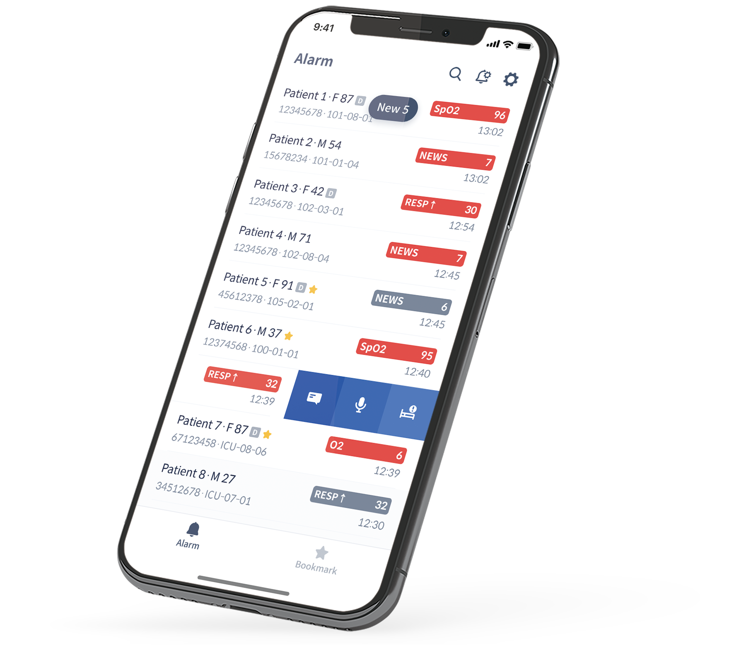
AI Solution for predicting Patient Deterioration
8

Slide 9







Operations
AITRISC-VC (“VitalCare”) uses easily accessible 19 features of EHR to provide reliable prediction scores
Multi-dimensional data in EHR
AI Model
Prediction Result
1️⃣ Sepsis Score
Sepsis risk in general ward within 4 hours
6 Vital Signs
Prediction
Module
2️⃣ Major Adverse Events Score
(Cardiac Arrest/Mortality/ICU Transfer) risk
in general ward within 6 hours
11 Blood Test results
3️⃣ Mortality Score
Mortality risk in ICU within 6 hours
2 Patient Status Info.
(Glasgow Coma Scale, Age)
Explainable AI
Module
9

Slide 10
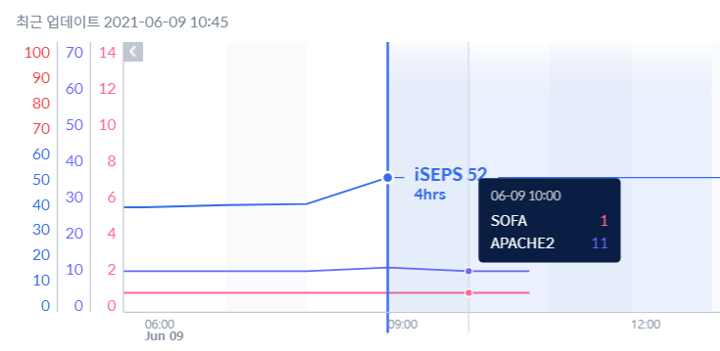
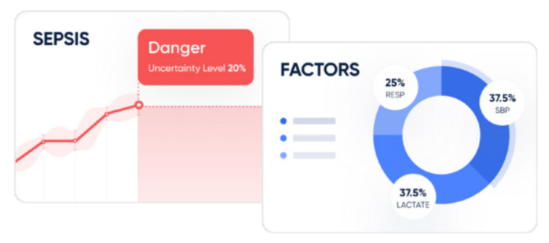
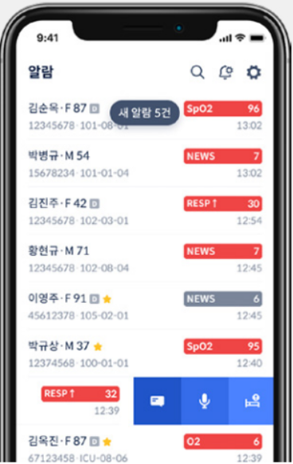

Main Features
Monitoring patients in real-time with three features
Clinical Benefit
Explainable AI
User Experience
Event Prediction
→ Precise detection of target event
Interpretable Result
→ Providing to medical staff
Workflow Enhancement
→ Fit for clinical workflow
• Clinical Paper
• Uncertainty score
“How confidence is the model on this score?”
• Feature Importance graph
“Which input feature had the most influence?”
• User friendly interface
• Optimization of clinical workflow
• Mobile solution for remote access
Sangchul Hahn et. al., “Event Prediction Model Considering Time and Input Error Using Electronic Medical Records in the Intensive Care
Unit: A Retrospective Study” JMIR (2021)
Saehoon Kim et. al., “A Deep Learning Model for Real-time Mortality
Prediction in Critically ill Children” CRITICAL CARE (2019)
10

Slide 11
Performance (1/3)
Higher predictive power than conventional early warning scores or similar tools
General wards ^{#1}
Intensive Care Units ^{#2}
Major Adverse Events
(Cardiac Arrest, ICU transfer, Mortality)
Mortality
AITRICS-VC | AUROC 0.909
AITRICS-VC | AUROC 0.964
MEWS* | AUROC 0.633
APACHE* | AUROC 0.888
NEWS* | AUROC 0.648
* AUROC (Area Under ROC curve)
* MEWS (Modified Early Warning Score)
* NEWS (National Early Warning Score)
* qSOFA Score (quick Sequential Organ Failure Assessment Score)
* APACHE Score (Acute Physiology and Chronic Health Evaluation Score)
Sepsis
AITIRCS-VC | AUROC 0.929
Reference: #1. IRB No. NHIMC 2018-06-004-001, National Health Insurance Ilsan Hospital (KR)
#2. Sung M, et al. “Event Prediction Model Considering Time and Input Error Using Electronic Medical Records in the Intensive Care Unit: Retrospective Study”, JMIR Med Inform 2021;9(11):e26426
qSOFA* | AUROC 0.687
22.4%
11

Slide 12
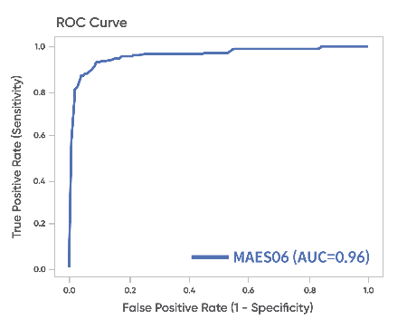
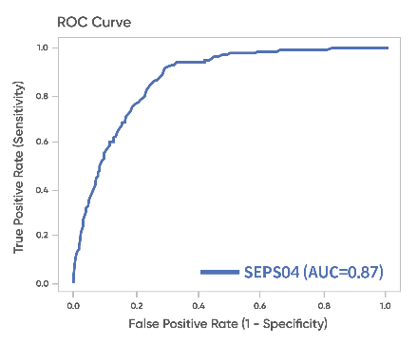
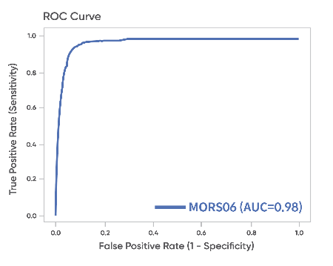
Performance (2/3)
Pivotal Clinical Trial for medical device approval in KR
General wards
Major Adverse Events
(Cardiac Arrest, ICU transfer, Mortality)
AUROC 0.961 (n=2,953)
Sepsis
AUROC 0.869 (n=3,668)
Intensive Care Units
Mortality
AUROC 0.975 (n=754)
Reference: National Health Insurance Ilsan Hospital (KR)
IND No. 1334, 1335, 1336
IRB No. NHIMC 2022-04-011-002,
2022-04-012-002, 2022-04-013-002
12

Slide 13


Performance (3/3)
Model expansion & performance validation in US population
Dataset
General wards
Sepsis
AITIRCS-VC | AUROC 0.834
Logistic Regression* | AUROC 0.717
Cleveland Clinic Foundation Data
Re-training & Evaluation with an independent test dataset
Period : Dec 2004 - Dec 2019
IRB No. 18-316: Medical Records: Retrospective Big Data EHR Study to Predict Disease Progression and Optimize Patient Outcomes
Publication is under review
XGBoost* | AUROC 0.759
Intensive Care Units
Mortality
AITIRCS-VC | AUROC 0.921
Type | ICU | GW
Patient | 175,973 | 178,076
Logistic Regression* | AUROC 0.890
XGBoost* | AUROC 0.890
* LR/XGB : Conventional Machine Learning Method
13

Slide 14
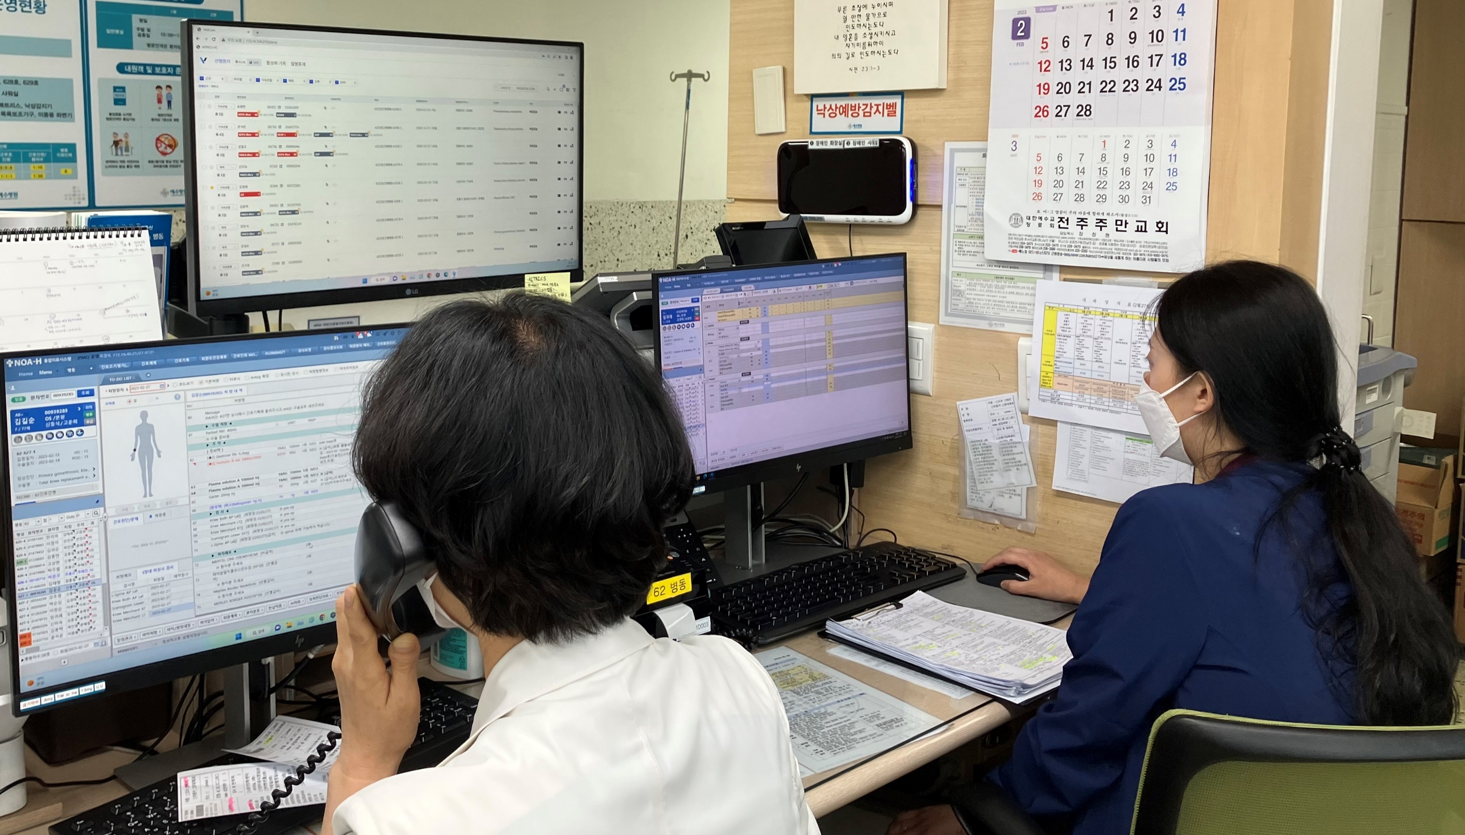



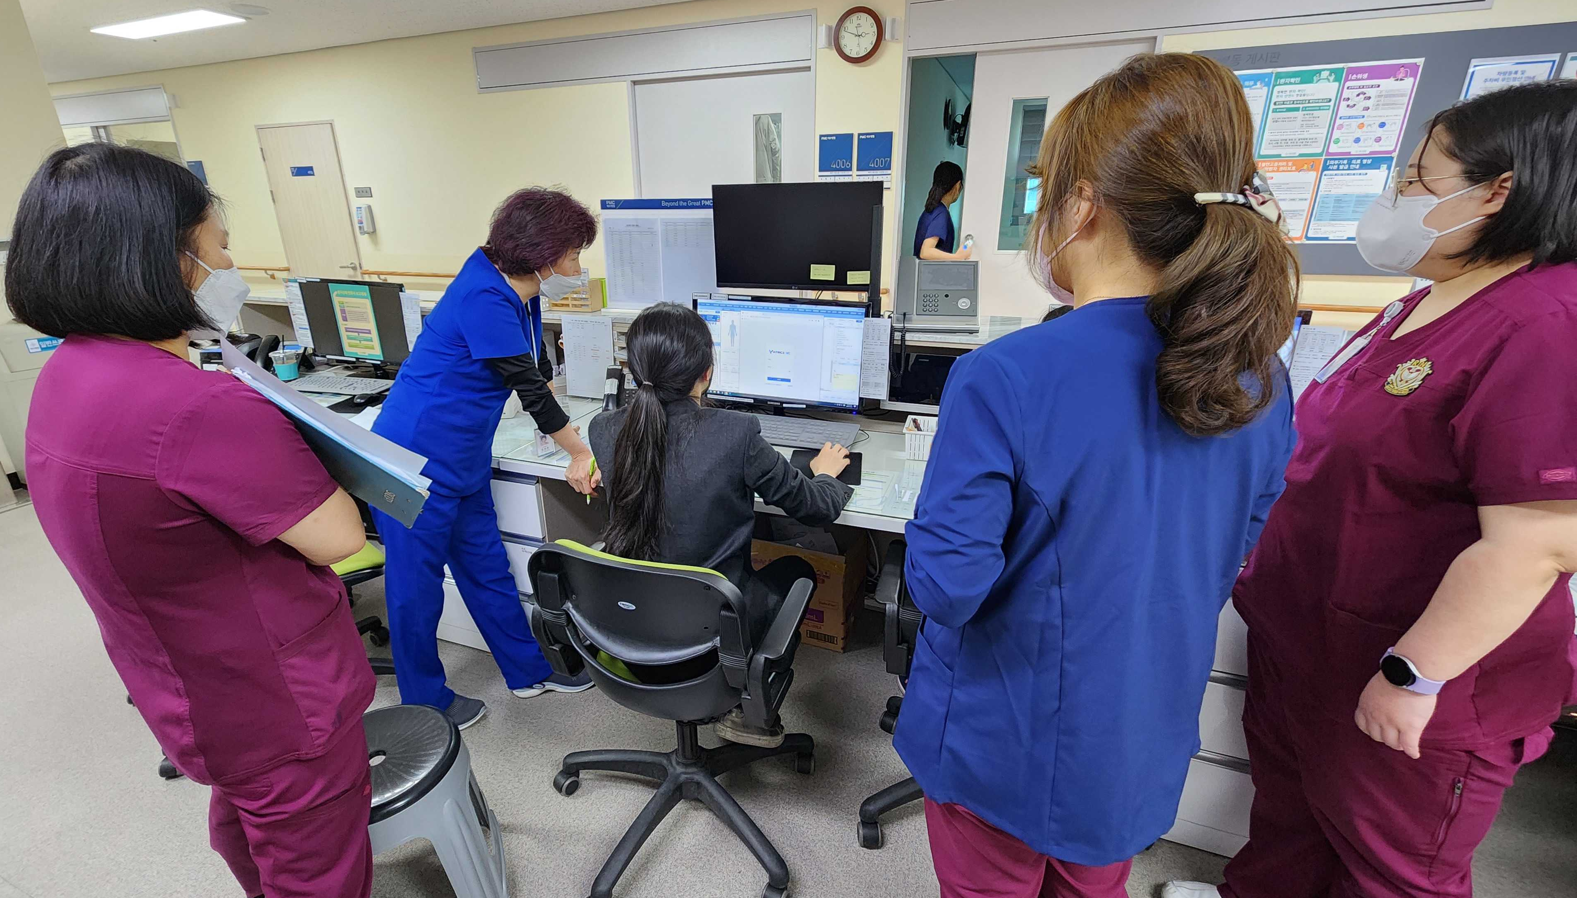
Real-world Evidence
with national health institutions and top-tier hospitals
National Health Insurance Ilsan Hospital (715 beds)
National Cancer Center (521 beds)
Severance Hospitals (2,119 | 742 | 595 beds)
Presbyterian Medical Center Jeonju (730 beds)
NCC
Rapid market entry since medical device approval in October 2022
* offering free services for low-income individuals qualified from the government
Designated as a conditional ‘new Health Technology’ for evidence development
nHTA (new Health Technology Assessment) scheduled by 2025
14

Slide 15
New TG or subtopic proposal
: Artificial Intelligence based Early Warning Score for patient safety
We strive to make this technology available to all individuals,
regardless of their socio-economic status or background.
There are no global standard that incorporates technical, clinical, and regulatory issues of this technology
We are looking forward to building a community to collaborate
for a fair evaluation and adoption of this technology.
15

Slide 16



-Thank You-
http://www.aitrics.com/en
contact@aitrics.com
noah@aitrics.com
+82-2-569-5507

