Slide 1
FGAI4H-R-032-A01
Cambridge, 21-24 March 2023
Source: | University of Oxford
Title: | AI for NCD care In Africa
Contact: | Sintieh Nchinda Ngek Ekongefeyin University of Oxford United Kingdom | E-mail: sintieh.ekongefeyin@reub.ox.ac.uk
Abstract: | This PPT contains a presentation on the use of AI in Non-communicable Diseases in Africa.

Slide 2
Plan
The Problem
Evidence : Applications of AI in Health
Challenges : NASSS
Idea
Conclusion

Slide 3
Problem
NCDs leading cause of morbidity/mortality¹
41 million, annually
W.H.O - Africa region highest burden¹
8 in 10
Traditionally
Develop infrastructure
Train personnel
Digital health
Artificial intelligence

Slide 4
Evidence : Applications of AI in Health
Digital Diagnostics & Therapeutics
Image analysis
Predictive models for CVDs
Digital Aids for face-to-face
eTriage
Video Consultations
Managing Chronic Conditions
Health tracking
eConsult (Asynchronous)

Slide 5
Evidence : Applications of AI in NCD
Mobile phones
Computer vision and smart phone camera
Reminder systems
SMS-based applications eg mPulse Mobile, ChronologyMD
AI for patient Empowerment
Chatbots eg “Vik”
Integrated care.
Wholistic care for people with NCDs.
Promoting connected care.
AI integrated EHR system
Notes:
Computer vision and smart phone camera (LABOVITZ ET AL, QUOTED BY BABEL ET AL)
SMS-based applications sending reminders eg mPulse Mobile, ChronologyMD
Chatbots eg “Vik” to empower patients with breast cancer and their relatives. Over 20% of participants became aware of their clinical decisions
AI assistant robots have been shown to be effective in insulin adherence for T1D

Slide 6
NASSS Framework
Nonadoption, abandonment, scale-up, spread and sustainability Framework
7 Domains
Condition
Technololgy
Value Proposition
Intended
Organization
Wider system
Embeding & adaption overtime
AI 4 Health in NCDs.
Notes:
Adapted Trisha Greenhalgh et al., Beyond Adoption: A New Framework for Theorizing and Evaluating Nonadoption, Abandonment, and Challenges to the Scale-Up, Spread, and Sustainability of Health and Care Technologies.J Med Internet Res 2017;19(11):e367

Slide 7
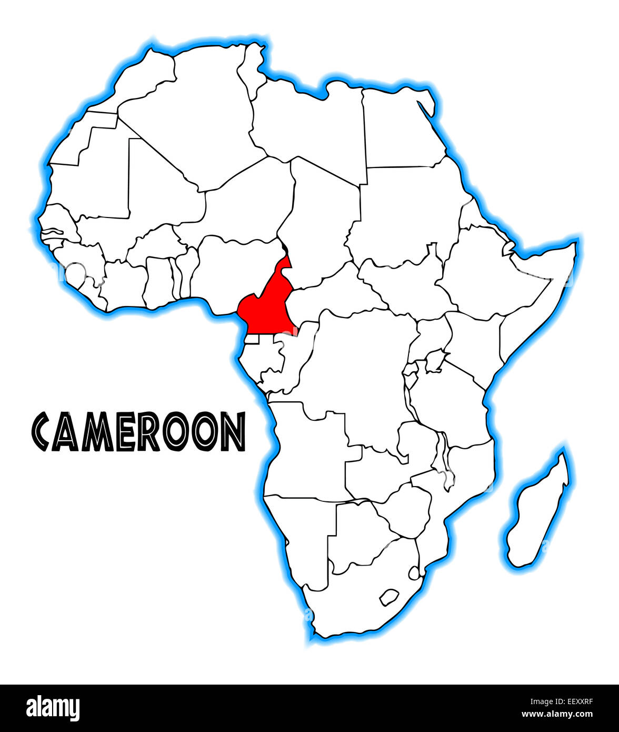
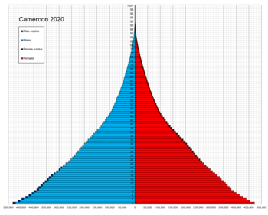
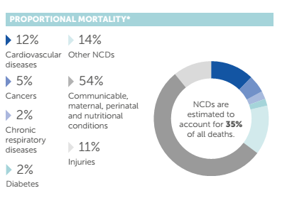
NCDs Cameroon
Total Population 27 million people
UHC ?
NCDs : Premature mortality estimated at 22%
Objectives:
Provide verified NCD awareness information to at least 1 million Cameroonians by 2030.
Support at least a million Cameroonians in leading healthy lifestyles.
Detect, Diagnose and provide long-term support to at least a thousand living with and/or at risk of NCDs.
Ensure 98% of Diagnosed have personalized follow-up and can get access to drugs and support for adherence.
1
2
3
4

Slide 8
Project Phases
Social Media Campaigns
Community Campaigns
Tips on all social media channels
Understanding the situation
Phase 1
Phase 2
Phase 3
Phase 4
Local Media Campaigns
Mobile and Web Application for follow-up
Visit media houses (TV and Radio).
Wearables link services.
Providing health education tips, and chat boxes with our team for follow-up.

Slide 9
NCD Healthcare Marketplace
MED ACCESS
HOSPITALS
PHARM
OTHERS
LABS
POPULATION
HEALTH CARE PROFESSIONAL
Notes:
Thus, we present MED ACCESS, a “healthcare marketplace” established to make the available health services easily and rapidly accessible to the community.
By connecting :
- Health care providers
- Healthcare users
- Healthcare facilities
In one access point in realtime

Slide 10
The Future - AI NCD Remote Support
Notes:
This presents to us the problems
- Lack of access to healthcare due to
fewer numbers of healthcare personnel
unawareness of health services

Slide 11
Opportunities
Mindset
TECHNO-OPTIMIST vs SOCIOTECHNICAL
TECH Infrastructure
Practicabilty with Doctors
Awareness of the population

Slide 12
Thank you
sintieh.ekongefeyin@reuben.ox.ac.uk

Slide 13
AI for NCD Care In Africa
Sintieh Nchinda Ngek Ekongefeyin, MD, MSC(c)
MSc Applied Digital Health, University of Oxford
MD – University of Buea

