Slide 1
FGAI4H-R-031-A01
Cambridge, 21-24 March 2023
Source: | Commonwealth Centre for Digital Health (UK)
Title: | Att.1 – Presentation - Viewing AI for health through a perspective of social determinants of health
Contact: | Pandula Siribaddana Andrew Farlow | E-mail: pandula.siribaddana@cwcdh.org E-mail: andrew.farlow@oriel.ox.ac.uk
Abstract: | This PPT contains a presentation of FG-AI4H-R-031.

Slide 2
Viewing AI for Health through the Perspective of Social Determinants of Health
Pandula Siribaddana (Commonwealth Centre for Digital Health, UK)
Andrew Farlow (University of Oxford, UK)

Slide 3
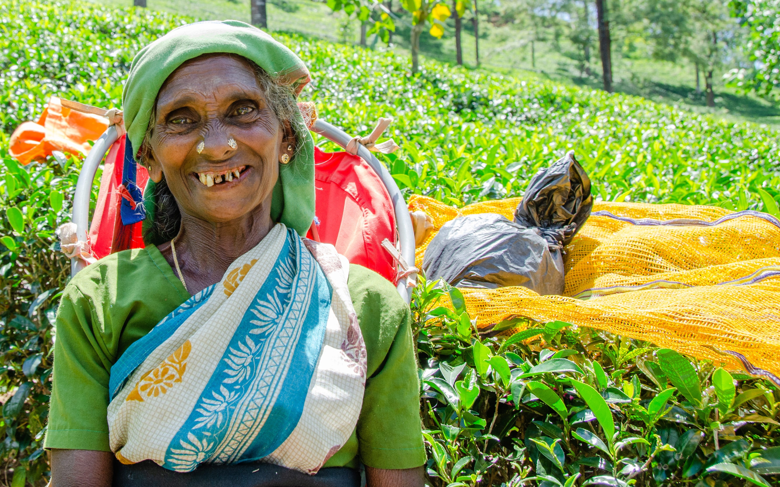
Meena (a psudoname), a lady working in a tea plantation in a remote area.
Image Source: https://www.pxfuel.com/en/free-photo-qjnoz#google_vignette

Slide 4
Health inequity

Slide 5
Social determinants of health
“the conditions in which people are born, grow, work, live, and age, and the wider set of forces and systems shaping the conditions of daily life” (WHO)
Education
Income/Employment
Environment
Housing
Transport
Access to food and nutrition
Gender
Age

Slide 6
Ensuring health and wellbeing

Slide 7
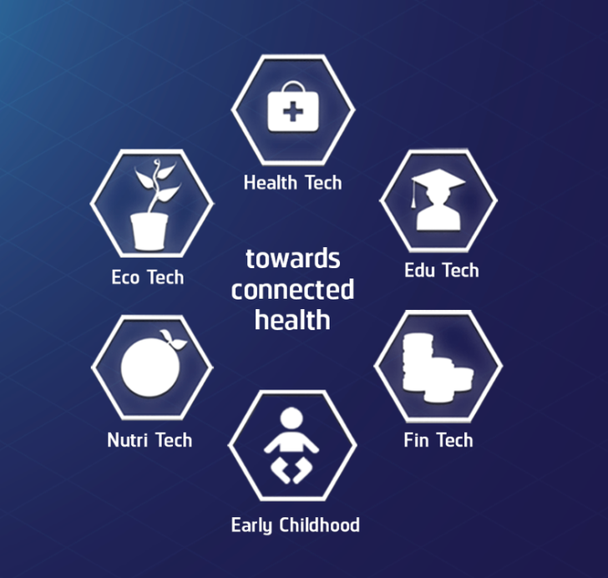
Applying Social Determinants of Health (SDH) to create a Digital Health Ecosystem – CWCDH experience

Slide 8
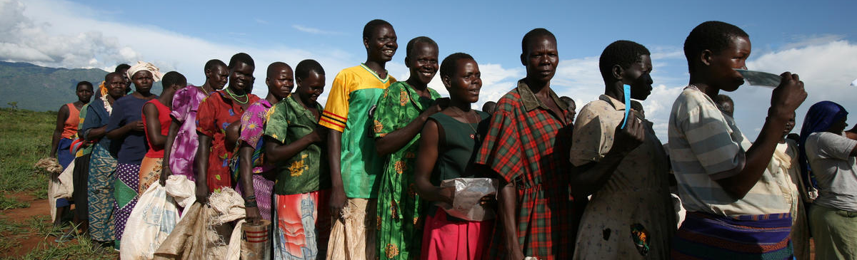
SDH as a catalyst to creating an AI4H ecosystem
Image Source: https://humanrights.berkeley.edu/programs-projects/past-projects/vulnerable-populations
SDH based approach presents an opportunity to expand the current reach of AI4H
An opportunity to reach the most vulnerable populations in the world
and a means of addressing health inequities

Slide 9
Plan of action
Convene a small group of researchers, practitioners, and policy-makers to focus on, and critically evaluate, the use of social determinants of health as a framework for expanding the AI4H discourse.
Build and strengthen an online community of practice as part of the Collaborations and Outreach activity of the Focus Group / Global Initiative around addressing social determinants of health using AI.
Generate greater awareness among digital innovators of the potential for their innovations to be impactful on the health and wellbeing of the most vulnerable populations.
Convene a workshop in Sri Lanka towards the end of the year with the participation of stakeholders and interested groups/individuals with the aim of showcasing how AI and digital tools may be applied in addressing inequity in health and wellbeing.

Slide 10
Thank you!
Pandula Siribaddana (pandula.siribaddana@cwcdh.org)
Andrew Farlow (andrew.farlow@ndm.ox.ac.uk)

