Slide 1
FGAI4H-R-029-A03
Cambridge, 21-24 March 2023
Source: | TG-POC Topic Driver
Title: | Att.3 – Presentation (TG-POC)
Contact: | Nina Linder | E-mail: nina.linder@helsinki.fi
Abstract: | This PPT summarizes the content of FG-POC for presentation and discussion during the meeting.

Slide 2
Background
FG-AI4H decided to create the TG-POC at the meeting at the virtual meeting 20-21 May 2021
We have a Nordic-East African team
U Helsinki (FIN), Uppsala U, Karolinska Inst (SWE)
Kinondo Kwetu Hospital and Diani Primary Health care center, (Kenya)
MUHAS, Dar es Salaam, (Tanzania)

Slide 3
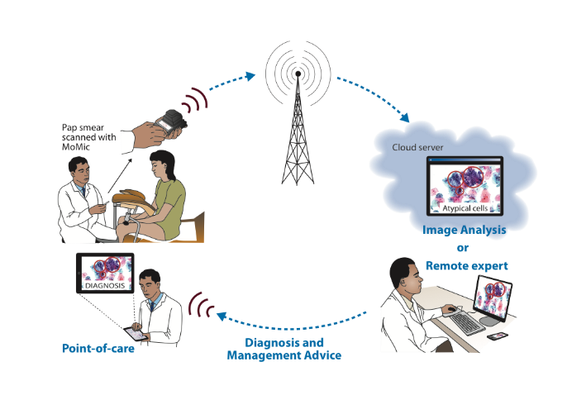
Our solution: system uses a small sized scanner for point-of-care diagnostics
Creates a digital slide of the sample using a small sized microscope scanner
Magnification comparable to a lab level microscope
Connected via mobile networks (3G/4G) to a central server
Digital sample is transferred for remote diagnosis done by a
Human expert
AI or
A combination of both

Slide 4
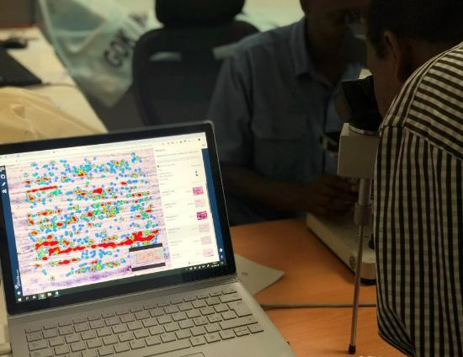
Advantages of the point-of-care AI-based diagnostics
Creates high quality images for diverse diagnostics (cancer and infectious diseases)
Allows remote consultation at the point-of-care
Allows task-shifting
Reduces skills needed and decreases workforce burden
Can be used for
monitoring disease outbreaks
storage of image data within drug and vaccine trials
teaching in basic and advanced levels

Slide 5
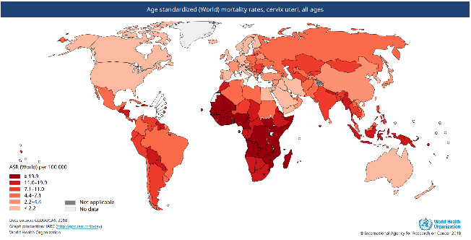
AI-based cervical cancer screening in East Africa
Most common cancer in the African region (22% of female cancers)
Affects relatively young women, preventable, early detection crucial
Mortality is expected to double by 2030, with the largest burden in sub-Saharan Africa
Deaths due to cervical cancer /100.000 females
Globocan 2018, WHO

Slide 6
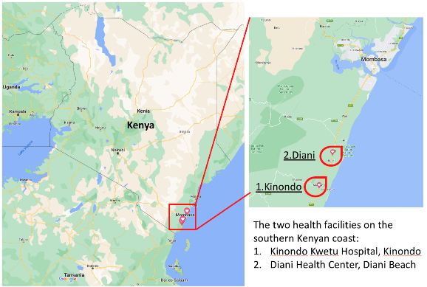
Clinical studies in Kenya for screening of cervical cancer using AI
We have published a proof-of-concerpt study for utilizing a microcope scanner for screening of cervical cancer at Kinondo Kwetu Hospital
700 women within an HIV program Center

Slide 7
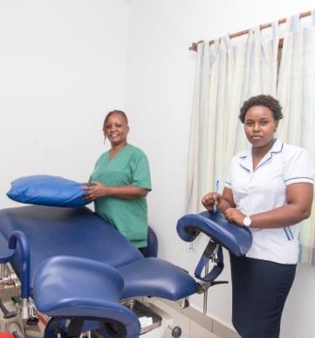
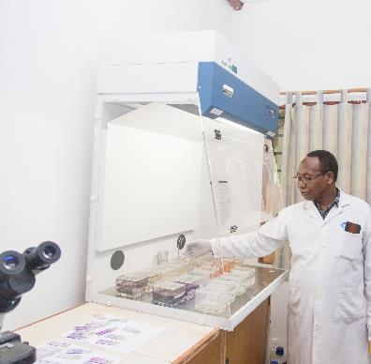
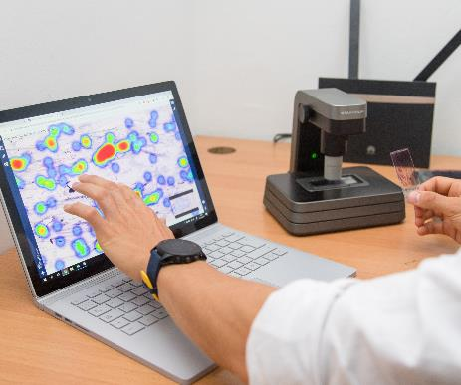
Sample acquisition and collection of data
Nurses taking samples
Lab technician preparing slides
Slide scanner uploading digital slides over 3G/4G network

Slide 8
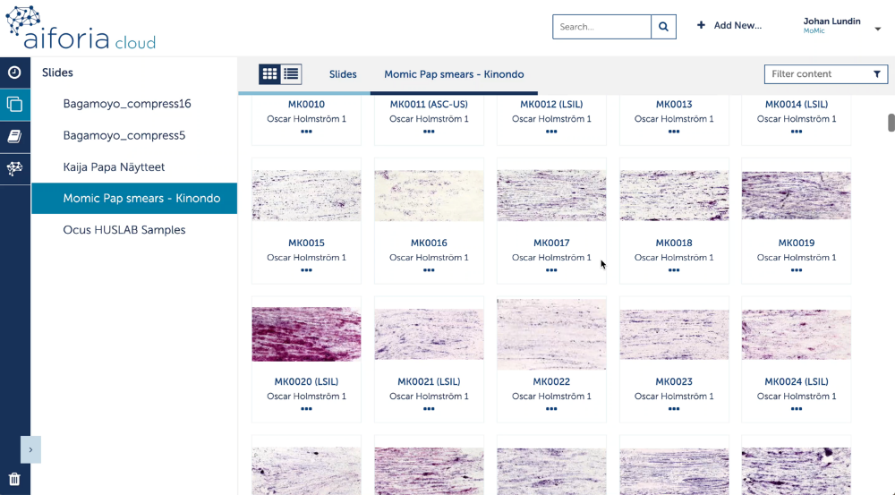
AI for detection of atypical cells in cervical smears
750 patient´s cervical smears
Samples digitized with mini scanner
Images uploaded to cloud server
Training of algorithm
Detecting cellular atypia
Results showing heat map for high grade cellular lesions

Slide 9
Status update: Validation study Kenya Feb 2022- Dec 2023
Validation of algorithms on a new patient sample cohort from two health care facilities in Kenya
Collection of 760 cervical samples was finalized
Diagnostic precision and cost-efficacy to be analysed during Q2 2023

Slide 10
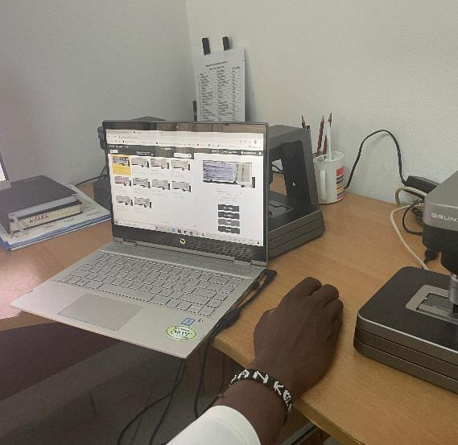
Cost effectiveness included
Costs for training of technicians
AI cloud platform subscription costs, time spent by technician in uploading, the digital sample, WiFi/Mobile upload costs (airtime)
AI processing costs, time spent by pathologist in preparing the report, costs related to sending the report back to the local clinic, (regular mail, WiFi/Mobile download costs, airtime)

Slide 11
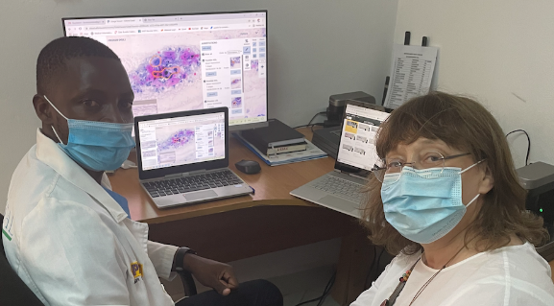
At the Kinondo Kwetu Hospital AI lab in September 2022 with the laboratory technologist (Kevan Olumasayi) who does the sample scanning and storage of digital images.

Slide 12
Collaboration with the Working Group on Clinical Evaluation
We are evaluating the document by using it from the start of a new validation study in Tanzania for cervical screening with deep learning

Slide 13
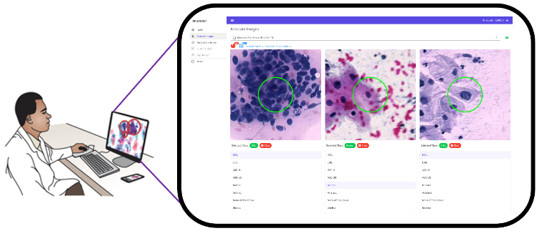
Next steps
Preparing next study for cervical screening using AI at the POC in Tanzania
Study center identified
Ethics application under preparation
Initial contacts with researchers studying breast cancer for diagnostics in low-resource settings
Prepare for publication of cervical screening validation study 07/2023
Topic group POC workshop planned for 09/2023
TG documents will be expanded and updated for mature versions
Validation of a new validator tool for the expert to verify the AI-based cellular findings

Slide 14
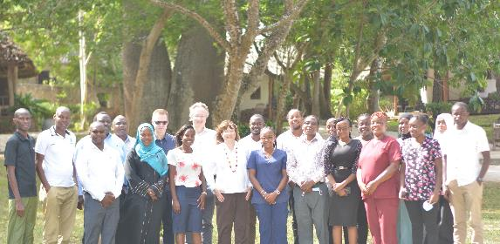
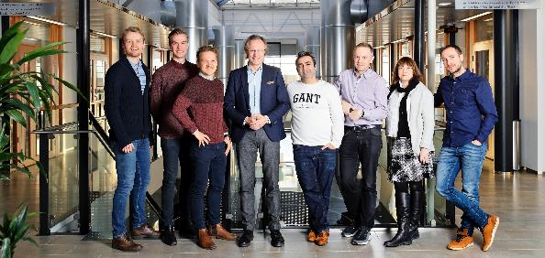
Team
Team in Kenya
Team at at FIMM-Helsinki University
Special thanks to:
Harrison Kaingu, Kinondo Kwetu Hospital
Johan Lundin, FIMM and KI
Andreas Mårtensson, Uppsala University
Billy Ngasala, MUHAS, Tanzania

