Slide 1
FGAI4H-R-021-A03
Cambridge, 21-24 March 2023
Source: | TG-Symptom Topic Drivers
Title: | Att.3 – Presentation (TG-Symptom)
Contact: | Henry Hoffmann Martin Cansdale | E-mail: henry.hoffmann@ada.com E-mail: martin@livehealthily.com
Abstract: | This PPT summarizes the status of work within TG-Symptom, for presentation and discussion during Meeting R.

Slide 2
Meeting O Update for the
Topic Group “Symptom Assessment”
Topic Group:
Symptom Assessment
Update for Meeting R
Berlin, 31 May – 2 June 2022

Slide 3
AI-based Symptom Assessment
Mobile/Web Applications – sometimes called ”Symptom Checkers” that
Allow users to enter (INPUT)
Patient information (age, sex…)
Current presenting complaints (symptoms, free text)
To then engage in a dialog similar to a doctor collecting (INPUT)
Additional symptoms, findings, factors, attributes, investigations (lab, imaging, genetics…)
To finally provide the user with (OUTPUT)
Pre-clinical triage (emergency, see doctor today, self-care…)
Possible causes (disease A 93%, B 73% - e.g. in ICD10, SNOMED CT)
Additional recommended investigations, treatment advice, explanations

Slide 4
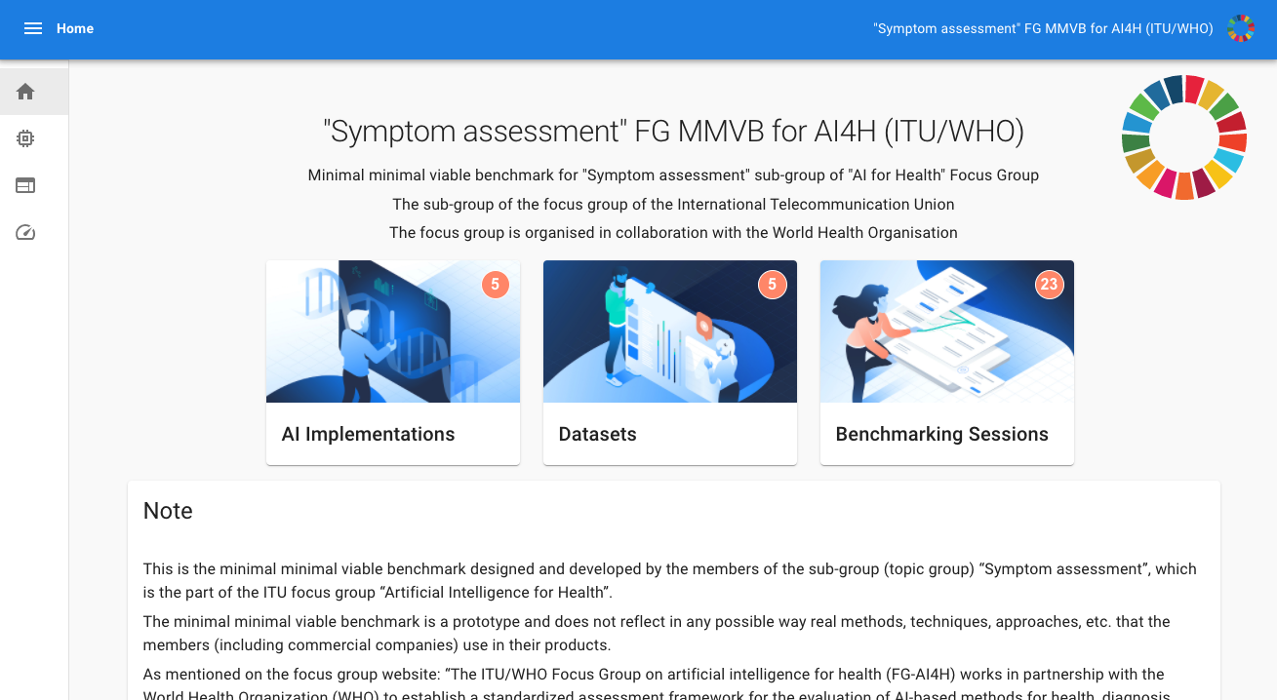
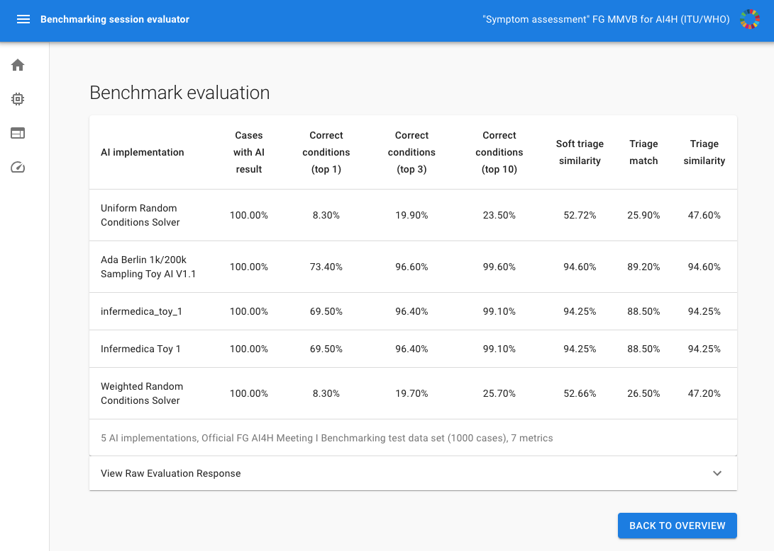
Benchmarking Approach
General approach
Started with toy AI and toy data to build a benchmarking system
Stepwise increasing complexity
Learn all the relevant details for the real benchmarking
Benchmarking approach
MMVB 2.2 with annotation tool and benchmarking process
Integrate annotation tool with open-code initiative annotation, evaluation, and reporting packages
FHIR/SNOMED CT used for storage and communication of cases
Workstreams
Technical
Case Annotation / Medical
Audit

Slide 5
Annotation Workstream
Annotation tool testing and development
New doctors joined from Healthily and Infermedica
Unique opportunity to review and test tool + guidelines in combination
Reviewed, commented on current guidelines
Performed parallel encoding tests (all doctors annotating the same case to analyse inter-annotator-agreement)
Decision to split the document into
Introduction/Background on AI4H
Technical handbook for the annotation tool
Guideline on “How to encode a case”
(Probably similar guidelines for peer review needed)
Next steps
Implement the document changes
Review/align with latest versions of annotation specification/guideline documents (e.g. DEL5.3) mentioned by Marc & Shan
Review parallel encoding test results

Slide 6
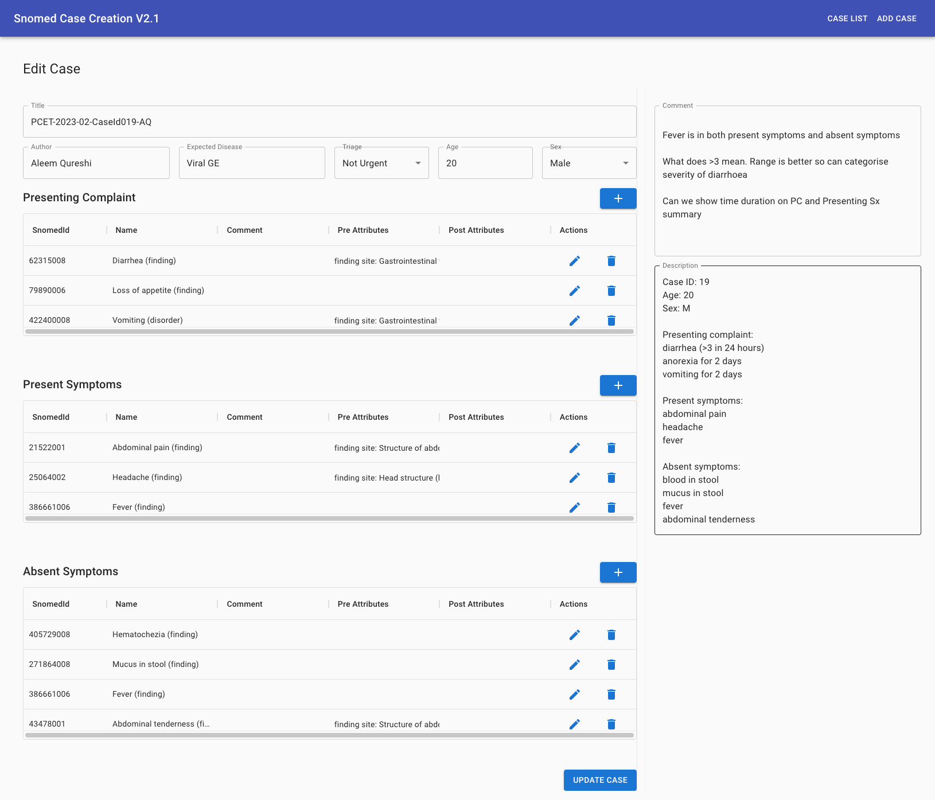
Technical Workstream
Annotation tool improvements
New doctors used case vignettes to test the tool
Collected technical feedback
Changes implemented based on the feedback
Explicit ”time since onset” attribute handling (e.g. headache for 3 days rather than sub-acute)
Usability improvements e.g. changing the layout so that the case vignetted are permanently visible
Introduction of case title for improving workflow around the (test) annotation process
Next steps
Integration with OCI annotation package (as Marc mentioned, we had technical alignment meetings)
Update systems to use FHIR as output format

Slide 7
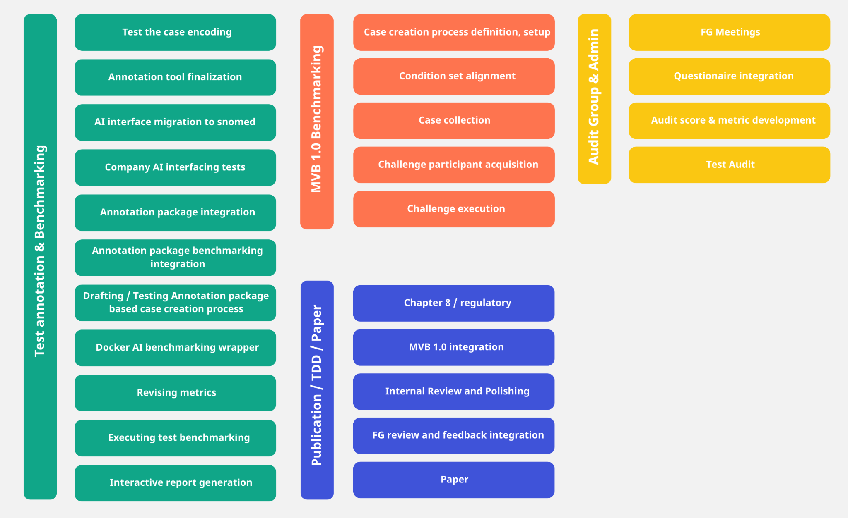
Audit Workstream
Current Status
Audit questionaire filled in by 2 companies
Analysis / review of results started
Evaluation criteria in development
Next steps
Upcoming synchronization meetings of the Audit Group in April 2023

Slide 8
Thank you!
ITU/WHO FG AI4H TG Symptom Assessment
Meeting R Update
Cambridge, 21-24 March 2023

