Slide 1
FGAI4H-R-012-A03
Cambridge, 21-24 March 2023
Source: | TG-Falls Topic Driver
Title: | Att.3 – Presentation (TG-Falls)
Contact: | Pierpaolo Palumbo Barry Greene Inês Sousa | E-mail: pierpaolo.palumbo@unibo.it E-mail: barry.greene@kinesis.ie E-mail: ines.sousa@aicos.fraunhofer.pt
Abstract: | This PPT contains updates on the Topic Group Falls in the elderly.

Slide 2
Outline
Commentary on the stratification tool for community-dwelling older adults of the World Guidelines for Falls Prevention and Management for Older Adults
Systematic review and individual participant data meta-analysis

Slide 3
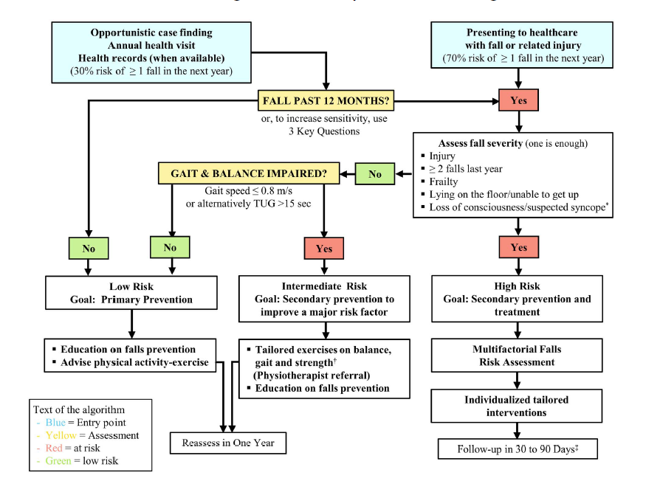
Commentary
…
Decision tree for fall risk stratification, assessment, and intervention
Two entry points: i) opportunistic/annal health visit, ii) presenting to healthcare after a fall
Three binary split nodes: i) history of falls or 3KQ, ii) fall severity, iii) gait and balance impairment
Three output risk strata. i) low, ii) intermediate, iii) high risk

Slide 4
Commentary
…
Submitted,
Under review

Slide 5
Commentary
Model design
Advocacy for multifactorial models
Validation
Need for validation
Usability
Need to address the usability-performance trade-off
Potential effects
Need to estimate the proportion at risk and the effects of opportunistic health visits
Advantages of a continuous risk score
Future research
Risk estimation + intervention recommendations, AI, clinical decision support systems
…

Slide 6
Systematic review and individual participant data meta-analysis
Review title:
“Systematic review and individual participant data meta-analysis of publicly available datasets for wearable inertial sensor-based fall risk assessment”
Aim/question:
Which datasets are available for training and validating models for wearable inertial sensor-based fall risk assessment? *
What is the prognostic value for falls of features derived from wearable inertial sensors?
Review on datasets for wearable inertial sensor-based fall prediction
Analyses on the pooled dataset
* Khan, S. M. et al. A global review of publicly available datasets for ophthalmological imaging: barriers to access, usability, and generalisability. Lancet Digit. Heal. 3, e51–e66 (2021).

Slide 7
Systematic review and individual participant data meta-analysis
Inclusion criteria:
Peer-reviewed articles/conference proceedings in English including datasets with the following characteristics:​
Datasets including at least 20 individuals ​​
Datasets where the predicting features comprised of at least one inertial sensor-based feature
Datasets from any community-dwelling population
Datasets with individual-level (not aggregated) information about falls*
Falls collected after the predicting features (prospective design) ​#
* occurrence of at least one fall in a given time period OR number of falls OR date of first fall occurrence
# retrospective studies included only for sensitivity analyses
Review on datasets for wearable inertial sensor-based fall prediction
Analyses on the pooled dataset
Registration: PROSPERO 2022 CRD42022367394
https://www.crd.york.ac.uk/prospero/display_record.php?RecordID=367394

Slide 8
Systematic review and individual participant data meta-analysis
Review team:
Jose Luis Albites Sanabria, University of Bologna, Bologna, Italy
Barry Greene, Kinesis Health Technologies Ltd, Dublin, Ireland
Killian McManus, Kinesis Health Technologies Ltd, Dublin, Ireland
Luca Palmerini, University of Bologna, Bologna, Italy
Pierpaolo Palumbo, University of Bologna, Bologna, Italy
Inês Sousa, Fraunhofer Portugal AICOS, Porto, Portugal
Kimberley S. van Schooten, University of New South Wales, Sydney, Australia
Two sub-teams for screening and feature extraction. Each sub-team:
2 independent reviewers
1 reviewer for solving disagreement
Review of datasets for wearable inertial sensor-based fall prediction
Analyses on the pooled dataset

Slide 9
Systematic review and individual participant data meta-analysis
Features to extract [1]:
Study population
Sampled population
Sample size
Geographic location
Study design
Clinical features for fall prediction
Characteristics of inertial sensors (acc., acc. + gyro, etc.)
Protocol for inertial sensor assessment (sensor location, standardized task/free living)
Outcome measures
Fall definition
Protocol for collecting fall information (fall diaries, phone calls, etc.)
Dataset accessibility (open access, open access with barriers, regulated access, not accessible)
Quality assessment:
PROBAST (Prediction model Risk Of Bias ASsessment Tool) [2]
Risk of bias, applicability
Participants, predictors, outcome, analysis
11 + 9 signalling questions
[1] Moons KGM et al. Critical appraisal and data extraction for systematic reviews of prediction modelling studies: the CHARMS checklist. PLoS Med. 2014 Oct ;11(10):e1001744.
[2] Wolff RF et al. PROBAST: A tool to assess the risk of bias and applicability of prediction model studies. Ann Intern Med. 2019 Jan 1;170(1):51–8.

Slide 10
Systematic review and individual participant data meta-analysis
Access request:
Email
Form: rationale, data management, authorship policy [1]
Meta-analysis:
Data storage facility: secure, large
Two possibilities
Share data: one-stage IPD meta-analysis
Share only algorithms and results: two-stage IPD meta-analysis
Univariate analysis: i) ORs, RaRs, and HRs, ii) Mixed-effect logistic regressions
Multivariate model [2]
Review on datasets for wearable inertial sensor-based fall prediction
Analyses on the pooled dataset
[1] https://www.icmje.org/recommendations/browse/roles-and-responsibilities/defining-the-role-of-authors-and-contributors.html
[2] Ahmed I, Debray TPA, Moons KGM, Riley RD. Developing and validating risk prediction models in an individual participant data meta-analysis. BMC Med Res Methodol. 2014;14(3).
Notes:
Initially, Ferath Kherif and Marc Lecoultre committed for helping us with data management in AWS. No reply from them to the last email
10

Slide 11
Systematic review and individual participant data meta-analysis
PubMed: 26 reviews, Web of Science: 23 reviews, Scopus: 33 reviews
Google Dataset Search Mendeley Data, IEEE DataPort, Physionet, Figshare, Dataverse, Dryad, hand search
To do
19 unique review articles
834 articles to screen
19 duplicates removed
815 articles screened for title and abstract
690 articles excluded
To do
125 articles to screen for full-text eligibility
Feature extraction
Access request
One/two-stage IPD meta-analysis
No IMU: n = 3
Wrong outcomes: n = 4
No info on falls: n = 25
Less than 20 subjects: n = 4
Non community-dwelling: n = 6
Retrospective: n = 51
93 articles excluded
32 articles included in the review
Notes:
834 or 956 papers to screen?
11

Slide 12
Thank you

