Slide 1
FGAI4H-R-010-A03
Cambridge, 21-24 March 2023
Source: | TG-Dental Topic Driver
Title: | Att.3 - Presentation (TG-Dental)
Contact: | Dr Joachim Krois | E-mail: joachim.krois@gmail.com
Abstract: | This PPT summarizes the status of work within TG-Dental, for presentation and discussion during the meeting.

Slide 2
Meeting R TG-Dental Update
March 21–24, 2023
Falk Schwendicke, Joachim Krois, Tarry Singh, Jae-Hong Lee, Akhilanand Chaurasia, Robert André Gaudin, Sergio Uribe, Hossein Mohammad-Rahimi, Janet Brinz, Anahita Haiat, Gürkan Ünsal, Nielsen Santos Pereira, Ulrike Kuchler, Shankeeth Vinayahalingam, Balazs Feher, Francesc Perez Pastor, Lisa Schneider, Chen Nadler, Sahel Hassanzadeh-Samani, Parisa Motie, Ragda Abdalla-Aslan, Teodora Karteva, Jelena Roganovic, Kunaal Dhingra, Prabhat Kumar Chaudhari, Olga Tryfonos, Marja Laine, Rata Rokhshad, Fatemeh Sohrabniya, Zeynab Pirayesh, Shada Alsalamah, Sakher AlQahtani, Revan Birke Koca-Ünsal, Lubaina T. Arsiwala, Parul Khare, Amit Punj, Manal Hamdan, Zaid Badr, Tamara Peric, Mihiri Silva, Bree Jones, Miroslav Radenković, Martha Duchrau, Mohammed Omar, Gowri Sivaramakrishnan, Jaisri Thoppay, Saujanya Karki, Tarja Tanner, Marja-Liisa Laitala, Johannes Tanne, Sanaa Chala, Raphaël Richert, Pierre Lahoud, Julien Issa, Nisha Manila, Fahad Umer, Gauthier Dot, Sharon Tan, Sara Haghighat

Slide 3
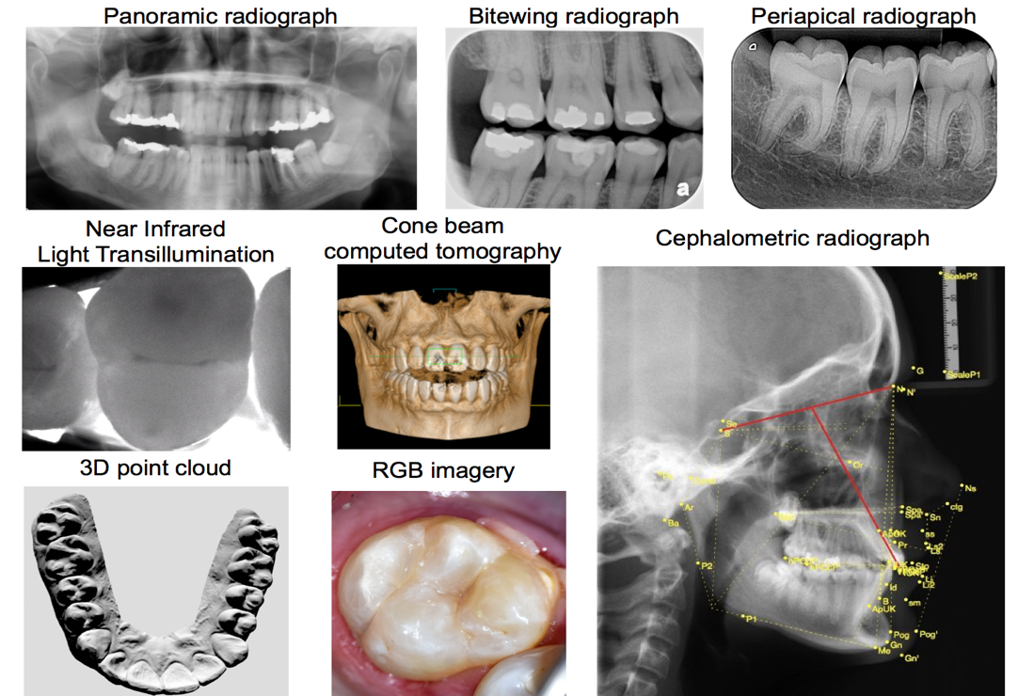
TG-Dental – An overview
Dental Diagnostics and Digital Dentistry
Established at Meeting G (New Delhi, India)
Data modalities
Imaging
Dental history
Clinical investigation
further physical or (bio)chemical or microbiological assessments

Slide 4
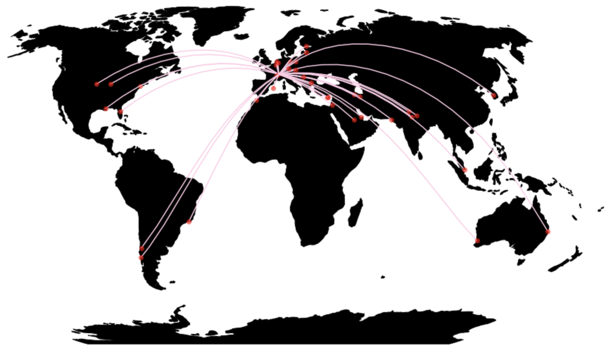
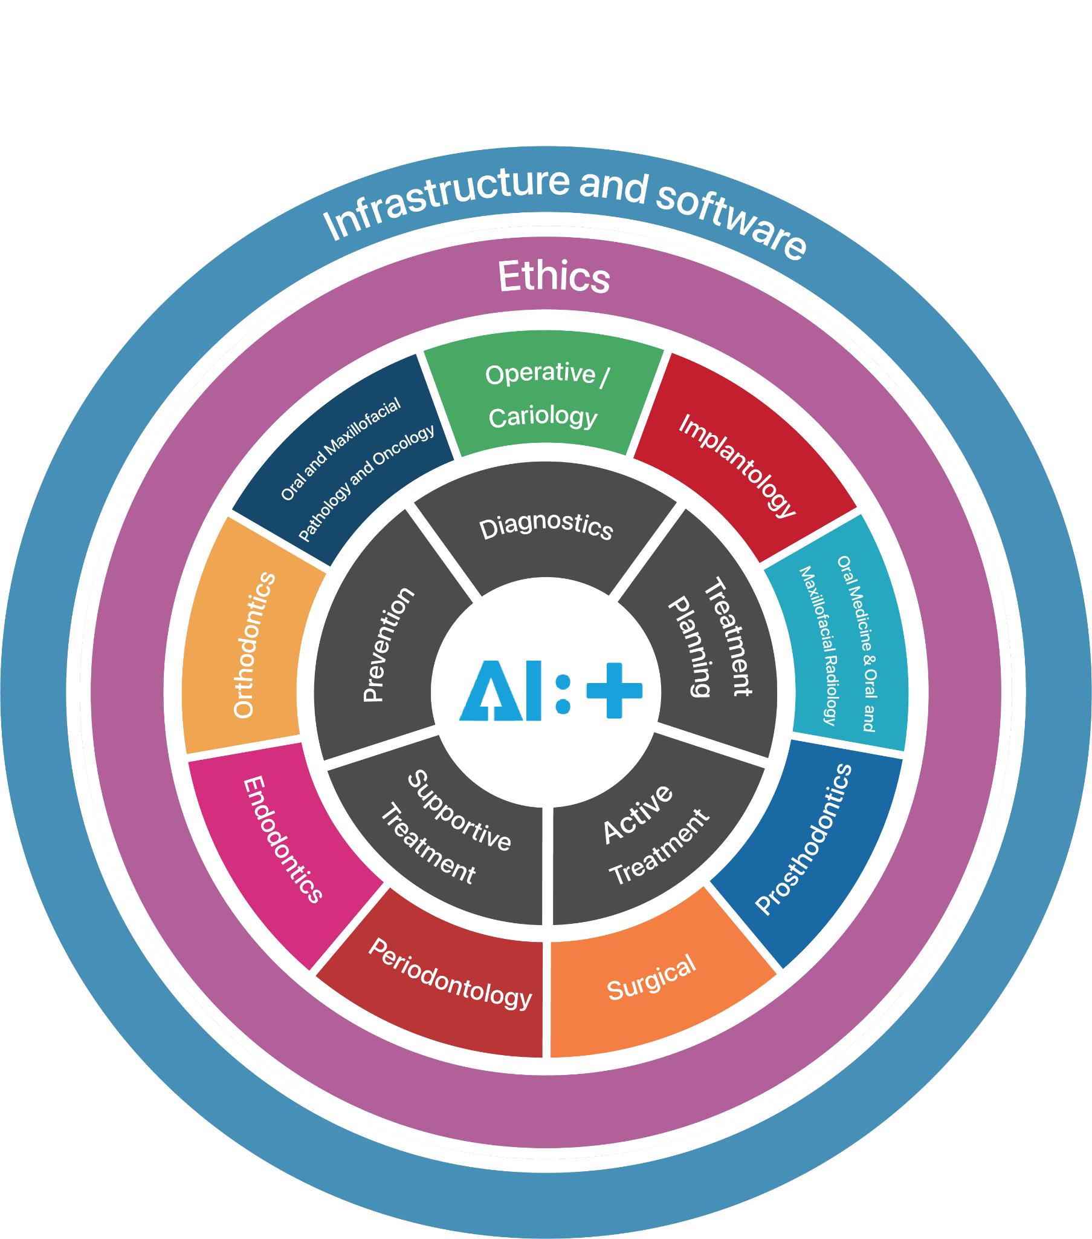
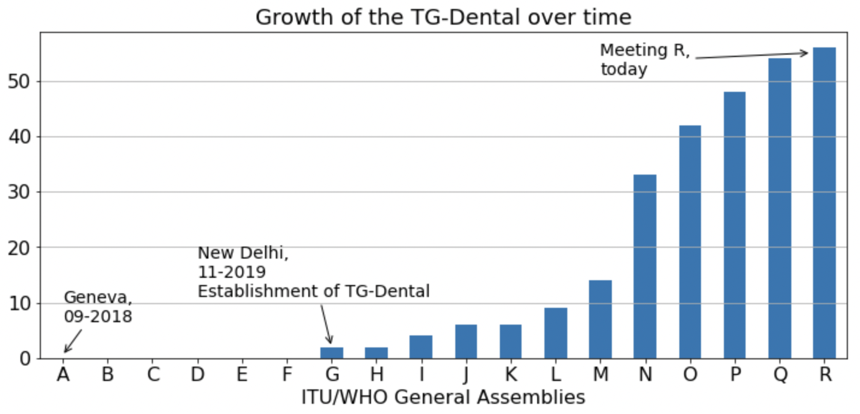
TG-Dental – Contributors
57 members
23 countries
6 continents
Notes:
Shank, Ulrike and Balazs is missing

Slide 5
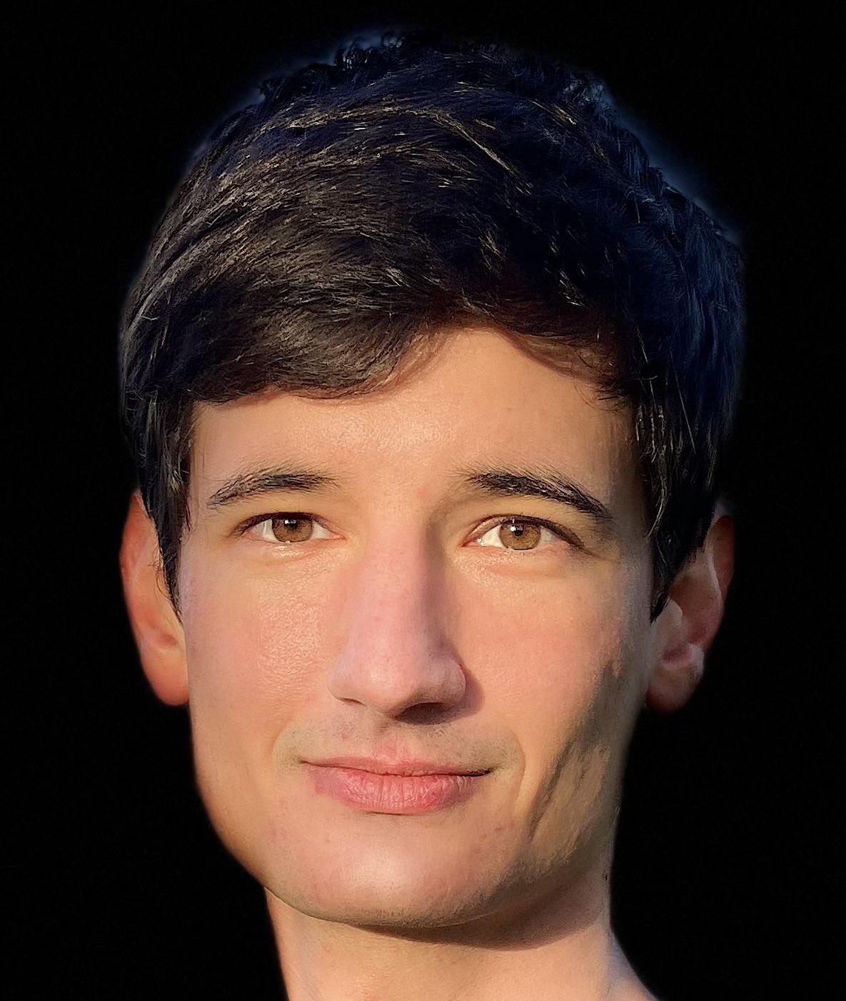
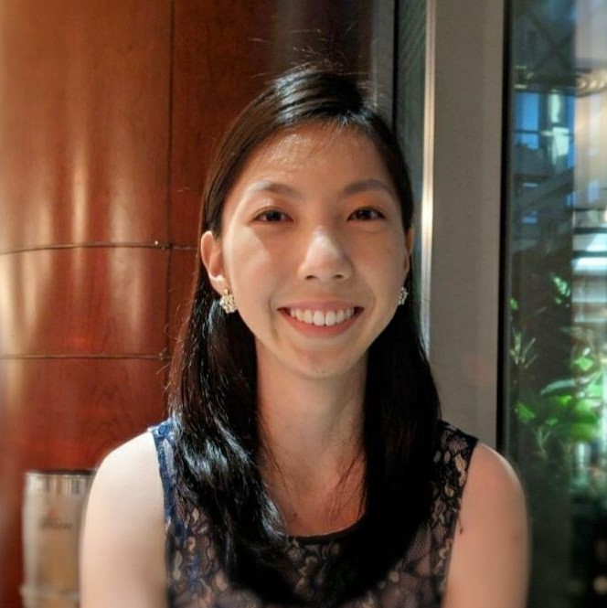
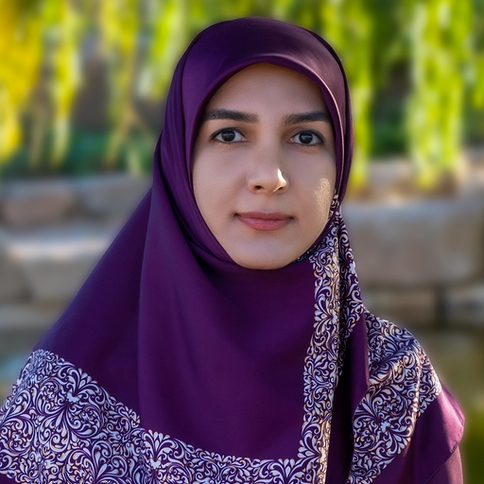
Welcoming three new members to the topic group
Gauthier Dot, DDS, PhD Université Paris Cité, AP-HP
Arts-et-Métiers Institute of Technology
Paris, France
Sharon Tan
Saw Swee Hock School of Public Health,
National University of Singapore,
Singapore
Sara Haghighat
Dentist/Researcher
Shiraz University of Medical Sciences
Iran

Slide 6
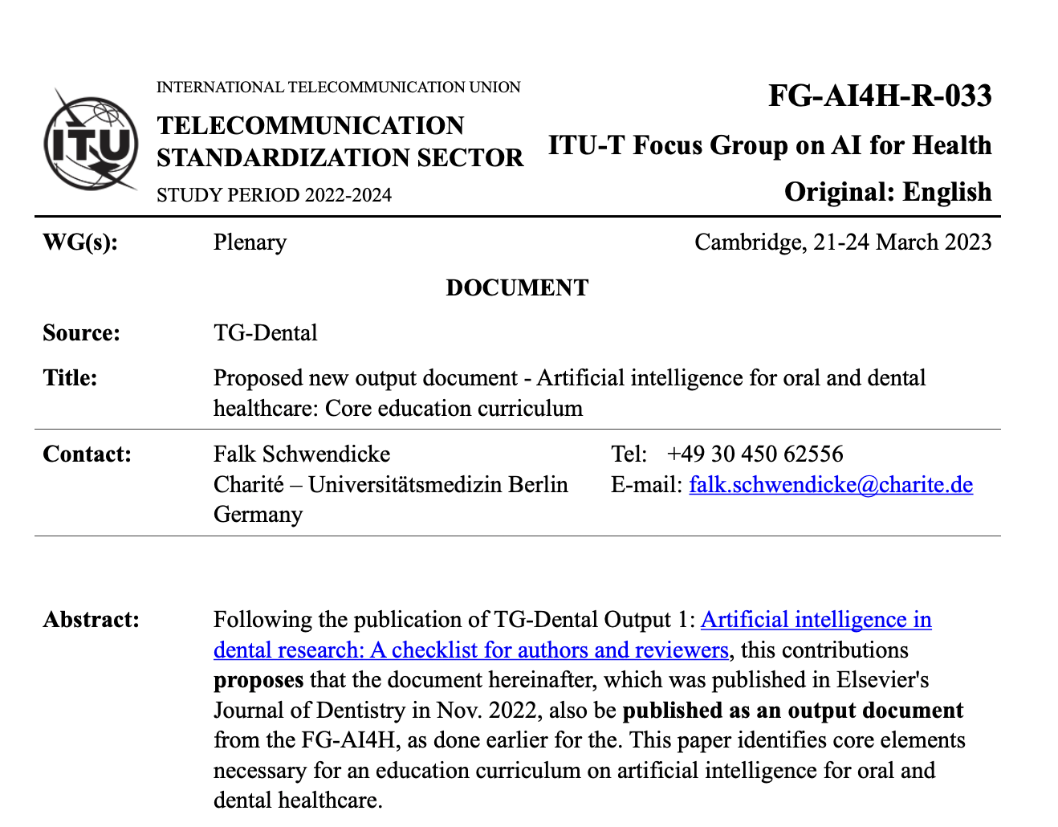
Dental AI Curriculum
Artificial intelligence for oral and dental healthcare: Core education curriculum
Falk Schwendicke^{1,2}, Akhilanand Chaurasia^{2,3}, Thomas Wiegand^{2,4}, Sergio E. Uribe^{2,5, 6}, Margherita Fontana⁷, Ilze Akota⁸, Olga Tryfonos^{2,9}, Joachim Krois^{1,2} on behalf of the IADR e-oral health network and the ITU/WHO focus group AI for Health.
(1) Basic definitions and terms, the principle of machine learning, the idea of training, validating and testing models, the definition of reference tests, dynamic and static AI, black box and explainability
(2) Use cases, types of AI, typical setup of AI software
(3) Evaluation metrics, their interpretation, the relevant impact of AI on patient or societal health outcomes
(4) Issues around generalizability and representativeness, explainability, autonomy and accountability

Slide 7
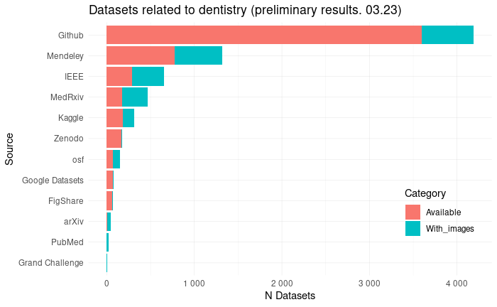
Dataset review
Characteristics to evaluate
Dataset size
Type of images
Type of annotations
Image resolution
Metadata
Class balance
Diversity
preliminary results
Notes:
An international group of researchers is evaluating the characteristics of dental and maxillofacial image datasets available for machine or deep learning. This will provide insight into the availability, characteristics and quality of publicly available datasets and identify best practices for sharing this valuable information.
The protocol is already registered and the databases and search engines used are shown in the figure on the left. Preliminary results are shown in the graph on the right.
So far we have found about 500 imaging datasets (in turquoise) and expect have the results by mid 2023.

Slide 8
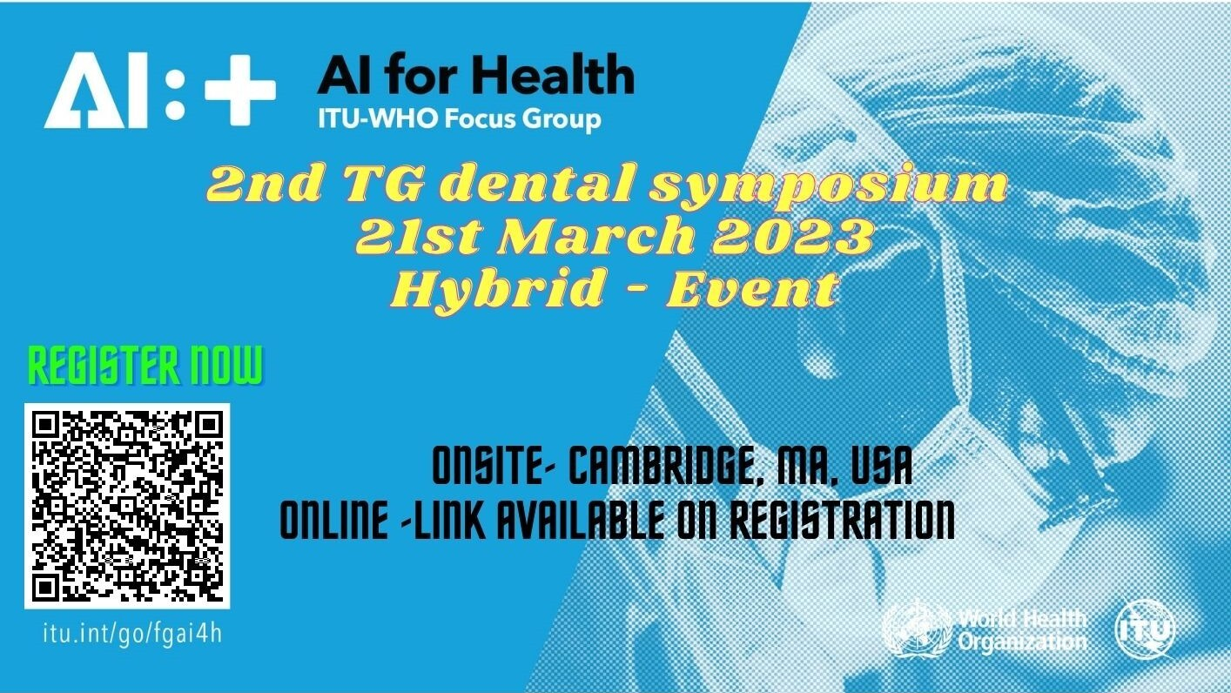
2nd TG-Dental Symposium
Notes:
An international group of researchers is evaluating the characteristics of dental and maxillofacial image datasets available for machine or deep learning. This will provide insight into the availability, characteristics and quality of publicly available datasets and identify best practices for sharing this valuable information.
The protocol is already registered and the databases and search engines used are shown in the figure on the left. Preliminary results are shown in the graph on the right.
So far we have found about 500 imaging datasets (in turquoise) and expect have the results by mid 2023.

Slide 9
Thank you!
March 21–24, 2023
Falk Schwendicke, Joachim Krois, Tarry Singh, Jae-Hong Lee, Akhilanand Chaurasia, Robert André Gaudin, Sergio Uribe, Hossein Mohammad-Rahimi, Janet Brinz, Anahita Haiat, Gürkan Ünsal, Nielsen Santos Pereira, Ulrike Kuchler, Shankeeth Vinayahalingam, Balazs Feher, Francesc Perez Pastor, Lisa Schneider, Chen Nadler, Sahel Hassanzadeh-Samani, Parisa Motie, Ragda Abdalla-Aslan, Teodora Karteva, Jelena Roganovic, Kunaal Dhingra, Prabhat Kumar Chaudhari, Olga Tryfonos, Marja Laine, Rata Rokhshad, Fatemeh Sohrabniya, Zeynab Pirayesh, Shada Alsalamah, Sakher AlQahtani, Revan Birke Koca-Ünsal, Lubaina T. Arsiwala, Parul Khare, Amit Punj, Manal Hamdan, Zaid Badr, Tamara Peric, Mihiri Silva, Bree Jones, Miroslav Radenković, Martha Duchrau, Mohammed Omar, Gowri Sivaramakrishnan, Jaisri Thoppay, Saujanya Karki, Tarja Tanner, Marja-Liisa Laitala, Johannes Tanne, Sanaa Chala, Raphaël Richert, Pierre Lahoud, Julien Issa, Nisha Manila, Fahad Umer, Gauthier Dot, Sharon Tan, Sara Haghighat

