Slide 1
FGAI4H-R-004-A02-R1
Cambridge, 21-24 March 2023
Source: | TSB
Title: | Att.2 - FG Deliverable status update - Presentation
Contact: | Simão Campos Bastiaan Quast | E-mail: simao.campos@itu.int bastiaan.quast@itu.int
Abstract: | This PPT contains highlights and proposed steps forward for the publication of FG-AI4H deliverables as the FG nears its sunset.

Slide 2
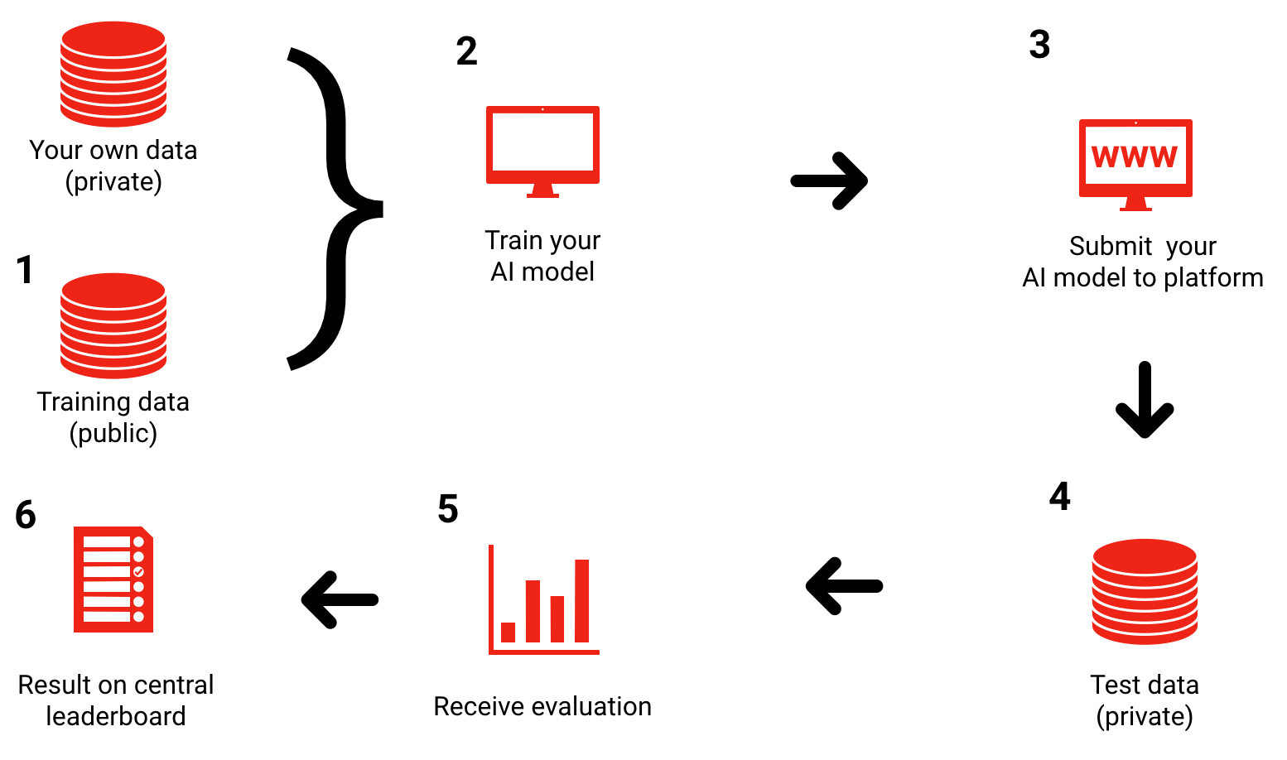
Recap: FG vision: benchmarking framework
Possible approaches:
1) Closed environment (prototype available)
2) Via interface
3) Federated

Slide 3
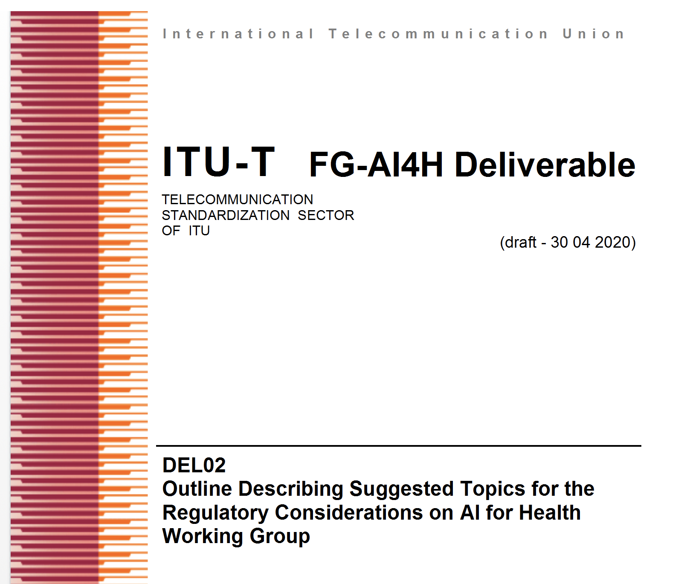
Overview of deliverables
No. | Title
00 0.1 | Overview of the FG-AI4H deliverables AI4H Terminology
1 | AI4H ethics considerations
2 2.2 | AI4H regulatory considerations Good practices for health applications of machine learning
3 | AI4H requirements specifications
4 | AI4H software life cycle specification
5 | Data specification
6 | AI training best practices specification
7 | AI4H evaluation considerations
8 | AI4H scale-up and adoption
9 | AI4H applications and platforms
10 | AI4H use cases: Topic description documents
Four pillars:
Ethics
Regulations
Technology
Clinical evaluation and use cases

Slide 4
Recap FG-AI4H Deliverable interdependency

Slide 5
Recap: Focus Group outputs; where and how
Focus Groups are ITU instruments for new workstreams, with great flexibility. Regular ITU standardization happens in ITU Study Groups, these standards become ITU-T Recommendations (like WHO Guidelines).
Focus Group publication options:
Submit to a Study Group: if accepted → ITU-T Recommendation
Submit deliverables elsewhere, e.g., WHO or academia (derivatives, in particular conferences and other proceedings)
Create their own brand e.g., "ITU/WHO AI for Health Framework"
Combination of the above, including potential joint / dual publications

Slide 6
Outputs approved online in March 2023
DEL 2.1: Mapping of IMDRF essential principles to AI for health software
DEL 3: AI4H requirement specifications
DEL 5.1: Data requirements
DEL 5.3: Data annotation specification
DEL 5.4: Training and test data specification.
DEL 5.5: Data handling
DEL 6: AI training best practices specification
DEL 7: AI for health evaluation considerations
DEL 7.2: AI technical test specification
DEL 10: AI4H use cases: Topic description documents

Slide 7
Submitted online March 2023 - Comments received
DEL 4: AI software life cycle specification Doc R-044 (Text) + A01 (Resolution log)
DEL 7.4: Clinical evaluation of AI for health Doc R-052 (Text) + A01 (Resolution log) [not uploaded yet]
Options for this meeting for each of the above documents:
Approve here and now
Ask for more changes, then:
Submit for online approval
Review at the next meeting

Slide 8
Remaining deliverables - Horizontal
Del No | Deliverable | Editor | Maturity
0 | Overview of the FG-AI4H deliverables | Shan Xu
5 | Data specification | Marc Lecoultre
5.2 | Data acquisition | Rajaraman Subramanian, Vishnu Ram | D
5.6 | Data sharing practices | Ferath Kherif, Banusri Velpandian
7.1 | AI4H evaluation process description | Vacant
7.3 | Data and artificial intelligence assessment methods (DAISAM) reference | Luis Oala
8 | AI4H scale-up and adoption | Sameer Pujari, Yu Zhao and Javier Elkin | F
9 | AI4H applications and platforms | Manjeet Chalga | D
9.1 | Mobile applications | Khondaker Mamun, Manjeet Chalga | D
9.2 | Cloud-based AI applications | Khondaker Mamun | D
Notes:
Maturity Grade Maturity
A 80% and up
B 51 to 79%
C 26 to 50%
D Under 25%
F 0

Slide 9
Remaining deliverables – Topic groups
Del No | Deliverable | Editor | Maturity
10.1 | Cardiovascular disease management (TG-Cardio) | Benjamin Muthambi
10.2 | Dermatology (TG-Derma) | Harsha Jayakody, Ivy Lee
10.3 | Diagnosis of bacterial infection and anti-microbial resistance (TG-Bacteria) | Nada Malou | F
10.4 | Falls among the elderly (TG-Falls) | Inês Sousa and Pierpaolo Palumbo | A/B
10.6 | Malaria detection (TG-Malaria) | Rose Nakasi
10.7 | Maternal and child health (TG-MCH) | Alexandre Chiavegatto Filho
10.9 | Ophthalmology (TG-Ophthalmo) | Arun Shroff | A/B
10.10 | Outbreak detection (TG-Outbreaks) | Auss Abbood; Alexander Ullrich; Khahlil Louisy and Alexander Radunsky
10.12 | AI for radiology (TG-Radiology) | Darlington Ahiale Akogo | A/B
10.14 | Symptom assessment (TG-Symptom) | Henry Hoffmann and Martin Cansdale | A/B
10.16 | Volumetric chest CT (TG-DiagnosticCT) | Kuan Chen
10.17 | Dental diagnostics and digital dentistry (TG-Dental) | Falk Schwendicke and Joachim Krois; Tarry Singh | A/B
10.18 | Falsified Medicine (TG-FakeMed) | Franck Verzefé
10.19 | Primary and secondary diabetes prediction (TG-Diabetes) | Andrés Valdivieso | D
10.21 | AI for musculoskeletal medicine (TG-MSK) | ​​​​​Peter Grinbergs​ (EQL, UK) and Yura Perov
10.22 | AI for human reproduction and fertility (TG-Fertility) | Susanna Brandi and Eleonora Lippolis
10.23 | AI in traditional medicine (TG-TM) | Saketh Thrigulla​
10.24 | AI for point-of care diagnostics (TG-POC) | Nina Linder
Notes:
Maturity Grade Maturity
A 80% and up
B 51 to 79%
C 26 to 50%
D Under 25%
F 0

