Slide 1
FGAI4H-Q-047-A01
Douala, 6-9 December 2022
Source: | Editor DEL9.1
Title: | Att.1 - Presentation - Updates on DEL9.1 - Mobile Applications
Purpose: | Discussion
Contact: | Manjeet Singh Chalga | E-mail: manjeetchalga@gmail.com, chalgams.hq@icmr.gov.in
Abstract: | This PPT contains updates on DEL9.1 - Mobile Applications.

Slide 2
FG-AI4H
Douala, 6-9 December 2022
DEL-09 : AI4H Applications and Platforms
Dr Manjeet Singh Chalga
Scientist-D
Indian Council of Medical Research, India
+91-95827 76792
manjeetchalga@gmail.com, chalgams.hq@icmr.gov.in

Slide 3
Objectives:
to understand development of AI tool for Health using Mobile Applications & Cloud Applications
to discuss on technology, security and legal issues related to these AI tools
to coordinate the process in collaboration with the Focus Group management and working groups.

Slide 4
Key features required for development of AI tool for Health using Mobile Application
PAS 277:2015 Health and wellness apps. Quality criteria across the life cycle. Code of practice
Good practice guidelines on health apps and smart devices (mobile health or mhealth)
Guiding Principles of Practice and Transparency for Mobile Health Solutions (CTA-2073)

Slide 5
Mobile Applications for Health increasing globally^{[1]}
In 2018, Mobile Applications on Health valued around US$28.320 billion
By 2023, Mobile Applications is estimated to touch US$102.35 billion
Compounded Annual Growth Rate is 29.30%
In the first quarter of 2022
52,565 healthcare apps were available at Google play store
51,320 healthcare apps were available at Apple App Store
[1] Mobile Health (mHealth) App Market 2017-2023: https://www.globenewswire.com/news-release/2017/12/15/1262662/0/en/Mobile-Health-mHealth-App-Market-2017-2023-by-App-Type-Service-Connected-Medical-Device-Geography.html

Slide 6
Health Apps for Consumers (Approx. 85%) ^{[2]}
Education & Prevention
Scheduling & Reminders
Patient Engagement & Support
Chronic Disease Management
Condition Education & Management
Telehealth & Telemedicine
Prescription Filling & Adherence
Health Services Directory
Self-Monitoring
Symptom Checkers
Rehabilitation Programs
Lifestyle & Wellness
Mental Health
Fitness & Dieting
Women’s Health
[2] Liquid State : A Dive into Health Apps: Types, Trends & Tips for Success (https://liquid-state.com/mobile-health-apps-types-trends-tips/)

Slide 7
Health Apps for Professionals (Approx. 15%) ^{[2]}
Medical Reference & Database
Drug Reference
Disease Diagnosis
Medical Calculators
Clinical Communication
Hospital Information Systems
Medical Education & Teaching
Telehealth
Patient Health Tracking
Remote Patient Monitoring
Appointments & Clinical Assistance
Managing Clinical & Financial Records
Professional Networking
[2] Liquid State : A Dive into Health Apps: Types, Trends & Tips for Success (https://liquid-state.com/mobile-health-apps-types-trends-tips/)

Slide 8
Basic Structure of Mobile Application and Cloud based Applications developed by ICMR- eGovernance Cell for Disease Surveillance
Applications for Disease Surveillance contains repeated pattern of questionnaire.
Content Management System for developing web based health information system are available for generating questionnaire for Disease Surveillance
ICMR-eGovernance Cell has developed its own Web based and Mobile App based system which can be replicated easily to conduct research studies

Slide 9
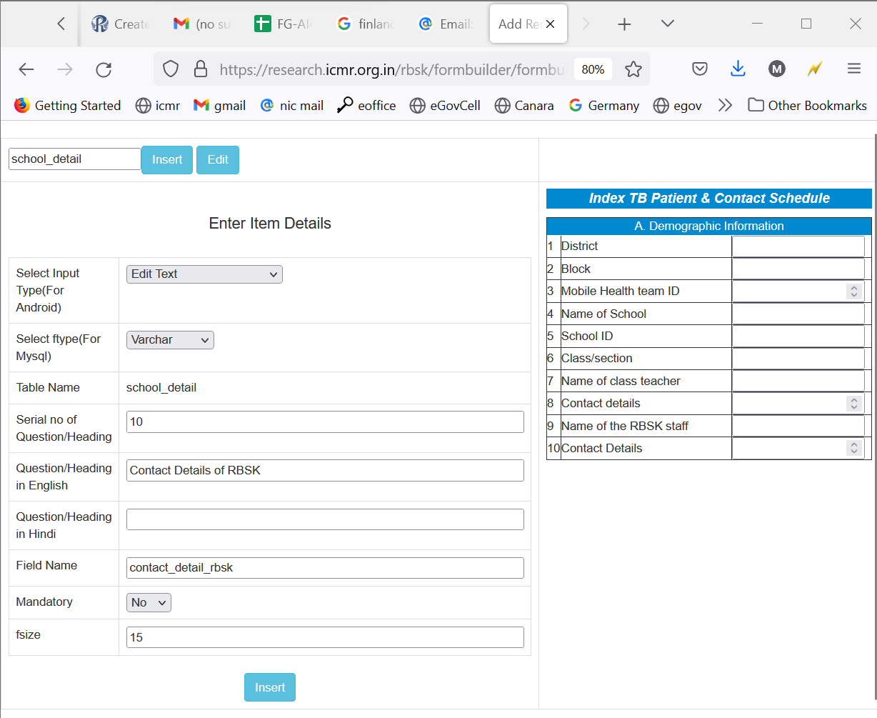
Web based system for preparing questionnaire for Disease Surveillance based Research Projects

Slide 10
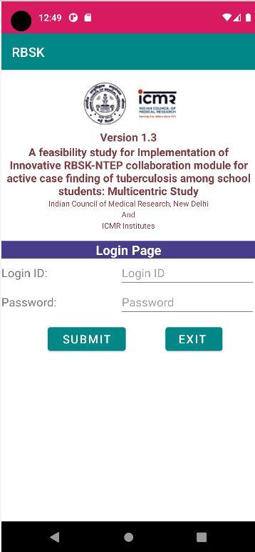
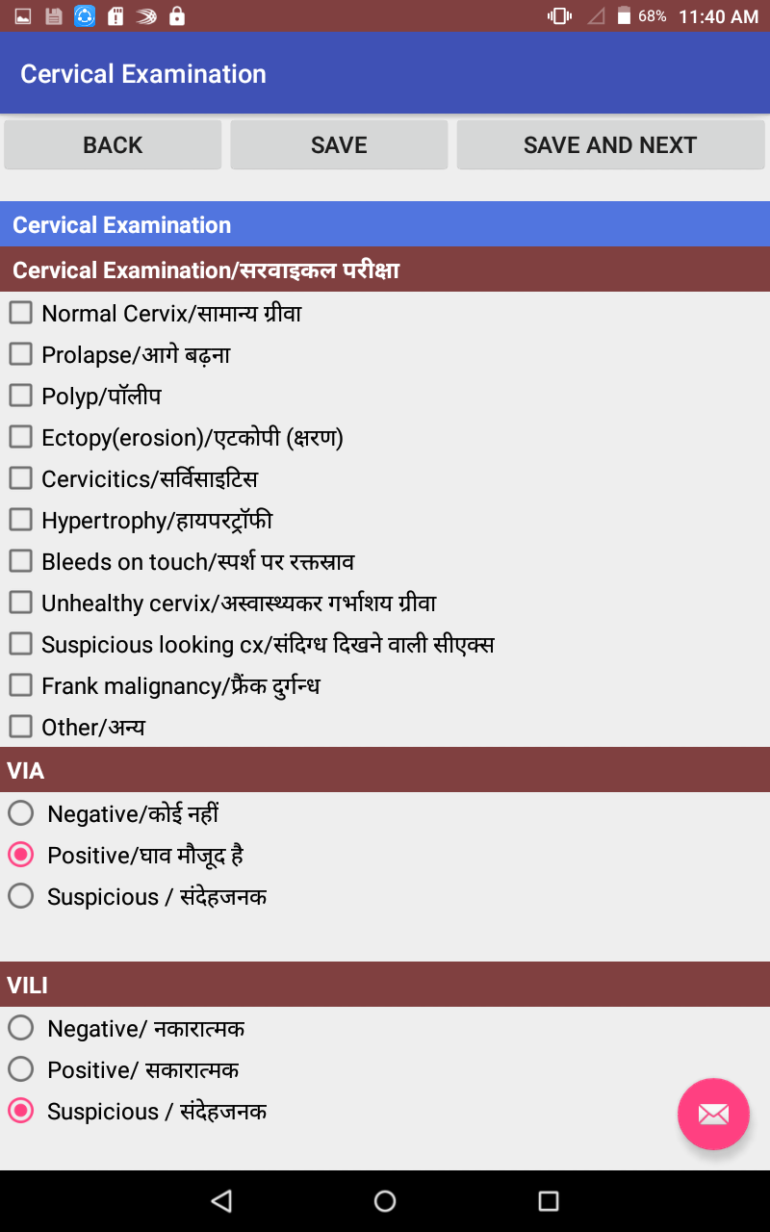
Working of Web & Mobile App based System
Common Questionnaire Database
Internet
Data Synchronization
Web Server
Mobile Application

Slide 11
Research Activities being Conducted at
ICMR-eGovernance Cell using automated system
TB prevalence in Tribal Population
RBSK-TB among school students
Adherence to TB Preventive Treatment
Strengthening NTEP Program
Mega TB Elimination Project
Mobile App to Assign Cause of Death
Palliative Care for Cancer patients
AI Tool for Screening/detection of TB using Chest X-rays
...

Slide 12
Benefits of automated Website & App System
Updation in website & App is easy by modifying common questionnaire database
Easy Data synchronisation between App & website
Easy Data validation
Export of Data in Decoded/Encoded format is easy
Easy to implement Security policies
Easily replicable

Slide 13
Thank You

