Slide 1
FGAI4H-Q-043
Douala, 6-9 December 2022
Source: | WG-Ethics
Title: | WG-Ethics update
Purpose: | Discussion
Contact: | Andreas Reis (WHO) Ursula (Yu) Zhao (WHO) | reisa@who.int zhaoy@who.int
Abstract: | This PPT contains an update from Ethics Sub-Group on activities on WG-Ethics.

Slide 2
ITU/WHO Focus Group "AI for Health"
17th Workshop/Meeting:
6-9 December 2022 Douala, Cameroon
Update from Ethics Sub-Group
7th December 2022

Slide 3
WHO publications on Ethics and governance of artificial intelligence for health
WHO is also issuing technical guidance documents :
May 2020: Ethical Considerations to guide use of digital proximity contact tracing (COVID-19)
Future documents will include ethical considerations of use of AI in pharmaceutical R&D, health financing, reproductive health etc.

Slide 4
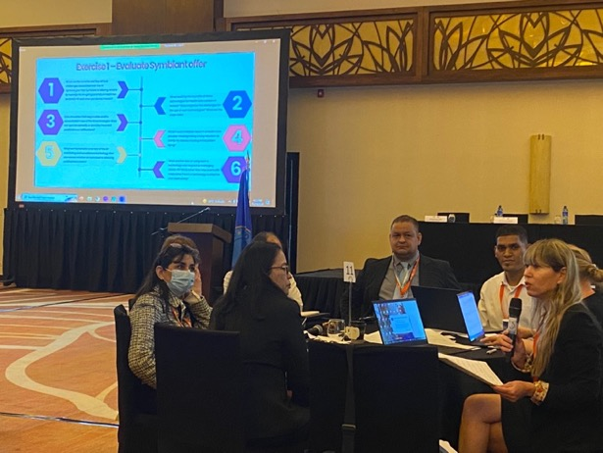
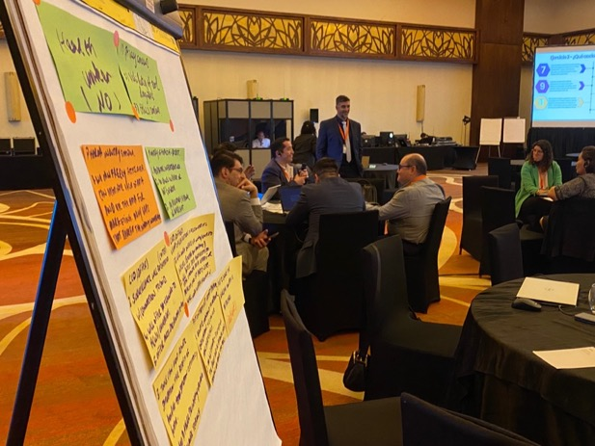
Updates on recent activities on Ethics & AI
Regional workshops
Pan-Americas region: 14 November 2022
Pilot workshop
70+ participants from Pan American countries
AI use cases in different health programmes
Case study: Welcome to country Amara

Slide 5
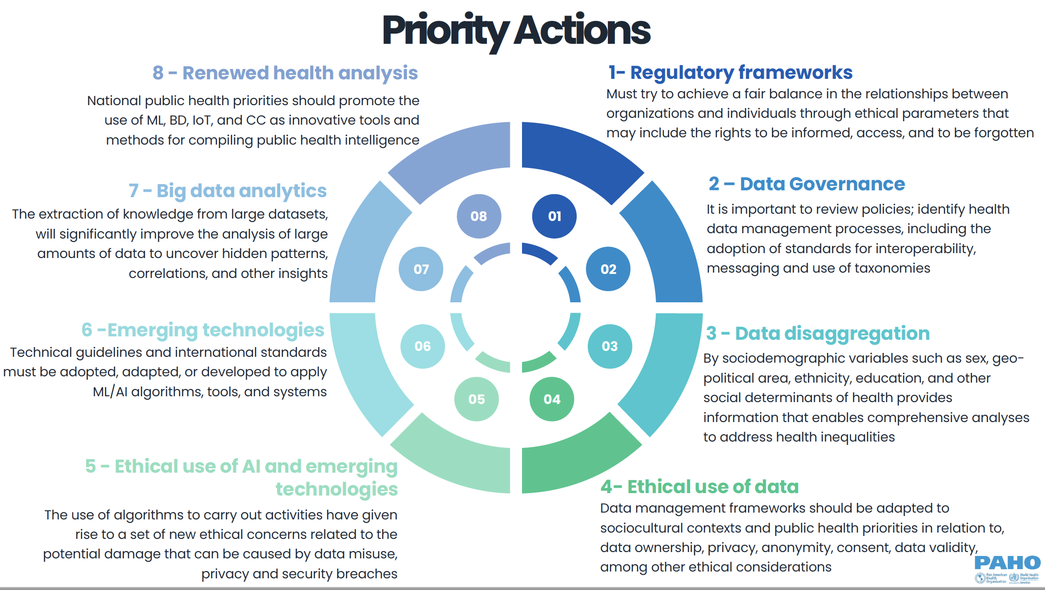
Updates on recent activities on Ethics & AI
Regional workshops
Pan-Americas region: 14 November 2022

Slide 6
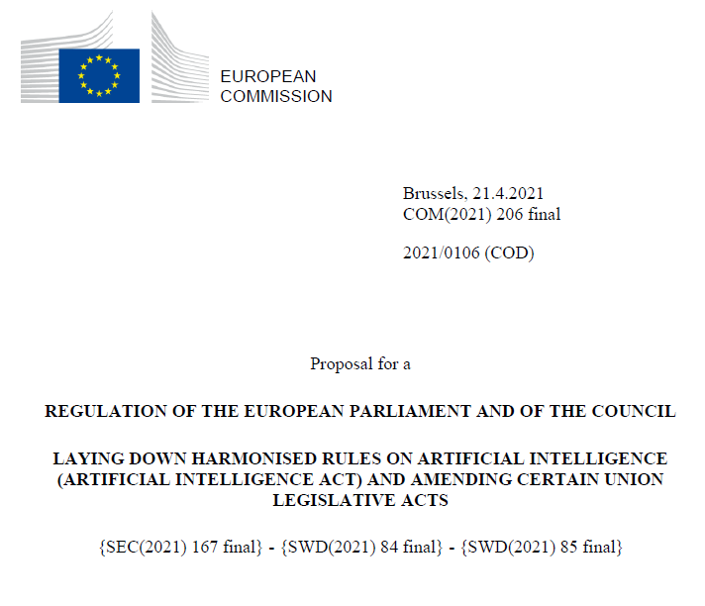
Updates on recent activities on Ethics & AI
Regional workshops
Europe region: 01-02 December 2022
10 Participants from Western Balkan countries
EU oriented

Slide 7
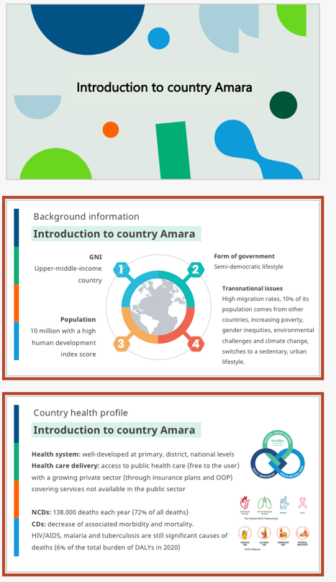
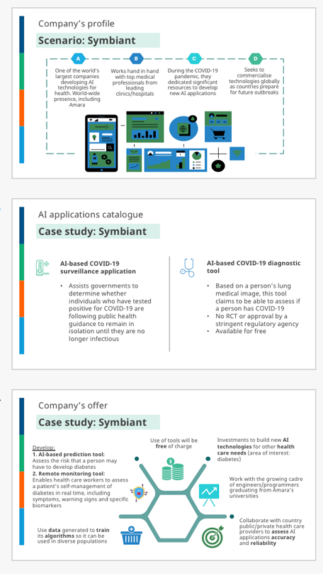
Case study – Country Amara
Introduction to Country Amara
Introduction to Scenario
Should Country Amara accept the offer?
Time keeping and other rules

Slide 8
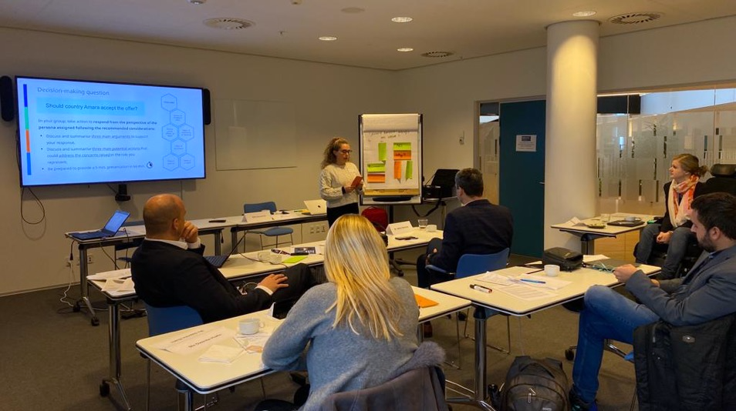
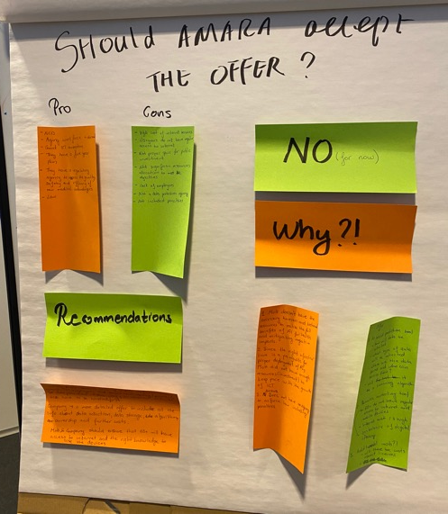
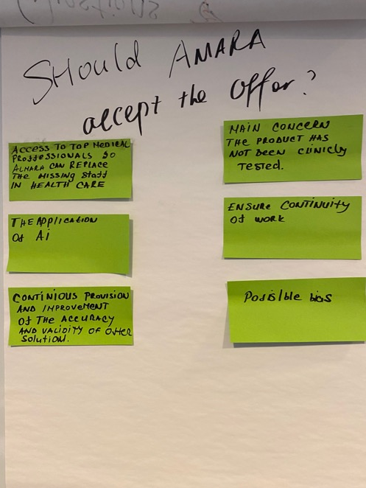
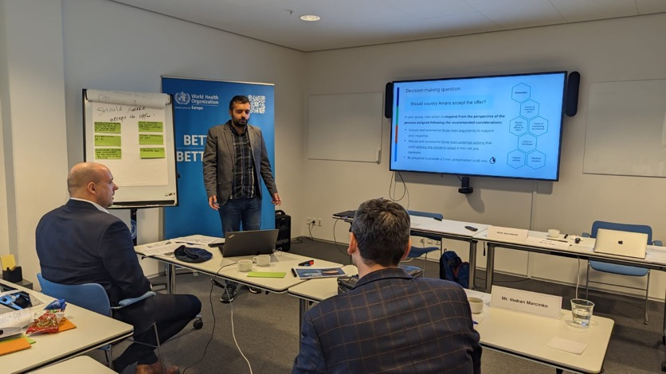
Persona:
Health worker
Persona:
Senior policy officer
“By analysing the same question from a very different perspective, we felt much clearly the issues that we always heard from doctors and health workers, and we realize that more communication between these two stakeholders is needed so to avoid unnecessary misunderstandings .”

Slide 9
Updates on recent activities on Ethics & AI
Upcoming regional workshops
Eastern Mediterranean region: 14-16 December 2022
Outlook 2023 and 2024:
2-3 configurable workshops/sessions at WHO regions per year
Participant handbook
Implementation toolkit

Slide 10
Updates on recent activities on Ethics & AI
Dissemination
Participation in AI and health ethics discussion convened by Google Health
Presentation and discussion with UNFPA (Asia) on the use of AI-based cervical cancer technologies
Discussions with FIND regarding ethics of AI-based diagnostics
Development of checklist and policy brief related to legislation accounting for ethics for use of AI for health.

Slide 11
Recent WHO/ITU Ethics Sub-Group activities
(2nd half of 2022)
Online curriculum for programmers
Development of on-line curriculum for programmers on integrating ethical considerations into the design of AI health technologies.
Background: Generic WHO online training course on Ethics & Governance of AI
(nearly 10 000 enrolments)
Demand by AI designers on specific training course

Slide 12
Recent WHO/ITU Ethics Sub-Group activities
(2nd half of 2022)
Online curriculum for programmers
Target audience
The course targets those individuals involved in data creation, data acquisition, model development, model evaluation, and model deployment of AI technologies for health applications, whether they work in public, private or not-for-profit sectors. It is expected to be of interest to:
full stack developers,
software engineers,
data scientists,
front and back-end specialists, and
principal investigators and/or site investigators.

Slide 13
Recent WHO/ITU Ethics Sub-Group activities
(2nd half of 2022)
Online curriculum for programmers
Objectives
Identify and describe the ethical challenges and risks that can materialize during the AI technology lifecycle.
Assess the ethical challenges and risks by raising relevant issues or questions throughout the decision-making process in all phases of the AI lifecycle.
Mitigate ethical challenges and risks by making informed decisions while integrating ethical, medical, epistemic, societal, and political considerations and values.

Slide 14
Recent WHO/ITU Ethics Sub-Group activities
(2nd half of 2022)
Online curriculum for programmers
Methodology
Modules organized around the AI-product development lifecycle and how different ethical principles apply at each stage.
Case-study (challenge) based approach
Provide examples of tools and technologies that are associated with implementing ethical design in practice.

Slide 15
Recent WHO/ITU Ethics Sub-Group activities
(2nd half of 2022)
Online curriculum for programmers
Next steps
Open call closed on 6th December
Provider selected and course skeleton draft by end of 2022
Course development 1st semester 2023
Goal: Course live by 1st August 2023

Slide 16
We must ensure the Digital Health revolution is safe, sustainable and leaves no one behind.
Thank you!

