Slide 1
FGAI4H-Q-042
Douala, 6-9 December 2022
Source: | WG-DAISAM
Title: | ML4H Trial Audits–Iteration 2.0
Purpose: | Discussion
Contact: | Pradeep Balachandran | E-mail: pbn.tvm@gmail.com
Abstract: | This presentation contains the latest updates on the ML4H trial audits–Iteration 2.0 project.

Slide 2
ML4H Audit :Scope
Aims at conducting the verification and validation of the technical, clinical, regulatory and ethical requirements of ML4H solutions developed by the Topic Groups following a structured audit process.
Long term goal : Standardized audit framework for conformity assessment
of ML4H products.

Slide 3
Team Progress Evaluation
 | Progress Chart
 | Assessment Platform on boarding | Audit –Qualitative & Quantitative assessment | Audit Report Generation | JoMS / Peer Journal manuscript preparation | Peer Review Process
Teams | Stage I | Stage II | Stage III | Stage IV | Stage V
TG-MSK | ✓
TG-Neuro | ✓
AI-Vengers-Collab | ✓
TG-Symptoms | ✓
TG-Radiology | ✓ | ✓ | ✓
TG-Ophthalmology | ✓ | ✓ | ✓
TG-Falls | ✓ | ✓ | ✓
TG-Psychiatry | ✓ | ✓ | ✓ | ✓
TG-Outbreaks | ✓ | ✓ | ✓ | ✓
TG-Dental | ✓ | ✓ | ✓ | ✓ | ✓

Slide 4
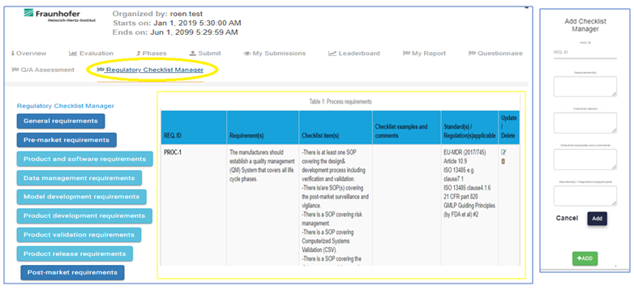
Audit Framework- Current Progress
“Regulatory Checklist Manager” implementation as an ML4H audit workflow utility towards verification of regulatory requirements.

Slide 5
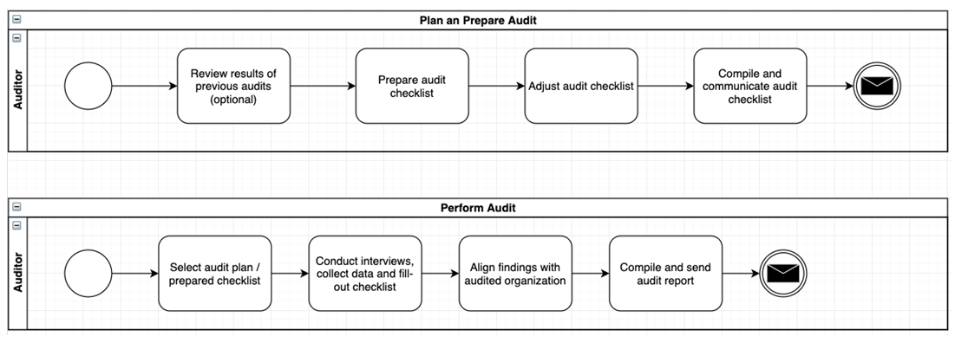
Audit Framework- Current Progress
Process Flow Implementation

Slide 6
Thank you

