Slide 1
RADIOLOGY IN AFRICA
Prof. Dr Ahmed Ahidjo
Professor of Radiology
Consultant Diagnostic and Interventional Radiologist
Department of Radiology
University of Maiduguri Teaching Hospital
PMB 1414, Borno State, Nigeria
Email: ahmedahidjo@hotmail.com

Slide 2
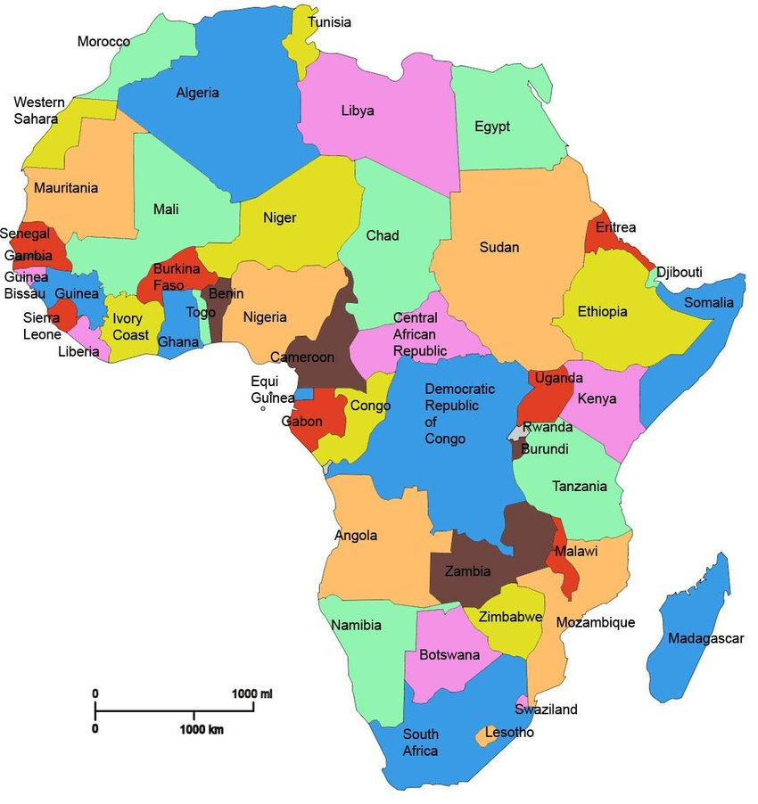

Slide 3
OUTLINE
CLINICAL SERVICE
Equipment
Personnel
Skills
Public/Private
Primary, Secondary or Tertiary
TRAINING
Residency
Radiography
RESEARCH
Mostly for academic progression
Need for research
Grants

Slide 4
RADIOLOGY EQUIPMENT
Ultrasound
Radiography units-mobile, static, conventional, digital
Fluoroscopy
Mammography
Dexa
Angiography
CT
MRI

Slide 5
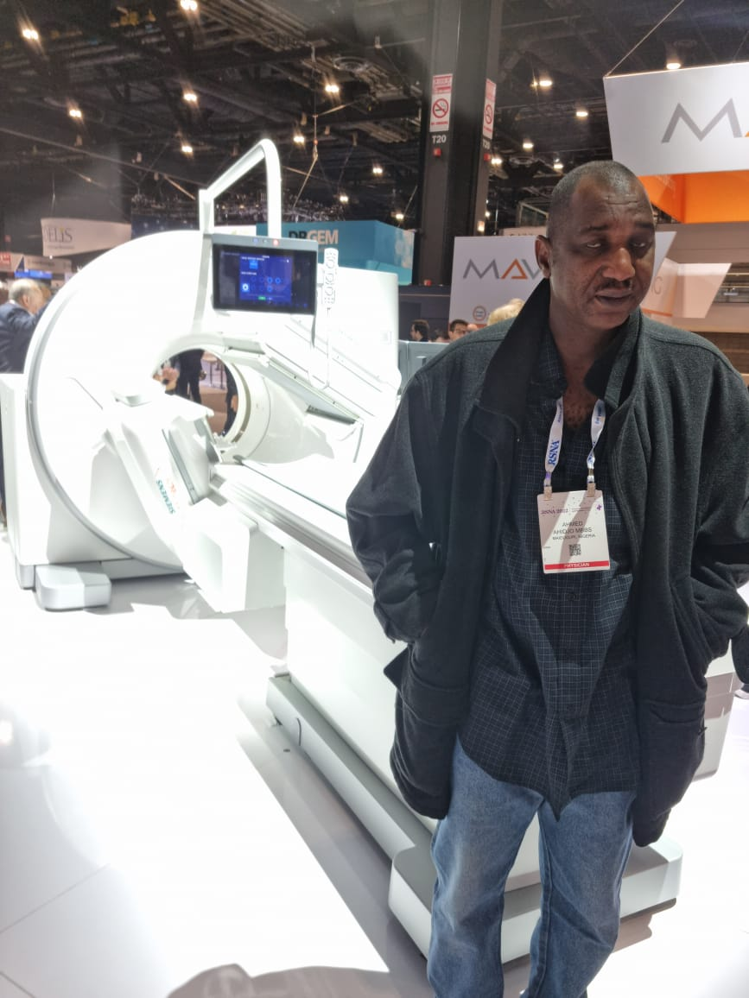
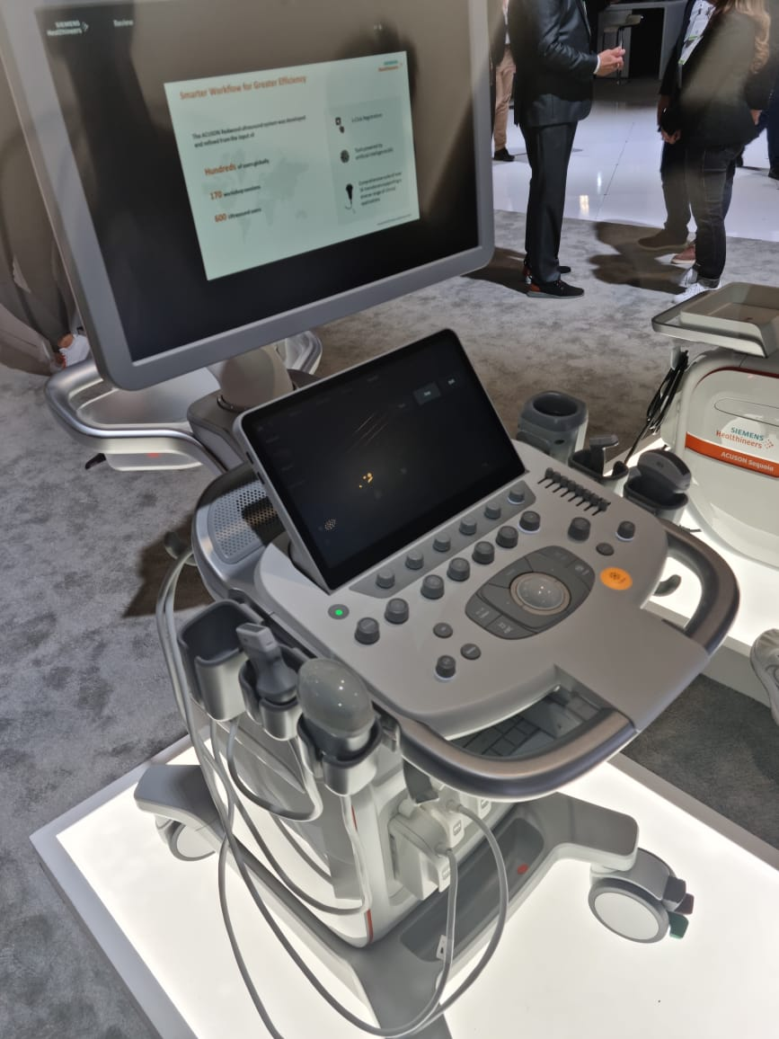

Slide 6
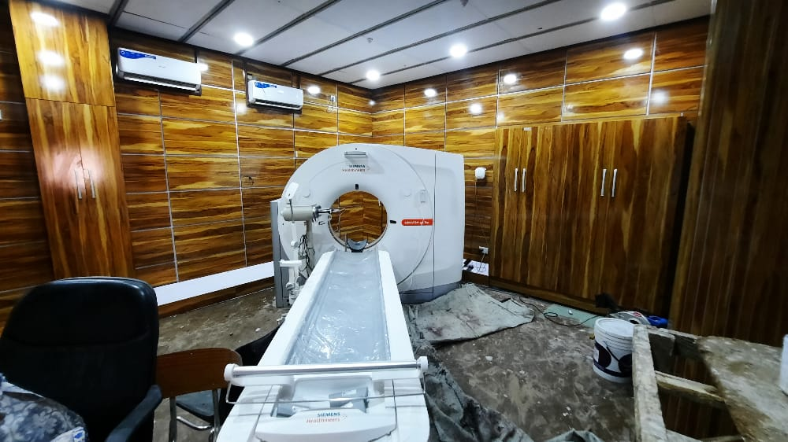

Slide 7
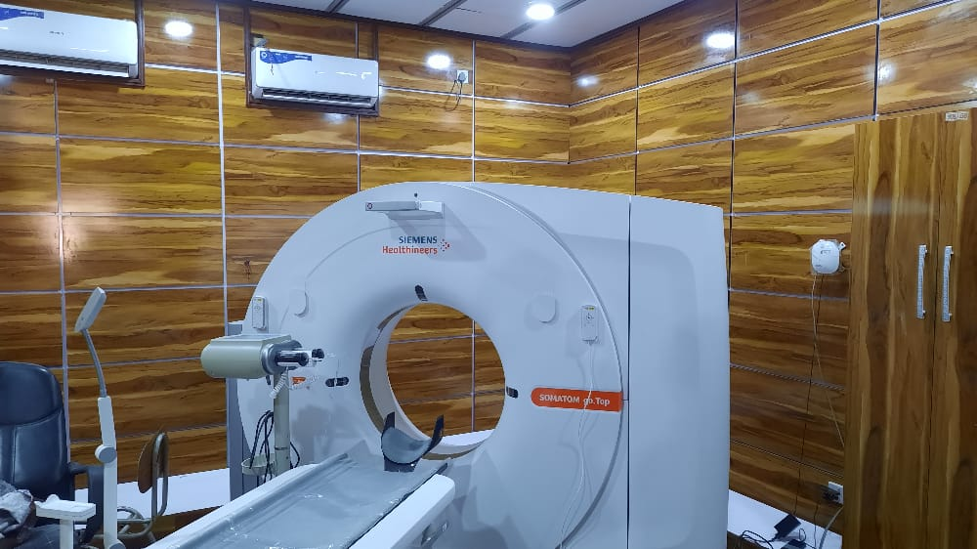

Slide 8
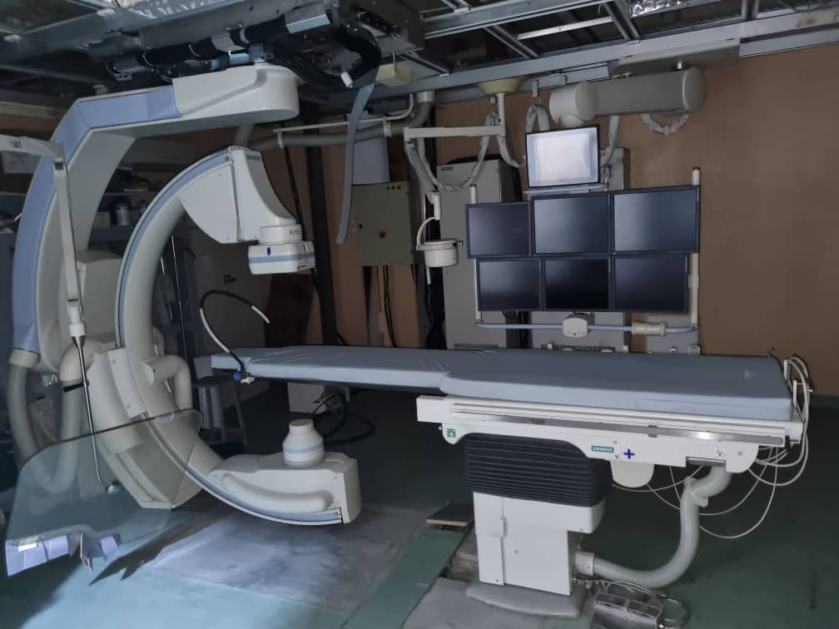
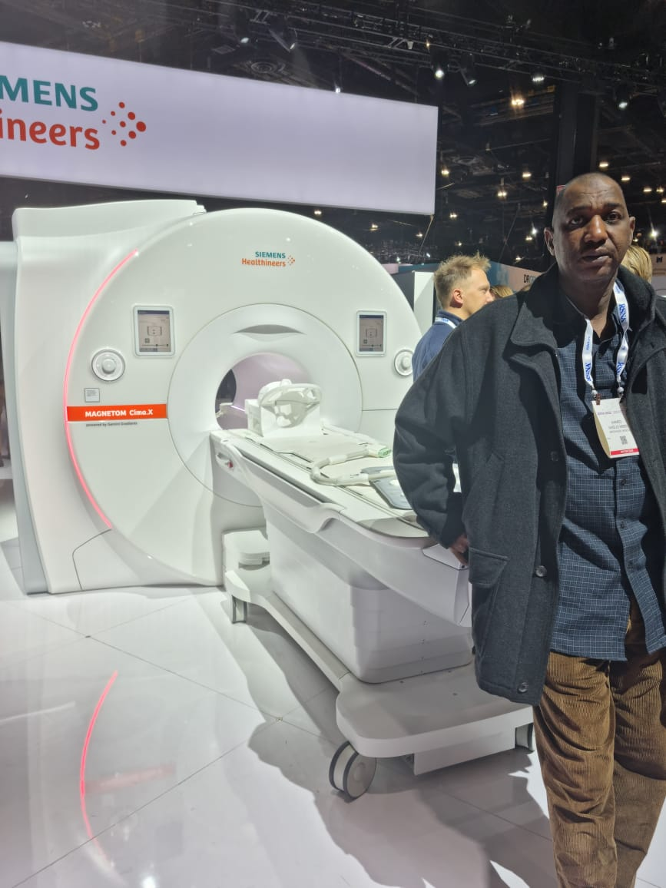

Slide 9
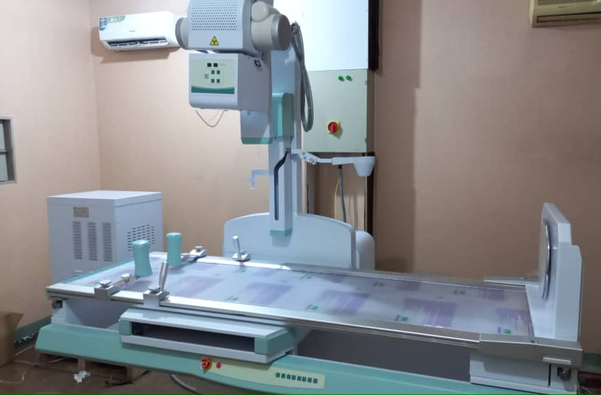

Slide 10
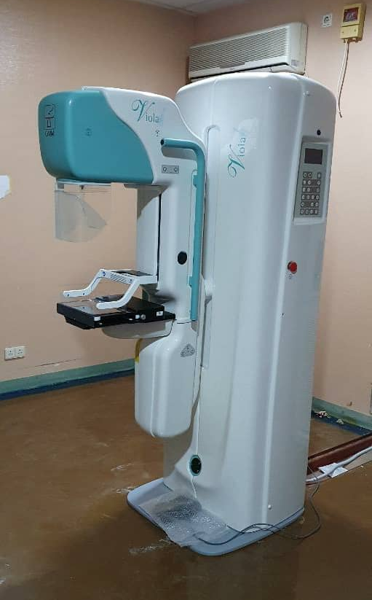
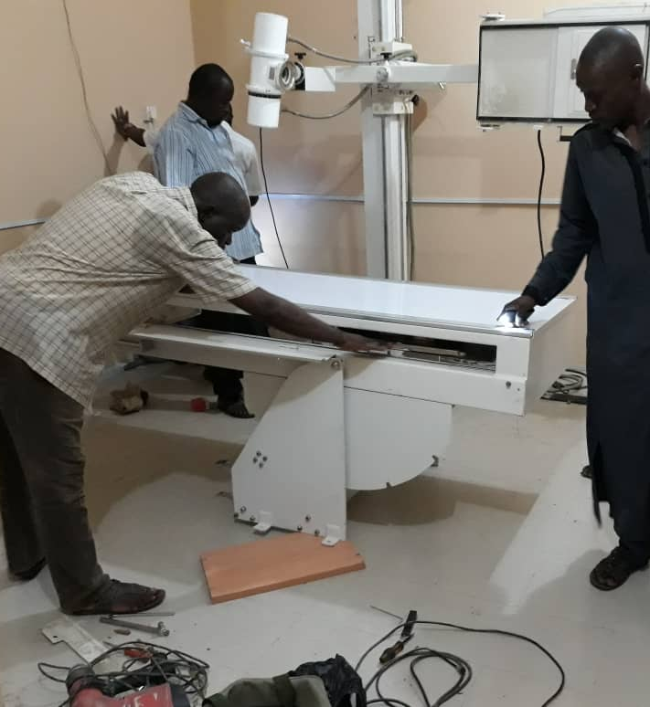

Slide 11
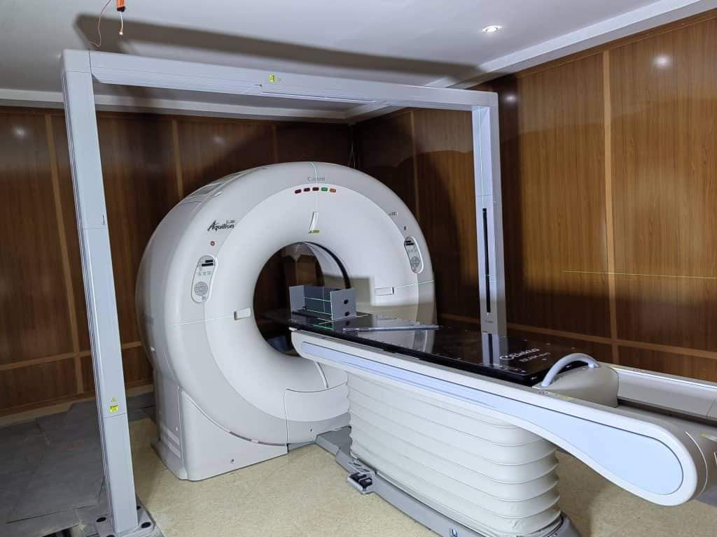

Slide 12
RADIOLOGY SPECIALTIES:
General Radiology
Neuro-Radiology
Breast/Female Imaging
Vascular and Interventional Radiology
Musculoskeletal Radiology
Chest Radiology
Paediatric Radiology
Uro-Radiology
Emergency Radiology

Slide 13
MODALITY BASED SPECIALTIES
Ultrasound
Mammography
Angiography
CT
MRI

Slide 14
TRAINING
1. RESIDENCY
Requirement
Duration
Accreditation
Institutions
Fellowship/Memberships
MSc/PhD
Short term Clinical attachment
CPD

Slide 15
2. RADIOGRAPHERS/TECHNICIANS
Training Programme
Service
Availability
Team Work
Delegated duty

Slide 16
PROFESSIONAL SOCIETIES
Continental/African
Regional
Country Societies
State Chapters

Slide 17
INTERVENTIONAL RADIOLOGY
Practice
Training
Societies
Collaboration

Slide 19
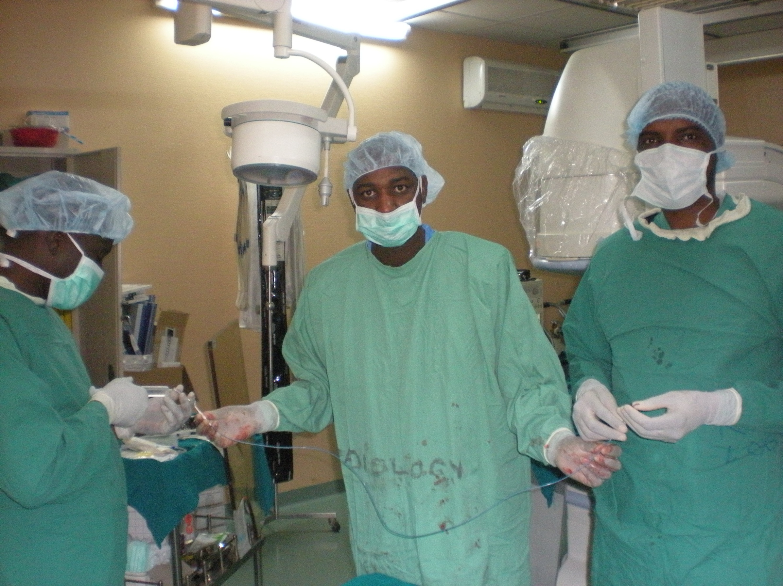

Slide 20
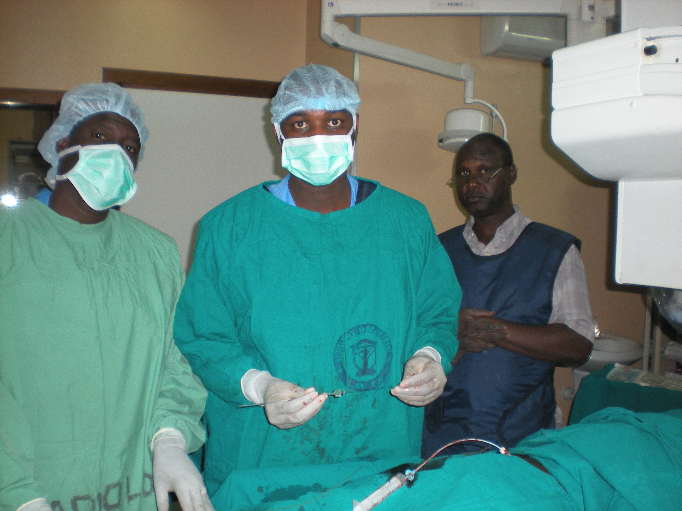

Slide 21
ARTIFICIAL INTELLIGENCE AI
What is it?
My experience
RSNA 2022
Benefits
Challenges
Infrastructural deficits
Funding
Electricity
Funding
Human Resources
Africanizing/domesticating software

Slide 22
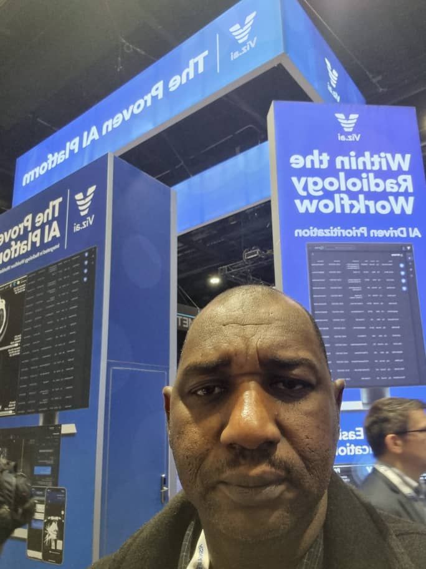
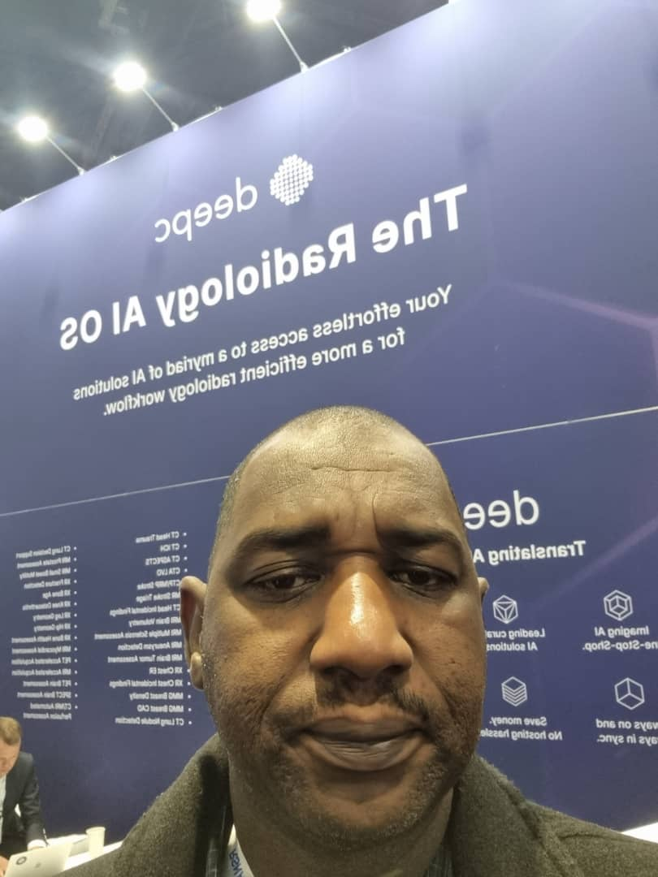

Slide 23
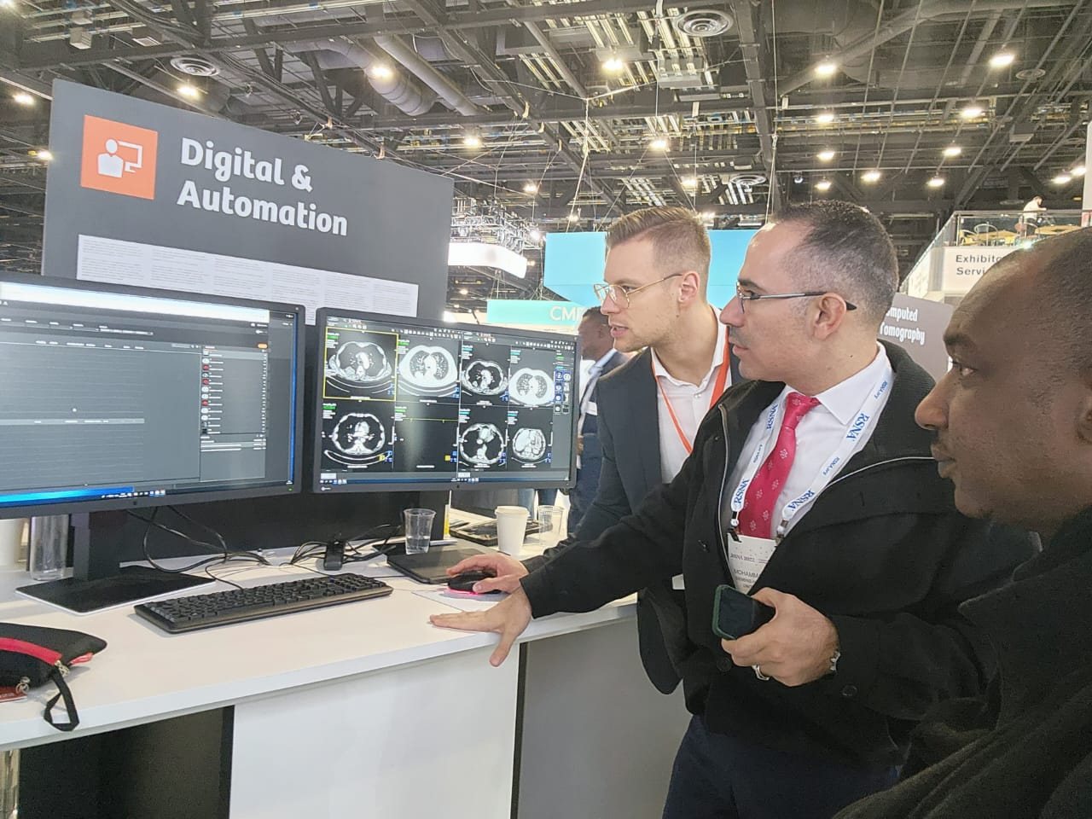

Slide 24
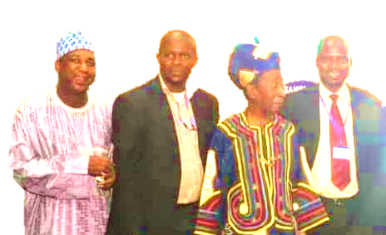
GOODBYE
AU REVOIR
MIYETTI

