Slide 1
FGAI4H-Q-039
Douala, 6-9 December 2022
Source: | HPI
Title: | OCI update - AI-supported Medical Image Annotation Platform
Purpose: | Discussion
Contact: | Tony Arnold Daniel de Jonge Konrad Gerlach Richard Keil Tim Riedel Johanna Schlimme Janis Wehen | E-mail: bp-lippert-team@lists.myhpi.de
Abstract: | This PPT contains a presentation on AI-supported Medical Image Annotation Platform as an update to OCI.

Slide 2
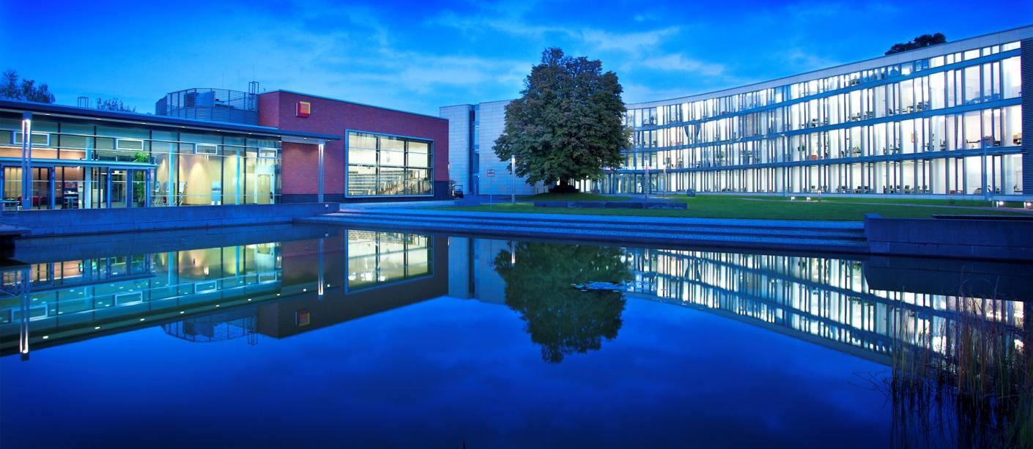
Bachelor Project
AI-supported Medical Image Annotation Platform
07.12.2022
Tony Arnold, Daniel de Jonge, Konrad Gerlach, Richard Keil, Tim Riedel, Johanna Schlimme, Janis Wehen

Slide 3
Introduction
7 students in the 5th bachelor semester (IT-Systems Engineering)
Project duration: ~9 months (until July 2022)
2 days per week working until March, after that full time
Bachelor thesis will be based on the project
contact: bp-lippert-team@lists.myhpi.de
Bachelor Project
AI-supported Medical Image Annotation Platform
Goal: To provide a flexible human-in-the-loop AI solution for easy use of ML models on medical image data along with comfortable project management for data and model versioning.
07.12.2022

Slide 4
AI-supported Annotation Service
supports existing Visian frontend
allows training models and automatically using them for inference on existing datasets
leads to an iterative workflow which allows researchers to generate and directly re-use medical image annotations
ability to easily self-host and deploy
allows easy integration with 3rd party services to provide custom annotation functionality (e.g. FG-AI4H Platform)
Bachelor Project
AI-supported Medical Image Annotation Platform
07.12.2022

Slide 5
General Workflow
Bachelor Project
AI-supported Medical Image Annotation Platform
07.12.2022

Slide 6
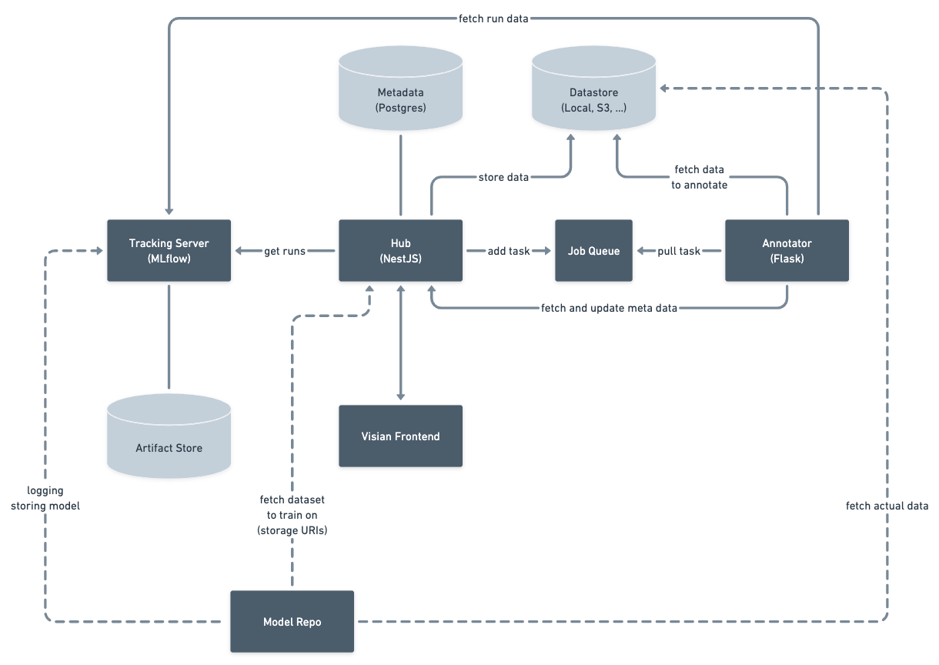
AI-supported Annotation Service
Bachelor Project
AI-supported Medical Image Annotation Platform
07.12.2022

Slide 7
Thank you for your attention!
07.12.2022
Tony Arnold, Daniel de Jonge, Konrad Gerlach, Richard Keil, Tim Riedel, Johanna Schlimme, Janis Wehen

