Slide 1
FGAI4H-Q-033-A01
Douala, 6-9 December 2022
Source: | Editors DEL7.4
Title: | Att.1 - Presentation - DEL7.4 Update: Clinical evaluation of AI for health
Purpose: | Discussion
Contact: | Naomi Lee Shubs Upadhyay Eva Weicken | E-mail: naomi.lee@lancet.com E-mail: shubs.upadhyay@ada.com E-mail: eva.weicken@hhi.fraunhofer.de
Abstract: | This PPT contains a presentation of: Status update Working Group on Clinical Evaluation Updates on DEL 7.4.

Slide 2
FG-AI4H Working Group on Clinical Evaluation Deliverable 7.4
FG-AI4H meeting “Q”, 06-09 December 2022
Naomi Lee, Shubs Upadhyay, Eva Weicken

Slide 3
Overview & activities
FG-AI4H Working Group on Clinical Evaluation

Slide 4
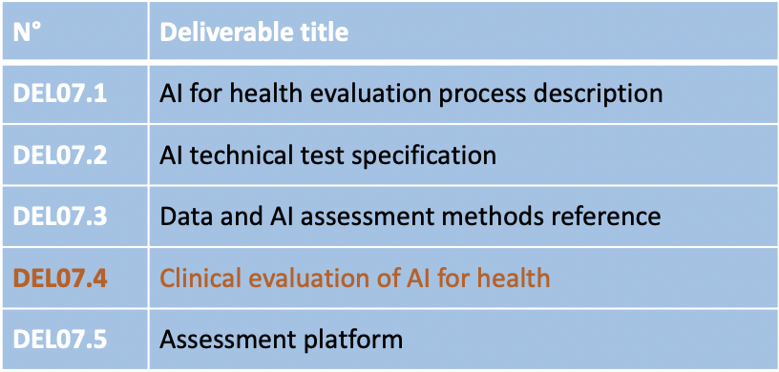
Objective
Collaboration with other expert groups & global stakeholders
Guidance for best practice evaluation and principles of evaluation
Special consideration LMIC settings
Framework for: clinicians, researchers, developers, regulators, policy makers & patients, public
To be used with other FG-AI4H guidance

Slide 5
Collaboration 65+ members
External expert group (in alphabetical order): AbouElkhir Osama (Tachy Health, Dubai), Akogo Darlington (minoHealth AI Labs, Ghana), Allen Megan (Inspired Ideas, Tanzania), Alsalamah Shada (WHO, Switzerland), Balachandran Pradeep (Freelancer E-Health, India), Bastawrous Andrew (Peek Vision, Global Eye Health, UK), Bathke Arne (Paris Godron University Salzburg, Austria), Chiavegatto Filho Alexandre (São Paulo University, Brazil), Cresswell Kathrin (University of Edinburgh), Darkoh Ernest (BroadReach Healthcare, South Africa), Ehrenfeld Jesse (AMA, USA), Fehr Jana (Hasso-Plattner-Institute, DE), Fürstenau Daniel (Copenhagen Business School, Denmark), Gaudin Robert (Charitè, DE), Gilbert Stephen (University of Dresden, DE), Greaves Felix (Science, Evidence and Analytics, NICE, UK), Gupta Saurabh (Department of Cardiology, All Inst. of Medical Sciences, New Delhi), Gütter Zdenek (University Hospital Olomouc, Czechia), Hatton Grace (Sensyne Health, UK), Ho Dean (National University of Singapore, Singapore), Ibrahim Hussein (Doctors.net.uk, UK), Islam Shariful (Deakin University, AUS), Jarral Reza (Pro Care, NZ), Jeon Jonghong (Electronics and Telecommuncations Research Institute, South Korea), John Oommen (George Institute for Global Health, India), Kadam Rigveda (Head of digital access, FIND, Switzerland), Kherif Ferath (LREN, Switzerland), Kuku Stephanie (WHO, UCL, Switzerland, UK), Kurtys Michal (Infermedica, Poland), Lapão Luís (Velez) (University of Lisbon, Portugal), Linder Nina (University of Helsinki, Finland), Loh Irving (infermedica, USA), Loveys Kate (University of Auckland, NZ), Magrabi Farah (Macquarie University, Sydney, AUS), Mahajan Arnav (Department of Medicine, University College Cork, Ireland), Malpani Rohit (WHO, Switzerland), Mamun Khondaker (CMED Health, Bagladesh), Masud Jakir Hossain Bhuiyan (CTS Bangladesh), Matin Rubeta (Oxford University Hospitals NHS Foundation Trust, UK), Matthew Fenech (Una Health, DE), McCradden Melissa (University of Toronto, Canada), Menezes Audrey (Healthily, UK), Murchison Andrew (Oxford University Hospitals NHS Trust, UK), Murphy Lisa (Centre for Improving Data Collaboration at NHSX, UK), Nakasi Rose (Makerere University, Uganda), Oala Luis (Fraunhofer Heinrich Hertz Institute, DE), Pankova Natalie (Metadvice, UK), Piekut Agata (Health Action Tank, Poland), Porras Lina (1Doc3, Colombia), Reddy Sandeep (Deakin University, AUS), Salim Ally (Inspired Ideas, Tanzania), Schwendicke Falk (Charitè, DE), Sethi Tavpritesh (Indraprastha Institute of Information Technology Delhi, India), Sood Harpreet (NHS, UK), Sousa Inês (Fraunhofer Portugal, Portugal), Srivastava Manish (Virginia Polytechnic Institute & State Univ., USA), Starlinger Johannes (Howto Health Digital Business Solutions, DE), Wasswa William (Global Auto Systems LTD, Uganda), Werneck Leite Alixandro (Tribal, Mexico)
Writing group (in alphabetical order): Carolan Jane (UCL Institute of Health Informatics, UK), Denniston Alastair (University of Birmingham, UK), Karpathakis Kassandra (Decimal.Health, USA), Lee Naomi (Lancet, UK), Liu Xiao (University of Birmingham, UK), Upadhyay Shubhanan (Ada Health, DE), Weicken Eva (Fraunhofer HHI, DE), Wilkinson Thomas (World Bank Group, USA)

Slide 6
Timeline

Slide 7
The framework
FG-AI4H Working Group on Clinical Evaluation

Slide 8
Table of content
Executive Summary
Introduction
Model design and suitability
Algorithmic validation
Clinical validation
Deployment and ongoing monitoring
Economic evaluation
Conclusions and recommendations for future action
References
Link to Del 7.4

Slide 9
Framework for evaluation of AI in health

Slide 10
Latest activities & next steps
FG-AI4H Working Group on Clinical Evaluation

Slide 11
Latest activities
Publication (alongside WG-RC document), submitted to WHO
Outreach & communication, e.g., CAICT
Collaboration, e.g., FIND
Improvement and implementability, e.g., Helsinki University, topic group Point-of-care (case study, "testing" of WG-CE doc)
Further work, e.g. Economic evaluation
establish an expert group & finding a chair(s) and interested contributors

Slide 12
Outreach, collaborations, communication WG-CE meeting Oct ’22: Identifying the “What”
Education
Create a shorter, condensed version (2-pager)
Creating training materials (e.g., WHO-course) and slides for decision makers, developers
WG-CE = forum for people to get the ability to get together & convene
Accessibility
Making sure this group is advocate for access to clinical evaluation for in health

Slide 13
Implementation, gaps & further work WG-CE meeting Oct ’22: Identifying the “What”
Implementation & Gaps
Closing the implementation gap? Could include: case studies, round tables, WHO course, checklist
Making sure to continuously involve FG-AI4H topic groups
Focusing on LMIC or any other context?
making sure results of evaluation trials in hospitals s are reported and shared transparently (a gap?)
Implementation test by TG-POC will provide more information on the gaps of this document
Economic evaluation
Create an expert group on economic evaluation
Need to find chair(s) and interested members & organize a follow-up meeting with experts

Slide 14
Who do we need to work on this?
&
How can the ideas be realized?

Slide 15
Thank you!
For feedback & questions, please contact
naomi.lee@lancet.com, shubs.upadhyay@ada.com, eva.weicken@hhi.fraunhofer.de

