Slide 1
FGAI4H-Q-032-A01
Douala, 6-9 December 2022
Source: | Editors DEL10
Title: | Att.1 - Presentation - DEL10 Update: AI4H use cases: Topic Description Documents
Purpose: | Discussion
Contact: | Eva Weicken | E-mail: eva.weicken@hhi.fraunhofer.de
Abstract: | This PPT contains a presentation of: an introduction to the topic groups an update on DEL 10_0 “Del. 10_0: AI4H use cases: Topic Description Documents”

Slide 2
24 topic groups
Huge variety of specific health use cases in the context of AI​

Slide 3
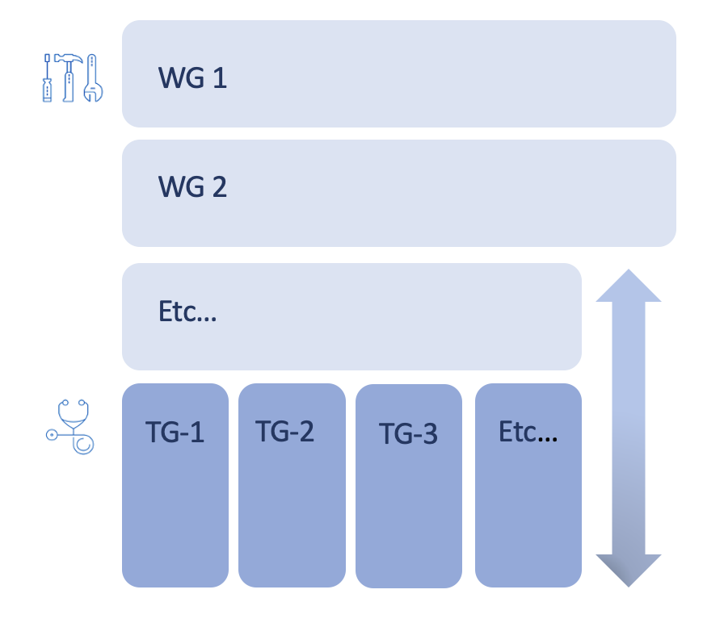
Topic groups x Working groups Matrix structure
WG = Working Groups
TG = Topic Groups

Slide 4
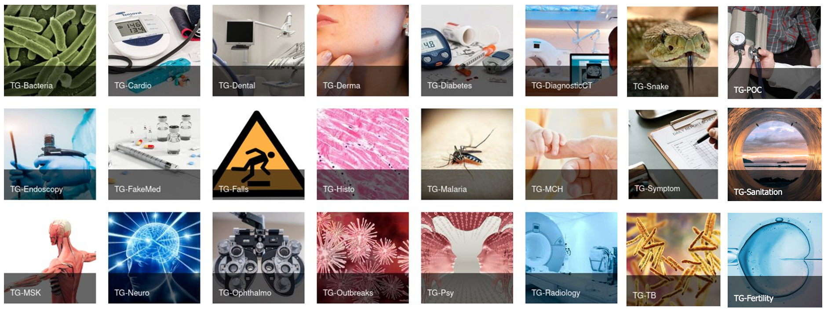
TGs create benchmarking standards for AI-for-health: organization
specific health/AI use case, e.g., Malaria detection from blood smear images, tuberculosis screening from x-rays
producing evidence and case studies, propose procedures to benchmark AI models, combine experts & data
Topic driver(s) organize work, collaboration site
Developing a topic description document (iteratively improved)

Slide 5
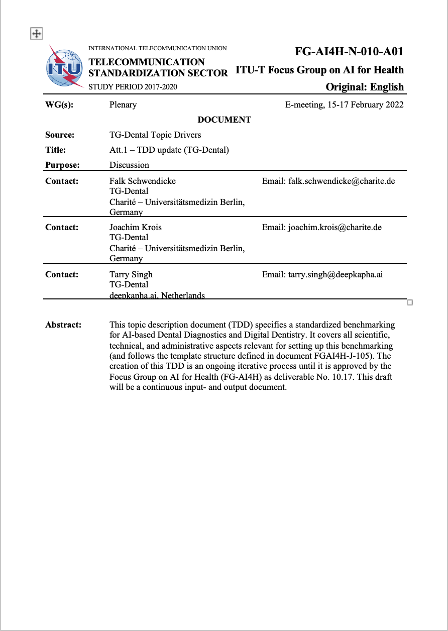
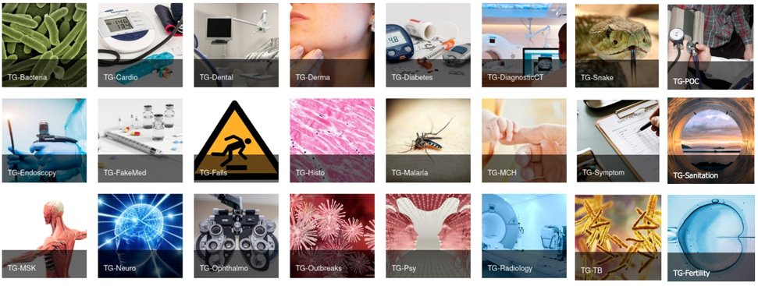
TGs create benchmarking standards for AI-for-health: Topic description document
Topic description document
template (J-105)
Source: ITU
Topic groups (TGs) create output documentation
Sections on the ethical, technical, clinical, regulatory requirements for the benchmarking
Categories: Background, features, operations, considerations

Slide 6
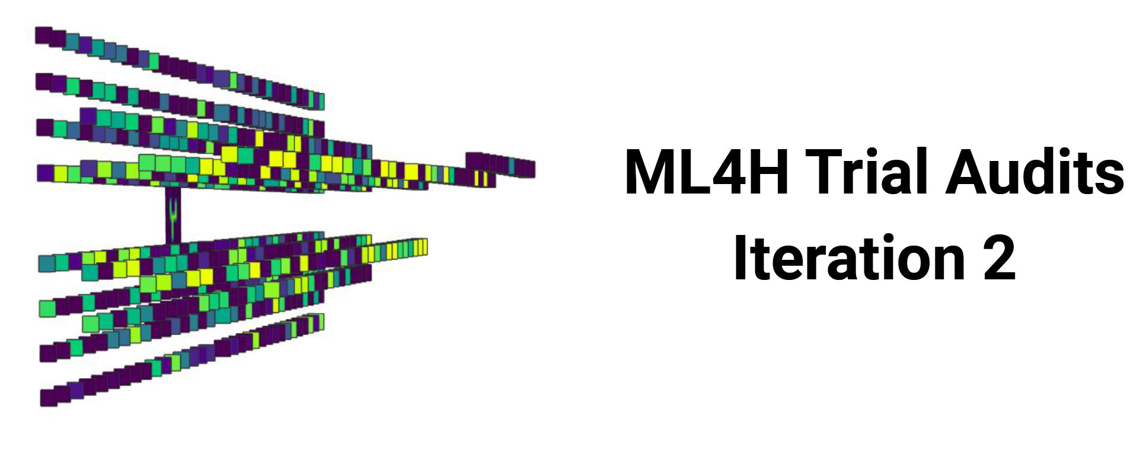
More topic group activities
& Open Code Initiative
Topic groups
Ophthalmology – Malaria – Symptoms – Psychiatry – Snakes – Radiology – Neurology – Outbreaks – Dental – Falls – … tbc
Source: aiaudit.org

Slide 7
Thank you for your attention!
Contact info:
Eva Weicken eva.weicken@hhi.fraunhofer.de

