Slide 1
FGAI4H-Q-030-A01
Douala, 07-09 December 2022
Source: | Markus Wenzel¹, David Neumann¹, Sandeep Reddy², Annika Reinke³, Alberto Merola⁴, Steffen Vogler⁵ ¹Fraunhofer HHI, ²Deakin University, ³DKFZ, ⁴AICURA medical, ⁵Bayer
Title: | Att.1 - Updated DEL07: AI for Health Evaluation Considerations - Presentation
Purpose: | Discussion
Contact: | Markus Wenzel | E-mail: markus.wenzel@hhi.fraunhofer.de
Abstract: | Summary of updates in DEL07: AI for Health Evaluation Considerations (see FG-AI4H-Q-030-R1-A01), for presentation and discussion during the meeting.

Slide 2
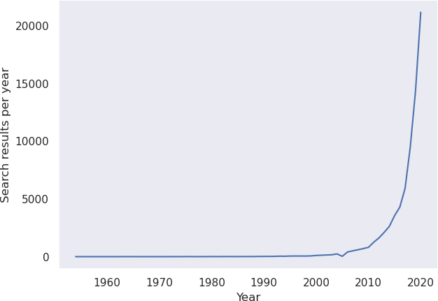
Background: Healthcare AI Models
Offer great potential for many applications in healthcare
Recognize, classify, predict, warn early, recommend, help to decide, …
Effective, safe, accurate on new data, robust, plausible, fair?
Standards for trustworthy healthcare AI needed
Careful evaluation plays crucial role

Slide 3
Deliverable 7) AI4H Evaluation Considerations
Background
Evaluation process
Novelty
Standardized model benchmarking
Benchmarking platform requirements
Best practices from literature

Slide 4
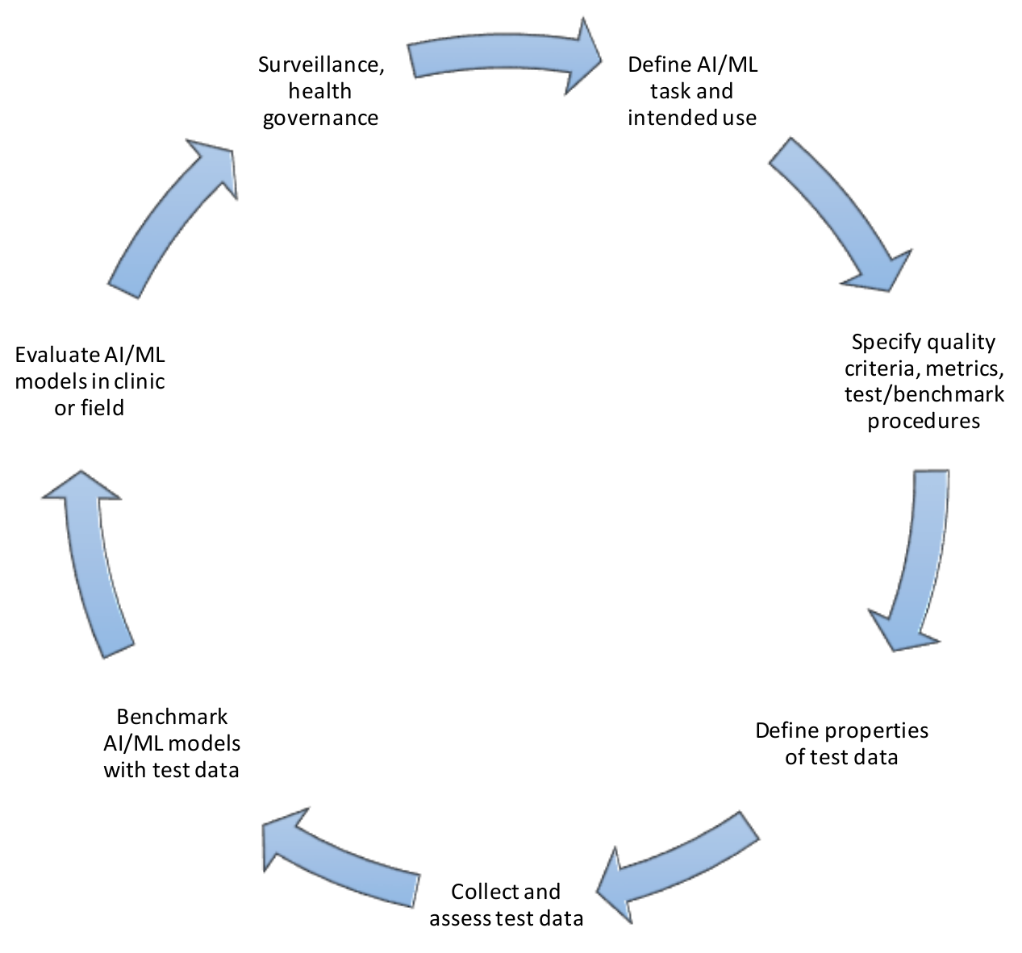
Cyclical Evaluation Process

Slide 5
Cyclical Evaluation Process
DEL 7.4) Clinical Evaluation
DEL 1) Ethics/ governance & DEL2) regulation
DEL 7.2) Technical test specification
DEL10.*) Topic Description Documents (TDDs)
DEL 7) Evaluation Considerations
DEL 5.*) Data specification etc.

Slide 6
Novel Aspects of Health AI Model Evaluation
Appropriate test data sets
Internal vs. external validation
Technical vs. clinical criteria
Proper benchmarking
Complex models and settings
Self-learning algorithms
Human factors
Misuse accurate tools
Design of clinical trials with AI
Agreement on/interoperable encoding of benchmarking cases
Testing existing AI products vs. ML-challenges

Slide 7
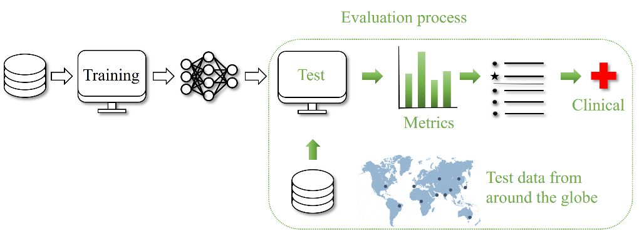
Standardized Benchmarking
Independent model validation with standard procedures on separate test data and subsequent clinical evaluation
(1) Closed environment, (2) Via interface, (3) Federated

Slide 8
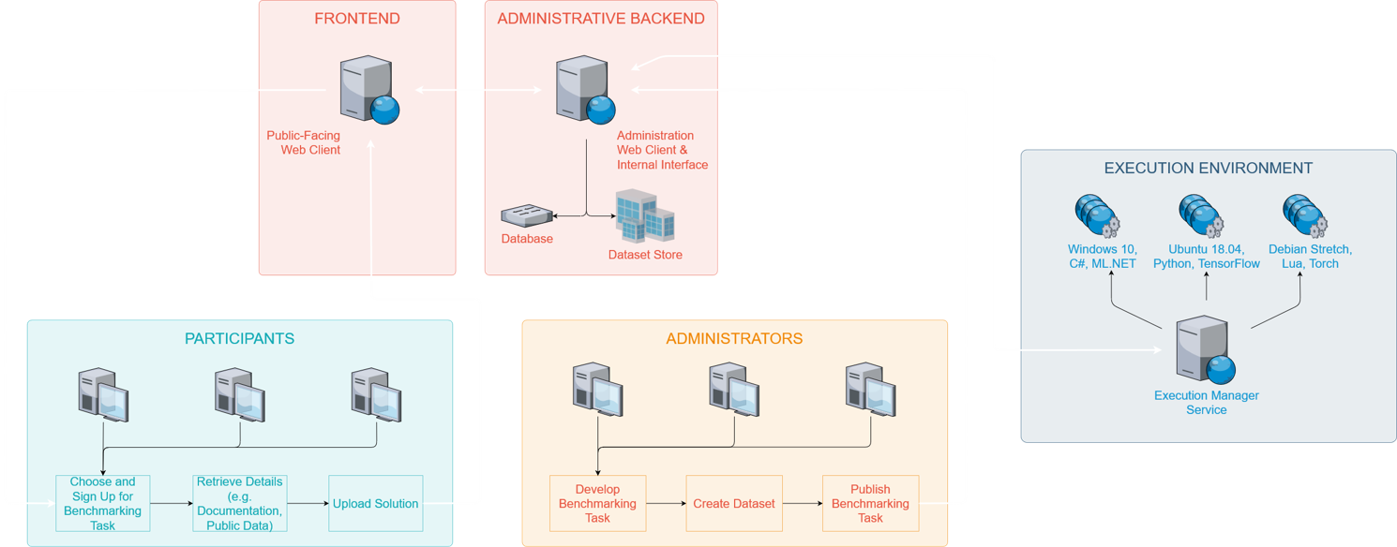
Benchmarking platform – requirements
System overview (administrative backend · frontend · execution environment)​
General considerations (security · hosting · computing resources · availability)​

Slide 9
Collection of Publications With Best Practices
Scientific literature and other documents
Relevant quotes & brief discussion
Please point us to literature you find relevant

Slide 10
Status Update
Improved text; current version in good shape; revision by 3rd appreciated
Turning vision for AI4H benchmarking platform into practice: http://github.com/fg-ai4h & https://health.aiaudit.org/ as part of https://ai4h.net
See talk later: evaluation package of FGAI4H Open Code Initiative

