Slide 1
FGAI4H-Q-029-A03
Douala, 6-9 December 2022
Source: | TG-TM Topic Driver
Title: | Att.3 – Presentation (TG-TM)
Purpose: | Discussion
Contact: | Saketh Ram Thrigulla | E-mail: dr.saketram@gmail.com
Abstract: | This PPT contains a presentation of: Status update Talking Group on Traditional Medicine Updates on DEL.10.2.

Slide 2
Call for Participation in the Topic Group “AI for Traditional Medicine” (TG-TM) Deliverable DEL.10.2.
FG-AI4H meeting “Q”, 06-09 December 2022
Saketh Ram Thrigulla, Topic Driver, TM-TG

Slide 3
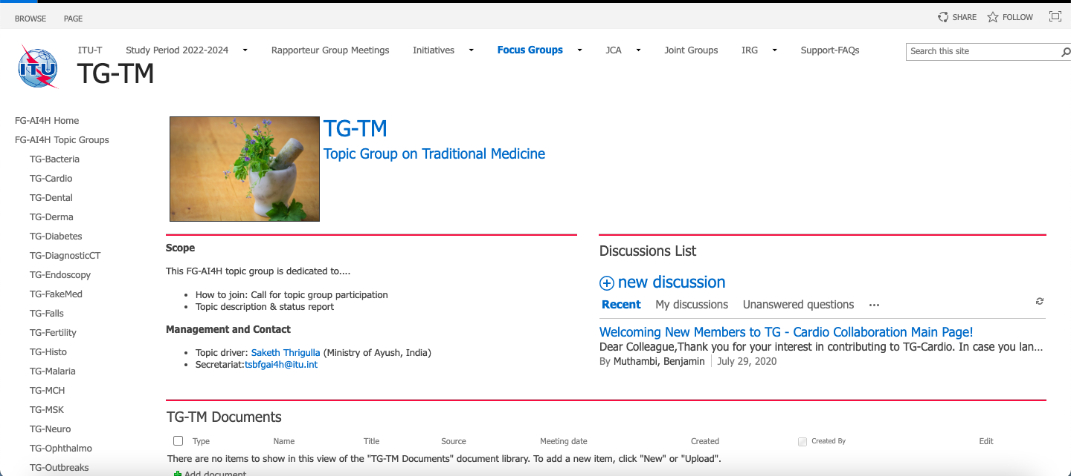
Overview & activities
AI for Traditional Medicine” (TG-TM)

Slide 4
Objective
Engagement from members of the medical and artificial intelligence (AI) communities (including clinicians, technologists, entrepreneurs, potential benchmarking data providers, machine learning experts, software developers, researchers, regulators, policy-makers, companies/institutions, and field experts) with a vested interest in shaping the benchmarking process of AI for Traditional Medicine.

Slide 5
Timeline
FG-AI4H-P-04
Plenary in Helsinki, 20-22 September 2022
TG-TM Proposal Submitted
TDD, &
CfTGP (TG-TM)
Uploaded to AI4Helath Site
Douala, 6-9 December 2022
Pooling the expertise,
Periodical Meetings,
Updating of the document

Slide 6
Group members 7+ members. TDD, CfTGP (TG-TM) finalized and uploaded
Nirog Street, Metro, E5, Lane No 1, Westend Marg, near Saket, Saidulajab, New Delhi, Delhi 110030 Phone no.: +919319361976 E-mail: info@nirogstreet.com
Mr Ram N Kumar, CEO, Nirog Street, Ayuveda Expert. NirogStreet is a unique concept in the Ayurveda healthcare ecosystem. It was founded in June 2016. We are an impact organization striving to make Ayurveda the first call of treatment for people. Our technology-driven platform provides access to authentic Ayurveda doctors on a global scale. As the world is quickly moving from reactive to proactive healthcare, the demand for holistic healing methods such as Ayurveda is at an all-time high. Our Community-first approach leverages the wide network of practitioners and students to promote health and wellness in the society
Ayurvedic Point, Milan, Italy
Dr. Antonio Morandi, Scientific Director of the ICAM 2016 Chairman & Director, Ayurvedic Point, Milan, Italy President, Italian Scientific Society for Ayurvedic Medicine.
eGestalt Technologies, Bengaluru, India
V. Rangamannar, Software Architect, eGestalt Technologies Pvt. Ltd. Bengaluru
National Institute of Technology, Rourkela, India
Ms Usha Rani, B.Tech (College of Engineering, Osmania University, Hyderabad, India), Persuing M.Tech-Biomedical Engineering. Has work in development of prototypes for Breath Analysis, Urinalysis, Sweat Analysis based on Ayurveda diagnosis as Senior Research Fellow at National Institute of Indian Medical Heritage, Hyderabad
Ministry of Ayush, Government of India
Dr. T. Saketh Ram, Research Officer (Ayurveda), National Institute of Indian Medical Heritage, under Central Council for Research in Ayurvedic Sciences (CCRAS), Ministry of Ayush, Government of India.
Professor Nam, Dong Hyun, Ph.D.,KMD. Department of Biofunctional Medicine & Diagnostics, College of Korean Medicine, Sangji University, 83 Sangjidae-gil Wonju-si Kangwon-do, Republic of Korean, #26339 Office +82-33-738-7504, Fax +82-33-730-0653, E-mail: omdnam@sangji.ac.kr / omdnam@naver.com
Chang Shik Yin Professor College of Korean Medicine Seoul Campus

Slide 7
Definition of the AI task
AI4TM is utilized to replicate the logical understanding applied in traditional medicine diagnostic methods viz., Interview, Physical Examination and other specific diagnostic equipment, techniques to arrive at pre-diagnosis, prodromes, diagnosis, prognosis, determination of transient patterns, steady states viz., individual constitution etc.,
The AI tasks implemented are viz., classification, prediction, clustering, or segmentation task etc.,
AI4TM utilizes the big data generated in the form of text, sensor based data and other relevant parameters.
The output is intended towards producing objective, reproducible and clinically relevant diagnosis.

Slide 8
Current gold standard
Currently the TM diagnosis is done on one on basis (whole system approach) involving continuous interaction between the subject and the TM practitioner.
Many of the parameters utilized in TM diagnosis are predominantly subjective which is the very important limitation.
Further, discussions on this topic will provide this information.

Slide 9
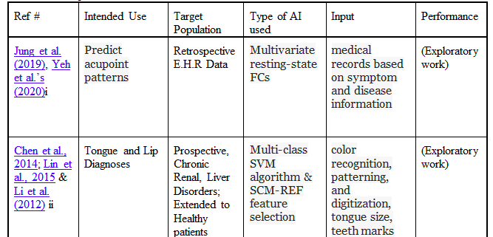
Existing ICT/AI solutions

Slide 10
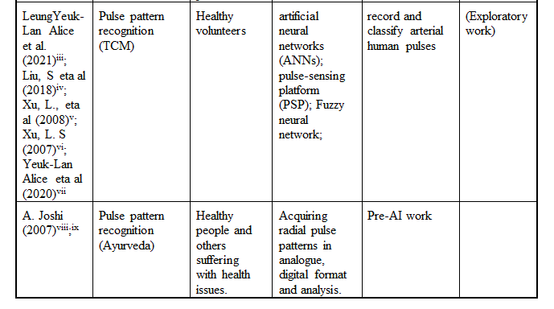
Existing ICT/AI solutions

Slide 11
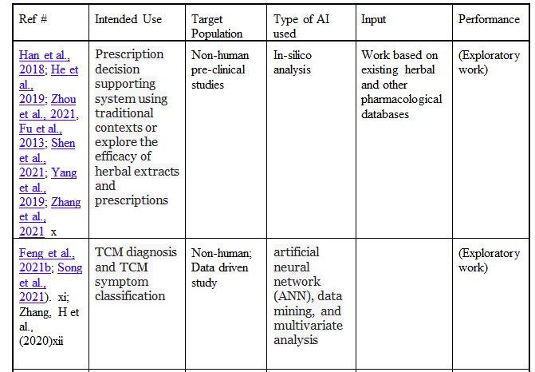
Existing ICT/AI solutions

Slide 12
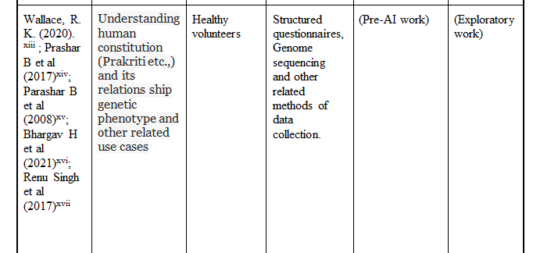
Existing ICT/AI solutions

Slide 13
Existing ICT/AI solutions

Slide 14
Relevance and impact of an AI solution
Subjective parameters and other whole system related data sets utilized in the TM diagnosis can be converted to objective parameters utilizing data analytics and AI and reduce the individual bias
Deploying such system ensures the objective approach in TM diagnosis and democratizes the knowledge system for wider reach. This certainly will have impact on impact on the health system, overall health system cost, life expectancy, or gross domestic product
Benchmarking this topic provide stakeholders with numbers for decision-making; does it simplify regulation, build trust, or facilitate adoption

Slide 15
Way forward
Wider, global participation from experts
Taking the discussion forward and updating the document.

Slide 16
Thank you!
For feedback & questions, please contact
dr.saketram@gmail.com

