Slide 1
FGAI4H-Q-021-A03
Douala, 6-9 December 2022
Source: | TG-Symptom Topic Driver
Title: | Att.3 – Presentation (TG-Symptom)
Purpose: | Discussion
Contact: | Henry Hoffmann Martin Cansdale | E-mail: henry.hoffmann@ada.com E-mail: martin@livehealthily.com
Abstract: | This PPT summarizes the status of work within TG-Symptom, for presentation and discussion during the meeting.

Slide 2
Meeting O Update for the
Topic Group “Symptom Assessment”
Topic Group:
Symptom Assessment
Update for Meeting Q
Berlin, 31 May – 2 June 2022

Slide 3
AI-based Symptom Assessment
Mobile/Web Applications – sometimes called ”Symptom Checkers” that
Allow users to enter (INPUT)
Patient information (age, sex…)
Current presenting complaints (symptoms, free text)
To then engage in a dialog similar to a doctor collecting (INPUT)
Additional symptoms, findings, factors, attributes, investigations (lab, imaging, genetics…)
To finally provide the user with (OUTPUT)
Pre-clinical triage (emergency, see doctor today, self-care…)
Possible causes (disease A 93%, B 73% - e.g. in ICD10, SNOMED CT)
Additional recommended investigations, treatment advice, explanations

Slide 4
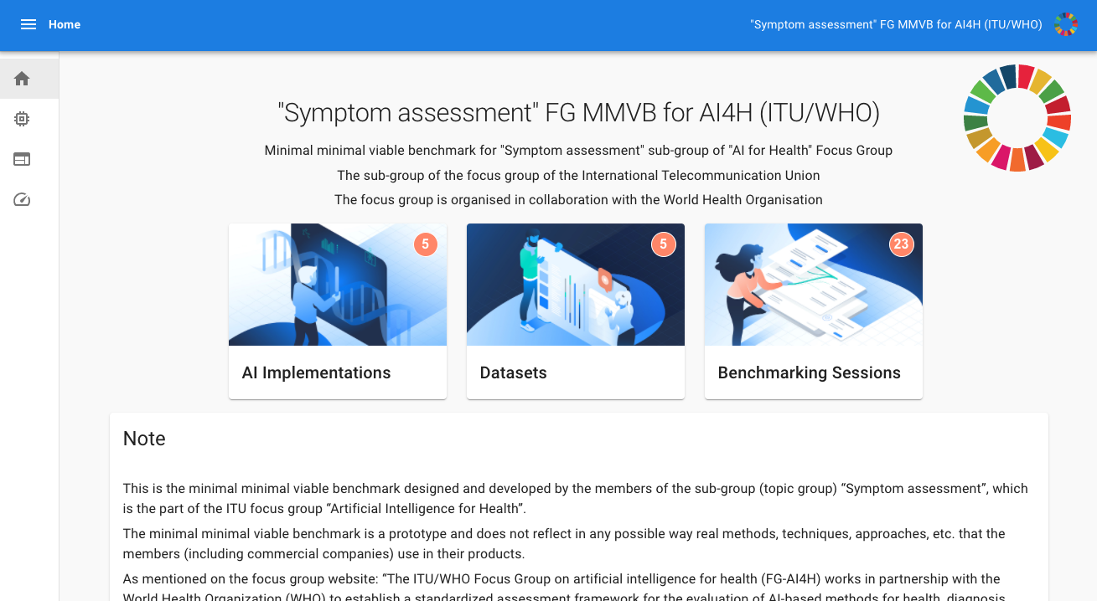
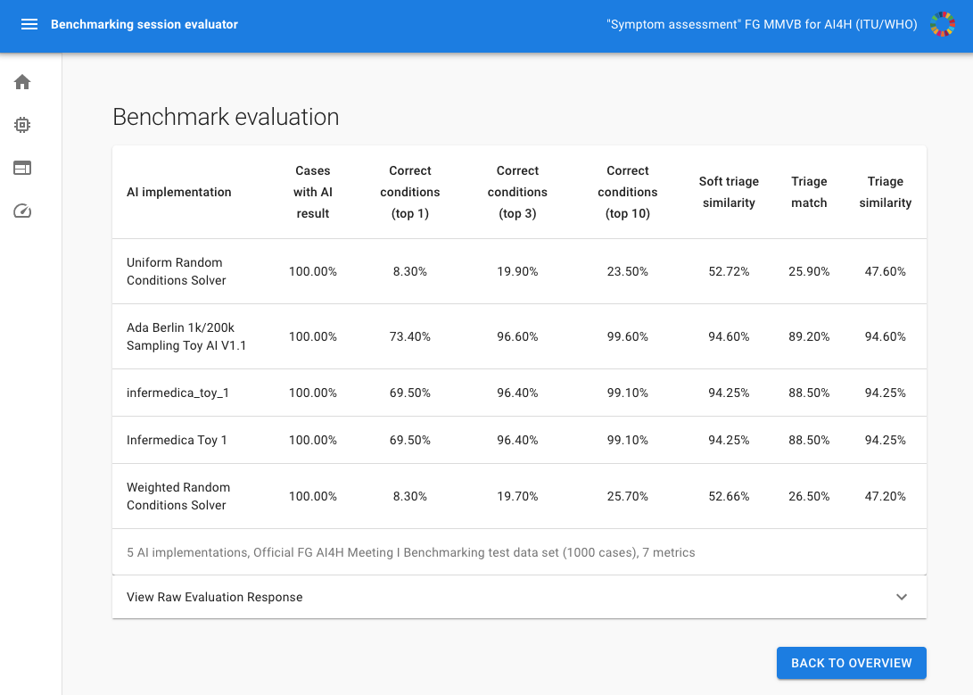
Benchmarking Approach
General approach
Started with toy AI and toy data to build a benchmarking system
Stepwise increasing complexity
Learn all the relevant details for the real benchmarking
Benchmarking approach
MMVB 2.2 with annotation tool and benchmarking process
Integrate annotation tool with open-code initiative annotation, evaluation, and reporting packages
FHIR/SNOMED CT used for storage and communication of cases
Workstreams
Technical
Case Annotation / Medical
Audit

Slide 5
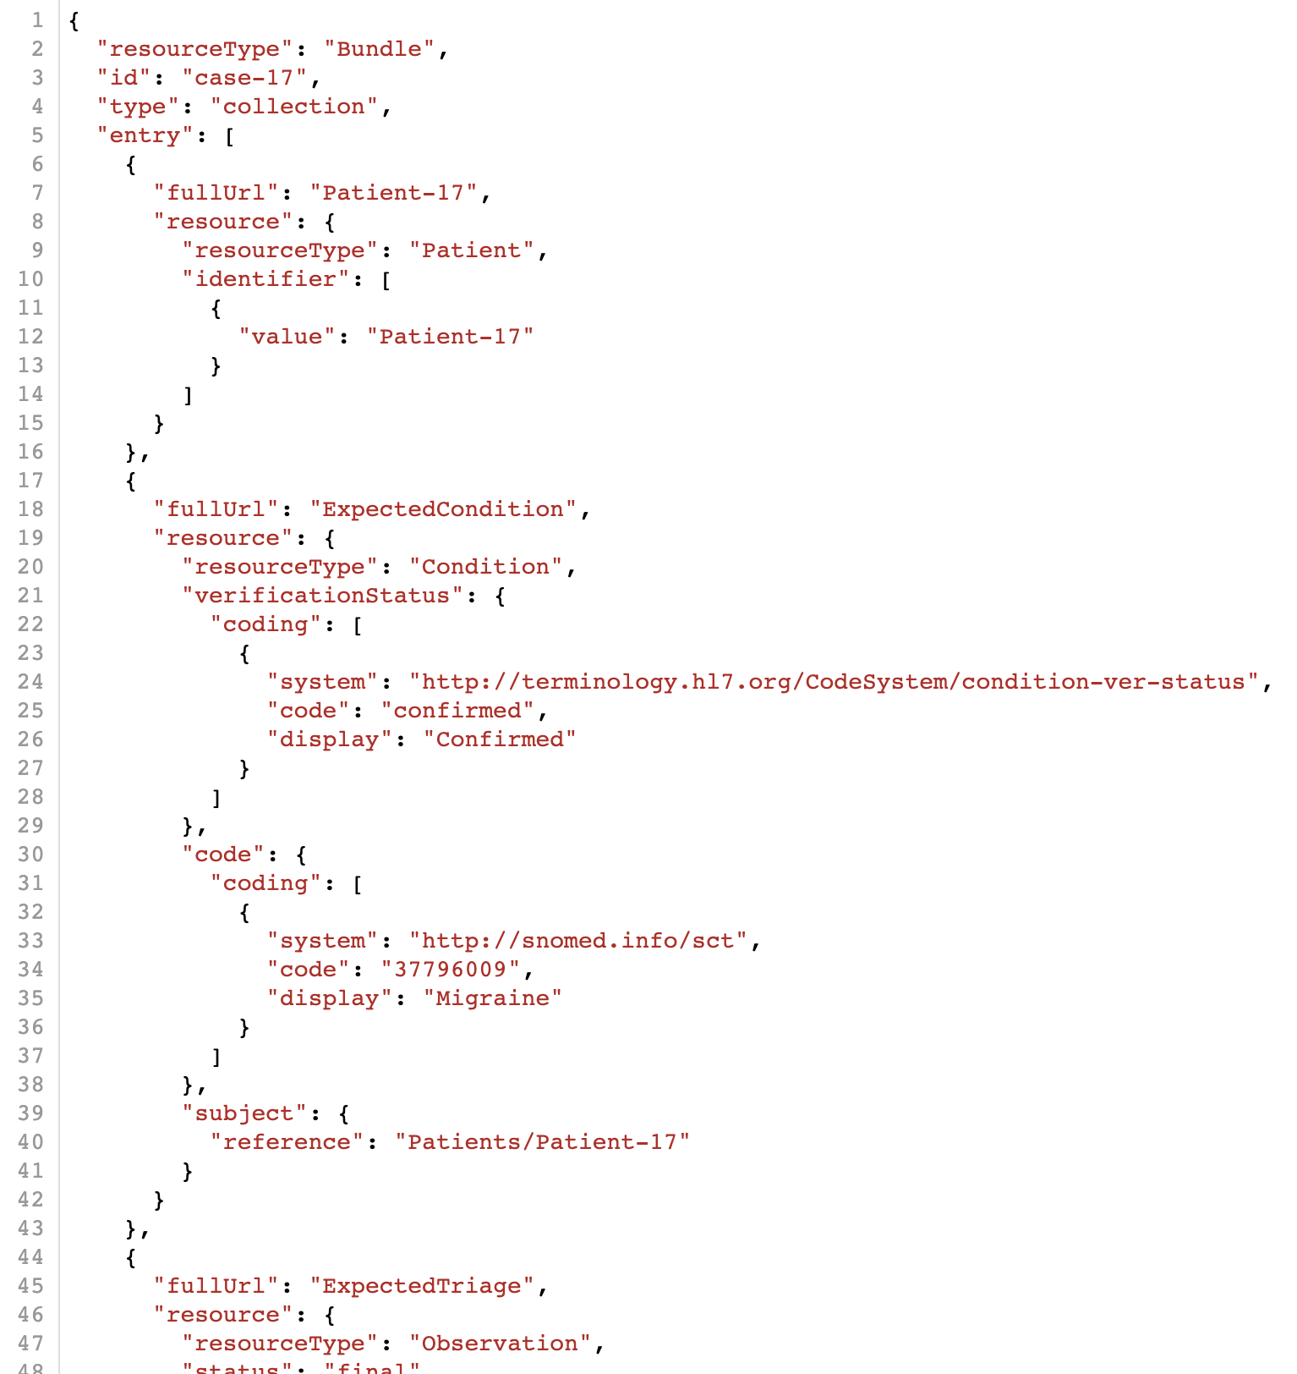
Technical Workstream
Test case storage and communication formats
Existing cases converted to FHIR format
Toy AI updated to accept test cases in FHIR format
Updated AI integrated with audit benchmarking system
Annotation tool repackaged for deployment on new infrastructure
Next steps
Finalise attribute handling in FHIR cases
Implement time-since-onset in FHIR cases
Update systems to use FHIR as output format:
AIs
Audit benchmarking
Annotation tool
Integration with OCI annotation package

Slide 6
Annotation Workstream
Annotation tool testing and development
Annotation tool updated based on feedback from testing
First version of step-by-step annotation guidelines
Annotation process tested by wider group of doctors
Feedback gathered through annotation tool and action points created
Next steps
Improvements based on collected feedback
Updated guidelines
Technical improvements to tool
Improved clarity of tool features

Slide 7
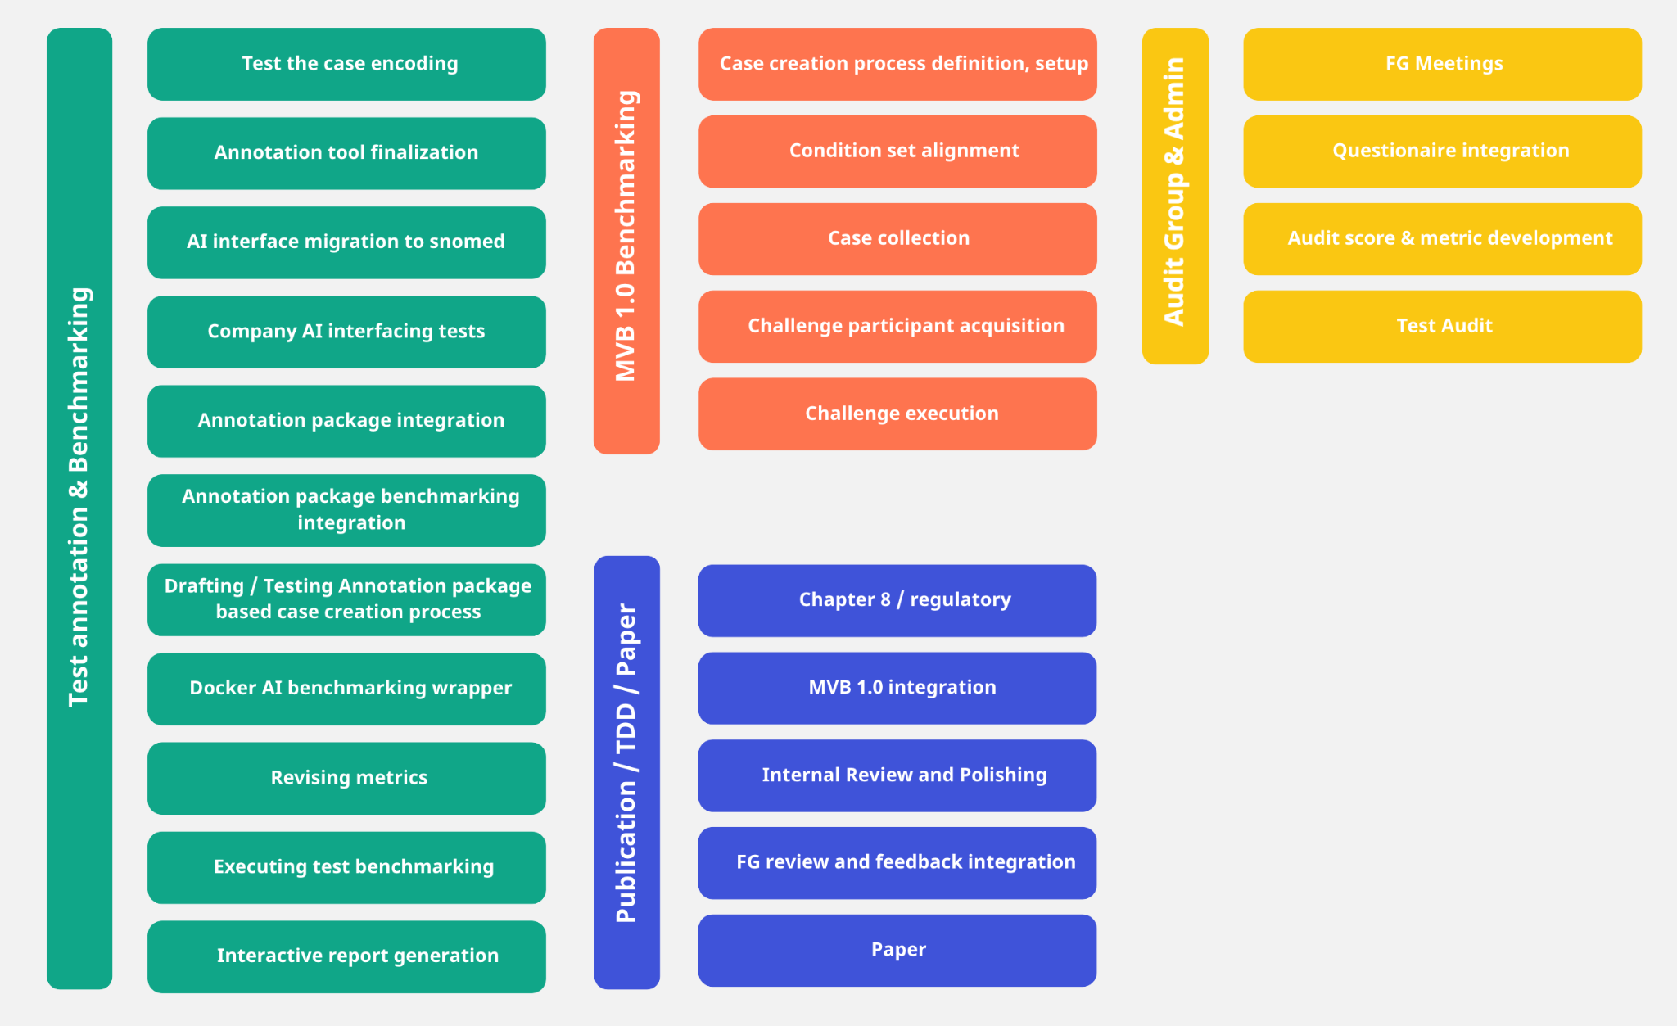
Audit Workstream
Current Status
Audit questionnaire filled in by 2 companies
Analysis / review of results started
Evaluation criteria in development
Next steps
Upcoming synchronization meetings of the Audit Group in December 2022

Slide 8
Thank you!
ITU/WHO FG AI4H TG Symptom Assessment
Meeting Q Update
Douala, 6 – 9 December 2022

