Slide 1
FGAI4H-Q-017-A03
Douala, 6-9 December 2022
Source: | TG-Ophthalmo Topic Driver
Title: | Att.3 – Presentation (TG-Ophthalmo)
Purpose: | Discussion
Contact: | Arun Shroff | E-mail: arunshroff@gmail.com
Abstract: | This PPT contains updates on the Topic Group on Ophthalmology.

Slide 2
Meeting N Topic Group Update
Ophthalmology (TG-Ophthalmo )
Meeting Q, 6 Dec – 9 Dec 2022
Arun Shroff, Topic Driver, TG-Ophthalmology

Slide 3
Topic Group – Ophthalmology
Standardized benchmarking of artificial intelligence for Ophthalmology.
Conditions/Sub-topics in this group:
  Diabetic Retinopathy (DR)
  Age Related Macular Degeneration (AMD)
  Glaucoma (GC)
  Pathological Myopia (PM)
  Red Eye (RE) – (Added Meeting G)

Slide 4
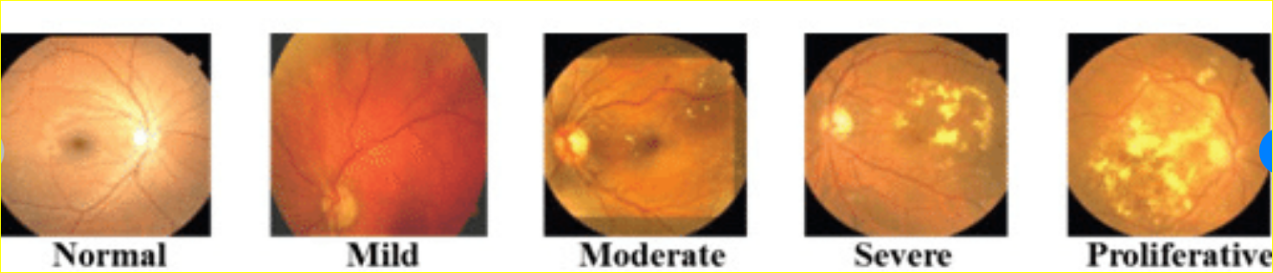
Benchmarking: DR Classifications
  Binary:
    [0 (Nogradable Image)] (Optional)
    1 (Non-referable Retinopathy = Normal or Mild)
    2 (Referable Retinopathy = Moderate, Severe, PDR)
  Multi-class Classification:
      [0 (Nongradable Image) ] (Optional)
      1(Normal)
      2 (Mild)
      3 (Moderate NPDR)
      4 (Severe NPDR)
      5 (PDR)

Slide 5
Benchmarking Metrics
Classification Tasks:
  Sensitivity:
    True Positive/(True Positive + False Negative)
  Specificity:
    True Negative/(True Negative + False Positive)
  AUC (Area Under ROC);
    Sensitivity Vs (1-Specificity) plotted at different points of the model
  Accuracy, F1 Score
  Cohen’s Kappa / Quadratic Kappa Score
Segmentation Tasks:
  IOU , Dice Coefficient

Slide 6
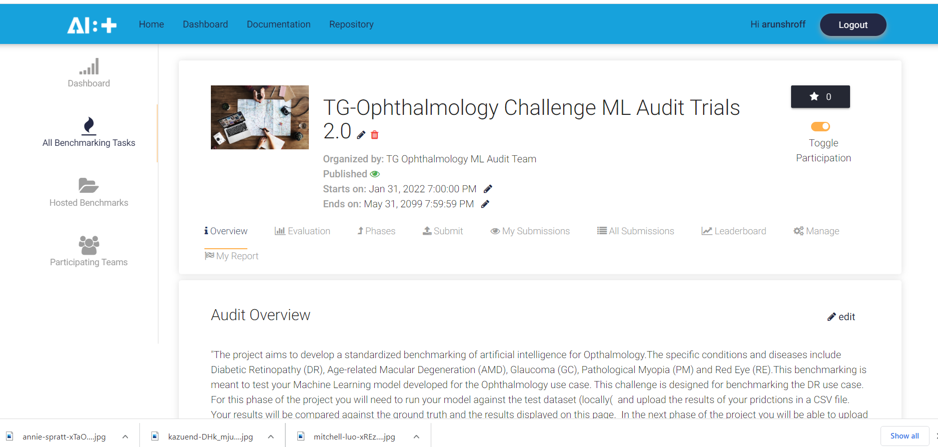
ML Audit Trials 2.0:
  The project aims to develop a standardized benchmarking of artificial intelligence for Ophthalmology. (https://health.aiaudit.org/)

Slide 7
ML Audit Trials 2.0:
  Participants provide their models for evaluation via the platform.
  After submission, they fill out a qualitative questionnaire, after which the benchmarking is run against the DR dataset.
  Results are provided in the form of a Q & A Assessment by the audit experts
  An audit report is generated containing:
    Data Specification Sheet
    ML Model Specification Sheet
    ML Model Summary Findings

Slide 8
ML Audit Trials 2.0: Progress Update
  Tasks Completed:
    Registration on MLaudit platform
    Updating challenge configuration files
    Creating & hosting a challenge (text prediction based)
    Participating in the challenge
    Creating an annotations & submission file for text predictions
    Completed the audit questionnaire
    Responded to comments & feedback of audit experts
    Completed the ML model summary
    Generated the audit report
    View challenge and audit results at: https://health.aiaudit.org/web/challenges/challenge-page/296/overview

Slide 9
TG-Ophthalmo Output Documents
TDD: Topic Group Description Document (FGAI4H-Q-017-A01)
Topic Group Call for Participation (FGAI4H-Q-017-A02)
Topic Group Collaboration Site:
  https://extranet.itu.int/sites/itu-t/focusgroups/ai4h/tg/SitePages/TG-Ophthalmo.aspx
  Dedicated mailing list : fgai4htgophthalmo@lists.itu.int​
​​

Slide 10
Next Steps
Updates to TDD:
    Complete remaining sections on ethics, benchmarking, reporting.
Dataset Procurement:
  Work on procuring other datasets (India, Asia, USA, etc. to account for regional variations)
Benchmarking:
  ML4h Audit Trial Iteration 2 – Implement Dockerized challenge (with images)
Prepare for Publication of TDD as ITU Deliverable:
  Timeframe
  Content & quality review
  Expert review

Slide 11
Thank you!

