Slide 1
FGAI4H-Q-014-A03
Douala, 6-9 December 2022
Source: | TG-Malaria Topic Driver
Title: | Att.3 – Presentation (TG-Malaria)
Purpose: | Information
Contact: | Rose Nakasi | E-mail: g.nakasirose@gmail.com
Abstract: | This PPT contains updates on the Topic Group on Malaria.

Slide 2

Topic Group-Malaria:
AI based detection of Malaria-an update
Meeting Q
Rose Nakasi, PhD
g.nakasirose@gmail.com
Makerere University, Uganda
E-meeting, 6th – 9th December 2022

Slide 3
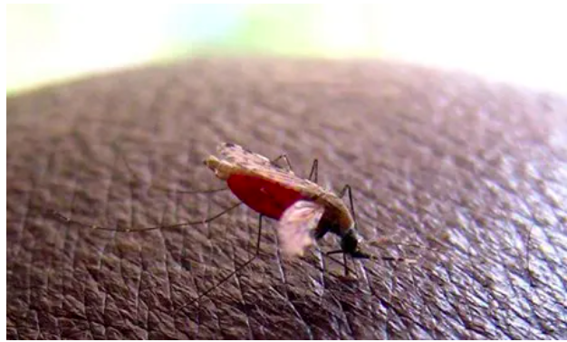
Background
Malaria burden in endemic Countries
    Accounts for over 3.4 billion cases globally
    Lack of enough trained lab technicians
      1.72 microscopes per 100,000
      population, but only 0.85 Microscopists per 100,000
Gold standard diagnosis(microscopy) challenge
    SOP requires not to view more than 30 slides a day
    Less diagnosis throughput
    Variations in individual expert judgment
AI solution
  Supports image analysis and has potential to improve the timeliness and accuracy
There is need to;
  Standardise benchmarking AI solutions for the detection of Malaria
Notes:
Why this Topic Group? Context, WHO/ITU necessity
The Global Problem
The opportunity (and the challenge) | What is Symptom Assessment? How might it help?
The case for benchmarking? Why needed?
How the Topic Group can help, what outcomes might feed into

Slide 4
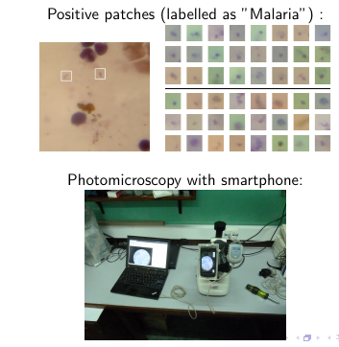
Digital imaging
Setup

Slide 5
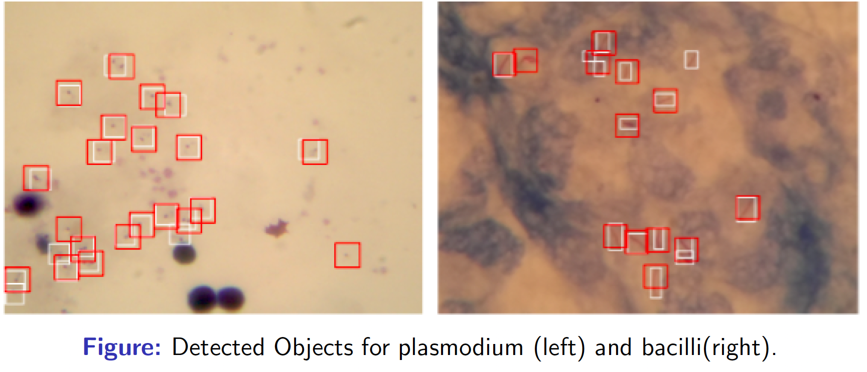
Digital Microscopy imaging analysis
Inference using CNN model

Slide 6
TG-Malaria activities
Quality datasets needed
  Have more datasets for training and testing
  Well labelled datasets
Solution
  AI models and approaches related to malaria detection.
  Suggestions on scoring metrics.
  Improvements on the benchmarking framework.
  Support to the group on different aspects (data, methods, benchmarking, etc.) of this topic
  Extension of the solution to improve disease surveillance and prediction.
    Heterogeneous Data needed

Slide 7
Updates so far
Online meetings
  Migrating competion to Codabench
  https://www.codabench.org/competitions/389/?secret_key=2f16646d-f5db-40c1-ae57-6a89c6802551
    focusing on benchmarking instead of competition
  Implementing classification task on codabench
  Discussions on the outcomes of the implemented platform

Slide 8
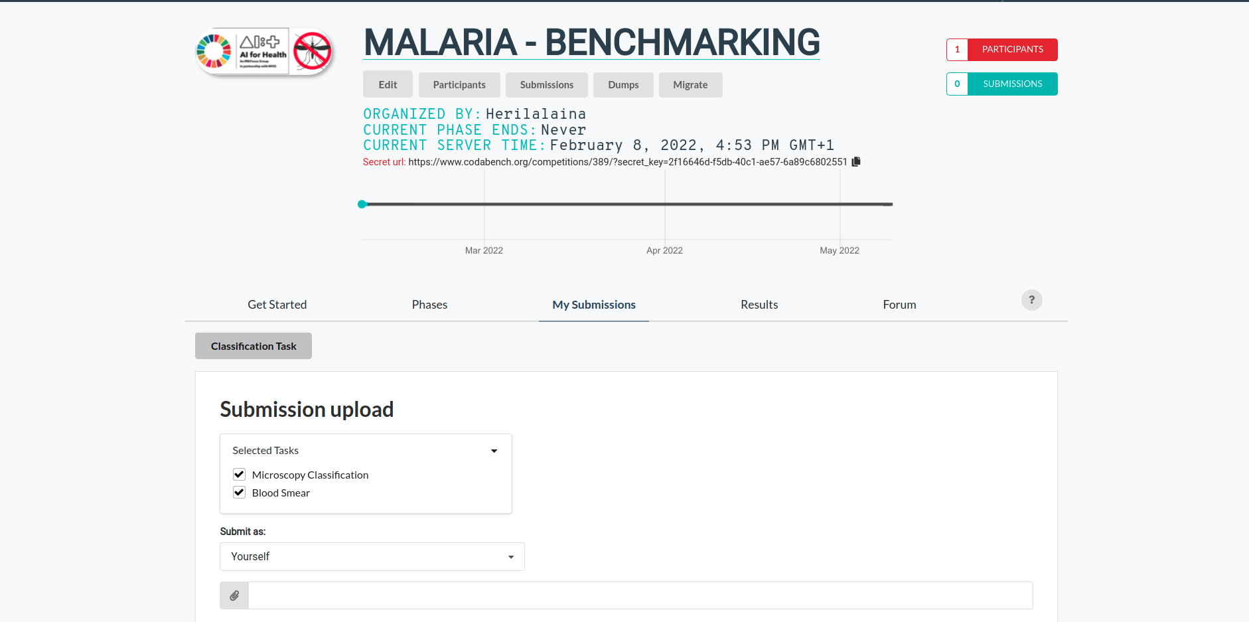
User interface for the Codabench
New Benchmarking-Malaria platform with codabench

Slide 9
Next benchmarking iterations
Our next set of activities include;
  Creating a new challenge based on codabench to a wider community
    Logistics needed
  To incorporate object detection tasks.
    plan to start with the VIPriors challenge template, which provides an end-to-end training of the model
    Need to work on data formats
Publishing outcomes of the competition
Data collection
  Collecting a benchmarking dataset in progress
  Include both thick blood and thin blood smear images

Slide 10
Call for participation
Participation can be in form of:
Provision of quality labelled data
AI models and algorithms for benchmarking task on malaria
General support on different aspects of this topic (data, methods, benchmarking, etc.)

Slide 11
Contact us
TG-Malaria
  fgai4htgmalaria@lists.itu.int
TG-Driver
  g.nakasirose@gmail.com

Slide 12
Topic Group members:
Name | Affiliation
Philippe Verstraete | Co-founder of Milan and Associates, Italy
Laura Moro, | Researcher, science & medical writer. Co-founder of AI Scope, Spain
Dr. Helmi Zakariah. | Cofounder of AIME company, Malaysia
Martha Shaka | Researcher at University of Dodoma, Tanzania
Ana Rivière Cinnamond | Advisor and Pubic Health Expert under Health Emergency Information & Risk Assessment Department with PAHO/WHO.
Rigveda Kadam | Senior Access Officer, FIND, Switetzerland
Seda Yerlikaya | Scientific Officer, FIND, Switetzerland
Herilalaina RAKOTOARISON | PhD student in Machine learning from the Université Paris-Saclay)

