Slide 1
FGAI4H-Q-007-A03
Douala, 6-9 December 2022
Source: | TG-Derma Topic Driver
Title: | Att.3 – Presentation (TG-Derma)
Purpose: | Discussion
Contact: | Harsha Jayakody Ivy Lee | E-mail: harsha@flash.health E-mail: ivyannlee@gmail.com
Abstract: | This PPT contains a presentation about AI application in Aesthetics.

Slide 2
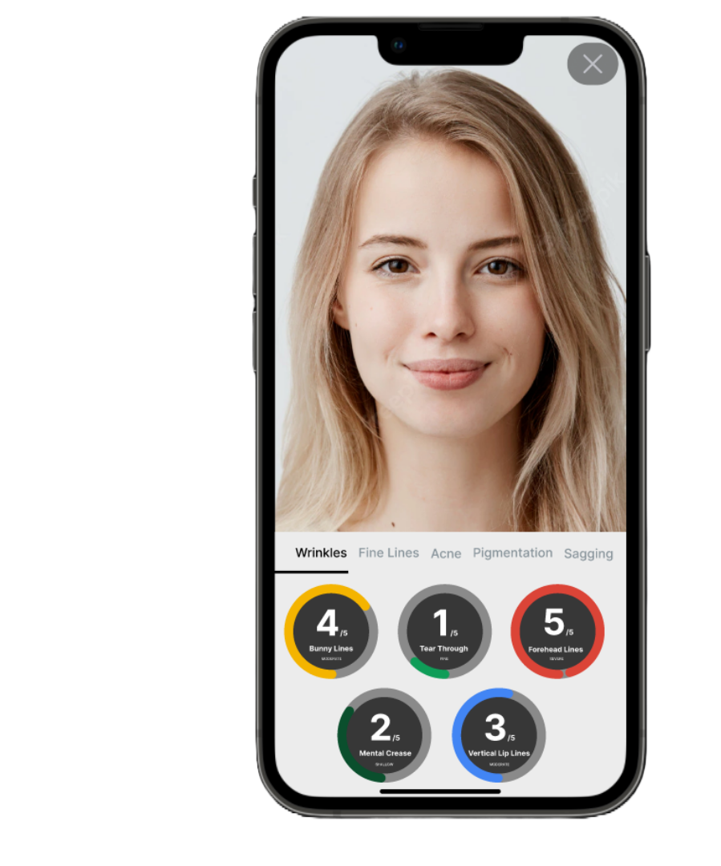
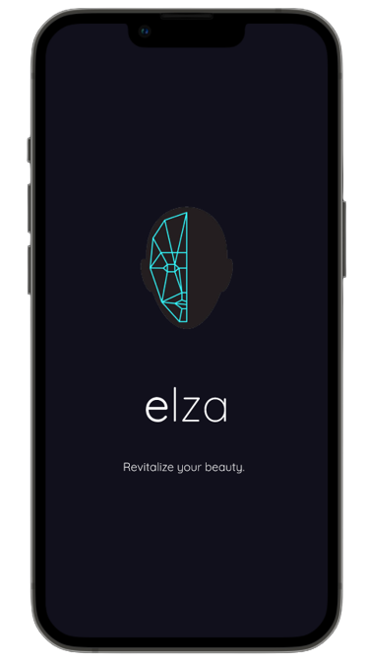
Product Overview
Elza is an artificial intelligence application that detects the cosmetic concerns of an individual and the app gives a range for each cosmetic concern following aesthetic skin treatment options to the end-user.

Slide 3
Development Method
Scan the face from the front and send the base64 image to the backend API endpoint as a request.
The backend receives the payload request and initiates the image processing as follows:
As a Deep Learning based approach to identifying the wrinkles, segmentation is selected.
Segmentation is a task to identify objects with their borders in an image. Hence not only we can detect the object (wrinkles) but also we can measure the area.
The face landmark detection model will be used to identify the position of the wrinkle.

Slide 4
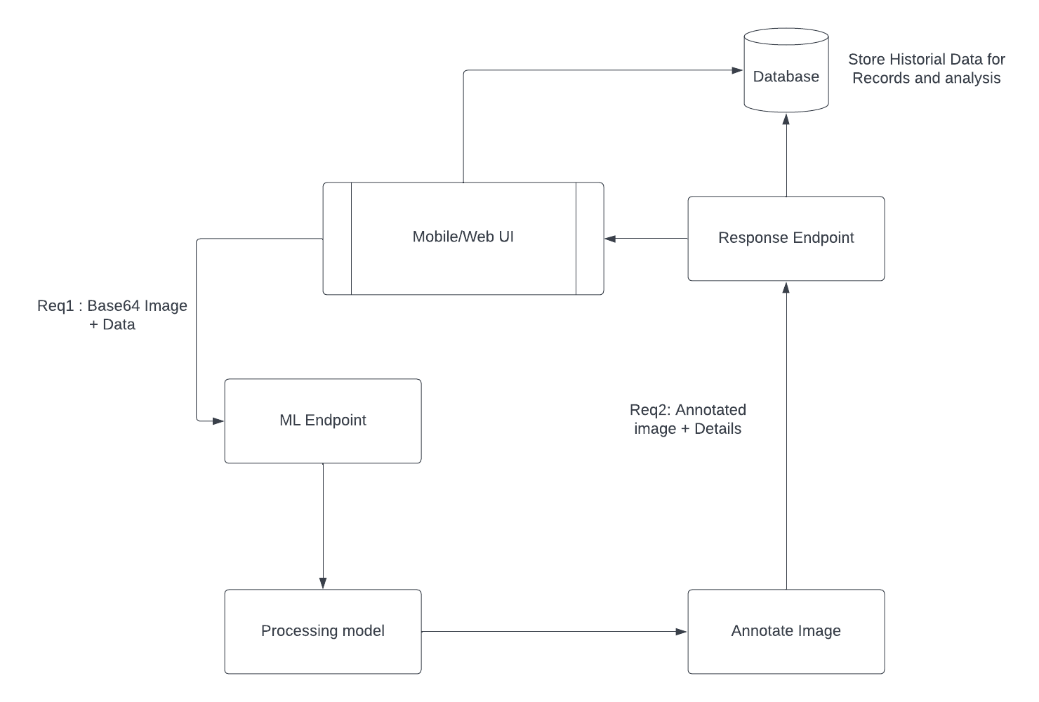
Software Architecture

Slide 5
TG Dermatology - Future Plans
Expand outreach for membership
Share existing resources on standards, guidelines, and education
Showcase high quality Derm AI solutions from across the globe
Identify needs and gaps in research, knowledge and practice for future collaborations

