Slide 1
FGAI4H-P-056
Helsinki, 20-22 September 2022
Source: | Editor
Title: | DEL5.3: Data annotation specification - Presentation
Purpose: | Discussion
Contact: | Shan Xu, CAICT, China | E-mail: xushan@caict.ac.cn
 | Sebastian Bosse, Fraunhofer HHI, Germany | Email: sebastian.bosse@hhi.fraunhofer.de
 | Jianrong Wu Tencent Healthcare, China | Email: edwinjrwu@tencent.com
Abstract: | This PPT contains a presentation of DEL5.3 presented at Meeting P of the FG-AI4H (Helsinki), 20-22 September 2022.

Slide 2
Contributors
Harpreet Singh ICMR, India | Email: hsingh@bmi.icmr.org.in
Yanwu Xu Intelligent Healthcare Unit, Baidu, China | Email: xuyanwu@baidu.com
Huihui Fang Artificial Intelligence Innovation Business, Baidu, China | Email: fanghuihui@baidu.com
Nathan Guo ShuKun Techonology, China | Email: guoning@shukun.net
Yajun Zhang Tencent Technology (Shenzhen), China | Email: yajunzhang@tencent.com
Chunyang Niu Zhejiang Lab, China | Email: niucy@zhejianglab.com
Guoqiang Li Zhejiang Lab, China | Email: gli@zhejianglab.com

Slide 3
Abstract
Data annotation, as a critical component of the data quality control on Artificial Intelligence for health, could be one of the most important determinants on model performance.
This deliverable is to give a framework of data annotation specification, including terms and definitions, framework, standard operating procedure, scenarios description and corresponding consistency criteria, as well as recommended metadata, etc. for different stakeholders to develop and implement AI-based tools in advancing healthcare.
A questionnaire is attached to gather input from different topic groups in FG-AI4H regarding data annotation.

Slide 4
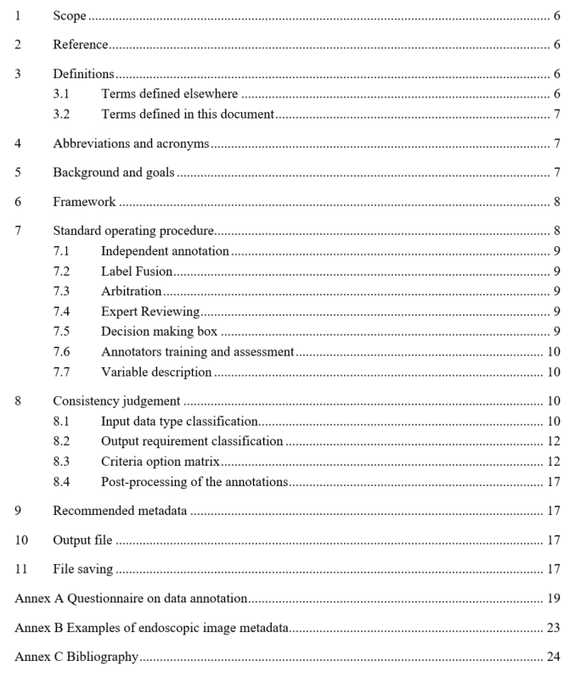
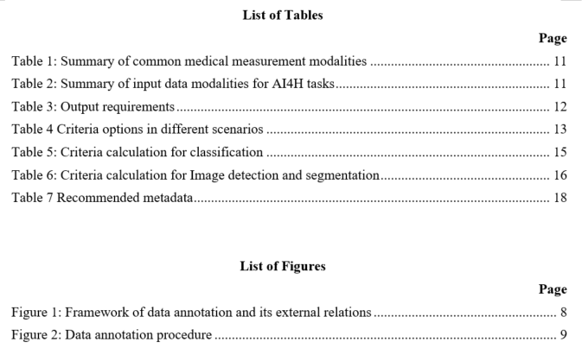
Content

Slide 5
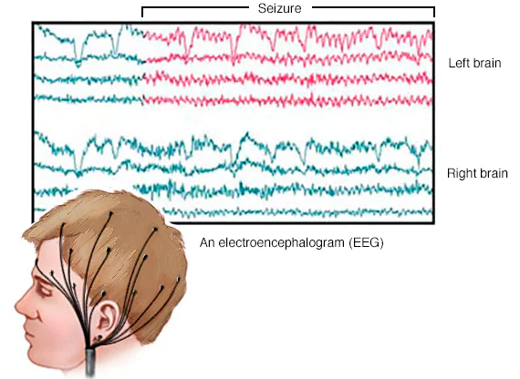
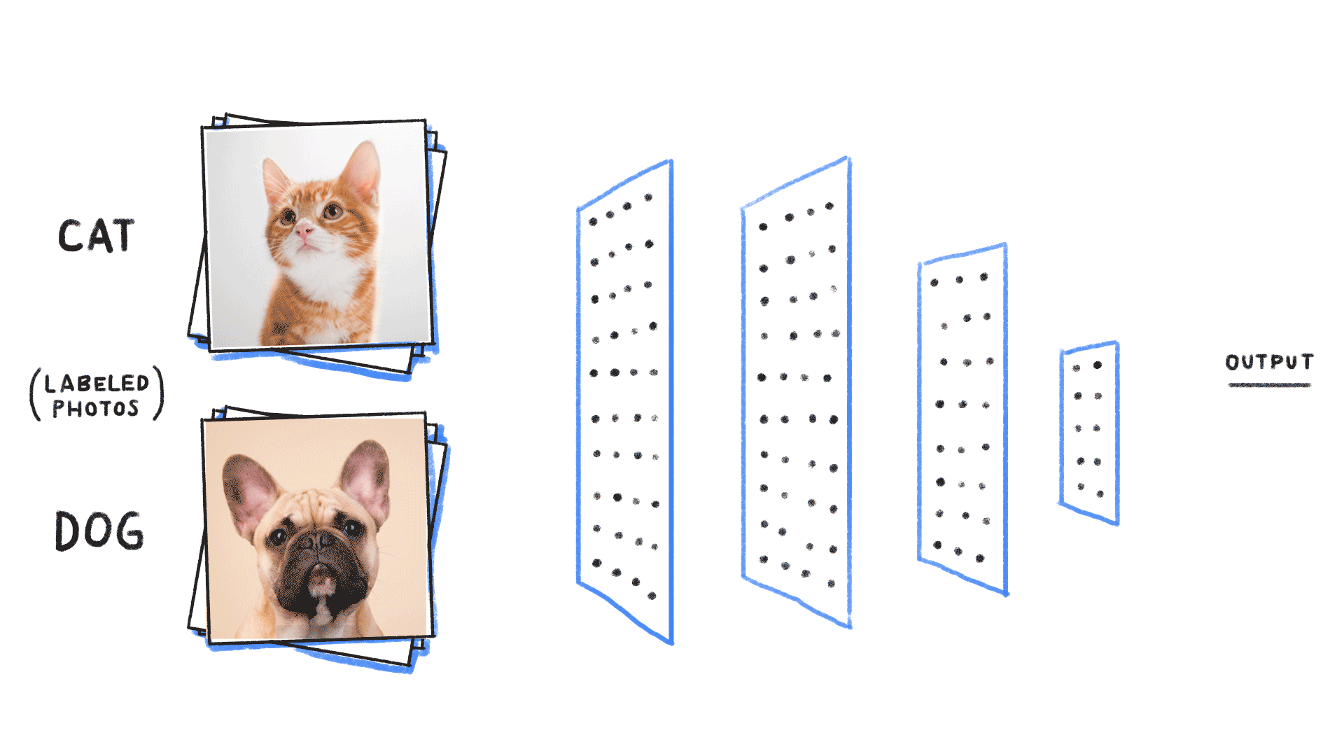

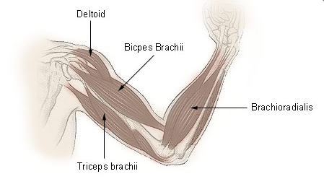
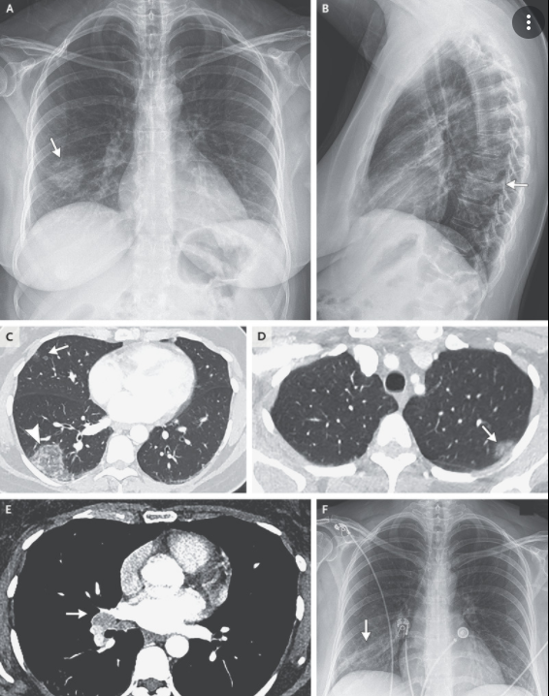

What is Data annotation
Perform operations such as categorizing, sorting, editing, marking, and annotating on the data to be labelled such as images, and add tags to the data to generate machine-readable data codes that meet the requirements of Artificial intelligence/machine learning training.

Slide 6
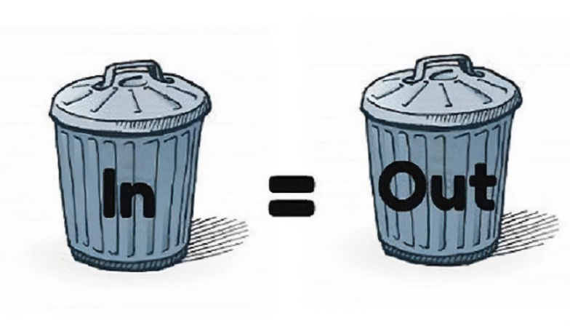


WHY data annotation is important
“Garbage in, Garbage out”
  Data format
  System interoperability
  Complex real world data
  machine-readable data codes
* IBM has estimated that poor data quality costs U.S. businesses $3 trillion per year

Slide 7
How data annotation works
Dataset
Input
Training dataset
Validation dataset
Test dataset
Annotators
Data Annotation
Standard Operating Procedure (SOP)
Supervised Machine Learning
Tools
Training Process
Testing & Evaluation
Output
Annotation Metadata

Slide 8
Complexity of Data annotation
Data modalities
Task diversity
Result inconsistency
Standard operation process

Slide 9
Common medical measurement
Table 1: Summary of common medical measurement modalities
 | Dimensionality | Description | Anatomies
X-ray | 2D, 2D+t | Produces images by measuring the attenuation of X-ray through the body, via a detector array | Most organs
CT | 2D, 3D, 3D+t | Creates 2D cross-sectional images of the body by using a rotating X-ray source and detector | Most organs
Ultrasound | 2D, 2D+t, 3D, 3D+t | A transducer array emits acoustic pulses and measure he echoes from tissue scatters ¹ | Most organs
MRI | 3D, 3D+t | Use a magnetic field to align protons; RF and gradient pulses are used to selectively excite protons in tissues and blood in order to measure their spatially encoded unclear magnetic resonance signals | Most organs
Nuclear | 2D, 3D, 3D+t | Measures the emission of gamma rays through decay of radioisotopes introduced into the body via external detectors/Gamma cameras. ¹ | All organs with radioactive tracer uptake
Microscopy | 2D, 3D, 3D+t | Typically uses an illumination source and lenses to magnify specimens before capturing an image¹ | Primarily biopsies and surgical specimens

Slide 10
Input modalities
Table 2: Summary of input data modalities for AI4H tasks
Data | Dimensionality | Description | Examples
Image | 2D | Two-dimensional medical imaging | Fundus photos
3D images | 3D | Three-dimensional spatial imaging | Sets of CT slices
4D | 4D（3D+t） | 3D space imaging changes over time | Heart film imaging
Video | 2D +t | Camera or monitor recording | Falls among the elderly
Audio/ signal | 1D +t | Sound or transmitted in signal form. | Heart sound /ECG
Text | 1D, 2D | Structured/ unstructured description in words | Case history, diagnosis extraction
Single number | 1D | Single measurement data | Blood pressure or respiratory rate

Slide 11
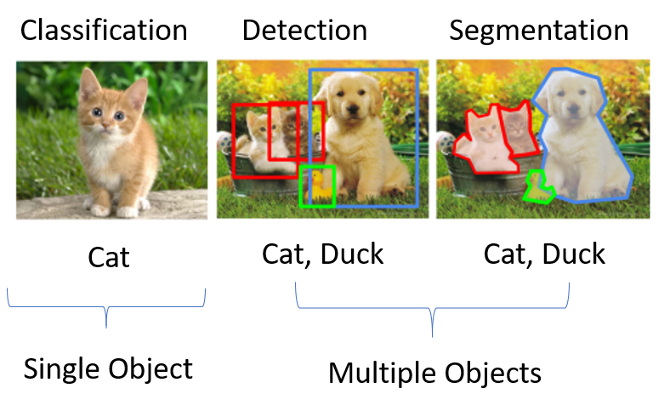
Complexity of Data annotation
Task diversity
Data modalities
Result inconsistency
Standard operation process

Slide 12
Output requirements
Table 3: Output requirements
Task | Description | Examples
Classification | The problem of classifying instances into two or more classes. | Identify abnormal tissue Diabetic retinopathy grade
Detection | Identify an object, usually marked with rectangle for further processing. | Detect the position of a coronary plaque for further processing
Segmentation | separate certain lesions, and draw the specific outline of the lesion | Tumour segmentation
Localization | Calculate the central coordinate of the anatomical structure | Localize the optic disc or macular fovea for further analysis of ocular fundus diseases

Slide 13
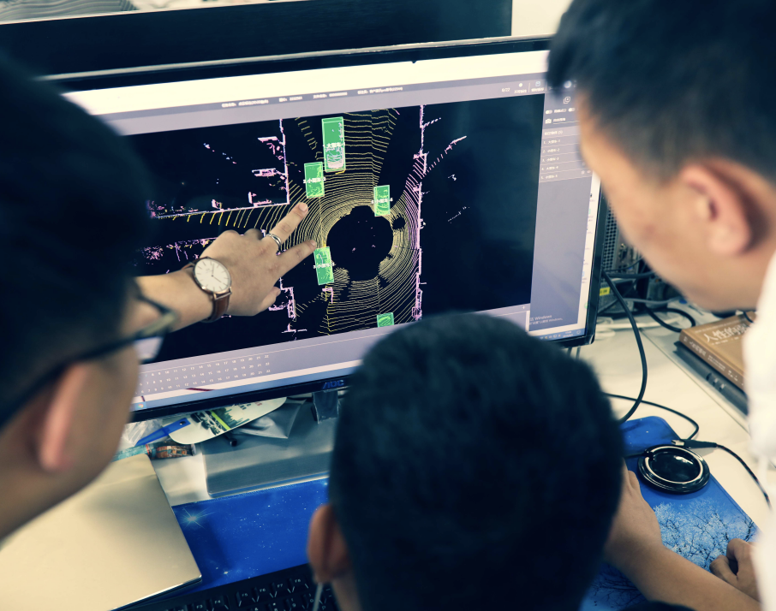
Complexity of Data annotation
Result inconsistency
Data modalities
Task diversity
Standard operation process

Slide 14
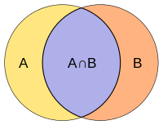
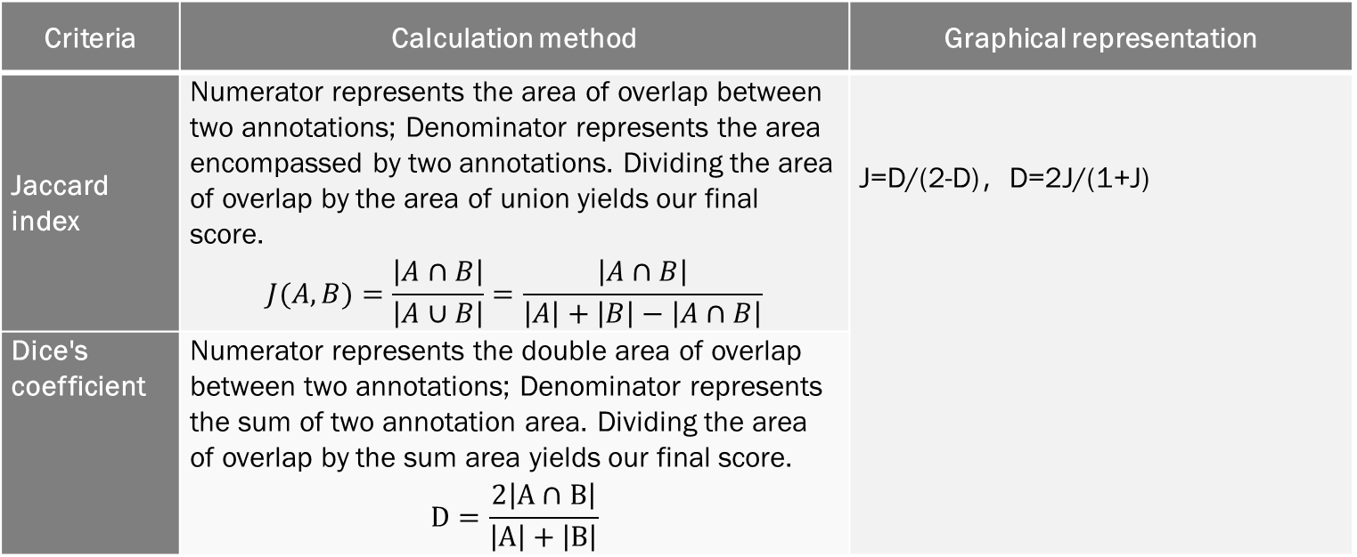
Criteria calculation
Table 6: Criteria calculation for Image detection and segmentation
Criteria | Calculation method | Graphical representation
Jaccard index | Numerator represents the area of overlap between two annotations; Denominator represents the area encompassed by two annotations. Dividing the area of overlap by the area of union yields our final score. $$J(A,B)=\frac{\left|A∩B\right|}{\left|A∪B\right|}=\frac{\left|A∩B\right|}{\left|A\right|+\left|B\right|−\left|A∩B\right|}$$ | J=D/(2-D)，D=2J/(1+J)
Dice's coefficient | Numerator represents the double area of overlap between two annotations; Denominator represents the sum of two annotation area. Dividing the area of overlap by the sum area yields our final score. $$D=\frac{2\left|A∩B\right|}{\left|A\right|+\left|B\right|}$$

Slide 15
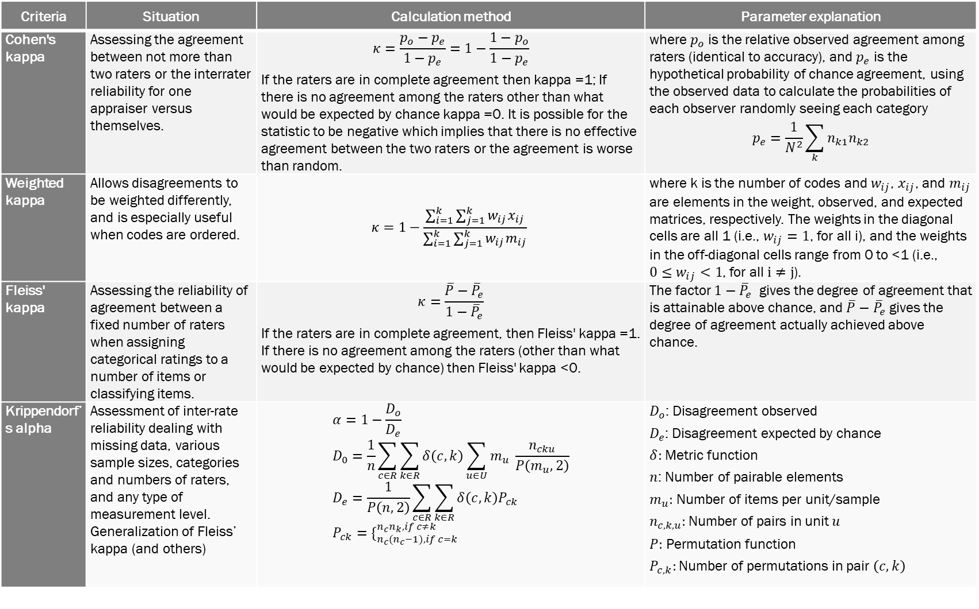
Table 5: Criteria calculation for classification
Criteria | Situation | Calculation method | Parameter explanation
Cohen's kappa | Assessing the agreement between not more than two raters or the interrater reliability for one appraiser versus themselves. | $$κ=\frac{p_{o}−p_{e}}{1−p_{e}}=1−\frac{1−p_{o}}{1−p_{e}}$$ If the raters are in complete agreement then kappa =1; If there is no agreement among the raters other than what would be expected by chance kappa =0. It is possible for the statistic to be negative which implies that there is no effective agreement between the two raters or the agreement is worse than random. | where $p_{o}$ is the relative observed agreement among raters (identical to accuracy), and $p_{e}$ is the hypothetical probability of chance agreement, using the observed data to calculate the probabilities of each observer randomly seeing each category $$p_{e}=\frac{1}{N^{2}}\sum_{k}{n_{k1}n_{k2}}$$
Weighted kappa | Allows disagreements to be weighted differently, and is especially useful when codes are ordered. | $$κ=1−\frac{\sum_{i=1}^{k}{\sum_{j=1}^{k}{w_{ij}x_{ij}}}}{\sum_{i=1}^{k}{\sum_{j=1}^{k}{w_{ij}m_{ij}}}}$$ | where k is the number of codes and $w_{ij}$, $x_{ij}$, and $m_{ij}$ are elements in the weight, observed, and expected matrices, respectively. The weights in the diagonal cells are all 1 (i.e., $w_{ij}=1$, for all i), and the weights in the off-diagonal cells range from 0 to <1 (i.e., ${0≤w}_{ij}<1$, for all $i≠j$).
Fleiss' kappa | Assessing the reliability of agreement between a fixed number of raters when assigning categorical ratings to a number of items or classifying items. | $$κ=\frac{\overline{P}−{\overline{P}}_{e}}{1−{\overline{P}}_{e}}$$ If the raters are in complete agreement, then Fleiss' kappa =1. If there is no agreement among the raters (other than what would be expected by chance) then Fleiss' kappa <0. | The factor $1−{\overline{P}}_{e}$ gives the degree of agreement that is attainable above chance, and $\overline{P}−{\overline{P}}_{e}$ gives the degree of agreement actually achieved above chance.
Krippendorf’s alpha | Assessment of inter-rate reliability dealing with missing data, various sample sizes, categories and numbers of raters, and any type of measurement level. Generalization of Fleiss’ kappa (and others) | $$α=1−\frac{D_{o}}{D_{e}} \\ D_{0}=\frac{1}{n}\sum_{c∈R}{\sum_{k∈R}{δ\left(c,k\right)}\sum_{u∈U}{m_{u} }\frac{n_{cku}}{P\left(m_{u},2\right)}} \\ D_{e}=\frac{1}{P\left(n,2\right)}\sum_{c∈R}{\sum_{k∈R}{δ\left(c,k\right)P_{ck} }} \\ P_{ck}=\{_{n_{c}(n_{c}−1), if c=k}^{n_{c}n_{k}, if c≠k}$$ | $D_{o}$: Disagreement observed $D_{e}$: Disagreement expected by chance $δ:$ Metric function $n$: Number of pairable elements $m_{u}:$ Number of items per unit/sample $n_{c,k,u}:$Number of pairs in unit $u$ $P:$ Permutation function $P_{c,k}:$ Number of permutations in pair $\left(c,k\right)$

Slide 16

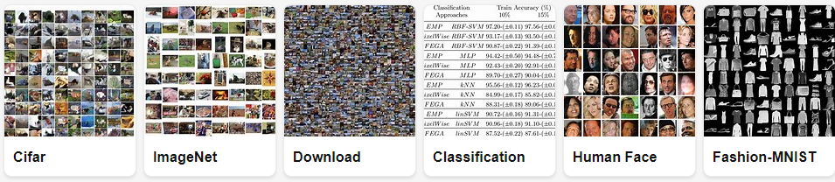
Complexity of Data annotation
Standard operation process
Data modalities
Task diversity
Result inconsistency
To enable large-scale dataset projects on high diversity of data formats and multi-annotators.

Slide 17
Standard operating procedure
Data Distribution
Independent Annotation
Arbitration
Annotator
-
1
Annotator
-
2
Annotator
-
i
Annotator
-
n
Annotation
??
Annotation
Annotation 1
Annotation 2
??
Annotation i
??
Annotation n
n+1
n+m
Label Fusion
Label Fusion
Consistency in
No
No
Consistency in
Labeling
Labeling
Expert
Yes
Reviewing
Yes
yes
No
Put in the Annotation Metadata Set
Put in the Annotation Metadata Set
Put in the Annotation Metadata Set
Put in the
Put in the
Put in the
training set
training set
training set
Discard
Figure 2: Data annotation procedure

Slide 18
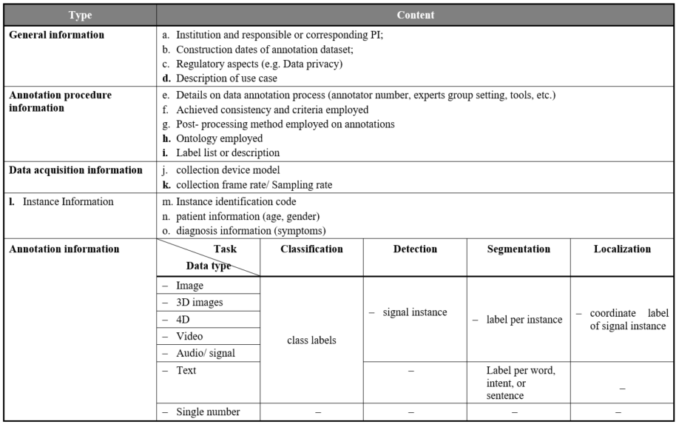
Table 7 Recommended metadata

Slide 19
Output file & File saving
The output files include the annotation documents and the origin images. The formats of the annotation documents include but are not limited to xml, json, txt, etc. The annotation documents should include at least three items: image path, object name and object coordinates. Supporting document may be given if it’s necessary to interpret the annotation information.
Both the images and the documents should be named according to the same rules for easy querying. For example, they can be named with the number of the classification of the object, and the document’s name is the same with the corresponding origin images.

Slide 20
Objectives
To assist the quality control of data annotation from standard operating procedure.
To reduce model performance problems caused by inconsistent data annotations.
To facilitate the training and education for non-professional annotators and improve common understandings.
large-scale dataset projects on high diversity of data formats and multi-annotators

Slide 21
Next steps
Collect suggestions and feedback
Finalize the deliverables at the next meeting
Input to SG16 Q28 work item on medical image quality control
Consider profiled standardization on data annotation for different use cases or diseases (need more capacity and expertise)
Key findings to Journal papers

Slide 22
FGAI4H
Thank you

