Slide 1
FGAI4H-P-055
Helsinki, 20-22 September 2022
Source: | Editor DEL09
Title: | DEL09: AI4H applications and platforms – Progress report
Purpose: | Discussion
Contact: | Manjeet Singh Chalga Scientist-C, ICMR, India | E-mail: chalgams.hq@icmr.gov.in
Abstract: | This PPT contains a progress report on DEL09.

Slide 2
FG-AI4H
DEL-09 : AI4H Applications and Platforms
Manjeet Singh Chalga
Scientist-D,
Indian Council of Medical Research, India
+91-95827 76792
manjeetchalga@gmail.com, chalgams.hq@icmr.gov.in

Slide 3
Objectives:
to prepare the rules for development of AI tool for Health using Mobile Applications & Cloud Applications
to provide a forum for open communication among various stakeholders,
to discuss on technology, security and legal issues related to these AI tools
to coordinate the benchmarking process in collaboration with the Focus Group management and working groups.

Slide 4
Key features required for development of AI tool for Health using Mobile Application
PAS 277:2015 Health and wellness apps. Quality criteria across the life cycle. Code of practice
Good practice guidelines on health apps and smart devices (mobile health or mhealth)
Guiding Principles of Practice and Transparency for Mobile Health Solutions (CTA-2073)

Slide 5
Auto-generated Website for Disease Surveillance
We identified Similar pattern of Questionnaire
TB prevalence in Saharia Tribes
TB prevalence in Contacts of TB
Effect of Pandemic on TB prevalence
Death due to TB
Cancer prevalence in Tea Garden Employee
Etc.

Slide 6
Auto-generated Website for Disease Surveillance
Data Sync
Auto-generated Website
Questionnaire

Slide 7
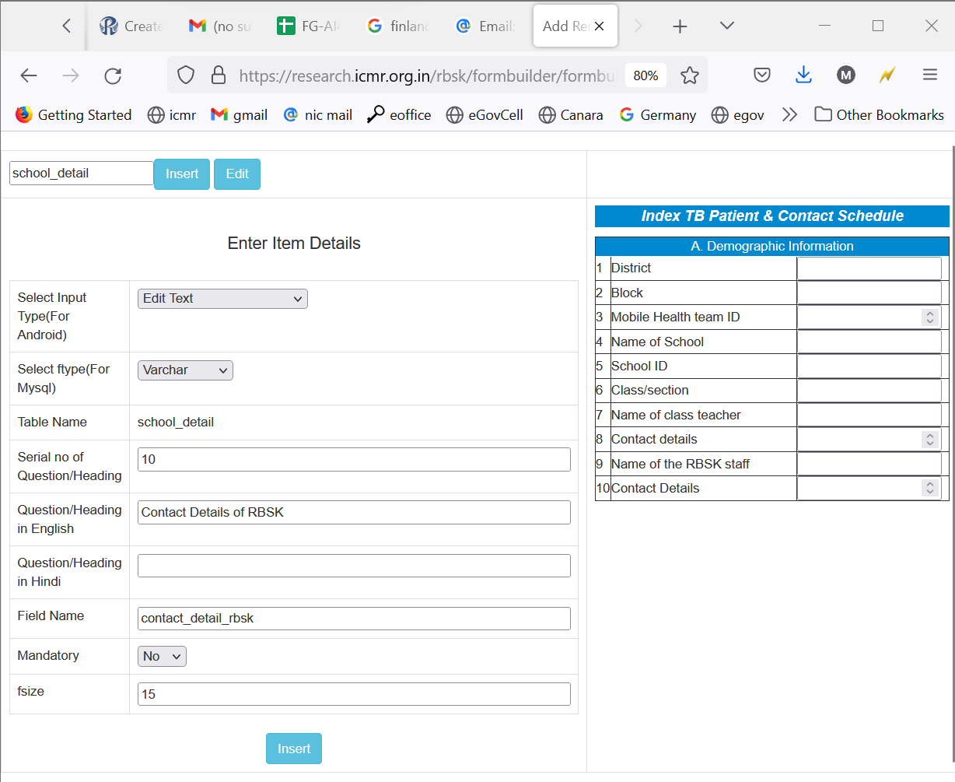
Auto-generated Website for Disease Surveillance

Slide 8
Auto-generated Website for Disease Surveillance
Questionnaire based automated web pages
Add
Edit
View
Delete
Meta-Data

Slide 9
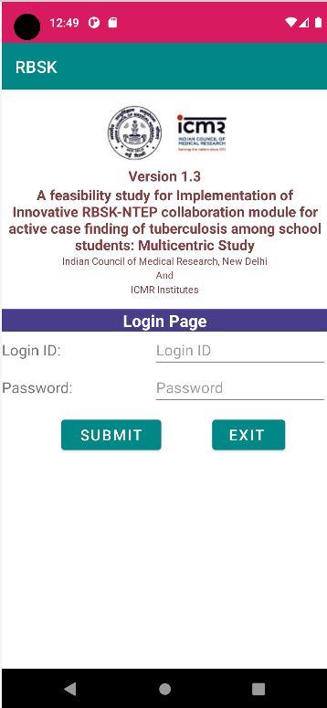
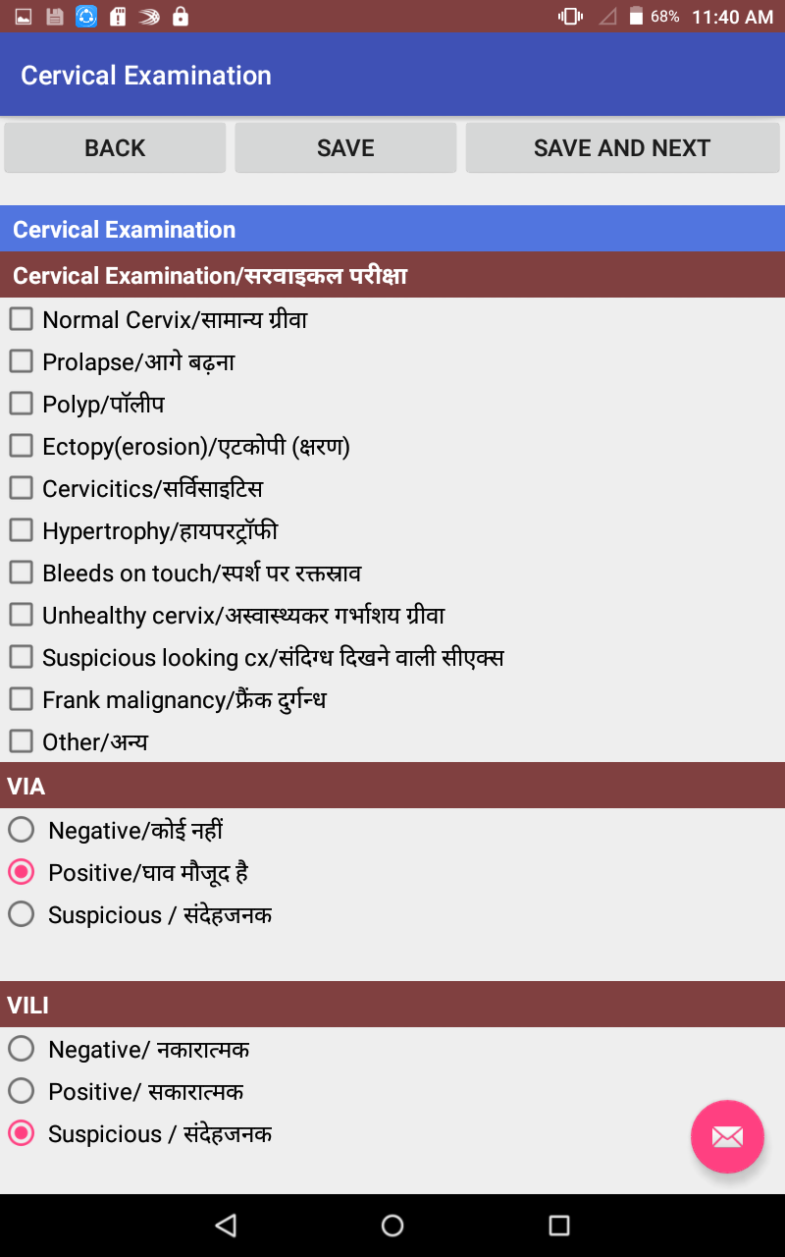
Designing of Apps for disease surveillance
Questionnaire
Internet
Data Sync
Web Server
Mobile Application

Slide 10
Some Projects where we developed dynamic questionnaire based Mobile Applications
TB prevalence in Saharia Tribes
TB prevalence in Contacts of TB
TB in children
Cause of Death
Cancer prevalence in Population
Palliative Care for Cancer Patients
Etc.

Slide 11
Benefits of developing automated Website & App
Modification in questionnaire is easy
Development of offline App is possible
Data synchronisation between App & website is easy
Data validation is also automated
Questionnaire serves as metadata during data analysis
Data Analysis can be automated
Security Application becomes easy
Most Important : Easily replicable

Slide 12
Project : AI Tool for TB identification
1st Objective – to identify TB patient
2nd Objective – to identify Type of TB
Collecting following Data from 20 Hospitals
Original X-ray or Dicom Files
Processing images to 600 x 600 size
Annotating abnormalities by Radiologist on processed images
Labeling abnormalities
Training to AI Tool

Slide 13
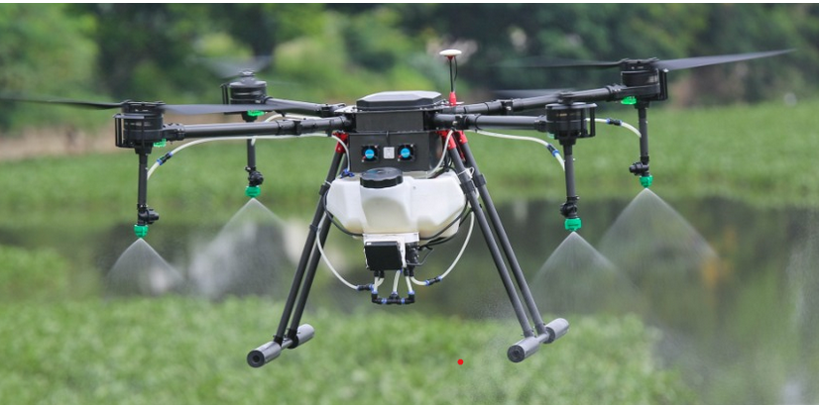
Upcoming Project :
Development of automated drone technology based system for mapping of breeding sites of mosquitoes to prevent vector transmission in urban and rural areas
*- Image taken from website http://marutzap.com/

Slide 14
Thank You

